Slide 1

Effects of a general speed limit on two-lane highway traffic
Diego De los Santos, Daniel Nezamabadi, Natalie Suter, Róbert Veres, Victor Vitéz

Slide 2




Effects of a general speed limit on two-lane highway traffic
Introduction
Fundamental Questions
Expected Results
Model
IDM
MOBIL
Implementation
idk
Results
yes pls
Extensions
Motivation
Diego De los Santos, Daniel Nezamabadi, Natalie Suter, Róbert Veres, Victor Vitéz

Slide 3
Introduction

Slide 4
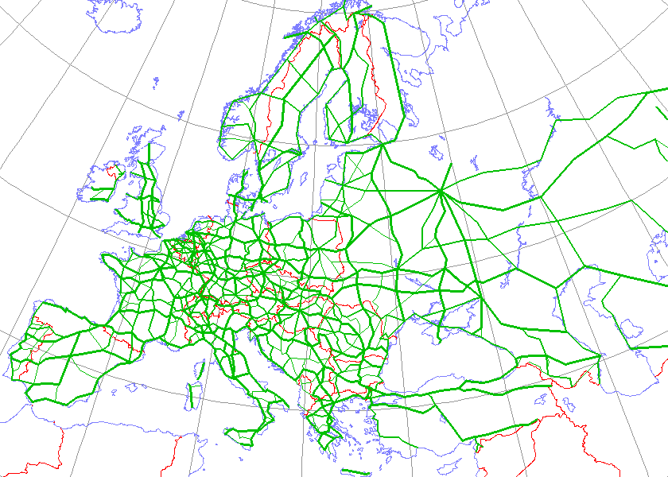
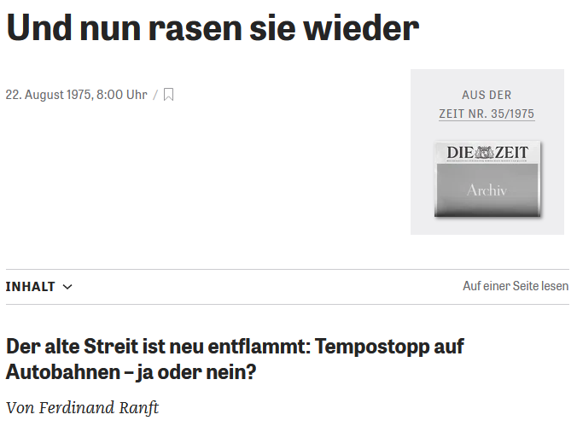
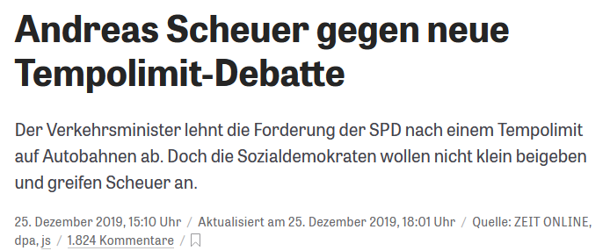
Motivation
Figure 1: E-Road Network over 1990 borders
By Kjhskj75 - http://en.wikipedia.org/wiki/Image:International_E_Road_Network.png, Public Domain, https://commons.wikimedia.org/w/index.php?curid=2875623
Figure 2: News article from 1975
Figure 3: News article from 2019
Notes:
Why?
Highways critical part of global infrastructure (Figure 1), used…
…to commute to work
…drive into holidays
…transport goods
Natural (especially as CS) wanting to optimize
sophisticated systems: communication between cars, autonomous driving
simple idea: general speed limit
Why look at general a speed limit
Relevant
Germany doesn’t have a general speed limit
Hotly debated all the time
Figure 2: 1975, “The old conflict has reignited: General speed limit on highways – yes or no”
Figure 3: 2019, “Andreas Scheuer (German Minister of Transport) against new general speed limit debate”
One argument seemingly brought up by both sides
Decreased travel time
Less traffic congestion
Higher speeds
→ Which argumentation makes more sense? Find out with simulation

Slide 5
Fundamental Questions and Expected Results
Fundamental Questions
Expected Results
How does a general speed limit affect highway traffic?
How do the results change when changing proportions and types of vehicles?
How do the results change when introducing random perturbations?
General speed limit decreases traffic congestion and thus increases highway throughput in basically all situations
Notes:
Fundamental Questions: From overall to more specific
How does a general speed limit affect highway throughput?
Does a general speed limit increase or decrease the average travel time
Argumentation we trying to analyze from last slide
How do the results change when changing proportions and types of vehicles
Highway not homogenous, different vehicle types and amount associated with them
More trucks? Less trucks?
How do the results change when introducing random perturbations?
Implementation will be explained
Car can suddenly slow down
React to a danger situation
Model something close to accidents
Expected Results:
General speed limit improves highway throughput/average travel time in basically all situations
Rational: Decreases differences in speed between individual cars → less traffic congestion

Slide 6
The Model
Notes:
Say what we needed our model to be able to do: give each car an individual driving style -> So we chose IDM

Slide 7

Intelligent Driver Model
IDM
Car-following Model
Output based on the state of the car and the leading vehicle
Accident-free
Driving style described by parameters

Slide 8

Intelligent Driver Model
v₀
Desired Speed
T
a
Maximum acceleration
s₀
b
Time Headway
Desired deceleration
Jam Distance

Slide 9
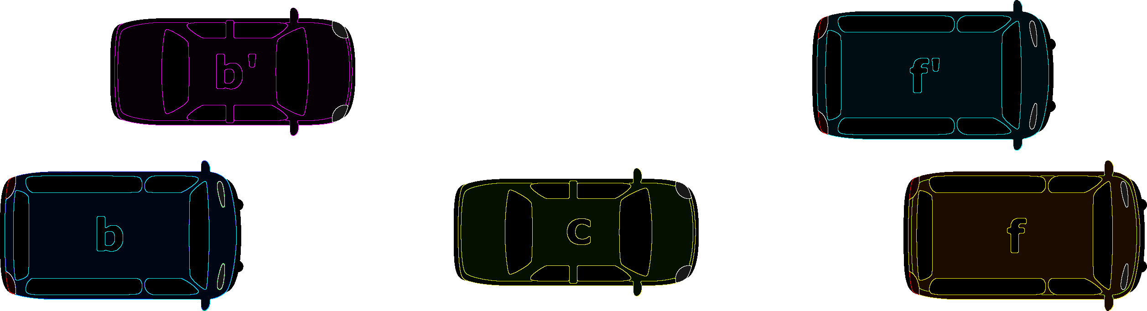


MOBIL
Politeness factor
Maximum safe deceleration
Threshold
Right Bias
Safety Criterion
Incentive Criterion
p
b_{save}
$$δ$$
$$∆b$$

Slide 10
Extensions
Disturbances
Trucks

Slide 11
Implementation
Notes:
Say what we needed our model to be able to do: give each car an individual driving style -> So we chose IDM

Slide 12
Implementation

Slide 13
Results
Notes:
Say what we needed our model to be able to do: give each car an individual driving style -> So we chose IDM

Slide 14
Results

Slide 15
Thank you for your Attention
Notes:
Say what we needed our model to be able to do: give each car an individual driving style -> So we chose IDM

Slide 16
Sources

