Slide 1

Implementing a Timeless Debugger in Ghidra
Derek ng
April 28, 2022
CS 4910

Slide 2
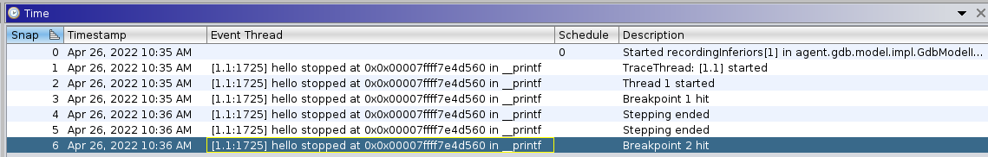
Background
Debugging tool included in Ghidra beginning in v10.0
Hook up GDB or WinDbg to use
“Snapshot” tool does exist where state of registers and memory is saved but only at breakpoints or steps
#include <stdio.h>
#include <stdlib.h>
void _start() {
int a = 3;
int b = 8;
int c = a + b;
printf("Hello world! Did you
know that %d + %d =
%d?\n", a, b, c);
exit(0);
}
b _start
si
si
b printf

Slide 3
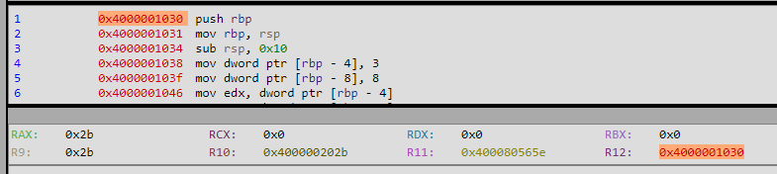
Goals
Create timeless debugger tool for Ghidra where the state of the registers and memory for every assembly instruction is saved
Essentially, I am creating the functionality of Qira but for Ghidra

Slide 4

Building the Timeless Debugger
Import Tenet trace and Tenet memory map
01
Create a snapshot out of each line of tenet trace to populate snapshot window
02
Use memory map to match Ghidra instructions to each line of tenet trace
03

Slide 5
1. Import tenet trace
rdi=0x7fb25403a190,rsi=0x1,rsp=0x7fff56db5f80,rdx=0x7fb254020530,rcx=0x7fff56db5f98,rax=0x1c,r8=0x7fb25403a728,r12=0x563c95151030,r13=0x7fff56db5f80,rip=0x563c95151030,mr=0x7fff56db5f78:ca200154b27f0000,mw=0x7fb25403a4ac:1c
rsp=0x7fff56db5f78,rip=0x563c95151031,mw=0x7fff56db5f78:0000000000000000
rbp=0x7fff56db5f78,rip=0x563c95151034
rsp=0x7fff56db5f68,rip=0x563c95151038
rip=0x563c9515103f,mw=0x7fff56db5f74:03000000
rip=0x563c95151046,mw=0x7fff56db5f70:08000000
rdx=0x3,rip=0x563c95151049,mr=0x7fff56db5f74:03000000
rax=0x8,rip=0x563c9515104c,mr=0x7fff56db5f70:08000000

Slide 6
2. Create snapshots
Parse Tenet trace
Create a snapshot for each line of Tenet trace
Change registers and memory of each snapshot according to trace
Program counter in trace was a little annoying
Ghidra’s debugger is so new that its JavaDoc is non-existent
Inspiration from PopulateTraceDemo.java and PopulateTraceQiraCompatible.java on how to create snapshots

Slide 7
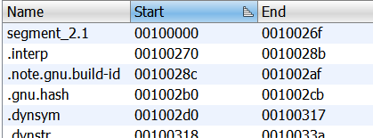
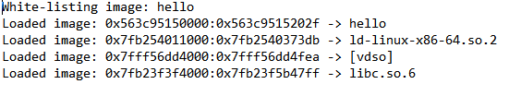
3. Match Snapshot to Assembly Instruction
Tenet traces do not include assembly instructions
Take assembly instructions from analyzed binary opened in Ghidra
Use Tenet trace memory map to create mapping between trace addresses and Ghidra addresses
Implementing this required finessing that turned Ghidra addresses into trace addresses

Slide 8
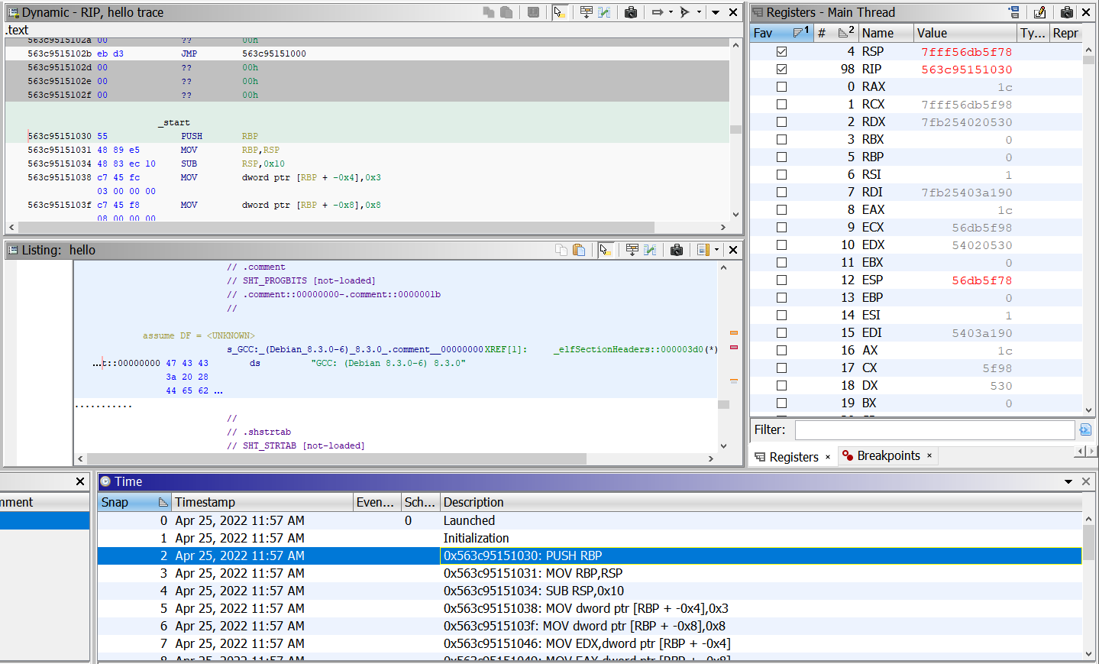
Results
Dynamic view
Registers changes
We now have window where user can scroll backwards and forwards over instructions and see contents of registers
Also added some code to get instructions to display in the Dynamic view
Demo
Snapshots for each instruction

Slide 9

Questions

