Slide 1



INTRODUCTION
Project Train C
Lê Tuấn Anh
Dương Hoàng Nam

Slide 2





Casio 590Vn Plus

Slide 3
Function
Basic Calculation
Polynomial
Inequality
Simul Equation
Basic Graph

Slide 4
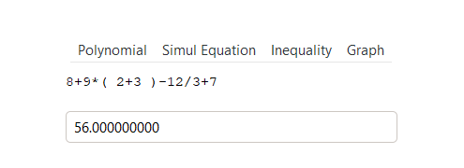
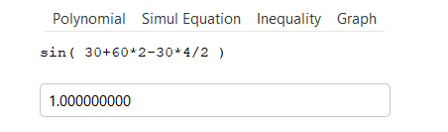
Basic Calculation
Addition, subtraction, multiplication, division
Sin, Cos, Tan, Cot

Slide 5
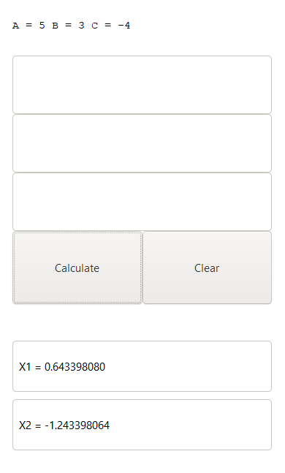
Polynomial
Polynomial Degree 2
Polynomial Degree 3
Polynomial Degree 4

Slide 6
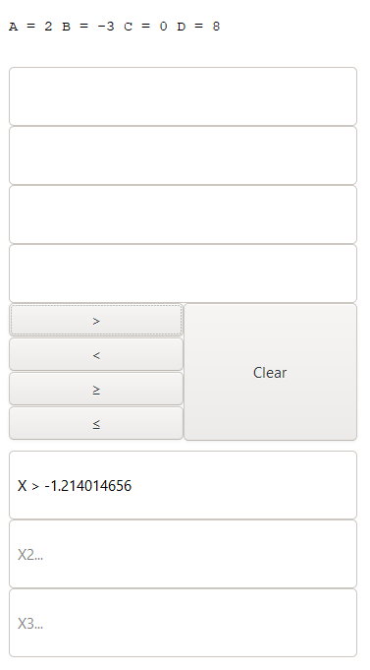
Inequality
Inequality Degree 2
Inequality Degree 3

Slide 7
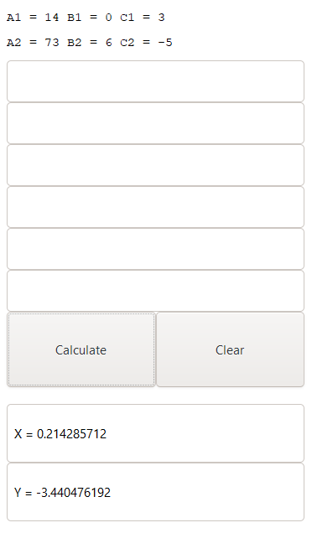
Simul Equation
Simul Equation 2
Simul Equation 3

Slide 8
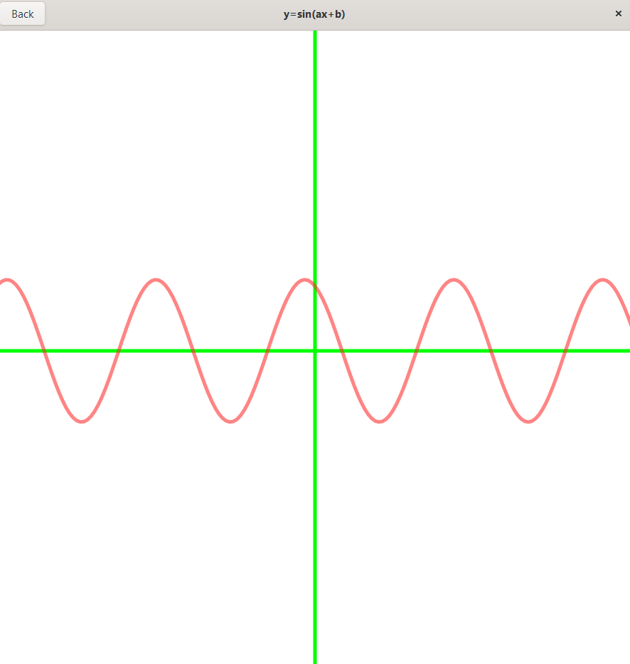
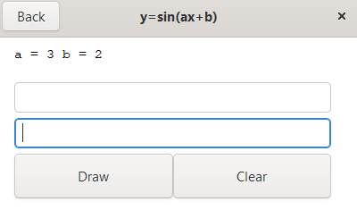
Graph

Slide 9
THANK YOU
FOR
YOUR LISTENING

