Slide 1
CS 288 Intensive Programming in Linux
Fall 2020
Professor Shan, Jianchen

Slide 2
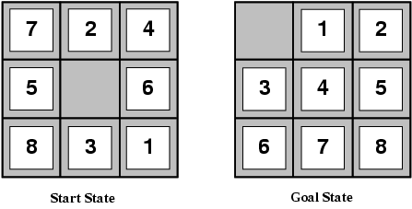
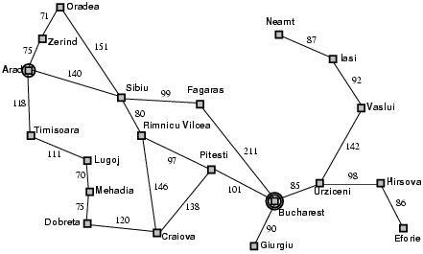

Solving problems by searching
The solution is a fixed sequence of actions
Search is the process of looking for the sequence of actions that reaches the goal
Start state
Goal state

Slide 3
Search problem components
Initial
state
Initial state
Actions
Transition model
What is the result of performing
a given action in a given state?
Goal state
Path cost
Assume that it is a sum of nonnegative step costs
The optimal solution is the sequence of actions that gives the lowest path cost for reaching the goal
Search algorithms: how do we find high quality solutions?
Goal state

Slide 4
Example: The 8-puzzle
States
Locations of tiles
8-puzzle: 362,880 states
15-puzzle: 1.3 trillion states
24-puzzle: 10²⁵ states
Actions
Move blank left, right, up, down
Path cost
1 per move
Optimal solution of n-Puzzle is NP(non-polynomial)-hard

Slide 5
Example: Path finding
Find a path from Arad to Bucharest
Initial state
Arad
Actions
Go from one city to another
Transition model
If you go from city A to city B, you end up in city B
Goal state
Bucharest
Path cost
Sum of edge costs

Slide 6
Other real-world examples
Routing
Touring
VLSI layout
Assembly sequencing
Protein design

Slide 7
State space
All the possible states are connected to form a state space.
The set of all states reachable from initial state by any sequence of actions
Can be represented as a directed graph
nodes are states
links between nodes are actions
Three key factors define the state space of a problem
initial state, actions, and transition model

Slide 8
What do search algorithms do?
Begin at the start node and expand it by making a list of all possible successor states
Maintain a fringe or a list of unchecked and unexpanded states
At each step, pick a state from the fringe to check and expand
Keep going until you reach the goal state
Try to expand as few states as possible

Slide 9
All the states in search form a search tree
Starting state
Search tree is used to understand and explain search algorithms
“What if” tree of possible actions and outcomes
Root node corresponds to starting state
Children of a node correspond to it successors states
Edges corresponds to actions
A solution is a path starting from root and ending in the goal state
Action
Successor state
…
…
…
…
Goal state

Slide 10
All the states in search form a search tree
Nodes vs. states
A state is a representation of a physical configuration
A node is a data structure that is part of the search tree
Contains information about the current state and more (e.g., cost and pointers to link it to the fringe)
Multiple nodes may represent the same state
May not be merged (e.g. different costs)
Starting state
Action
Successor state
…
…
…
…
Goal state
Think about: how are the multiple solutions represented in a search tree?

Slide 11
Tree Search Algorithm Outline
Initialize the fringe using the starting state
While the fringe is not empty
Choose a fringe node according to search strategy and remove it from fringe
Check and expand the node
If the node contains the goal state, return solution
Otherwise, expand the node and add its children to the fringe
Note: Though it is tree search, you don’t need to actually build the tree structure (key data structure: fringe)

Slide 12
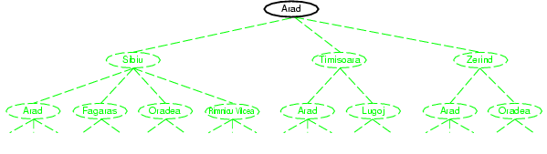
Tree search example

Slide 13
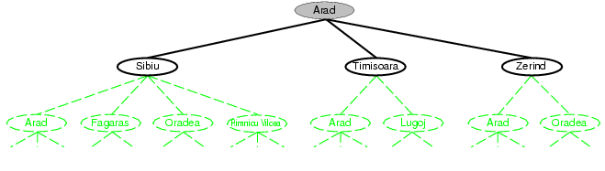
Tree search example

Slide 14
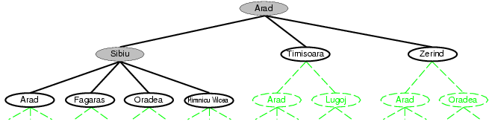
Tree search example
Fringe

Slide 15
Search strategies
A search strategy is defined by picking the order of node expansion
reflected by how nodes are organized in the fringe in actual implementations
Strategies are evaluated along the following dimensions:
Completeness: does it always find a solution if one exists?
Optimality: does it always find a least-cost solution?
Time complexity: number of nodes generated
Space complexity: maximum number of nodes in memory
Time and space complexity are measured in terms of
b: maximum branching factor of the search tree
d: depth of the least-cost solution
m: maximum length of any path in the state space (may be infinite)

Slide 16
Uninformed search strategies
Uninformed search strategies use only the information available in the problem definition
Breadth-first search
Depth-first search
Iterative deepening search

Slide 17
Breadth-first search
Expand shallowest unexpanded node
Implementation:
fringe is a FIFO queue, i.e., new successors go at end
A
B
C
D
E
F
G

Slide 18
Breadth-first search
Expand shallowest unexpanded node
Implementation:
fringe is a FIFO queue, i.e., new successors go at end
A
B
C
D
E
F
G

Slide 19
Breadth-first search
Expand shallowest unexpanded node
Implementation:
fringe is a FIFO queue, i.e., new successors go at end
A
B
C
D
E
F
G

Slide 20
Breadth-first search
Expand shallowest unexpanded node
Implementation:
fringe is a FIFO queue, i.e., new successors go at end
A
B
C
D
E
F
G

Slide 21
Breadth-first search
Expand shallowest unexpanded node
Implementation:
fringe is a FIFO queue, i.e., new successors go at end
A
B
C
D
E
F
G

Slide 22
Pseudo-code for BFS
Generate an initially empty queue and call it OPEN.
OPEN is the fringe.
2. Insert the start state into OPEN.
3. Dequeue a state n from OPEN. If dequeue fails because OPEN is empty, search fails.
4. If n is a goal state, the search succeeds.
5. Generate all successors to n and enqueue them into OPEN (end of OPEN).
6. Destroy node n
7. Return to step 3.

Slide 23
Depth-first search
Expand deepest unexpanded node
Implementation:
fringe = LIFO queue, i.e., put successors at front
A
B
C
D
E
F
G

Slide 24
Depth-first search
Expand deepest unexpanded node
Implementation:
fringe = LIFO queue, i.e., put successors at front
A
B
C
D
E
F
G

Slide 25
Depth-first search
Expand deepest unexpanded node
Implementation:
fringe = LIFO queue, i.e., put successors at front
A
B
C
D
E
F
G

Slide 26
Depth-first search
Expand deepest unexpanded node
Implementation:
fringe = LIFO queue, i.e., put successors at front
A
B
C
D
E
F
G

Slide 27
Depth-first search
Expand deepest unexpanded node
Implementation:
fringe = LIFO queue, i.e., put successors at front
A
B
C
D
E
F
G

Slide 28
Depth-first search
Expand deepest unexpanded node
Implementation:
fringe = LIFO queue, i.e., put successors at front
A
B
C
D
E
F
G

Slide 29
Depth-first search
Expand deepest unexpanded node
Implementation:
fringe = LIFO queue, i.e., put successors at front
A
B
C
D
E
F
G

Slide 30
Depth-first search
Expand deepest unexpanded node
Implementation:
fringe = LIFO queue, i.e., put successors at front
A
B
C
D
E
F
G

Slide 31
Depth-first search
Expand deepest unexpanded node
Implementation:
fringe = LIFO queue, i.e., put successors at front
A
B
C
D
E
F
G

Slide 32
Pseudo-code for DFS
1. Generate an initially empty stack and call it OPEN.
2. Insert the start state into OPEN.
3. Pop a state n from OPEN. If pop fails because OPEN is empty, search fails.
4. If n is a goal state, the search succeeds.
5. Generate all successors to n and push them onto OPEN (beginning of OPEN).
6. Destroy node n.
7. Return to step 3.

Slide 33
BFS vs DFS
BFS
can always (when?) find the best solution (shortest path)
Use a lot of memory
DFS
Returns the first solution it finds. May not find the best solution
Use less memory than BFS
may Fail in infinite-depth spaces (e.g., spaces with loops)
Modify to avoid repeated states along path
complete in finite spaces, but increase memory consumption

Slide 34
DFS with CLOSED list
1. Generate an initially empty stack and call it OPEN, and a list called CLOSED.
2. Insert the start state into OPEN.
3. Pop a state n from OPEN. If pop fails because OPEN is empty, search fails.
4. If n is a goal state, the search succeeds.
5. Generate all successors to n
6. Remove the successors that are already in OPEN or CLOSED list
7. Push the remaining successors onto OPEN (beginning of OPEN).
8. Add n into CLOSED list
9. Return to step 3.

Slide 35
Iterative deepening search
Use DFS as a subroutine
Check the root
Do a DFS searching for a path of length 1
If there is no path of length 1, do a DFS searching for a path of length 2
If there is no path of length 2, do a DFS searching for a path of length 3…

Slide 36
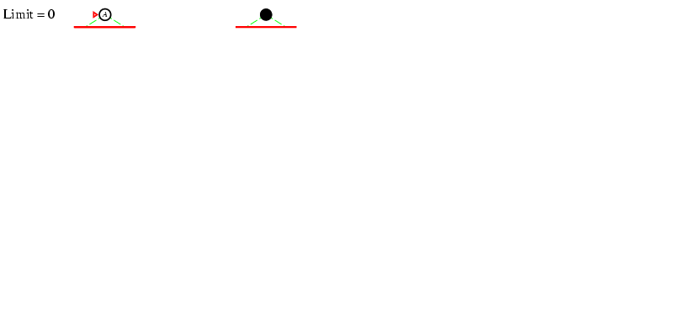
Iterative deepening search

Slide 37
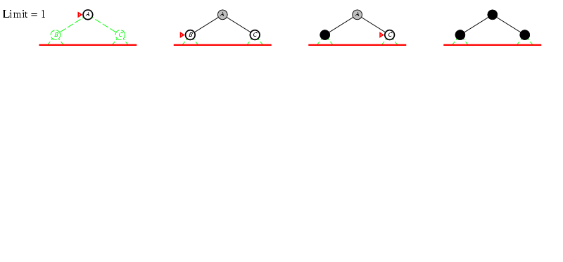
Iterative deepening search

Slide 38
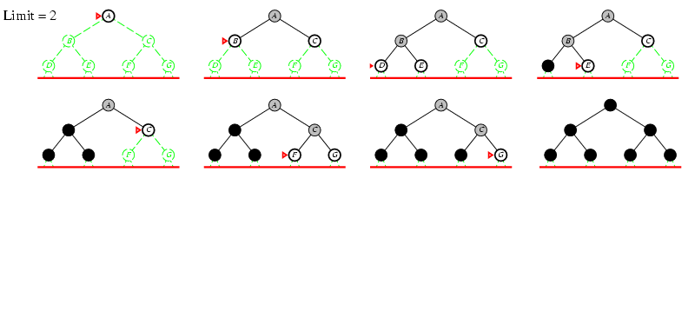
Iterative deepening search

Slide 39
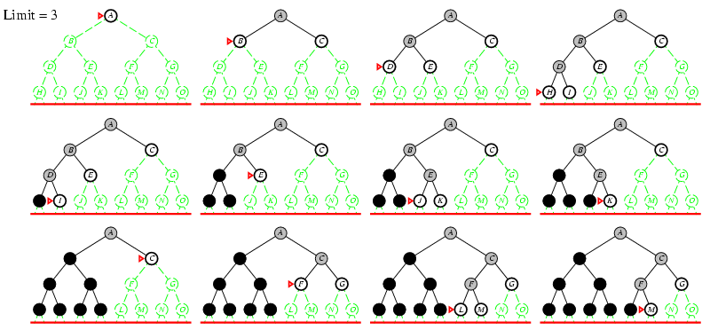
Iterative deepening search

Slide 40
Informed search
Idea: give the algorithm “hints” about the desirability of different states
Use an evaluation function to rank nodes and select the most promising one for expansion
Greedy best-first search
A* search

Slide 41
Heuristic function
Heuristic function h(n) estimates the cost of reaching goal from node n
Example:
Start state
Goal state

Slide 42
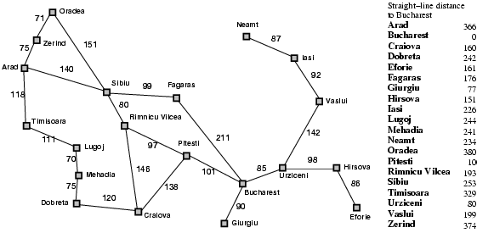
Heuristic for the path finding problem

Slide 43
Greedy best-first search
Expand the node that has the lowest value of the heuristic function h(n)

Slide 44

Greedy best-first search example

Slide 45
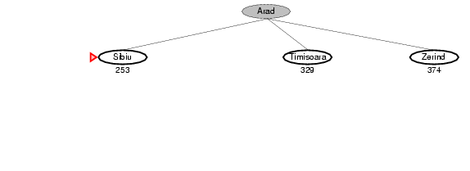
Greedy best-first search example

Slide 46
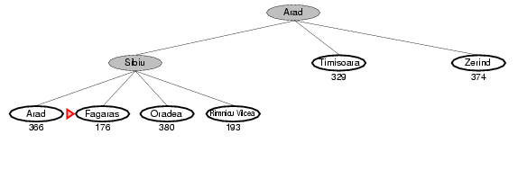
Greedy best-first search example

Slide 47
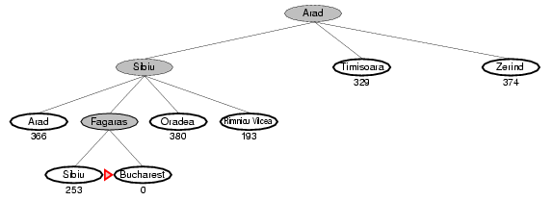
Greedy best-first search example

Slide 48
Greedy best-first search may get stuck in loops
start
goal

Slide 49
Greedy best-first search is not optimal

Slide 50
A* search
Idea: avoid expanding paths that are already expensive
The evaluation function f(n) is the estimated total cost of the path through node n to the goal:
f(n) = g(n) + h(n)
g(n): cost so far to reach n (path cost)
h(n): estimated cost from n to goal (heuristic)

Slide 51

A* search example

Slide 52
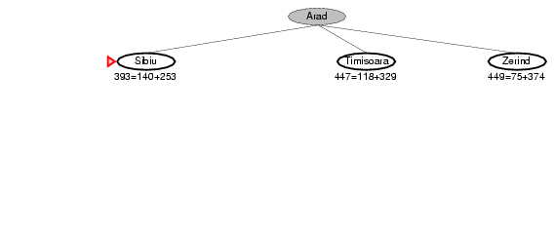
A* search example

Slide 53
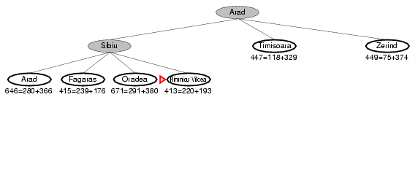
A* search example

Slide 54
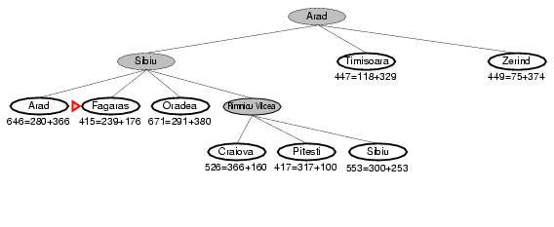
A* search example

Slide 55
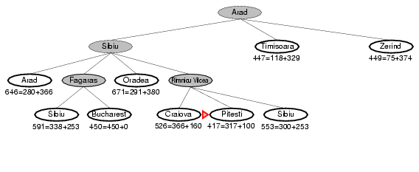
A* search example

Slide 56
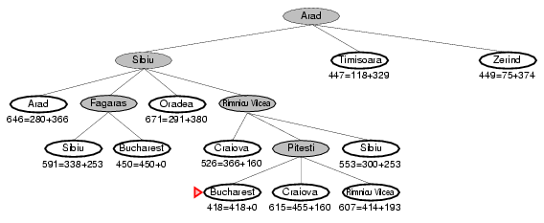
A* search example

Slide 57
Pseudo-code for A*
1. Generate an initially empty priority queue and call it OPEN, prioritized by f(n) value.
2. Generate an initially empty collection of states and call it CLOSED.
3. Insert the start state (or states) into OPEN.
4. Remove the state with smallest f(n) value (state n) from OPEN. If removal fails because OPEN is empty, search fails.
5. If n is a goal state, finish the search.
6. Generate all successors to n; push them onto OPEN (prioritized by f(n) value) if they are not in OPEN and CLOSED.
7. Add n to CLOSED.
8. Return to step 4.

Slide 58
Admissible heuristics
A heuristic h(n) is admissible if for every node n, h(n) ≤ h*(n), where h*(n) is the true cost to reach the goal state from n
An admissible heuristic never overestimates the cost to reach the goal, i.e., it is optimistic
Example: straight line distance never overestimates the actual road distance
Theorem: If h(n) is admissible, A* is optimal

Slide 59
Designing heuristic functions
Heuristics for the 8-puzzle
h₁(n) = number of misplaced tiles
h₂(n) = total Manhattan distance (number of squares from desired location of each tile)
h₁(start) = 8
h₂(start) = 3+1+2+2+2+3+3+2 = 18
Are h₁ and h₂ admissible?

Slide 60
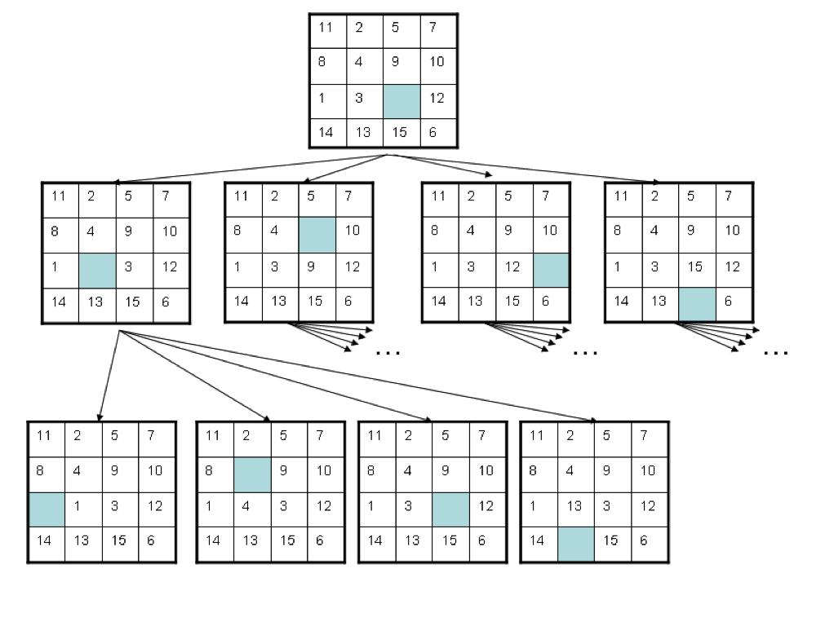
15-puzzle problem

