Slide 1
Embedded System Project Report
Greenhouse model
Group:
Nguyễn Văn Đăng 16146083 Nguyễn Hoàng Đức 16146091 Nguyễn Hoàng Đức 16146092
Ho Chi Minh City University of Technology and Education

Slide 2
Contents
Introduction
Summary
Components
Block diagram
How it works
Hardware interfaces & access to MySQL
UX-UI programming & access to MySQL
Simulation & Conclusion

Slide 3

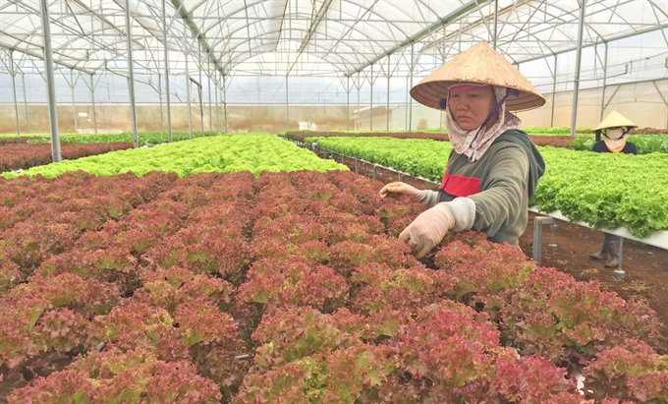
Introduction
Ho Chi Minh City University of Technology and Education
Summary
Advantages of greenhouse: high-yield, disease-free, save energy & water,…
Project objective: Real-time monitoring temperature, humidity, light and control I/O devices
Traditional agriculture
A farmer tends to lettuce in a greenhouse in Da Lat

Slide 4
Introduction
Ho Chi Minh City University of Technology and Education
Components
Raspberry Pi 3 Model B+
Sensors: Si7021 (Temperature, Humidity), GY-30 (Ambient Light)
Peripheral Modules: RTC DS3231, LCD OLED 0.96inch, 7-Segment display module
I/O devices: LED 3W, Fan, Pump, RC Servo, Buzzer

Slide 5
Introduction
Ho Chi Minh City University of Technology and Education
Block diagram
RC Servo
1 PWM
LEDs, Fan, Pump, Buzzer
5 I/O
(GPIO 22 to 26)
MCU
4 I2C
Sensors (Si7021, GY-30), RTC Module, LCD Oled
1 SPI
7-Segment Display

Slide 6
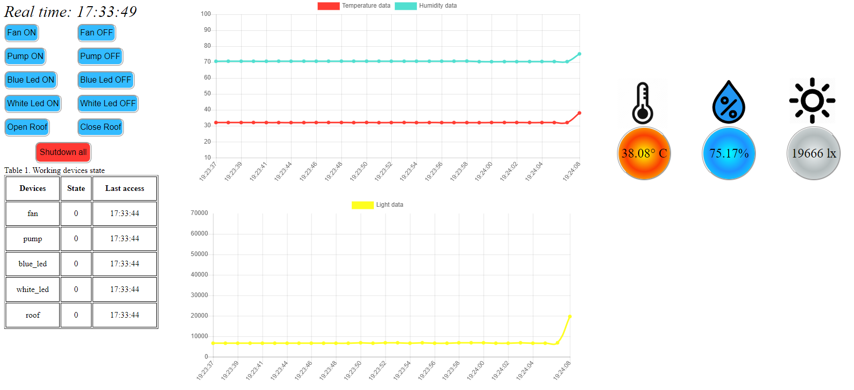

Introduction
Ho Chi Minh City University of Technology and Education
RC Servo
How it works
I/O devices
Sensors
Chart.php
Buzzer
IO.php
Oled
MySQL
Website (file .html)
RTC & 7-Seg display

Slide 7
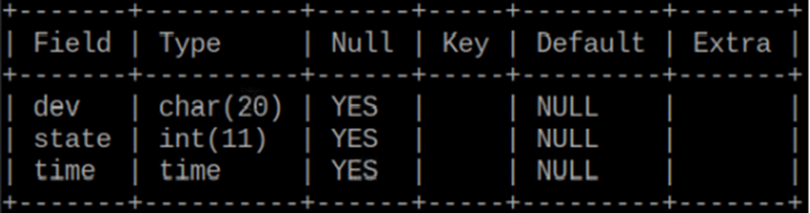
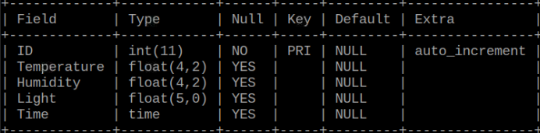
Introduction
Ho Chi Minh City University of Technology and Education
Hardware interfaces & access to MySQL
4 tables : alarm, io_dev (devices state, time), sensor(temperature, humidity, light, time), servo.
I/O devices control table
Sensor values table

Slide 8
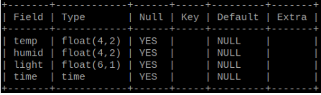
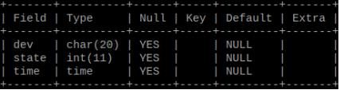
Introduction
Ho Chi Minh City University of Technology and Education
Hardware interfaces & access to MySQL
4 tables : alarm, io_dev (devices state, time), sensor(temperature, humidity, light, time), servo.
Alarm table
Servo control table

Slide 9
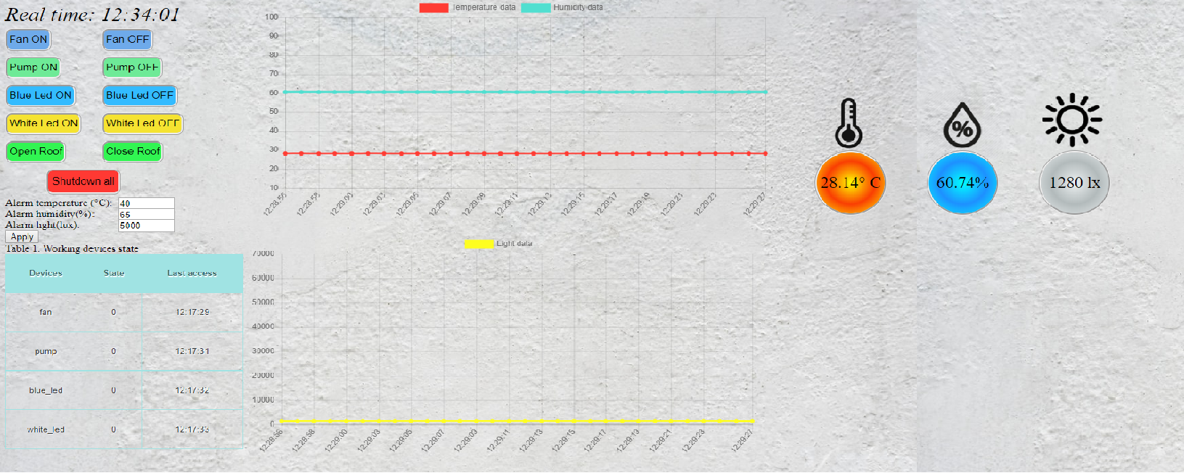
Introduction
Ho Chi Minh City University of Technology and Education
UX-UI programming & access to MySQL

Slide 10
Thank you.
Ho Chi Minh City University of Technology and Education

