Slide 1
Proof-of-Concept Use Cases
Use Case 1 : Identify inmates at risk of recidivism
What are the characteristics of current repeated offenders or recidivists (penjenayah berulang)?
How to identify the inmates prone to recidivism based on the characteristics of recidivists?
Solutions
Determinants analysis.
Predictive analysis using machine learning classifier to identify the inmates prone to recidivism given their attributes or characteristics.

Slide 2
Determinant Identification based on previous research
No. | Reference | Determinant
1. | http://surl.li/mtemj | Internal Factors: Age Marital Status Sentence Length Employment Alcohol-drug abuse history Social factors: Institutional and community support Stigma and social isolation Family support
2. | http://surl.li/mtell
3. | http://surl.li/mtelr
4. | http://surl.li/mtelv
5. | http://surl.li/mtfaz
6 | http://surl.li/mtfpr
Age
Younger inmates are more likely to be repeated offenders or recidivists
Sentence Length
Prisoners with longer sentences will have problems reintegrating into society
Employment
Ex-prisoners who were previously employed or who became employed after released are less likely to be recidivists
Problem: Data for social factors

Slide 3
Determinant Identification based on previous research
No. | Reference | Determinant
1. | http://surl.li/mtemj | Internal Factors: Age Marital Status Sentence Length Employment Alcohol-drug abuse history Social factors: Institutional and community support Stigma and social isolation Family support
2. | http://surl.li/mtell
3. | http://surl.li/mtelr
4. | http://surl.li/mtelv
5. | http://surl.li/mtfaz
6 | http://surl.li/mtfpr
Marital Status
Inmates who are married and have family are less likely to be repeated offenders
Alcohol-drug abuse history
Inmates with substance abuse history have a higher likelihood of relapse and recidivism
Problem: Data for social factors

Slide 4

ML Input-Process-Output Flow
Input
Output
ID | GENDER | RACE | AGE | SENTENCE LENGTH | HIGHEST EDU_LEVEL | …
411233 | M | M | 33.2 | 18 | LOWER SECONDARY | …
367114 | F | M | 39.7 | 12 | UPPER SECONDARY | …
467689 | M | I | 29.5 | 12 | LOWER SECONDARY | …
402870 | M | M | 22.4 | 18 | UPPER SECONDARY | …
558583 | M | M | 21.6 | 12 | UPPER SECONDARY | …
439814 | M | C | 46.7 | 18 | UPPER SECONDARY | …
464615 | M | I | 31 | 18 | UPPER SECONDARY | …
351199 | F | M | 24.6 | 12 | LOWER SECONDARY | …
392887 | F | M | 32.6 | 13 | UPPER SECONDARY | …
437200 | M | I | 29.1 | 12 | UPPER SECONDARY | …
ID | RECIDIVIST
411233 | HIGH RISK
367114 | LOW RISK
467689 | LOW RISK
402870 | HIGH RISK
558583 | LOW RISK
439814 | HIGH RISK
464615 | HIGH RISK
351199 | MODERATE RISK
392887 | MODERATE RISK
437200 | LOW RISK
ML Model
Actual Data
Notes:
Internal Factors:
Gender
Race
Age of first arrest
Dependents
Prison Years
Drug consumption
Education level
Skills for employment
External factors:
Institutional and community support
Stigma and social isolation

Slide 5
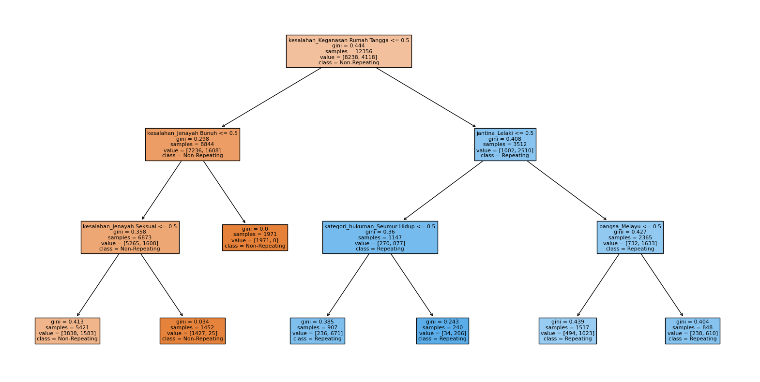
Random Forest Classifier

Slide 6
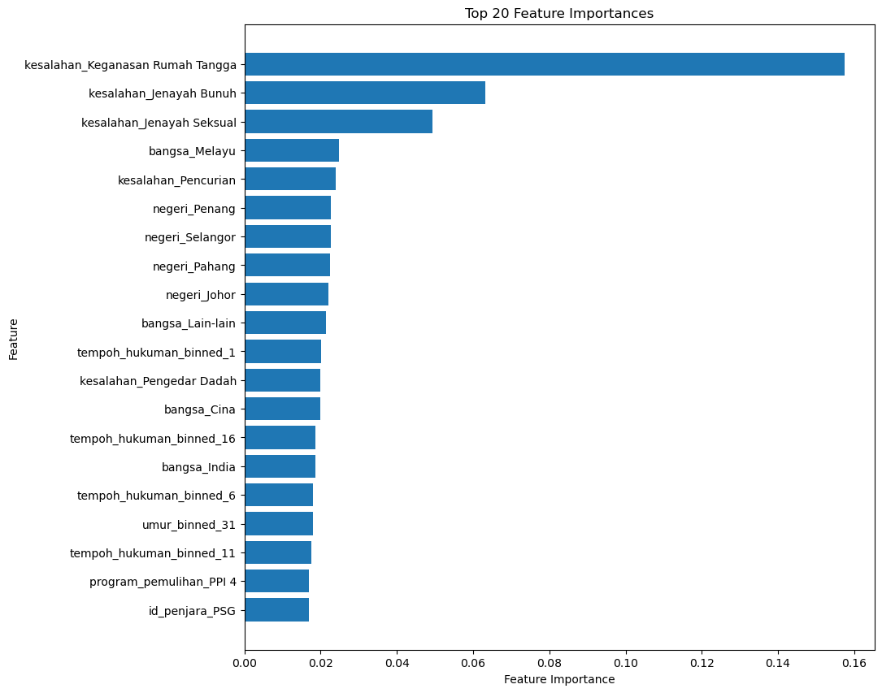
Feature Importances
The feature with the highest importance is 'kesalahan_Keganasan Rumah Tangga,' suggesting that domestic violence cases have the greatest influence within this context.
This is followed by 'kesalahan_Jenayah Bunuh' and 'kesalahan_Jenayah Seksual,' indicating that crimes related to murder and sexual offenses are also highly influential factors.
Ethnicity features such as 'bangsa_Melayu', 'bangsa_Cina', and 'bangsa_India' are included, implying that the ethnicity of individuals is a considerable predictor.

Slide 7
Proof-of-Concept Use Cases
Use Case 2 : Identify the most effective rehabilitation programme for inmates
What are the current rehabilitation programmes joined by the inmates?
How to identify the most effective rehabilitation programme?
Solutions
Determinants analysis.
Predictive analysis using machine learning classifier to identify the which programme is the most effective.

Slide 8
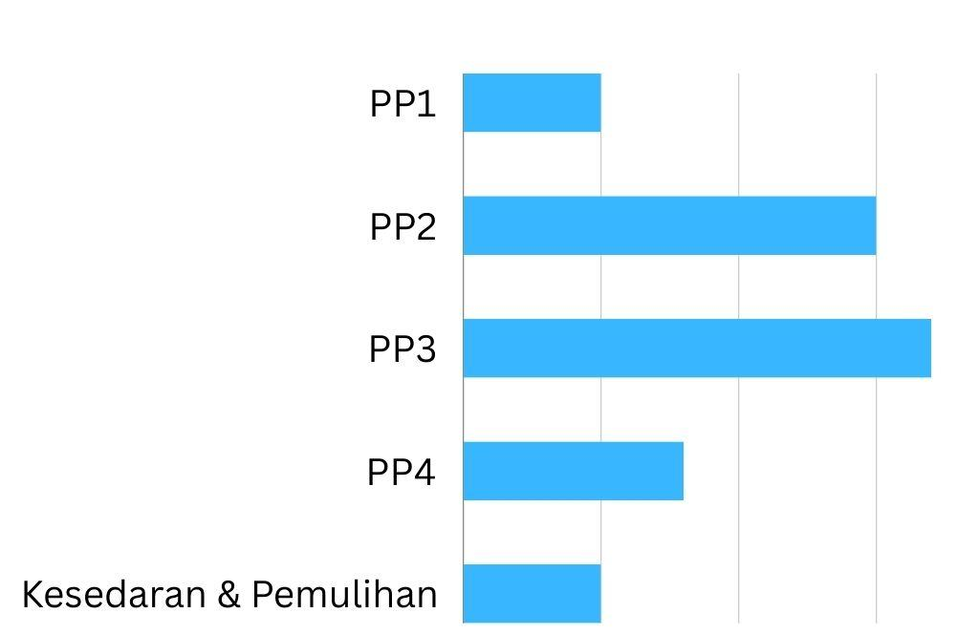
ML Input-Process-Output Flow
Input
ML Model
ID | GENDER | RACE | AGE | SENTENCE LENGTH | REHAB PROGRAMME | …
411233 | M | M | 33.2 | 18 | PP1 | …
367114 | F | M | 39.7 | 12 | KESEDARAN & PEMULIHAN | …
467689 | M | I | 29.5 | 12 | KESEDARAN & PEMULIHAN | …
402870 | M | M | 22.4 | 18 | PR3 | …
558583 | M | M | 21.6 | 12 | PP1 | …
439814 | M | C | 46.7 | 18 | PR2 | …
464615 | M | I | 31 | 18 | PP3 | …
351199 | F | M | 24.6 | 12 | PP2 | …
392887 | F | M | 32.6 | 13 | KESEDARAN & PEMULIHAN. | …
437200 | M | I | 29.1 | 12 | PP4 | …
Output
Actual Data
Notes:
Internal Factors:
Gender
Race
Age of first arrest
Dependents
Prison Years
Drug consumption
Education level
Skills for employment
External factors:
Institutional and community support
Stigma and social isolation

Slide 9
Proof-of-Concept Use Cases
Use Case 3 : Identify parolees (Orang dalam Parol) who may break their parole
What are the characteristics of parolees who have broken their parole?
How to identify current parolees who are likely to break their parole and those who are successful?
Solutions
Determinants analysis.
Predictive analysis using machine learning classifier to identify the parolees more likely to break their parole given their attributes or characteristics.
The procedure will be similar to the first use-case but for inmates who were granted parole.

Slide 10
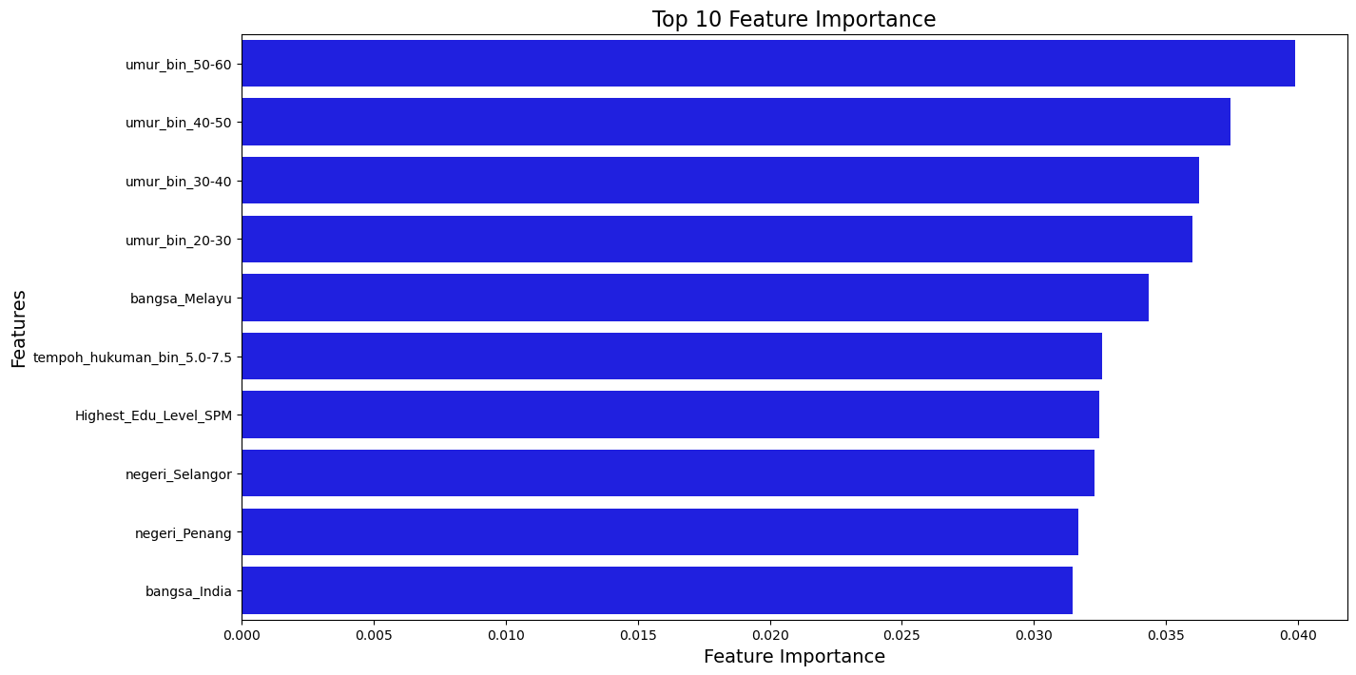
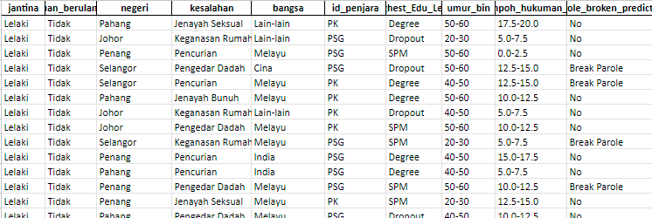
Feature Importance & Output

Slide 11
ML Input-Process-Output Flow
Input
Output
ID | GENDER | RACE | AGE | SENTENCE LENGTH | HIGHEST EDU_LEVEL | …
411233 | M | M | 33.2 | 18 | LOWER SECONDARY | …
367114 | F | M | 39.7 | 12 | UPPER SECONDARY | …
467689 | M | I | 29.5 | 12 | LOWER SECONDARY | …
402870 | M | M | 22.4 | 18 | UPPER SECONDARY | …
558583 | M | M | 21.6 | 12 | UPPER SECONDARY | …
439814 | M | C | 46.7 | 18 | UPPER SECONDARY | …
464615 | M | I | 31 | 18 | UPPER SECONDARY | …
351199 | F | M | 24.6 | 12 | LOWER SECONDARY | …
392887 | F | M | 32.6 | 13 | UPPER SECONDARY | …
437200 | M | I | 29.1 | 12 | UPPER SECONDARY | …
ID | BREAK_PAROLE
411233 | HIGH RISK
367114 | LOW RISK
467689 | LOW RISK
402870 | HIGH RISK
558583 | LOW RISK
439814 | HIGH RISK
464615 | HIGH RISK
351199 | MODERATE RISK
392887 | MODERATE RISK
437200 | LOW RISK
ML Model
Actual Data
Notes:
Internal Factors:
Gender
Race
Age of first arrest
Dependents
Prison Years
Drug consumption
Education level
Skills for employment
External factors:
Institutional and community support
Stigma and social isolation

Slide 12
Proof-of-Concept Use Cases
Use Case 4 : Identify inmates who may be involved in fights
What are the characteristics of inmates who were involved in fights?
How to identify inmates who are likely to get involved in fights?
Solutions
Determinants analysis.
Predictive analysis using machine learning classifier to identify which combinations of inmates, based on the determinants, are more or less likely to engage in fights.

Slide 13
Determinant Identification based on previous research
DeDe
Determinants
Race
Racial tensions and sentiments contribute to high risk of conflicts and violence among inmate
Gang affiliations
Gang affiliations may lead to increased tensions and conflicts between different group
Problem: Data for social factors

Slide 14
ML Input-Process-Output Flow
Input
Output
ID | GENDER | RACE | AGE DIFFERENCE | GANG AFFILIATION | …
411233 | M | M-C | 10 | SG | …
367114 | F | M-I | 13 | NG-NG | …
467689 | M | M-I | 5 | DG | …
402870 | M | M-C | 16 | G-NG | …
558583 | M | M-C | 10 | G-NG | …
439814 | M | C-C | 6 | SG | …
464615 | M | M-I | 3 | DG | …
351199 | F | C-I | 6 | NG-G | …
392887 | F | I-I | 10 | NG-NG | …
437200 | M | M-C | 12 | NG-G | …
ID | FIGHT
411233 | NO FIGHT
367114 | NO FIGHT
467689 | FIGHT
402870 | NO FIGHT
558583 | FIGHT
439814 | NO FIGHT
464615 | FIGHT
351199 | NO FIGHT
392887 | ALLIANCE
437200 | NO FIGHT
ML Model
Nomenclature
SG - Same Gang
NG - No Gang
DG - Different Gang
G - Gang
Notes:
Internal Factors:
Gender
Race
Age of first arrest
Dependents
Prison Years
Drug consumption
Education level
Skills for employment
External factors:
Institutional and community support
Stigma and social isolation

Slide 15
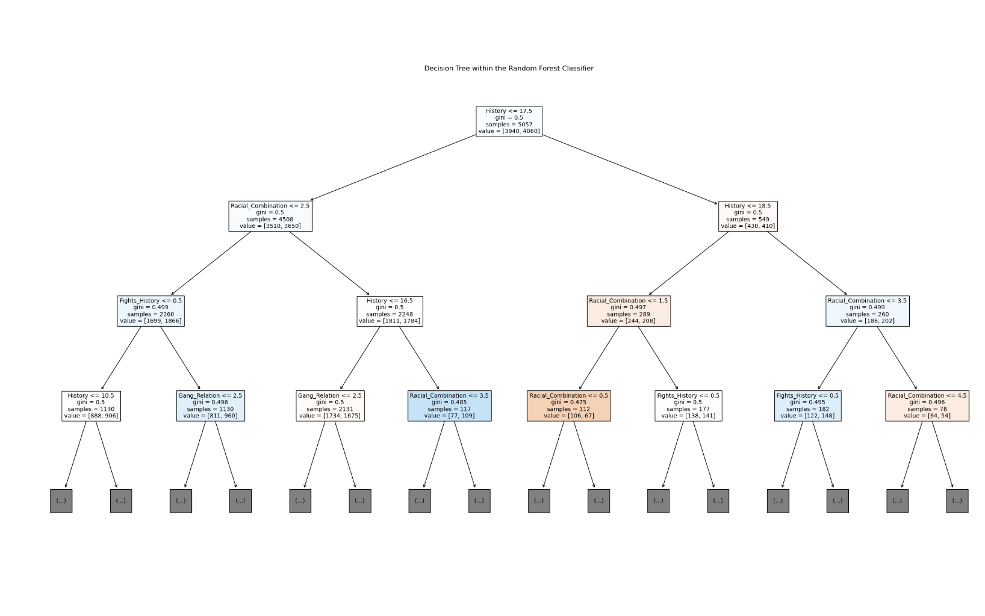
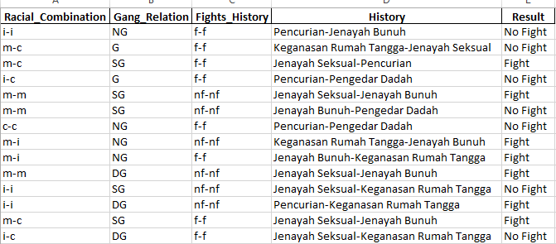
Decision Tree & Output

Slide 16
Proof-of-Concept Use Cases
Use Case 5 : Monitor and analyse the conversations among inmates and visitors
Is there any valuable insight to yield which will benefit the investigation further (e.g: solve crime, identify suspect)
How to identify whether there is any potential threat (e.g: someone plotting crime) through verbal communications
Solutions
Knowledge graph to illustrate the entities and the relationships between these entities as conveyed through spoken language
Perform word cloud analysis to identify the frequency and importance of words within conversations between inmates

Slide 17
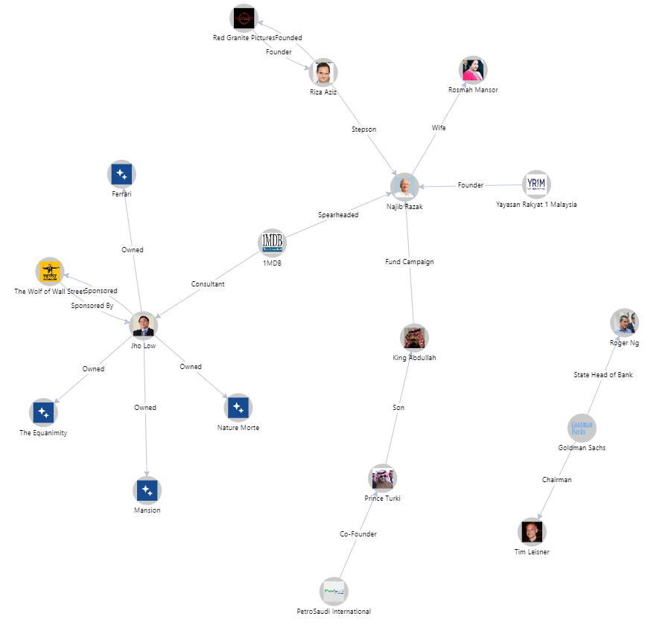
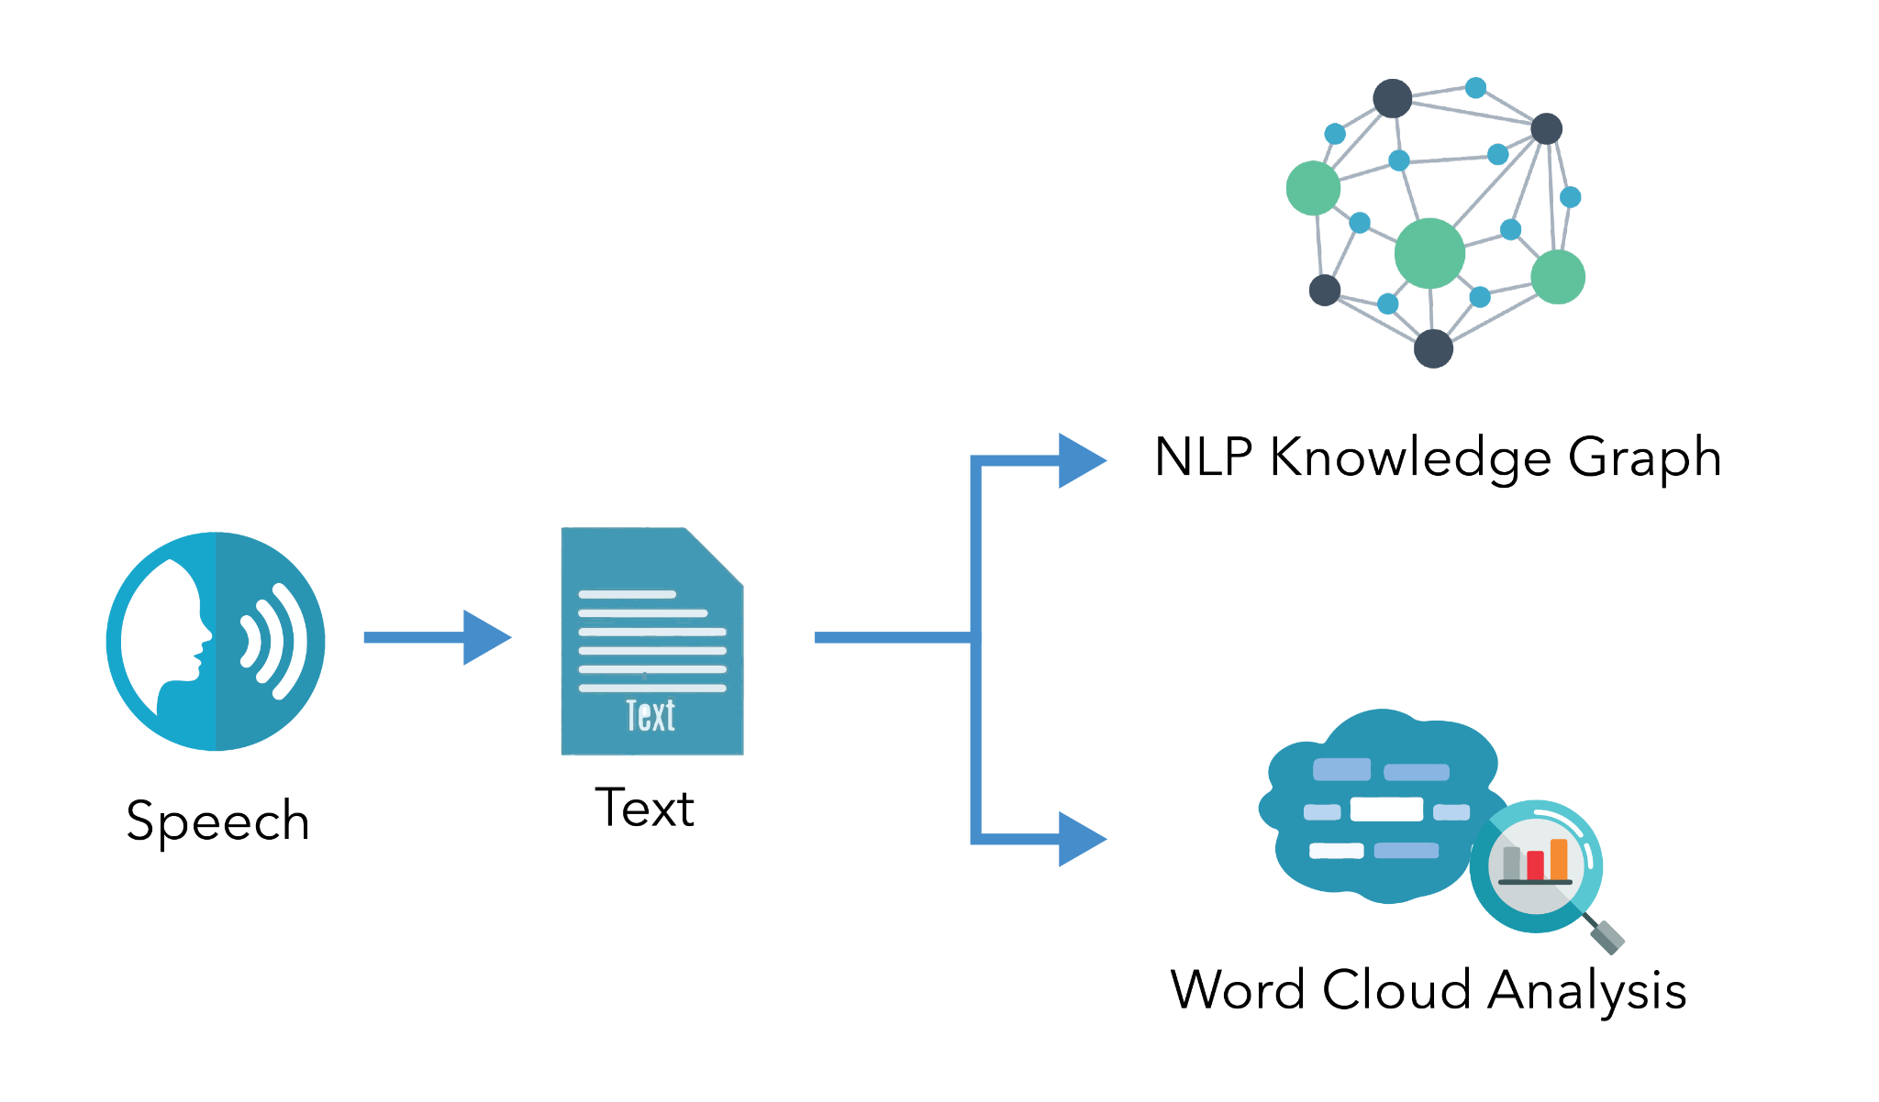
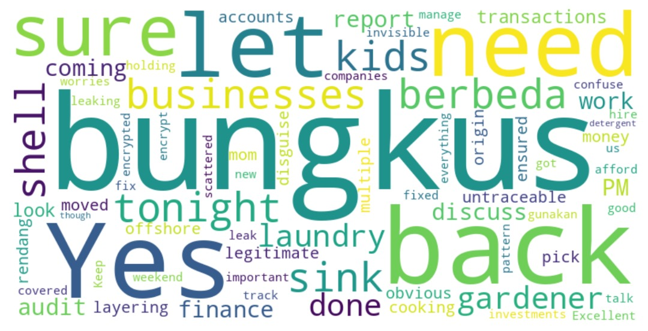
Here goes the process flow of speech to text and finally, analysis

