Slide 1
MLS/Resale Design Template
The idea is to create a new tab and replicate or borrow some components from the current tab.
From SMH Summary, add two more fields viz. Predicated/Suggested Pricing, and Affordability Index.
Add a Zip Code/ MetroArea Desirability Index field.
Show average desirability Index of the selected SMH Community.
The idea is to also add a layer of scatter points over the Map to show desirable areas.

Slide 2
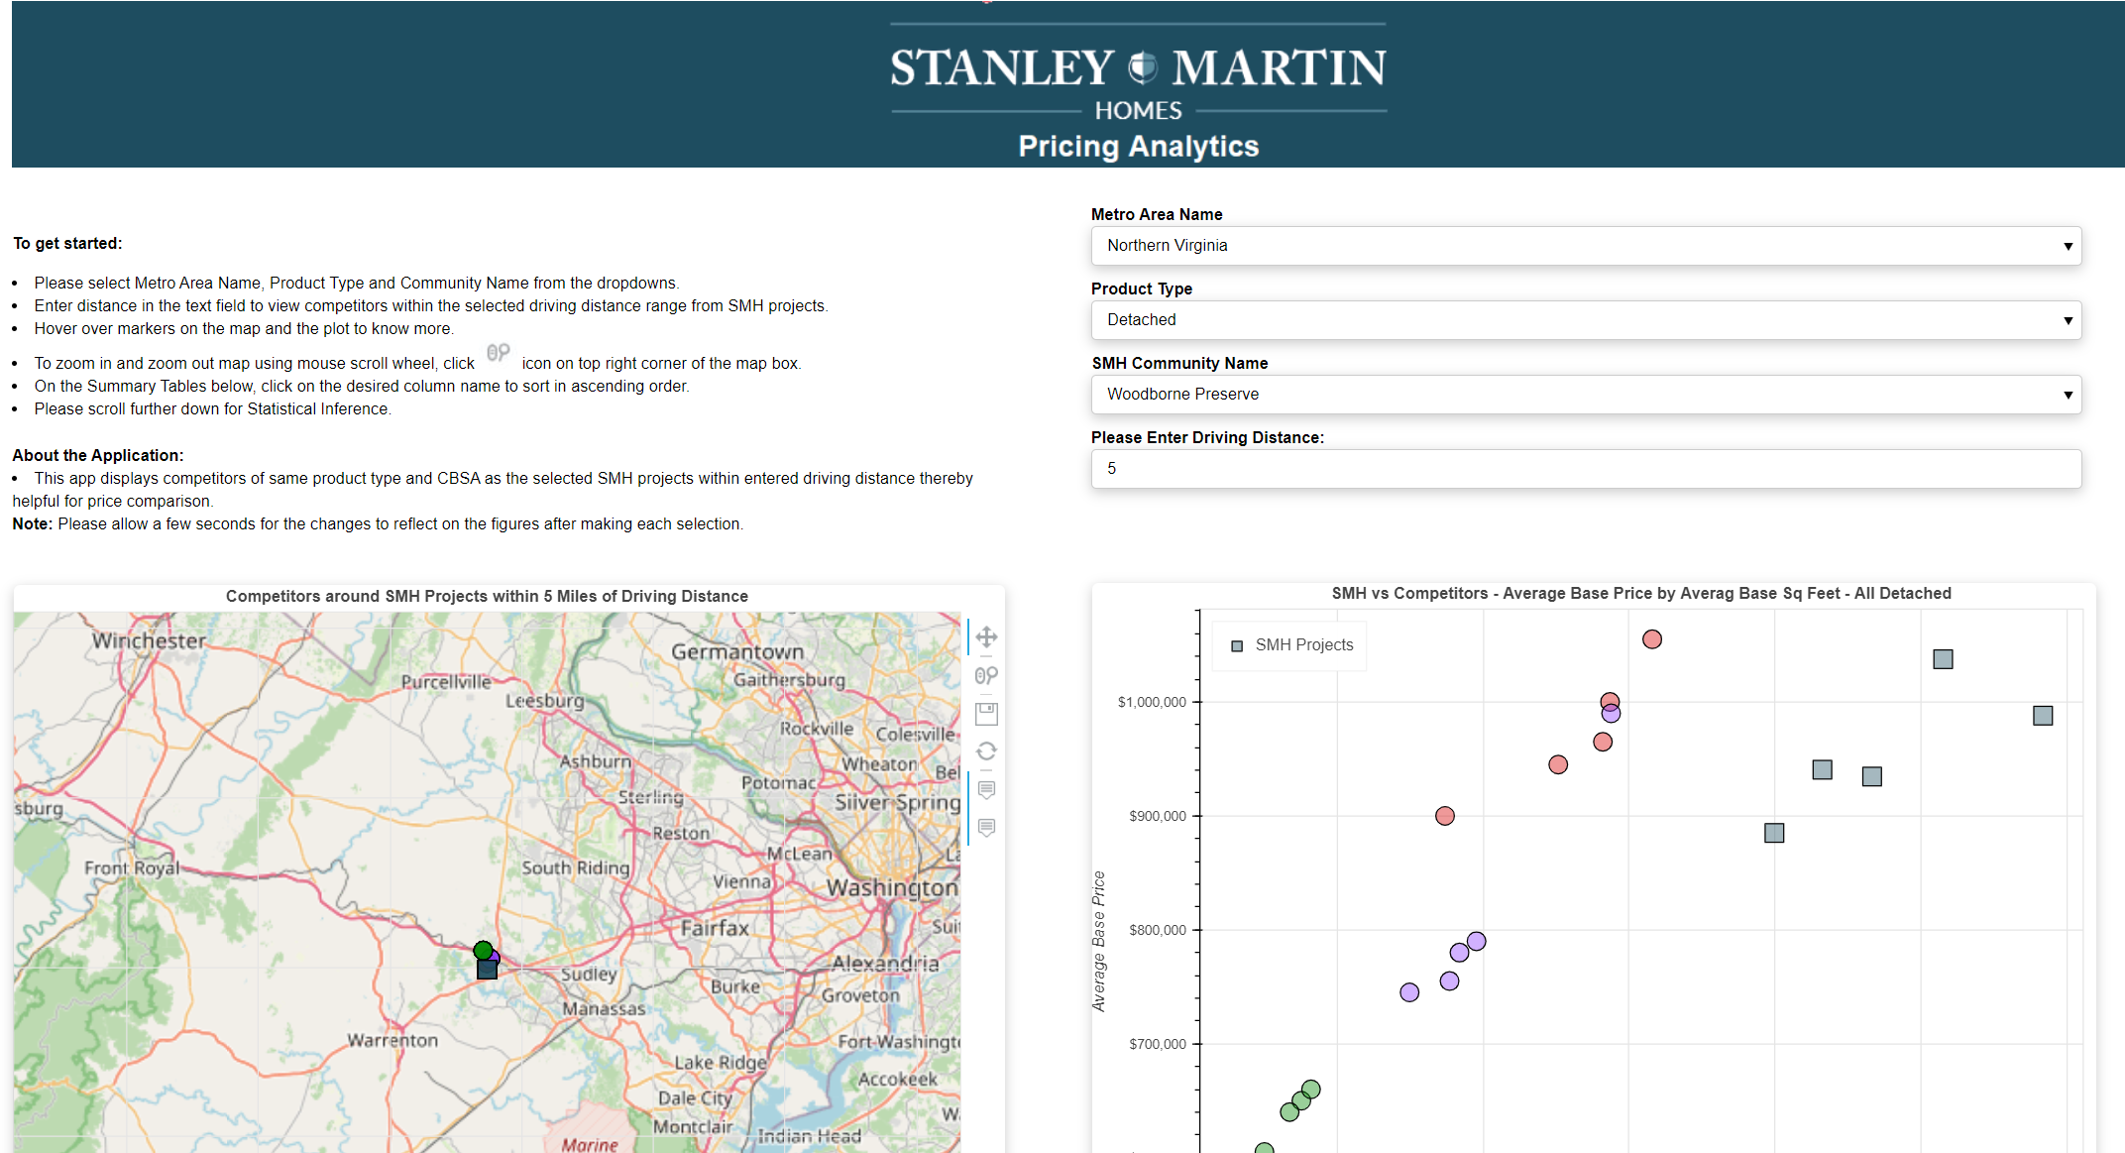
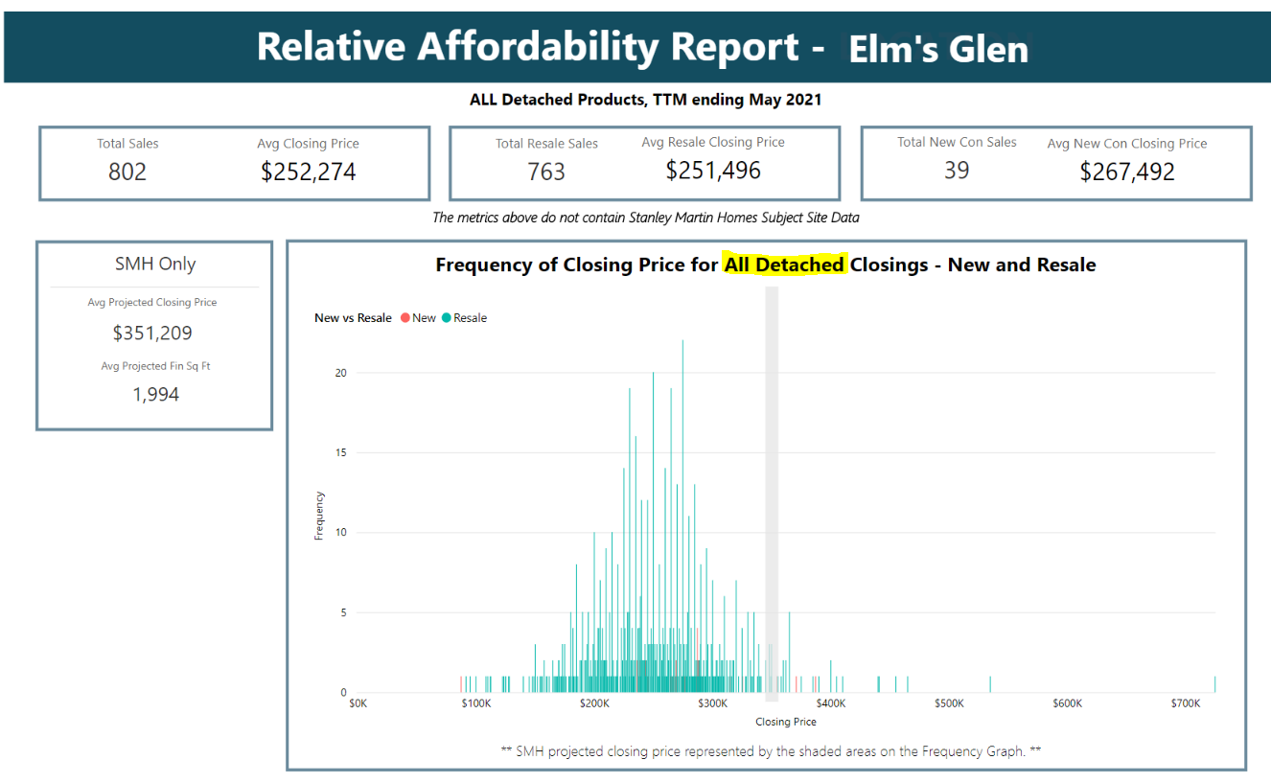
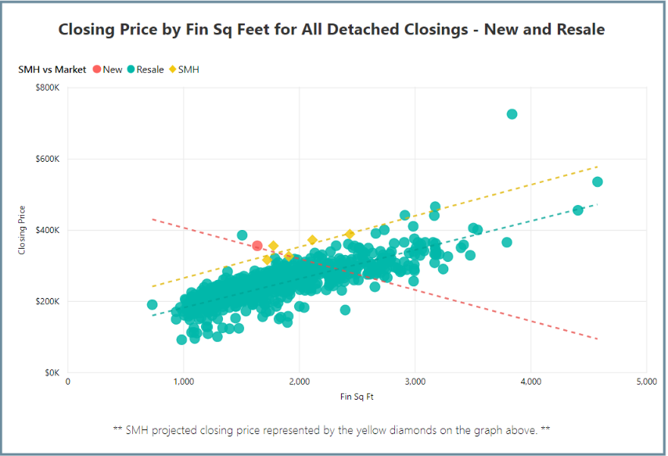

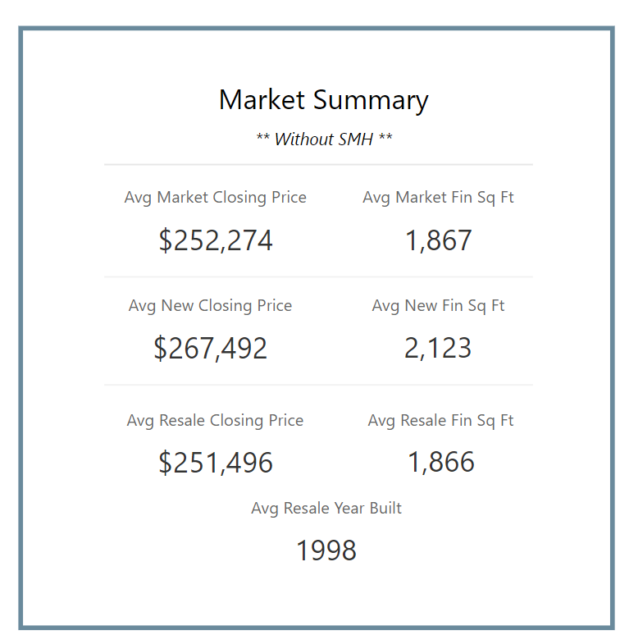
Community Desirability Score/Index
Elm’s Glen is SMH Community (ProjectID )

Slide 3
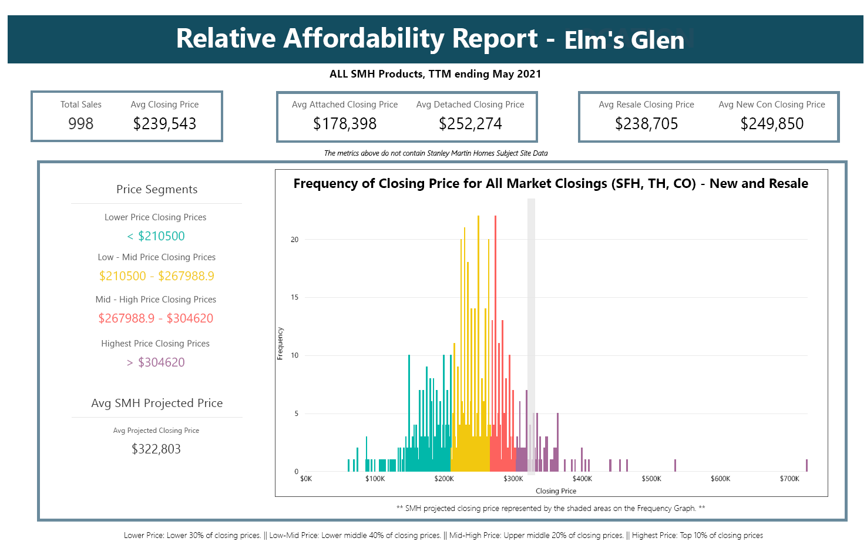

Slide 4
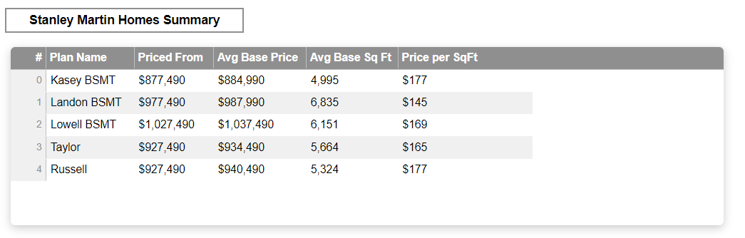
Updates Required to accommodate ML Modeling
The Predicted Prices and Affordability Index for Products can be displayed in the additional columns.
Affordability Index
Predicted/Suggested Pricing(ML)

Slide 5
Existing Application Design

Slide 6
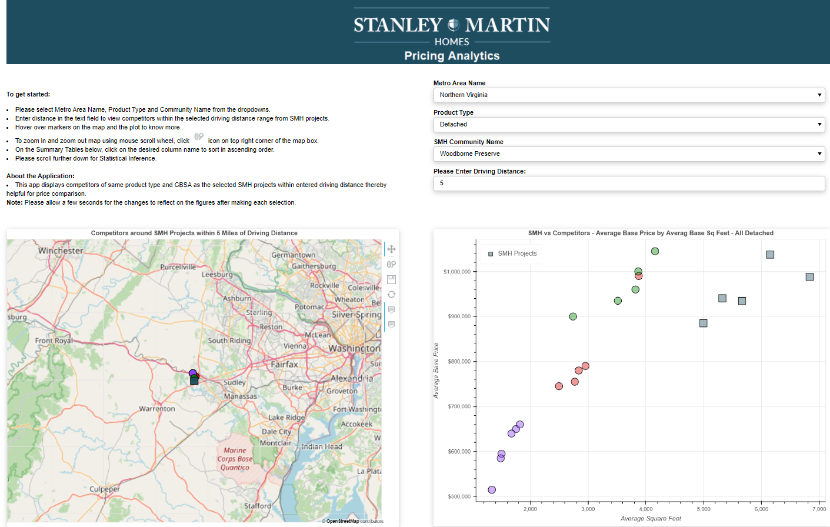
Current Layout
Zonda
MLS
Replicate
NYC Data Science Academy
This application displays New Construction data.
Notes:
Application Demo

Slide 7
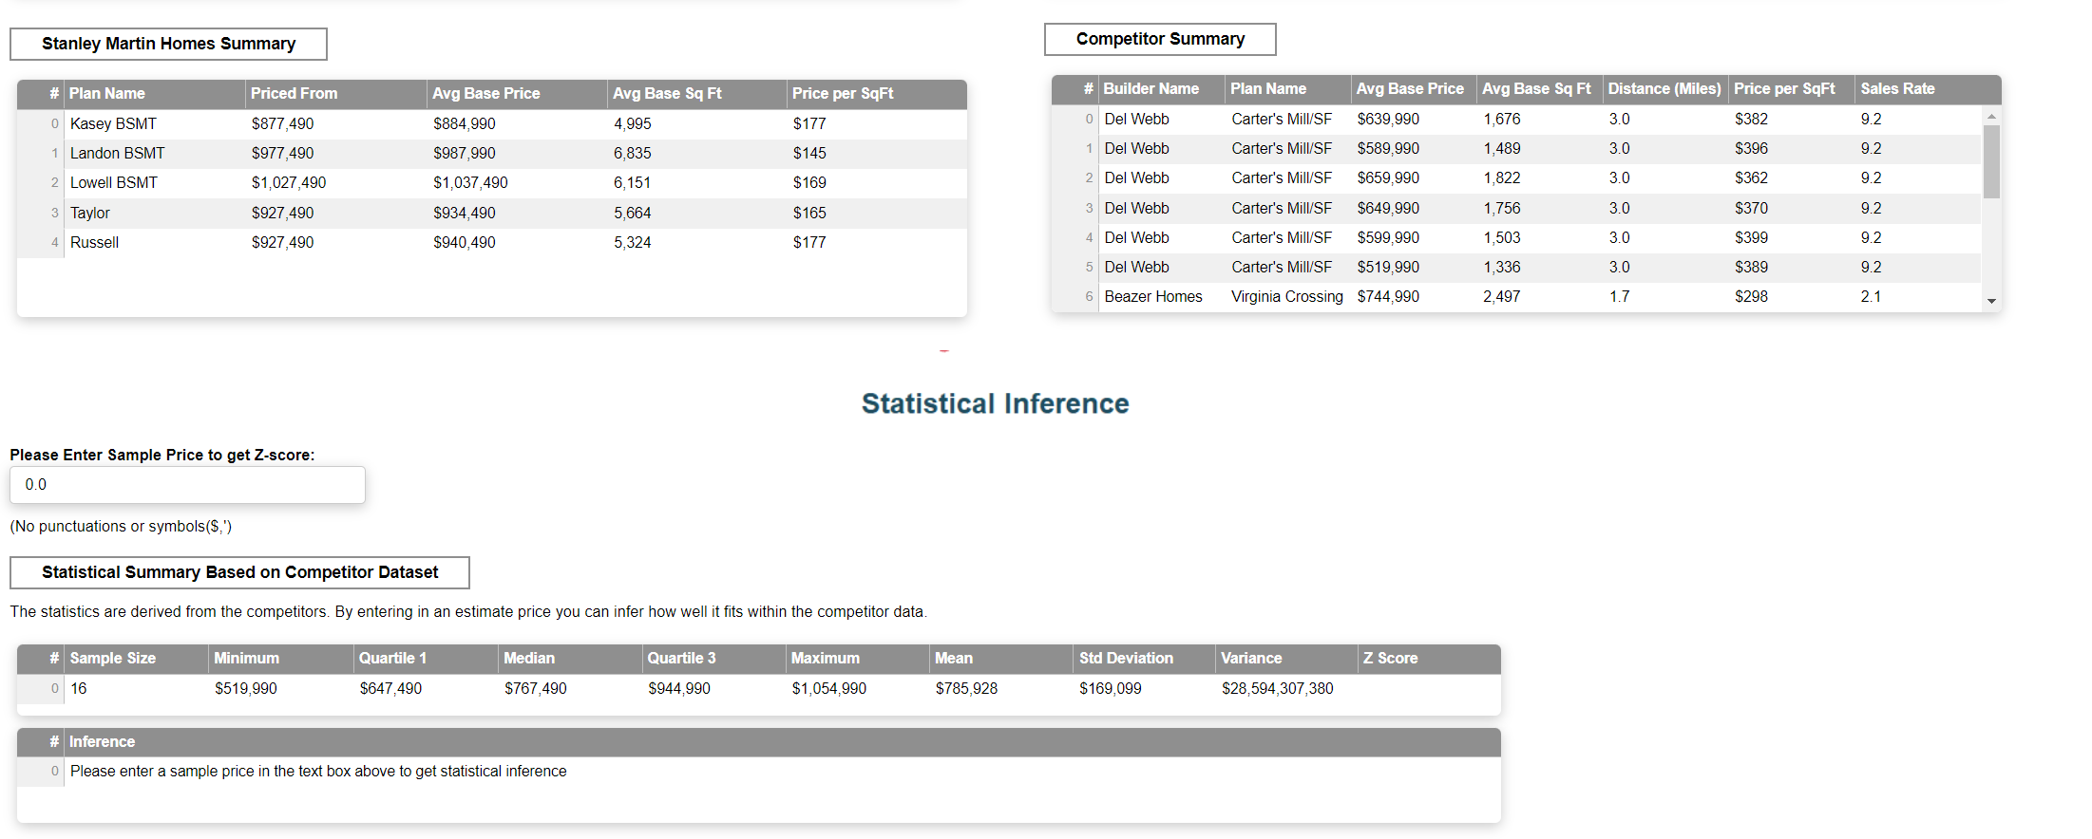

Slide 8
