Slide 1

ScrumLords Data Analytics Capstone
Team Members:
Genevieve Boardman
Kimara Morgan
Ashish Muthiraparambath
Dave Niedermier
Cierra Sparks
Notes:
Kimara

Slide 2

After winning the lottery we want to start a movie business to produce movies.
GOAL:
Produce the highest possible average rated movies.
Narrative
Notes:
Kimara

Slide 3
Initial Questions to Answer
What factors have the highest impact on the rating of a movie?
- Do we limit the date range for analysis?
- Do genres influence ratings?
- Do roles influence ratings?
Notes:
Kimara

Slide 4

Data Cleansing
Technical Challenges:
null values \\N
Data Type Conversions (startYear)
Comma Delimited Columns (One Hot Encoding)
Data Volume / Performance Consideration
Notes:
Kimara Null Values – We found that the dataset included an abnormal denotation of NULL. Our approach was to replace \\N with NaN values for python purposes and then converted columns to appropriate data type.
Had to get rid of movies that didn’t have a start year.
One Hot Encoding – [Genre Column] Split column with multiple values into multiple sub columns with numeric/Boolean values
Merging data became difficult due to the large dataset. Approx 2 gigs of data.

Slide 5
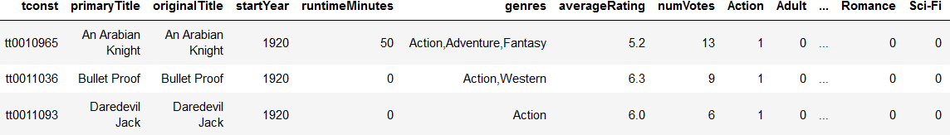
Data Cleansing
Decisions and Assumptions Made:
titleType = movie
isAdult = 0
Eliminate startYear = NULL
Split Genres to Unique Columns
Notes:
Kimara
Null Values – We found that the dataset included an abnormal denotation of NULL. Our approach was to replace \\N with NaN values for python purposes and then converted columns to appropriate data type.
Had to get rid of movies that didn’t have a start year.
One Hot Encoding – [Genre Column] Split column with multiple values into multiple sub columns with numeric/Boolean values
Merging data became difficult due to the large dataset. Approx 2 gigs of data.

Slide 6
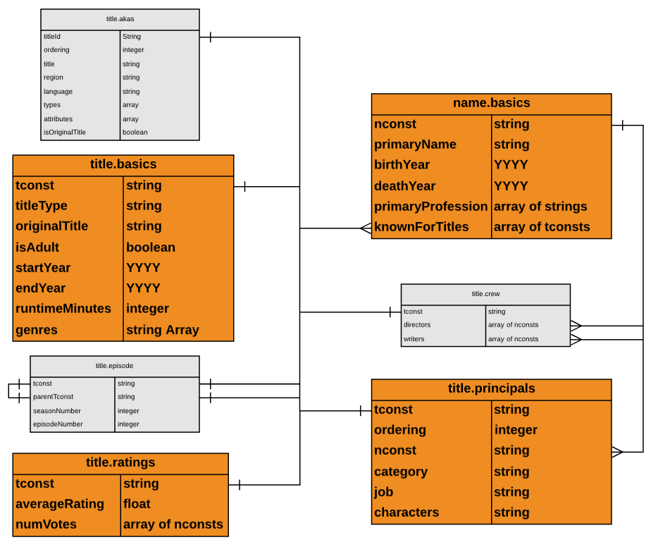
Targeted Tables
Notes:
Kimara

Slide 7

Exploration
Notes:
Genevieve

Slide 8
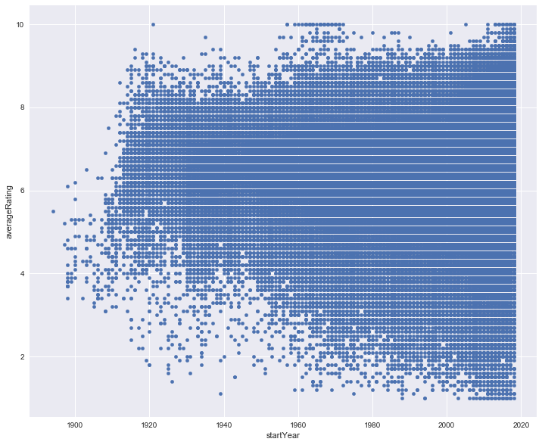
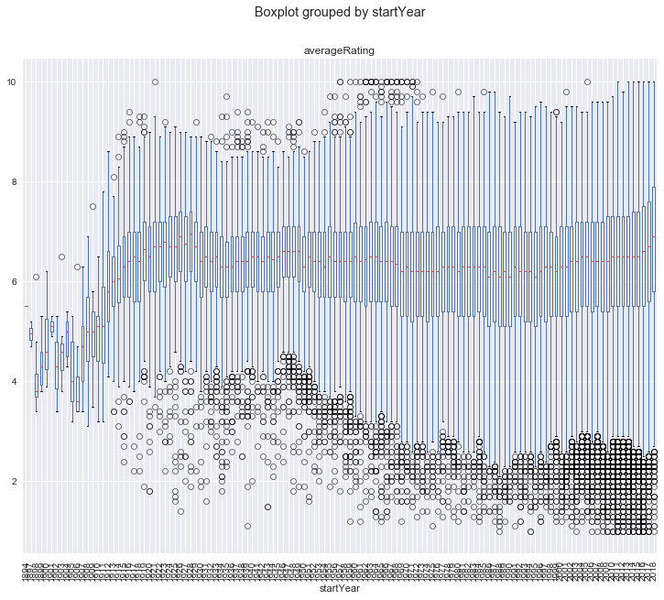
Movie Start Year
Notes:
Genevieve
In our questions to be answered we considered:
Do we limit the date range for analysis?
Tell the story of how we deciphered between 1894-1920 and 1920 vs 1980.
IMDb inception date in 1990.
Trend in the past 10 years:
Movie Inflation + Lower Outliers = Positive Trend of Avg Movie Ratings

Slide 9
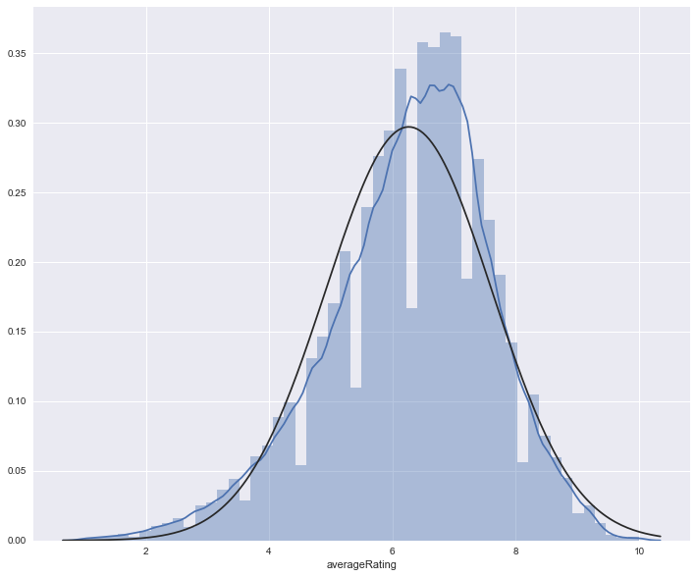
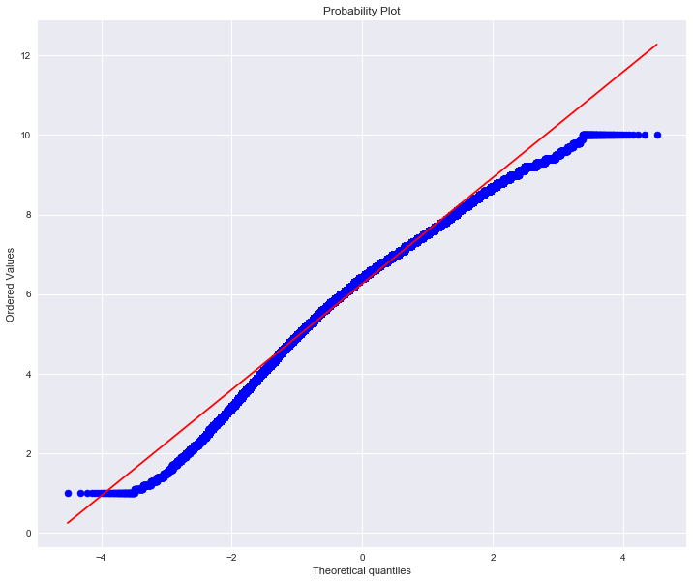
Average Rating Density
Notes:
Genevieve
We tested the normality of the average rating distribution. We used DistPlot for the light blue line (actual data) and ProbPlot for the black line (normalized distribution).
We are simply showing that the data is evenly distributed and average was the way to go. Slight right skew.

Slide 10
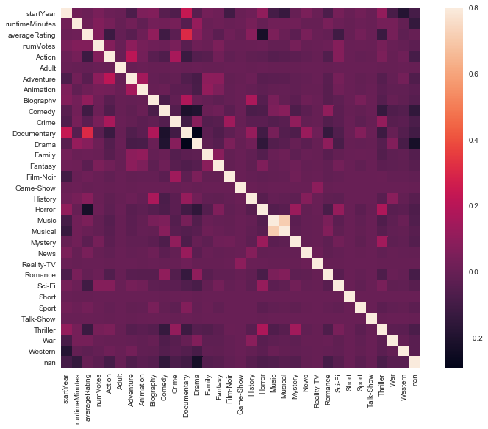
Genres Heatp
Genres HeatMap
Notes:
Genevieve Genres don’t correlate except with music/musicals and it still doesn’t correlate to avg rating

Slide 11
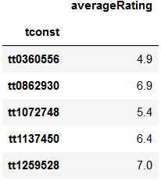
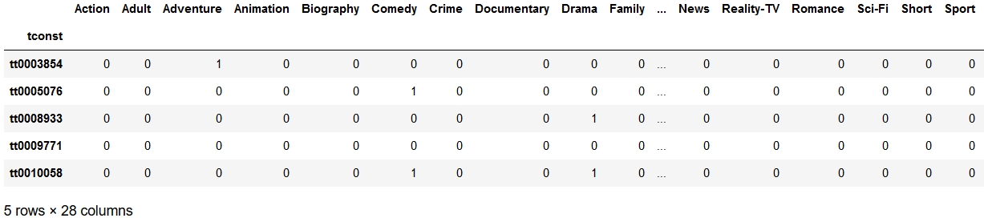
Genre Modeling Input Parameters
Prediction Target (y)
Predictors (X)
Notes:
Ashish
Decided to quickly model genre to confirm that genre as a feature could not predict the outcome of the movie rating
Used avg rating as our prediction target and genre as our predictor using one hot encoding.
NOTE: Test size = 0.33 or 33%
RandomState = 0

Slide 12

Genre Model Comparison
Notes:
Ashish
The variance score of 1 denotes perfect. Mean squared error as close to zero is desired.
Both model performed poorly and below expectations.

Slide 13
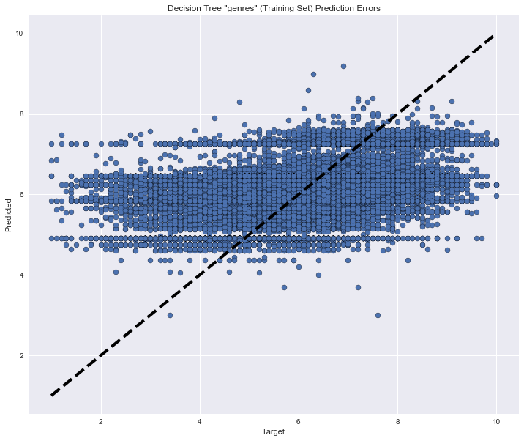

Decision Tree
Random Forest
Notes:
Ashish
Visual Output of model results. Should ideally follow the black line in a linear trend.

Slide 14
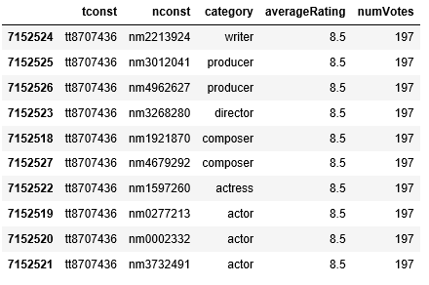
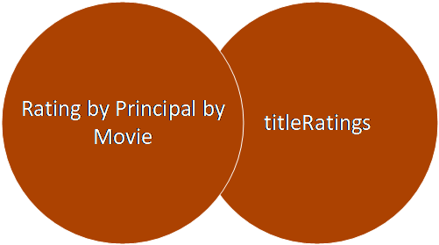
titlePrincipals Exploration Step 1: Inner Join to Produce Rating by Principal by Movie
Notes:
Dave
Manufacture data by inner joining ratings by principle by movie.

Slide 15
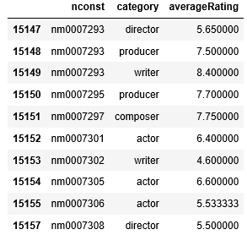
Step 2: Aggregate Average Ratings by Name by title.Principal Category
Notes:
Dave
Rolled up each category for each person to get an avg avg rating for that individual.

Slide 16
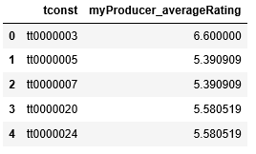
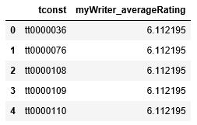
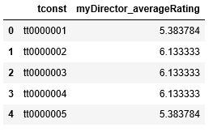
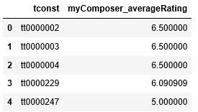
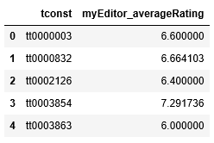
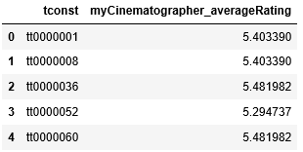
Step 3: Aggregate Each Role by Movie
Notes:
Dave
Deal with the problem of multiple roles on each movie. Rolled up to produce one avg for each and every role for that movie.

Slide 17
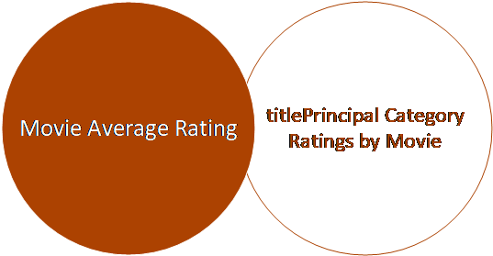
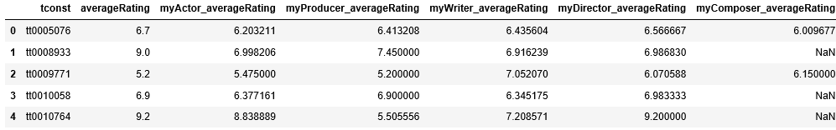
Step 4: Produce Final Dataset (by Movie)
Notes:
Dave
Left Outer Join Each titlePrincipal Category Average Rating to Movie Average Rating
Step 4: Produce Average Ratings For Each Role by Movie

Slide 18
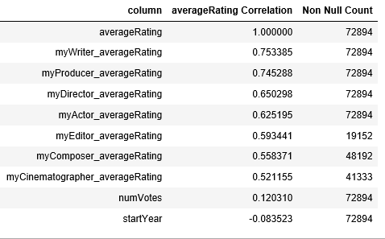
Correlation to averageRating & non Null Count
Notes:
Dave

Slide 19
Decision Tree
Produce the highest possible average rated movie
Movie
Non-Movie
Non-Adult
Adult
>=1920
< 1920
No Genre Filter
Filter Genre
Actors
Producer
Director
Writer
Notes:
Genevieve

Slide 20

Modeling
Notes:
Cierra
Now that we’ve cleansed and refined our dataset we transitioned into modeling.

Slide 21
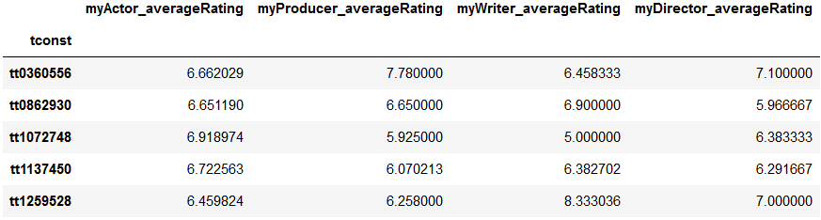
Title Principle Modeling Input Parameters
Prediction Target (y)
Predictors (X)
Notes:
Cierra
Similar to genre we used avgRating for the Prediction Target, title Principals for predictors.
As Dave mentioned, we only modeled the four roles due to non NULLS
NOTE: Test size = 0.33 or 33%
RandomState = 0

Slide 22
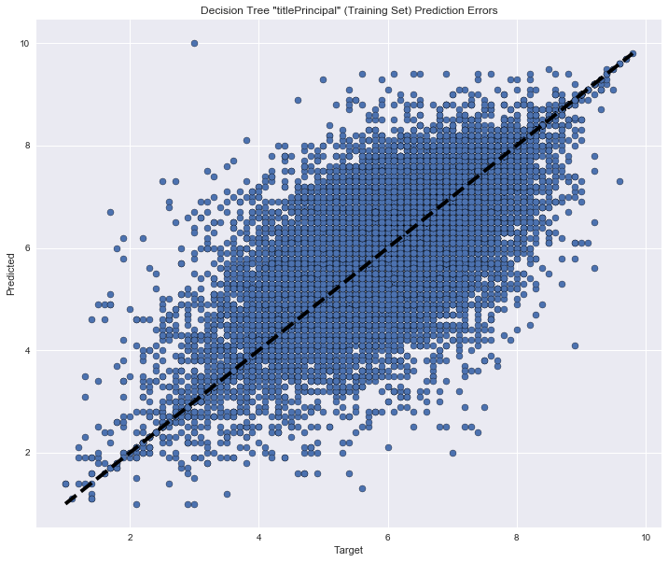
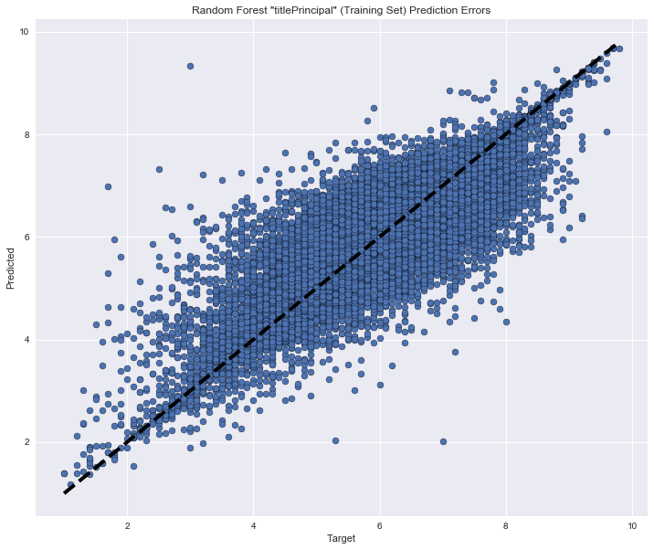
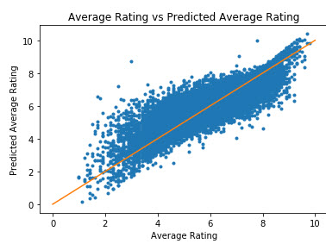
Decision Tree
Linear Regression
Random Forest
Notes:
Cierra
Looking at a visual of the models they appear to be very similar

Slide 23
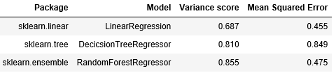
Title Principal Model Comparison
Notes:
Cierra
Based on the variance score and Mean Squared Error Random Forest had the best performance outputs. The variance score of 1 denotes perfect. Mean squared error as close to zero is desired.

Slide 24
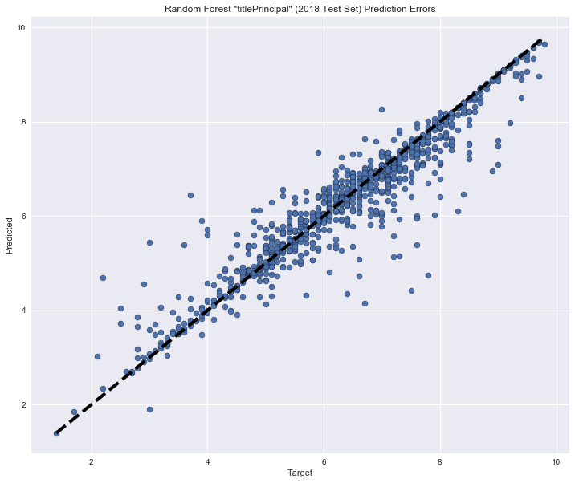
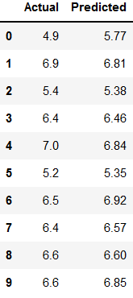
2018 Prediction Accuracy
Notes:
Cierra
Separated 2018 data for validation.
Refinement of the model.

Slide 25

Next Steps – Nice To Have
Further refine the Random Forest data model
Determine why “titleType = movie” includes genres that match TV shows
Dataset for movie budgets and earnings
Dataset that further defines release date and release country
Dataset to include movie Classifications Ratings (G, PG, PG-13, R, etc.)
Point in time comparison for Role Ratings (title.Principles)
Notes:
Cierra

Slide 26
Lessons Learned
Final Conclusions from Capstone
BLAH BLAH BLAH BLAH
BLAH BLAH BLAH BLAH
BLAH BLAH
Notes:
Ashish

Slide 27


Slide 28

Q&A

Slide 29
REFERENCES
https://encrypted-tbn0.gstatic.com/images?q=tbn:ANd9GcTPsmCzO9IEDELAmqhjq_YkE5lSgrfsc34d0hGhGyshSp1RorxE
https://www.google.com/imgres?imgurl=https%3A%2F%2Fartoffitness.net%2Fwp-content%2Fuploads%2F2016%2F06%2Fdetour-sign.gif&imgrefurl=https%3A%2F%2Fartoffitness.net%2Flight-rail-transit-lrt-detour-construction-stress%2Fdetour-sign%2F&docid=gmoSIU7x0AEPuM&tbnid=M9P34_9tSeZzuM%3A&vet=10ahUKEwi_ovyQy-DcAhWW2YMKHX4nCyYQMwihAigaMBo..i&w=450&h=494&bih=521&biw=1278&q=detour%20sign&ved=0ahUKEwi_ovyQy-DcAhWW2YMKHX4nCyYQMwihAigaMBo&iact=mrc&uact=8
https://www.google.com/imgres?imgurl=https%3A%2F%2Fwww.joshuanhook.com%2Fwp-content%2Fuploads%2F2017%2F07%2Fexplore.jpg&imgrefurl=https%3A%2F%2Fwww.joshuanhook.com%2Fexplore-and-experiment%2F&docid=Y4238KXw-HaI-M&tbnid=6HIfzclSNc0KIM%3A&vet=10ahUKEwj_uJjFk-PcAhXi34MKHTmrCtwQMwgzKAAwAA..i&w=1920&h=1080&bih=498&biw=1256&q=explore&ved=0ahUKEwj_uJjFk-PcAhXi34MKHTmrCtwQMwgzKAAwAA&iact=mrc&uact=8
https://www.google.com/url?sa=i&source=images&cd=&cad=rja&uact=8&ved=2ahUKEwj6rcih3-DcAhXI44MKHS76CC4QjRx6BAgBEAU&url=http%3A%2F%2Fschullns.com%2Flatest-news%2Fthanks-well-done%2F&psig=AOvVaw080tqyFusH5fL5mSWeTLjk&ust=1533930367930802
https://www.google.com/imgres?imgurl=https%3A%2F%2Fcdn.career.guru99.com%2Fwp-content%2Fuploads%2F2013%2F03%2FID-10086141.jpg&imgrefurl=https%3A%2F%2Fcareer.guru99.com%2Ftop-10-behavioral-interview-questions-with-answers%2F&docid=VVqSBIkRo8rshM&tbnid=PwQca22eXHkTiM%3A&vet=10ahUKEwiZyejH3uDcAhUrwYMKHe01DTQQMwjOASgTMBM..i&w=400&h=300&bih=511&biw=1265&q=questions&ved=0ahUKEwiZyejH3uDcAhUrwYMKHe01DTQQMwjOASgTMBM&iact=mrc&uact=8
https://www.techiexpert.com/wp-content/uploads/2018/06/What-can-data-do-for-students3.png

