Slide 1

ScrumLords Data Analytics Capstone
Team Members:
Genevieve Boardman
Kimara Morgan
Ashish Muthiraparambath
Dave Niedermier
Cierra Sparks

Slide 2

After winning the lottery we want to start a movie business to produce movies.
GOAL:
Produce the highest possible average rated movies.
Narrative

Slide 3
Initial Questions to Answer
What factors have the highest impact on the rating of a movie?
- Do we limit the date range for analysis?
- Do genres influence ratings?
- Do roles influence ratings?

Slide 4

Data Cleansing
Technical Challenges:
null values \\N
Data Type Conversions (startYear)
Comma Delimited Columns (One Hot Encoding)
Data Volume / Performance Consideration

Slide 5
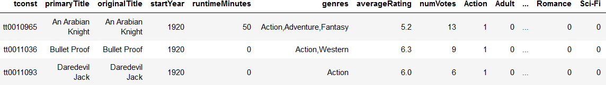
Data Cleansing
Decisions and Assumptions Made:
titleType = movie
isAdult = 0
Eliminate startYear = NULL
Split Genres to Unique Columns

Slide 6
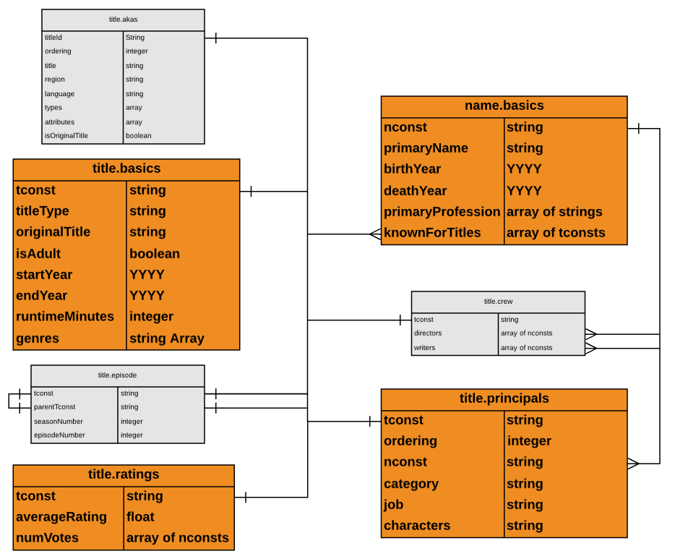
Targeted Tables

Slide 7

Exploration

Slide 8
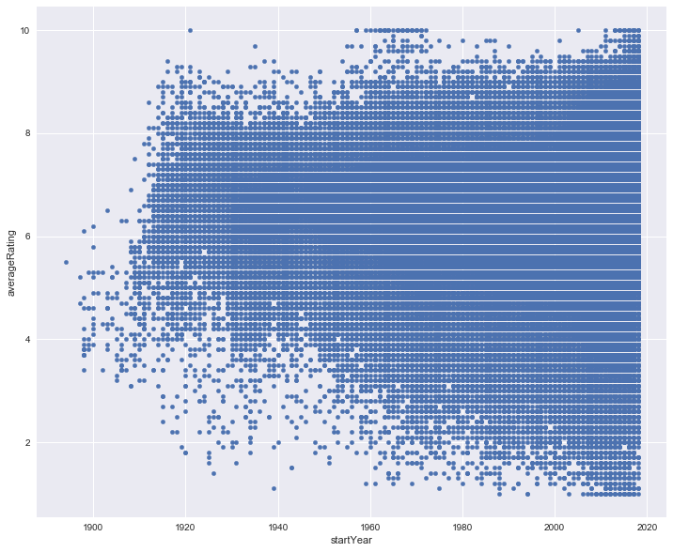
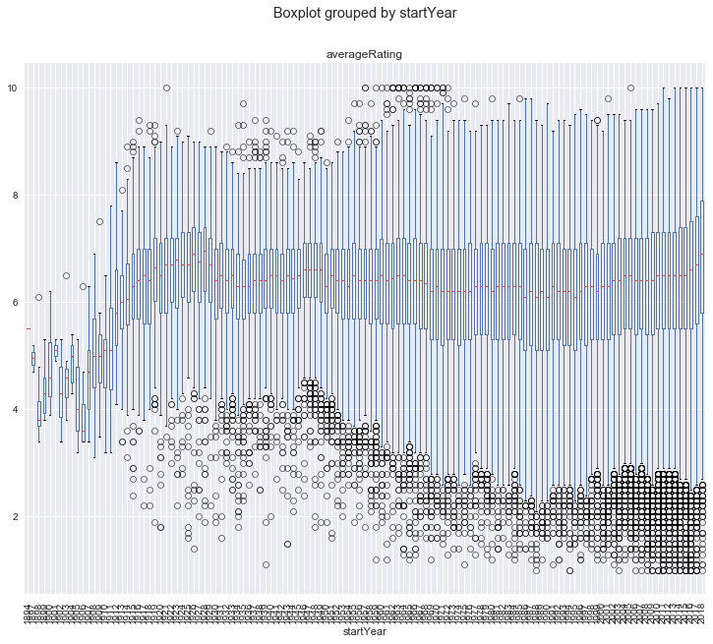
Movie Start Year

Slide 9
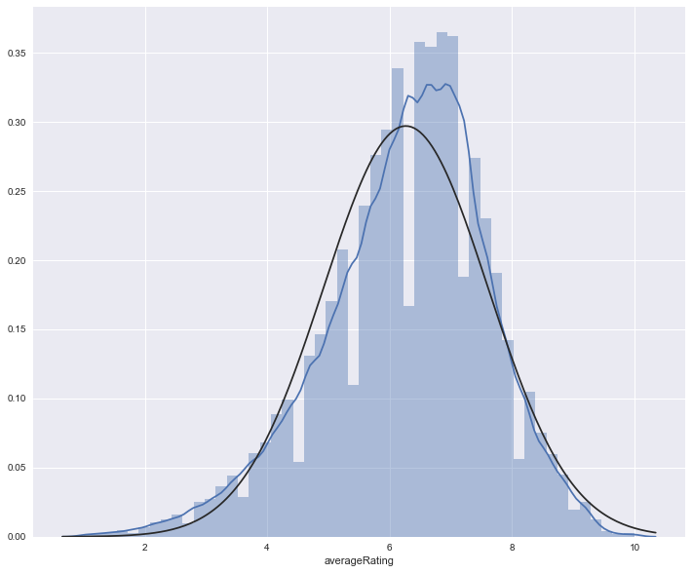
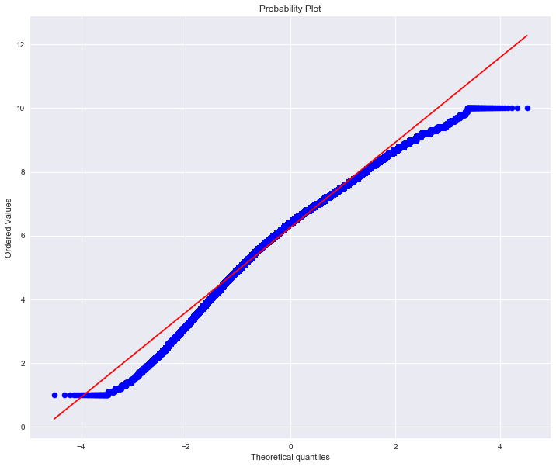
Average Rating Density

Slide 10
HeatMap for Genre?

Slide 11
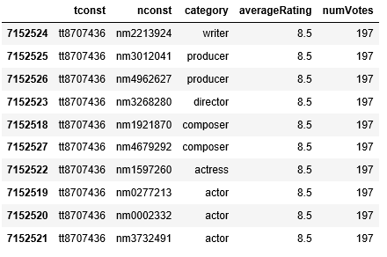
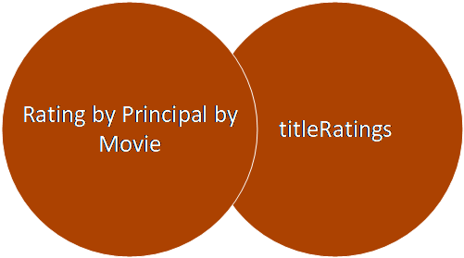
titlePrincipals Exploration Step 1: Inner Join to Produce Rating by Principal by Movie

Slide 12
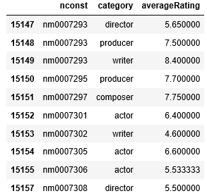
Step 2: Aggregate Average Ratings by Name by title.Principal Category

Slide 13
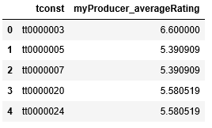
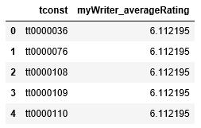
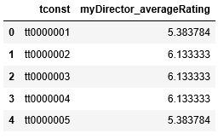
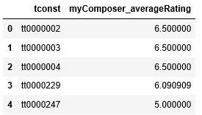
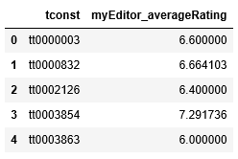
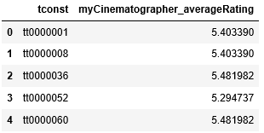
Step 3: Aggregate Each titlePrincipal Role Average Rating by Movie

Slide 14
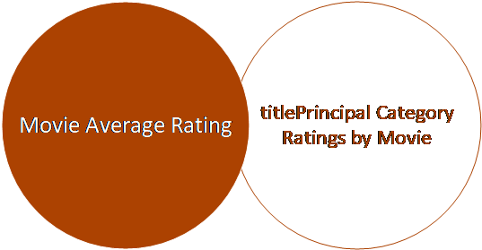
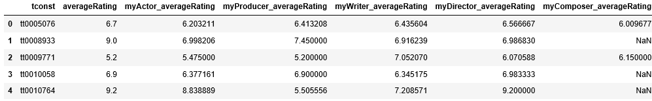
Step 4: Left Outer Join Each titlePrincipal Category Average Rating to Movie Average Rating

Slide 15
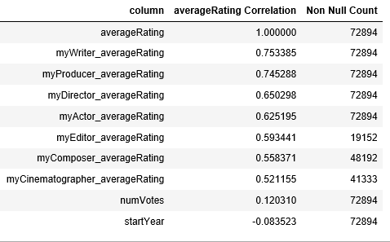
Correlation to averageRating & non Null Count

Slide 16

Modeling

Slide 17
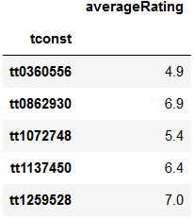
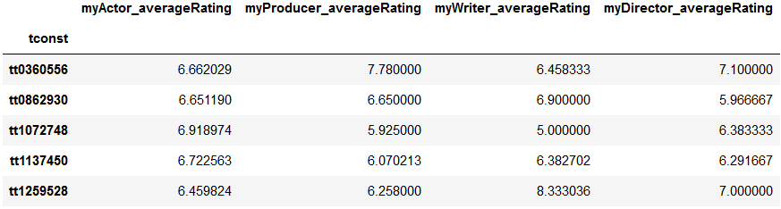
Modeling Input Parameters
Prediction Target (y)
Predictors (X)

Slide 18
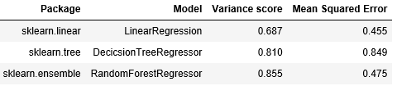
Model Comparison

Slide 19
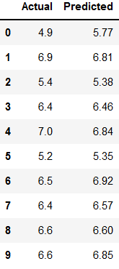
Prediction Accuracy

Slide 20
Lessons Learned
Final Conclusions from Capstone
BLAH BLAH BLAH BLAH
BLAH BLAH BLAH BLAH
BLAH BLAH

Slide 21
Decision Tree
Produce the highest possible average rated movie
Movie
Non-Movie
Non-Adult
Adult
>=1920
< 1920
No Genre Filter
Filter Genre
Actors
Producer
Director
Writer

Slide 22

Next Steps – Nice To Have
Determine why “titleType = movie” includes genres that match TV shows
Dataset for movie budgets and earnings
Dataset that further defines release date and release country
Dataset to include movie Classifications Ratings (G, PG, PG-13, R, etc.)
Point in time comparison for Role Ratings (title.Principles)

Slide 23


Slide 24

Q&A

Slide 25
https://encrypted-tbn0.gstatic.com/images?q=tbn:ANd9GcTPsmCzO9IEDELAmqhjq_YkE5lSgrfsc34d0hGhGyshSp1RorxE
https://www.google.com/imgres?imgurl=https%3A%2F%2Fartoffitness.net%2Fwp-content%2Fuploads%2F2016%2F06%2Fdetour-sign.gif&imgrefurl=https%3A%2F%2Fartoffitness.net%2Flight-rail-transit-lrt-detour-construction-stress%2Fdetour-sign%2F&docid=gmoSIU7x0AEPuM&tbnid=M9P34_9tSeZzuM%3A&vet=10ahUKEwi_ovyQy-DcAhWW2YMKHX4nCyYQMwihAigaMBo..i&w=450&h=494&bih=521&biw=1278&q=detour%20sign&ved=0ahUKEwi_ovyQy-DcAhWW2YMKHX4nCyYQMwihAigaMBo&iact=mrc&uact=8
https://www.google.com/imgres?imgurl=https%3A%2F%2Fwww.joshuanhook.com%2Fwp-content%2Fuploads%2F2017%2F07%2Fexplore.jpg&imgrefurl=https%3A%2F%2Fwww.joshuanhook.com%2Fexplore-and-experiment%2F&docid=Y4238KXw-HaI-M&tbnid=6HIfzclSNc0KIM%3A&vet=10ahUKEwj_uJjFk-PcAhXi34MKHTmrCtwQMwgzKAAwAA..i&w=1920&h=1080&bih=498&biw=1256&q=explore&ved=0ahUKEwj_uJjFk-PcAhXi34MKHTmrCtwQMwgzKAAwAA&iact=mrc&uact=8
https://www.google.com/url?sa=i&source=images&cd=&cad=rja&uact=8&ved=2ahUKEwj6rcih3-DcAhXI44MKHS76CC4QjRx6BAgBEAU&url=http%3A%2F%2Fschullns.com%2Flatest-news%2Fthanks-well-done%2F&psig=AOvVaw080tqyFusH5fL5mSWeTLjk&ust=1533930367930802
https://www.google.com/imgres?imgurl=https%3A%2F%2Fcdn.career.guru99.com%2Fwp-content%2Fuploads%2F2013%2F03%2FID-10086141.jpg&imgrefurl=https%3A%2F%2Fcareer.guru99.com%2Ftop-10-behavioral-interview-questions-with-answers%2F&docid=VVqSBIkRo8rshM&tbnid=PwQca22eXHkTiM%3A&vet=10ahUKEwiZyejH3uDcAhUrwYMKHe01DTQQMwjOASgTMBM..i&w=400&h=300&bih=511&biw=1265&q=questions&ved=0ahUKEwiZyejH3uDcAhUrwYMKHe01DTQQMwjOASgTMBM&iact=mrc&uact=8
https://www.techiexpert.com/wp-content/uploads/2018/06/What-can-data-do-for-students3.png

