Slide 1
ScrumLords Capstone

Slide 2

After winning the lottery we want to start a movie business to produce movies.
GOAL:
Produce the highest possible average rated movies.
Narrative

Slide 3
Initial Questions to Answer
What factors have the highest impact on the rating of a movie?
- Do we limit the date range for analysis?
- Do genres influence ratings?
- Do roles influence ratings?

Slide 4

Data Cleansing
Technical Challenges:
null values \\N
Data Type Conversions (startYear)
Comma Delimited Columns (One Hot Encoding)
Data Volume / Performance Consideration

Slide 5
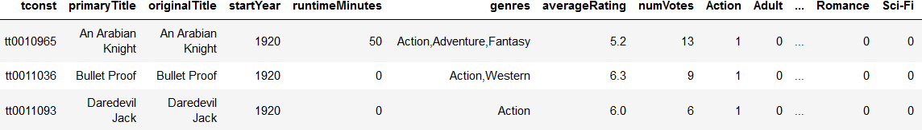
Data Cleansing
Decisions and Assumptions Made:
titleType = movie
isAdult = 0
Eliminate startYear = NULL
Split Genres to Unique Columns

Slide 6



Slide 7
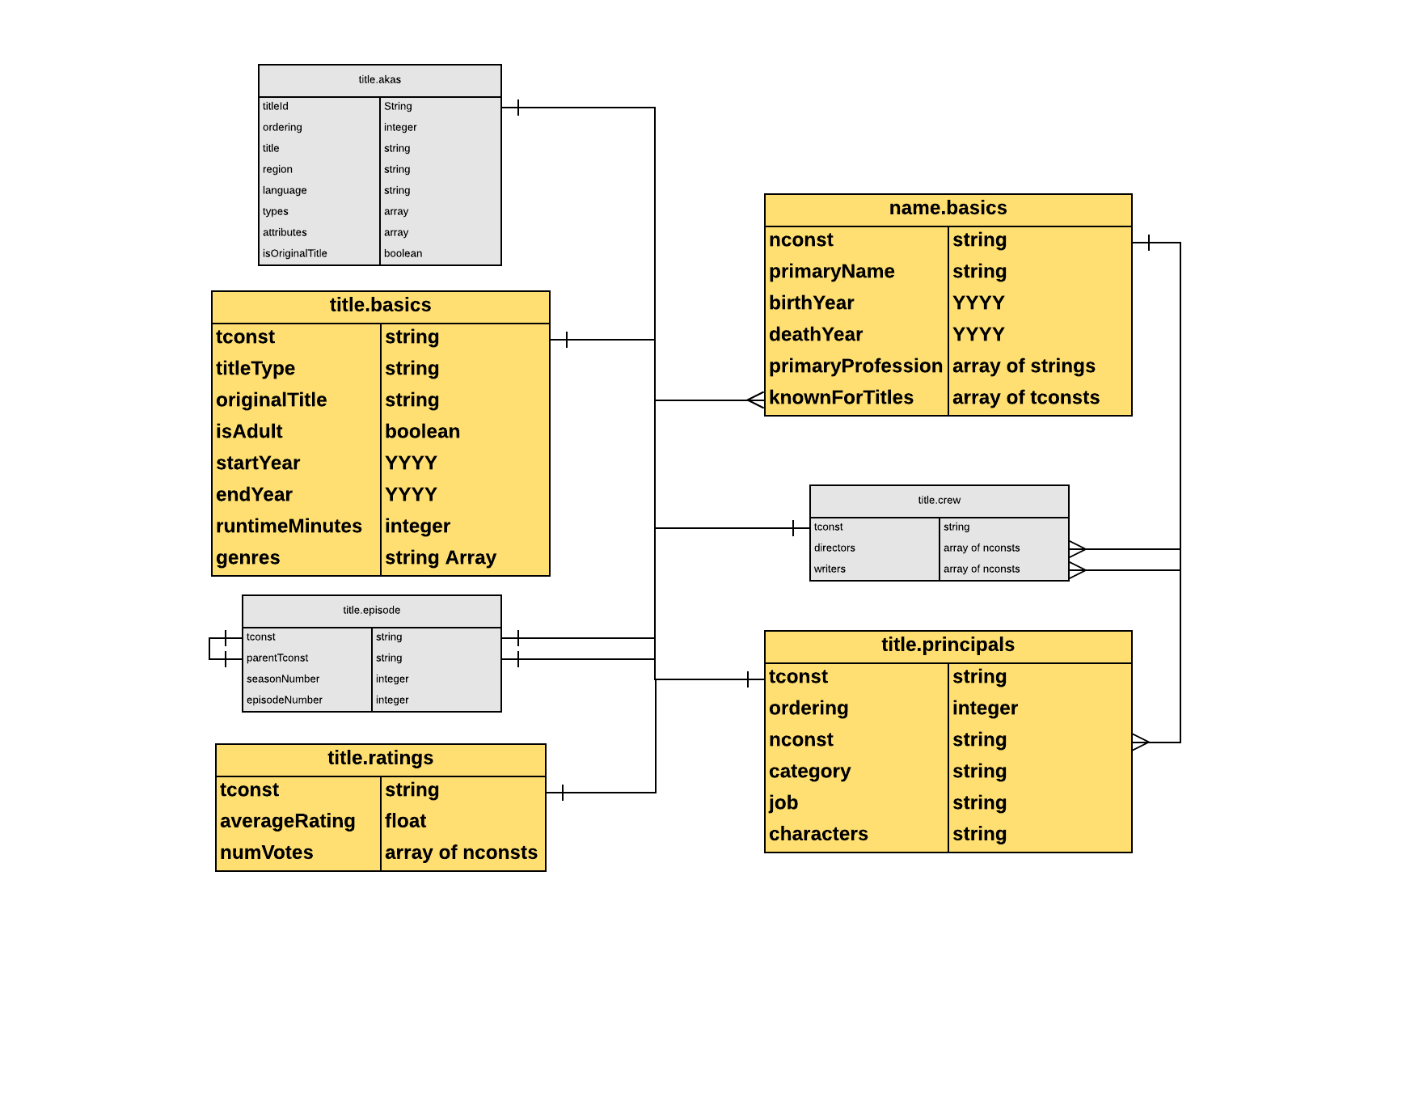
Targeted Tables

Slide 8
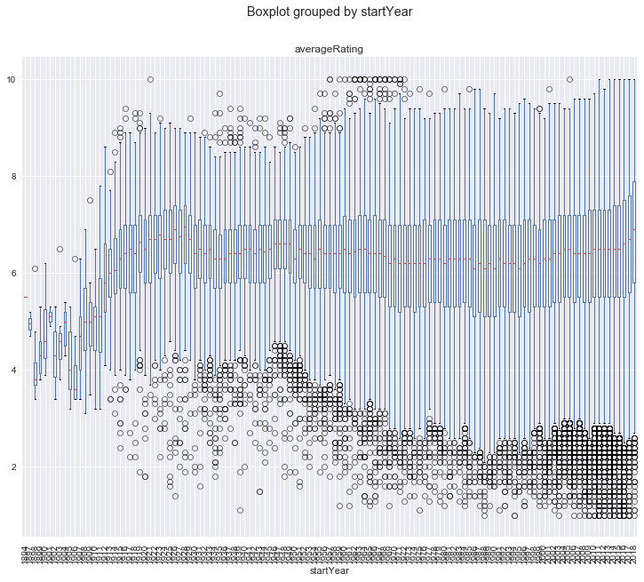
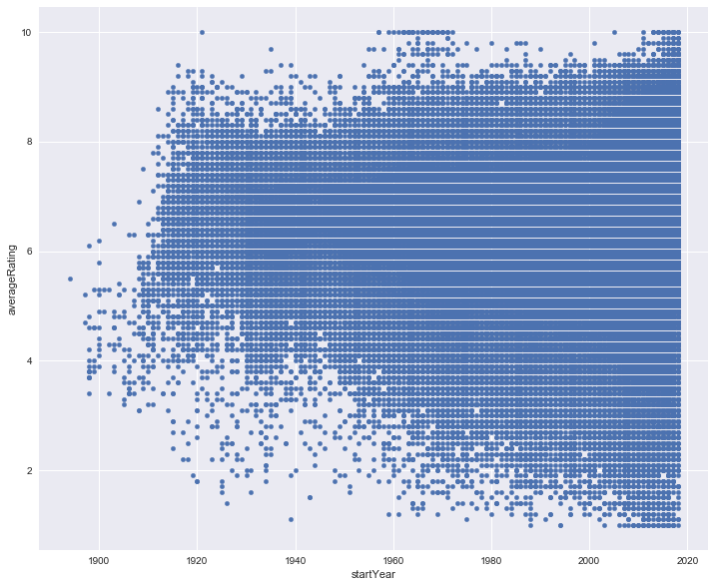
Movie Start Year

Slide 9
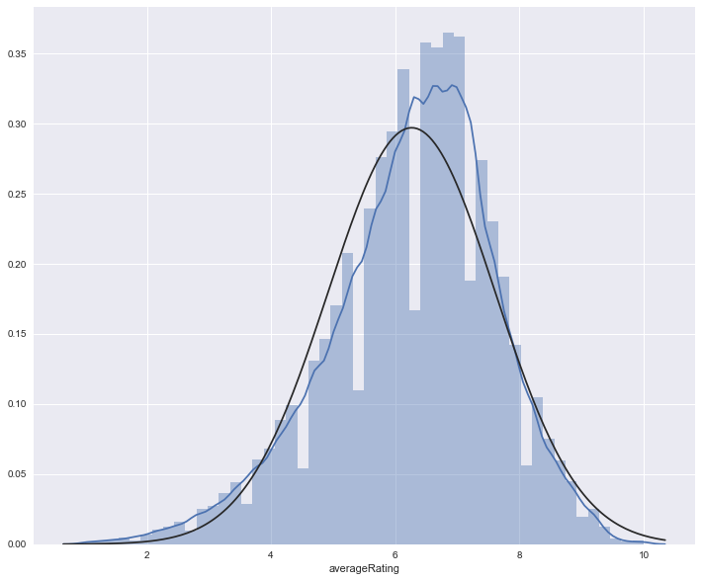
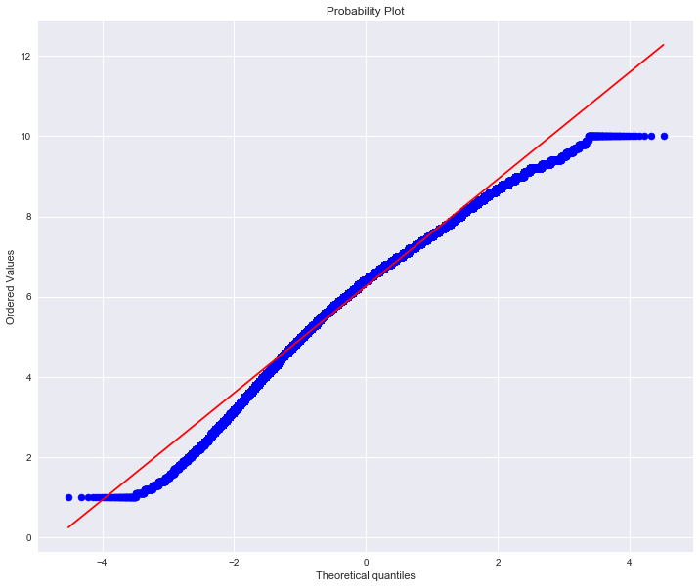
Average Rating Density

Slide 10
HeatMap for Genre?

Slide 11
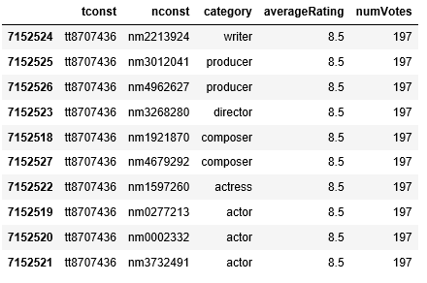
titlePrincipals Exploration Step 1: Inner Join to Produce Rating by Principal by Movie

Slide 12
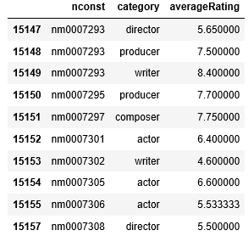
Step 2: Aggregate Average Ratings by Name by title.Principal Category

Slide 13
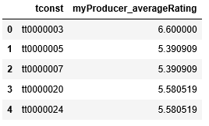
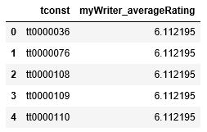
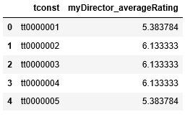
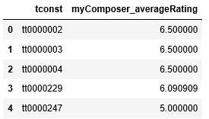
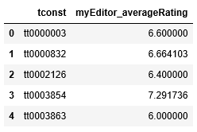
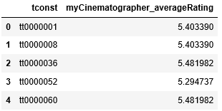
Step 3: Aggregate Each titlePrincipal Role Average Rating by Movie

Slide 14
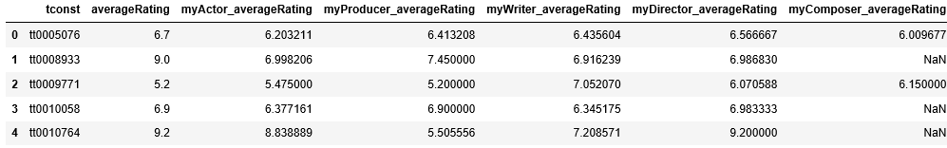
Step 4: Left Outer Join Each titlePrincipal Category Average Rating to Movie Average Rating

Slide 15
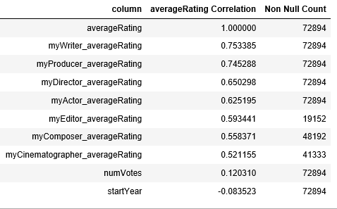
Correlation to averageRating & non Null Count

Slide 16
Modeling

Slide 17
Modeling

Slide 18

Next Steps – Nice To Have
Determine why “titleType = movie” includes genres that match TV shows
Dataset for movie budgets and earnings
Dataset that further defines release date and release country
Dataset to include movie Classifications Ratings (G, PG, PG-13, R, etc.)
Point in time comparison for Role Ratings (title.Principles)

Slide 19
Lessons Learned

Slide 20


Slide 21


Slide 22
https://encrypted-tbn0.gstatic.com/images?q=tbn:ANd9GcTPsmCzO9IEDELAmqhjq_YkE5lSgrfsc34d0hGhGyshSp1RorxE
https://www.google.com/imgres?imgurl=https%3A%2F%2Fartoffitness.net%2Fwp-content%2Fuploads%2F2016%2F06%2Fdetour-sign.gif&imgrefurl=https%3A%2F%2Fartoffitness.net%2Flight-rail-transit-lrt-detour-construction-stress%2Fdetour-sign%2F&docid=gmoSIU7x0AEPuM&tbnid=M9P34_9tSeZzuM%3A&vet=10ahUKEwi_ovyQy-DcAhWW2YMKHX4nCyYQMwihAigaMBo..i&w=450&h=494&bih=521&biw=1278&q=detour%20sign&ved=0ahUKEwi_ovyQy-DcAhWW2YMKHX4nCyYQMwihAigaMBo&iact=mrc&uact=8
https://www.google.com/imgres?imgurl=http%3A%2F%2Fgiantleap.in%2Fwp-content%2Fuploads%2F2016%2F01%2Fexplore-icon.jpg&imgrefurl=http%3A%2F%2Fgiantleap.in%2Fexplore-the-explorer-in-you%2F&docid=kViiLITvIvWUbM&tbnid=QnhjoFuVAgZ5SM%3A&vet=10ahUKEwjp7se21eDcAhXk34MKHdk3Ci4QMwg1KAIwAg..i&w=1600&h=1236&bih=515&biw=1269&q=explore&ved=0ahUKEwjp7se21eDcAhXk34MKHdk3Ci4QMwg1KAIwAg&iact=mrc&uact=8
https://www.google.com/url?sa=i&source=images&cd=&cad=rja&uact=8&ved=2ahUKEwj6rcih3-DcAhXI44MKHS76CC4QjRx6BAgBEAU&url=http%3A%2F%2Fschullns.com%2Flatest-news%2Fthanks-well-done%2F&psig=AOvVaw080tqyFusH5fL5mSWeTLjk&ust=1533930367930802
https://www.google.com/imgres?imgurl=https%3A%2F%2Fcdn.career.guru99.com%2Fwp-content%2Fuploads%2F2013%2F03%2FID-10086141.jpg&imgrefurl=https%3A%2F%2Fcareer.guru99.com%2Ftop-10-behavioral-interview-questions-with-answers%2F&docid=VVqSBIkRo8rshM&tbnid=PwQca22eXHkTiM%3A&vet=10ahUKEwiZyejH3uDcAhUrwYMKHe01DTQQMwjOASgTMBM..i&w=400&h=300&bih=511&biw=1265&q=questions&ved=0ahUKEwiZyejH3uDcAhUrwYMKHe01DTQQMwjOASgTMBM&iact=mrc&uact=8

