Slide 1

Evaluate-STIG
Presented by: Daniel Ireland

Slide 2

Evaluate-STIG
PowerShell scripts to automatically document STIG compliance
Reduces manual effort from hours/days to minutes.
Automatically determines which supported STIGs are applicable to the asset and creates the required checklists (CKL).
More automated coverage for STIG checks than traditional process of SCAP benchmark + manual review and supports STIGs where no benchmarks are available.
Can scan both local and remote machines.
Only validates compliance – does not make system changes or attempt to configure to STIG requirement.
Single code set that supports both Windows and Linux.

Slide 3
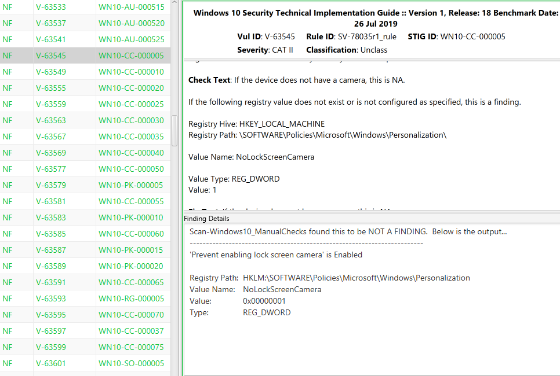
CKL Documentation
‘Check Text’ requirement is evaluated
And configuration documented into ‘Finding Details’
Notes:
Sample from STIG Viewer showing example of Finding Details documentation for item that is compliant.
Level of documentation includes the source of where the check results came from and the actual configuration of the setting.

Slide 4
Process Comparison
Traditional (SCAP + Manual)
Analyst:
Determines which STIGs are applicable to asset
Imports STIGs into STIG Viewer and creates blank checklists
Installs SCAP benchmarks (if available) and runs scan
Opens each checklist and imports applicable XCCDF file (if available)
Manually reviews and documents Not Reviewed and Open items for each STIG checklist.
Evaluate-STIG
Automation:
Automatically determines which STIGs are applicable to asset
Documents compliance directly into CKLs for each required STIG
Injects user-defined Comments from answer file if applicable
Analyst:
Finalizes checklists by documenting Open findings or completing any remaining Not Reviewed items.

Slide 5
CKL Completion Comparison

Slide 6
Real World Comparison
RDT&E Machine : 19 Checklists Required…
Adobe Reader DC Continuous Track | Microsoft Outlook 2016 *
Google Chrome | Microsoft PowerPoint 2016 *
Microsoft Edge | Microsoft Publisher 2016 *
Microsoft .NET Framework 4 | Microsoft Visio 2016 *
Microsoft Access 2016 * | Microsoft Word 2016 *
Microsoft Defender Antivirus | Mozilla Firefox
Microsoft Excel 2016 * | Oracle Java JRE 8 *
Microsoft Office System 2016 * | Windows 10
Microsoft OneDrive * | Windows Firewall
Microsoft OneNote 2016 *
 | SCAP | Evaluate-STIG
Total Remaining “Not Reviewed” Checks | 362 | 17
Total Labor Hours to Complete (4 mins per NR) | 24.1 | 1.1
* STIGs with no SCAP support

Slide 7
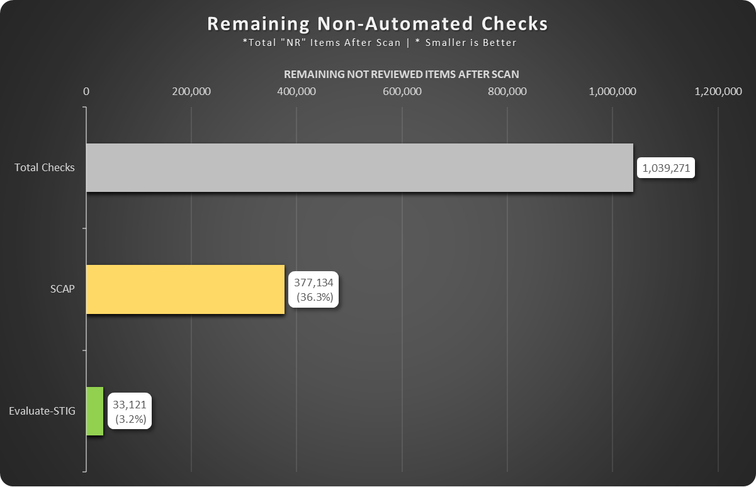
Crane Remaining “NR” After Automation
NSWC Crane’s Windows assets connected to its unclassified RDT&E network. Approximately 1800 assets with varying configurations.

Slide 8
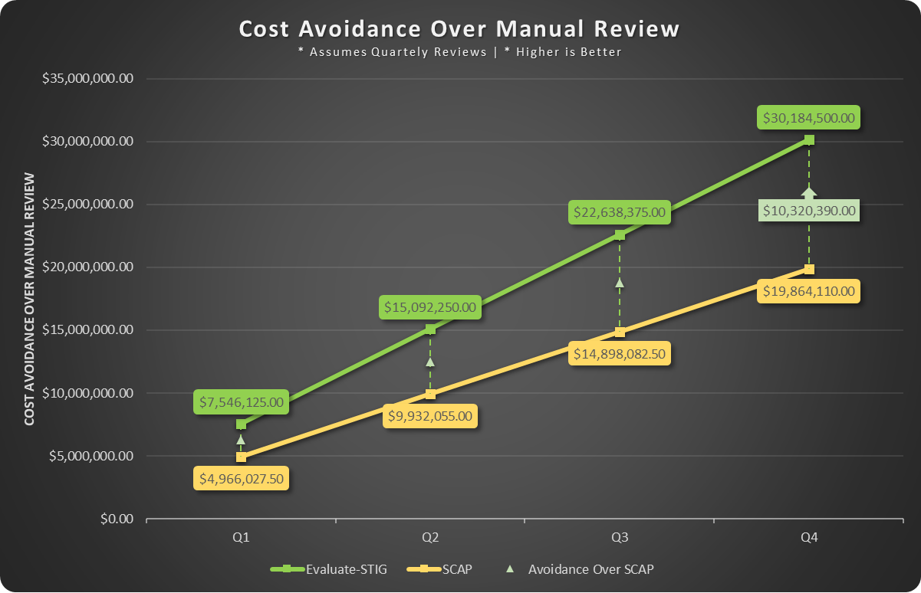
Crane Cost Avoidance
NSWC Crane’s Windows assets connected to its unclassified RDT&E network. Approximately 1800 assets with varying configurations.

Slide 9
User Profile Selection
Almost all user-based STIG checks direct the inspection of the HKEY_CURRENT_USER registry hive (the currently logged on user).
Scanning every user profile (NTUSER.DAT) on a system can lead to mass false positives due to how Windows applies user policy settings.
Evaluate-STIG mimics an administrator / auditor in-person session where the HKCU settings are inspected.
Evaluate-STIG looks at multiple data points before selecting which user profile to use:
Profile that most recently applied GPO is preferred.
If no profiles have processed GPO, then the user that most recently logged on.
If no user has ever logged on, then “.DEFAULT” user profile.

Slide 10
System Requirements
Supported Operating Systems:
Windows
Windows 10, Windows 11, Windows Server 2008 R2, Windows Server 2012, Windows Server 2012 R2, Windows Server 2016, Windows Server 2019, Windows Server 2022
Linux
Oracle Linux 7, Oracle Linux 8, RHEL/CentOS 7, RHEL 8, Ubuntu 16.04 LTS, Ubuntu 18.04 LTS, Ubuntu 20.04 LTS
Requires libicu and lshw be installed. apt install libicu lshw -y or yum install libicu lshw -y or dnf install libicu lswh -y
PowerShell:
PowerShell 5.1|PowerShell 7.x or greater (PowerShell 6 is not supported)
Note: Using Evaluate-STIG_Bash.sh, PowerShell is not required to be “installed” on Linux systems.
SQLPS or SqlServer PowerShell Module
Only required on systems with SQL installed
https://www.powershellgallery.com/packages/Sqlserver
SQLPS typically installed by default on SQL servers.
Evaluate-STIG will use either.

Slide 11
PowerShell Prerequisites
* These prerequisites are for Windows only and do not apply to Linux:
Evaluate-STIG code is digitally signed with a DOD issued code signing certificate. For maximum compatibility, ensure certificates are properly trusted (may be pushed via GPO):
DoD Root CA3 in the machine’s Trusted Root (Local Machine\Root) store
DOD ID CA-59 in the machine’s Intermediate Certification Authorities (Local Machine\CA) store
CS.NSWCCD.001 in the machine’s Trusted Publishers (Local Machine\Trusted Publishers) store
PowerShell execution policy should be AllSigned, RemoteSigned (recommended), or Unrestricted. Restricted is not supported. NOTE: Two .bat files are provided with Evaluate-STIG. One to verify these prerequisites are met and another to import the certificates into the proper stores. These .bat files are located in the Prerequisites subfolder.
For “no touch” systems, Evaluate-STIG may be run in a spawned instance of PowerShell that bypasses execution policy. This does not change the system’s configuration:
PowerShell.exe -ExecutionPolicy Bypass -File .\Evaluate-STIG.ps1 <ES Options>

Slide 12
Evaluate-STIG Options
Option | Description
-ScanType <“Unclassified” or ”Classified”> | Classification of the asset being scanned. “Unclassified” is default.
-Marking <String> | Use to optionally set Marking in CKL and on header/footer of files generated by Evaluate-STIG.
-VulnTimeout <int> | Maximum time in minutes allowed for a singular Vuln ID check to run. Default is 15 minutes.
-AnswerKey <key name> | Specify user-defined answer key to use in answer files. If not specified, answer key of “DEFAULT” will be used.
-AFPath <local or UNC path> | Sets path to answer files. If not specified, defaults to “.\AnswerFiles” in Evaluate-STIG folder.
-OutputPath <local or UNC path> | Sets path for Evaluate-STIG results to be saved. If not specified, defaults to C:\Users\Public\Documents\STIG_Compliance
-SelectSTIG <STIG shortname>, <STIG shortname> | Specify which STIGs to scan. For multiple STIGs, separate with comma. If not specified, Evaluate-STIG will scan for all applicable STIGs. Can use TAB to cycle through list of STIG shortnames or CTRL+SPACE to select from a list of STIG shortnames.
-SelectVuln <Vuln ID>, <Vuln ID> | Specify which vulnerability IDs to include in scan. For multiple vuln IDs, separate with commas. Requires -SelectSTIG parameter. Results will be saved to a "_Partial" folder under <OutputPath>.
-ExcludeVuln <Vuln ID>, <Vuln ID> | Specify which vulnerability IDs to exclude from scan. For multiple vuln IDs, separate with commas. Requires -SelectSTIG parameter. If a vuln ID is both selected (-SelectVuln) and excluded (-ExcludeVuln), exclusion will take precedent for that vuln ID.
-ExcludeSTIG <STIG shortname>, <STIG shortname> | Specify which STIGs to exclude from scan. For multiple STIGs, separate with comma. If not specified, Evaluate-STIG will scan for all applicable STIGs.
-ComputerName <IP>, <name>, <list>, <array> | Scan remote computer(s). Windows to Windows or Windows to Linux only. For multiple, separate with commas. Can be IP, name, .txt file, array object, or a combination. “Localhost” and “127.0.0.1” also valid.
-CiscoConfig <Path>, <Path> | Scan Cisco show tech-support output file(s). <Path> may be an individual file or a folder of show tech-support files. Multiple may be specified using commas.
-ThrottleLimit <int> | Set max concurrent connections for remote scans or max concurrent Cisco show tech-support files. Default is 10
-AltCredential | Prompt for alternate credential to be use for remote scans. If connected with AltCredential fails, will fall back to launching user credential.
-GenerateOQE | Creates Objective Quality Evidence (OQE) files in output path. Windows only.
-NoPrevious | Disable creation of Previous subfolder and preservation of previous CKLs.
-ApplyTattoo | Creates “Version” and “LastRun” values under HKLM:\SOFTWARE\Evaluate-STIG.
-ListSupportedProducts | Lists all products that Evaluate-STIG currently supports.
-ListApplicableProducts | Lists all Evaluate-STIG supported STIGs that are applicable to the asset.
-Version | Display the version of Evaluate-STIG and the running path.
-Update | Downloads updated Evaluate-STIG code from SPORK. Ignores AnswerFiles folder so will not overwrite user customizations.
-Proxy <String> | Specify proxy to use for -Update

Slide 13
Usage Examples
Perform a full unclassified scan:
.\Evaluate-STIG.ps1
Perform a classified scan of Edge and Windows 10 STIGs only using RDTE answer key from answer files stored on a file server:
.\Evaluate-STIG.ps1 –ScanType Classified –SelectSTIG MSEdge,Win10 –AFPath \\Server1\AnswerFiles -AnswerKey RDTE
Perform a remote unclassified scan of Workstation1 excluding Windows Firewall and Windows Defender using MyKey answer key:
.\Evaluate-STIG.ps1 –ComputerName Workstation1 –ExcludeSTIG WinFirewall,WinDefender –AnswerKey MyKey
Perform a full unclassified scan of multiple computers prompting for alternate credential and limiting to 7 concurrent connections:
.\Evaluate-STIG.ps1 –ComputerName localhost,Workstation1,Server1.mydomain.mil,C:\ComputersList.txt –AltCredential –ThrottleLimit 7
Display Evaluate-STIG’s help
Get-Help .\Evaluate-STIG.ps1 –Full

Slide 14
Remote Scans
Remote systems must resolve in DNS as all connections are made to the fully qualified domain name (FQDN) of the asset.
On Windows machines, PowerShell remoting must be enabled.
Can be done via Group Policy or the Enable-PSRemoting command.
Windows > Linux requires PowerShell 7.x installed on both the host and remote machines.
Linux > Linux recommend our Ansible playbook, Evaluate-STIG.yml, available in the Auxiliary Files on SPORK.
Linux > Windows is not supported.
Administrative rights on host and remote machines.
Host machine zips up the Evaluate-STIG files, Answer Files, and copies to remote machines.
Remote machines scan themselves.
As each remote machine completes it scan, host copies the results from remote to <OutputPath>.

Slide 15
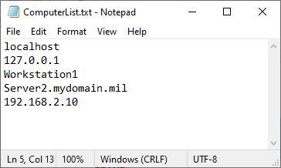
Remote Scanning Notes
Requires administrator access on remote systems.
Copies Evaluate-STIG and Answer File content to remote system and the remote scans itself.
-OutputPath is from host computer perspective. If not specified, results copied to C:\Users\Public\Documents\STIG_Compliance on host computer. Example: Results would be copied to E:\ drive on host computer; not on “Workstation1”.
-ComputerName can be single entry, multiple with comma separation, .txt file, array object, or combination:
Text file (.txt) list of computers should have one computer per line.
Hosts must resolve in DNS. All connections are to FQDN (except localhost).
-AltCredential to specify a credential to be used with remote connections. Evaluate-STIG will attempt this first, then try launching user; essentially allowing for 2 different credentials per scan.
Defaults to 10 concurrent connections. Can be changed with -ThrottleLimit.
.\Evaluate-STIG.ps1 –ComputerName Workstation1 –OutputPath E:\STIGResults
.\Evaluate-STIG.ps1 –ComputerName Workstation1
.\Evaluate-STIG.ps1 –ComputerName C:\ComputersList.txt, Server1.mydomain.mil
.\Evaluate-STIG.ps1 –ComputerName localhost, C:\ComputersList.txt, $ArrayOfComputers

Slide 16
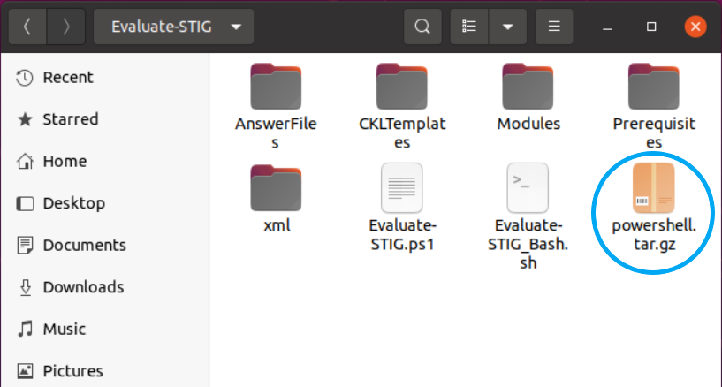
Linux Scans
Using the included Evaluate-STIG_Bash.sh removes the requirement to “install” PowerShell on Linux machines.
If performing a remote Linux scan from a Windows host, PowerShell is required to be installed on the Linux system.
Use --DownloadPS to download PowerShell archive to the Evaluate-STIG folder. This will be temporarily extracted to conduct the scan. For disconnected systems, download the linux-x64.tar.gz archive from the link below using a connected system, rename to powershell.tar.gz, and place in the Evaluate-STIG directory. https://github.com/PowerShell/PowerShell/releases/latest
Use -h to display the help.
Execute your scan.
sudo bash Evaluate-STIG_Bash.sh --DownloadPS
bash Evaluate-STIG_Bash.sh -h
sudo bash Evaluate-STIG_Bash.sh <Scan Options>

Slide 17
Answer Files
XML files to inject user-defined comment into the checklist’s Comments field and optionally set Status
Providing standardized verbiage for policy type checks (e.g. backups are stored offsite)
Automating checks where further validation is required (e.g. comparing list of approved Administrator group members to asset’s configuration)
Adding justification and mitigation statements for known Open items
Default path is .\Evaluate-STIG\AnswerFiles\ or specify an alternate path with –AFPath
PowerShell skillset strongly recommended

Slide 18
Answer File Development
ISSO and SME review CKL for checks requiring answers.
Review
Define
Build
Verify
SME executes a rescan using answer file to ensure expectation is met.
ISSO and SME collaborate on verbiage (Comment) and any criteria (ValidationCode).
SME writes/updates answer file based on defined requirements.

Slide 19
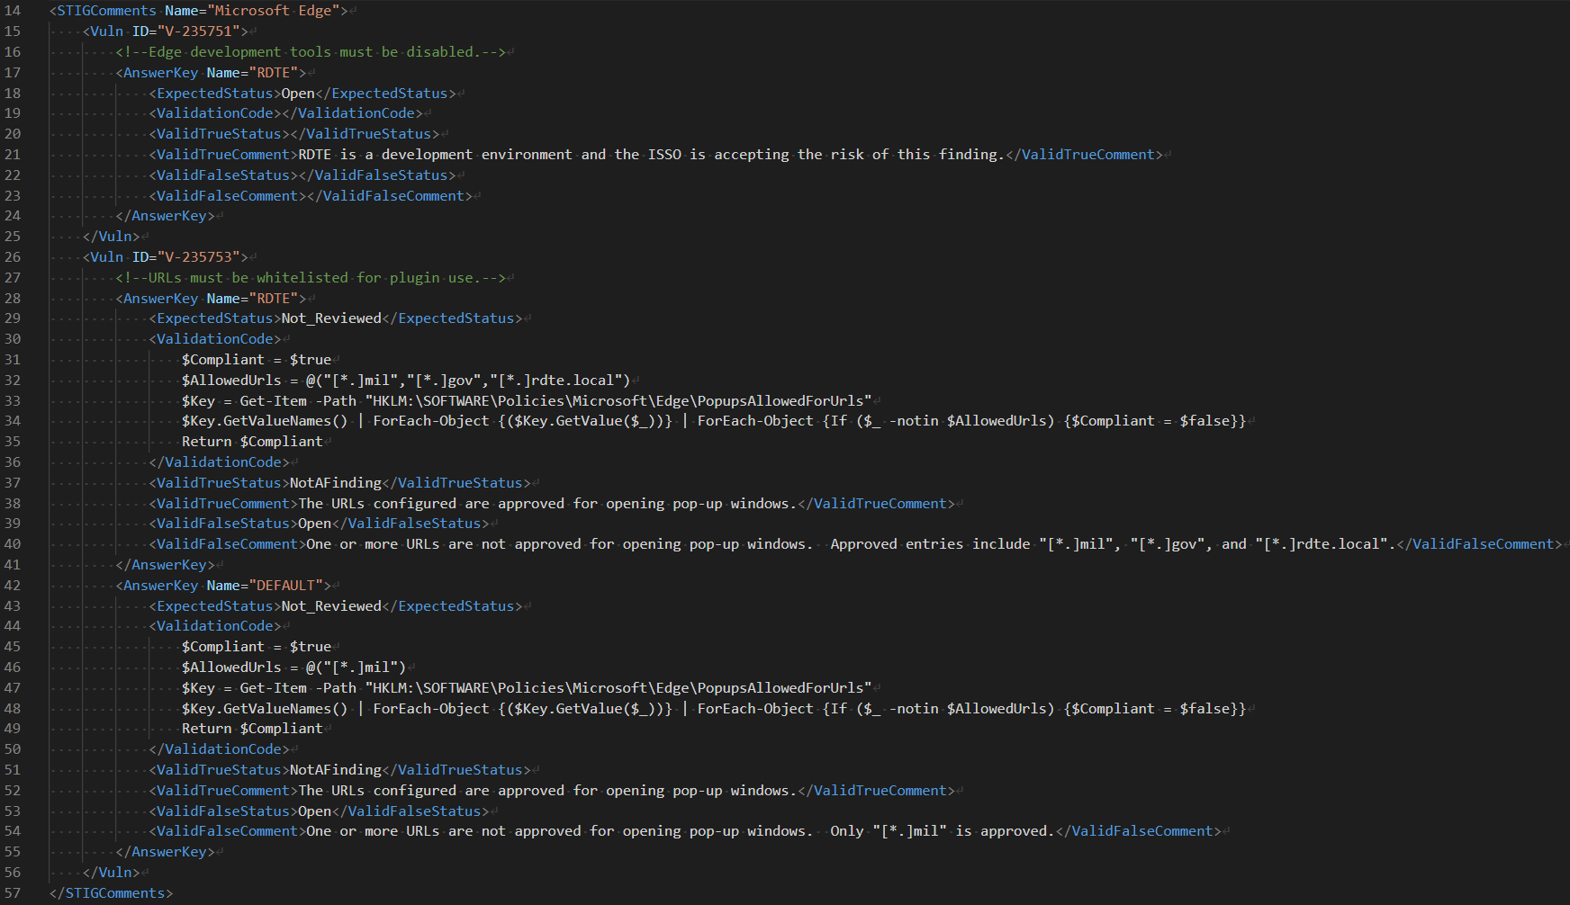
Example Answer File

Slide 20
Example Answer File
STIGComments Name – ShortName or Name of the STIG as it appears in -ListSupportedProducts output. Evaluate-STIG will automatically use this answer file for the STIG if a valid match is found.
Vuln ID – Vulnerability ID from the STIG. Multiple Vuln ID sections may be configured in a single answer file but each Vuln ID section must be unique within the answer file. For example V-12345 cannot be configured multiple times within the same answer file.
AnswerKey Name – Name to use with -AnswerKey. Multiple answer key sections may be configured within each Vuln ID section. “DEFAULT” may be used to apply the answer to any asset regardless of environment provided all other criteria are also met.
Note: In the event that a named answer key and a “DEFAULT” key are defined for a Vuln ID, the named key will take precedence if it is specified with the -AnswerKey option.
Note: If multiple answer files are found for a STIG, the most recently modified answer file will be used.

Slide 21
Example Answer File
ExpectedStatus – Original Status of the check in the CKL. If not a match, answer will not be applied.
ValidationCode – PowerShell code to be executed by Evaluate-STIG before applying answer. Code should return “true/false”. If this element is blank then “true” is assumed.
ValidTrueStatus – Status to set the check to in the CKL when the ValidationCode is “true”. If no status change is desired, leave blank or configure to be same as ExpectedStatus.
ValidTrueComment – Text to be added to the Comments field when ValidationCode is “true”.
ValidFalseStatus – Status to set the check to in the CKL when the ValidationCode is NOT “true”. If no status change is desired, leave blank or configure to be same as ExpectedStatus.
ValidFalseComment – Text to be added to the Comments field when ValidationCode is NOT “true”.
* Reminder: If ValidationCode is blank, then “true” is assumed and ValidTrueStatus/ValidTrueComment will be used.

Slide 22
Answer File Processing

Slide 23
Answer File Notes
File name does not matter but file extension must be “.xml”
Answer file automatically associated to STIG when <STIGComments Name> matches STIG Name or ShortName from -ListSupportedProducts.
<ValidationCode> is not required. If empty, <ValidTrueStatus> and <ValidTrueComment> will always be applied.
Comment text will always be applied to the Comments field in the CKL. It will also be duplicated to Finding Details if empty.
DO
Point -AFPath to a folder and NOT an answer file. Evaluate-STIG automatically selects the Answer File.
Use a single answer file for each STIG. Multiple <Vuln ID> and <AnswerKey Name> is supported in an answer file.
DON’T
Have multiple answer files for the same STIG in AFPath. This is not supported. In the event multiple answer files for a STIG are detected, Evaluate-STIG will only use the most recently modified file.
Specify the same <Vuln ID> more than once within an answer file. This is not supported.

Slide 24
Versioning and Updates
Evaluate-STIG is versioned as <Major>.<YYMM>.<Release> (e.g. 1.2301.1)
YYMM is the year and month from the current STIG quarter per DISA’s schedule.
Release will be incremented as needed for updates during a STIG cycle.
DISA’s posted STIG release schedule (https://public.cyber.mil/stigs/release-schedule/):
Q1 | End of January | [1.YY01.0]
Q2 | End of April | [1.YY04.0]
Q3 | End of July | [1.YY07.0]
Q4 | End of October | [1.YY10.0]
For currently supported STIGs, Evaluate-STIG is updated quarterly after the STIG Library Compilation .zip is posted to cyber.mil (approx. 1 – 2 weeks after). It is also updated for Windows OS STIGs once released to cyber.mil. Additional updates may also be posted as needed to address bug fixes or other changes.
New STIG support is added based on demand and resourcing.

Slide 25
Official Approvals
DADMS - ID 133953
Army - Assess Only (eMASS ID 4546)
NAVAIR – “All RMF authorization boundaries that fall under the NAVAIRSYSCOM Functional Authorizing Official”
NMCI – CCSW (eMASS ID 13969) and UCSW (eMASS ID 14441)

Slide 26
Supported STIGs (81 currently)
Adobe Acrobat Pro XI * | Microsoft Edge | Microsoft PowerPoint 2013 * | Microsoft Windows Server 2019
Adobe Acrobat Professional DC Classic * | Microsoft Excel 2013 * | Microsoft PowerPoint 2016 * | Microsoft Windows Server 2022
Adobe Acrobat Professional DC Continuous Track * | Microsoft Excel 2016 * | Microsoft Project 2013 * | Microsoft Word 2013 *
Adobe Reader DC Classic Track | Microsoft Exchange 2016 Edge Transport Server * | Microsoft Project 2016 * | Microsoft Word 2016 *
Adobe Reader DC Continuous Track | Microsoft Exchange 2016 Mailbox Server * | Microsoft Publisher 2013 * | Mozilla Firefox
Apache Server 2.4 UNIX Server * | Microsoft Groove 2013 * | Microsoft Publisher 2016 * | Oracle JRE 8 for Unix *
Apache Server 2.4 UNIX Site * | Microsoft IIS 8.5 Server * | Microsoft SharePoint Designer 2013 * | Oracle JRE 8 for Windows *
Apache Server 2.4 Windows Server * | Microsoft IIS 8.5 Site * | Microsoft Skype for Business 2016 * | Oracle Linux 7
Apache Server 2.4 Windows Site * | Microsoft IIS 10.0 Server * | Microsoft SQL Server 2014 Database * | Oracle Linux 8
Cisco IOS XE Router NDM | Microsoft IIS 10.0 Site * | Microsoft SQL Server 2014 Instance * | Postgre SQL 9.x *
Cisco IOS XE Switch L2S * | Microsoft InfoPath 2013 * | Microsoft SQL Server 2016 Database *+ | RHEL / CentOS 7 (using RHEL 7 STIG)
Cisco IOS XE Switch NDM * | Microsoft Internet Explorer 11 | Microsoft SQL Server 2016 Instance *+ | RHEL 8
Google Chrome Current Windows | Microsoft Lync 2013 * | Microsoft Visio 2013 * | Ubuntu 16.04
McAfee ENS 10.x Local Client *++ | Microsoft Office 365 ProPlus * | Microsoft Visio 2016 * | Ubuntu 18.04
McAfee VirusScan 8.8 Local Client | Microsoft Office System 2013 * | Microsoft Windows 10 | Ubuntu 20.04
Microsoft .NET Framework 4 | Microsoft Office System 2016 * | Microsoft Windows 11 | VMware Horizon 7.13 Agent *
Microsoft Access 2013 * | Microsoft OneDrive * | Microsoft Windows Firewall | VMware Horizon 7.13 Client *
Microsoft Access 2016 * | Microsoft OneNote 2013 * | Microsoft Windows Server 2008 R2 MS | VMware Horizon 7.13 Connection Server *
Microsoft Active Directory Domain * | Microsoft OneNote 2016 * | Microsoft Windows 2012 and 2012 R2 DC
Microsoft Active Directory Forest * | Microsoft Outlook 2013 * | Microsoft Windows 2012 and 2012 R2 MS
Microsoft Defender Antivirus | Microsoft Outlook 2016 * | Microsoft Windows Server 2016
* STIGs with no SCAP support
+ SQL 2016 used for SQL versions 2016 and greater
++ Separate Download not included with Evaluate-STIG distributable

Slide 27
FIN!
Questions?
Connect!
Download
NIPR
Unclassified Content only
https://spork.navsea.navy.mil/nswc-crane-division/evaluate-stig/-/releases
Unclassified and CUI Content
https://intelshare.intelink.gov/sites/NAVSEA-RMF
SIPR
Unclassified and CUI Content
https://intelshare.intelink.sgov.gov/sites/NAVSEA-RMF
Fusion Chat
https://chat.navsea.navy.mil/channel/evaluate-stig
Teams (Navy Flank Speed)
NAVSEA_RMF
EMAIL:
eval-stig_spt@us.navy.mil
Get Release Notifications:
Navy Personnel : Sign up Here
Non-Navy : Send an email to eval-stig_spt@us.navy.mil and we’ll get you added.

Slide 28
Agenda – Basic Usage
What is Evaluate-STIG
System Requirements and Prerequisites
Options
Demo - Basic Usage
Release Cadence
Approvals

Slide 29
Agenda –Remote & Linux Scans
Remote Scanning
Demo – Remote Scanning
Linux Scanning
Demo – Linux Scanning

Slide 30
Agenda – Answer Files
What Are They?
Development Cycle and Anatomy
Process Flow
Demo – Answer Files

Slide 31
Demo
Live Demo

Slide 32
Remote Scanning
Remote Scanning

Slide 33
Linux Scanning
Linux Scanning

