Slide 1

Nilavan Duraisami College of Science and Technology, Bellevue University DSC530-T301 2241: Data Exploration and Analysis Term Project Professor Matthew Metzger November 11, 2024

Slide 2

Introduction - Hypothesis and Statistical Question
Statistical Question: "Is BMI a significant predictor of medical expenses, regardless of smoking status?"
Hypothesis:
Null Hypothesis (H0): BMI does not significantly impact medical expenses.
Alternative Hypothesis (H1): BMI is a significant predictor of medical expenses, with higher BMI leading to increased costs.
Purpose of Analysis: To explore the relationship between BMI and medical expenses, while also considering other influential variables.

Slide 3
Overview of dataset
The medical insurance dataset provides a detailed view of various demographic and health-related factors that impact medical expenses. Key variables include age, sex, Body Mass Index (BMI), smoking status, number of dependents (children), residential region, and the total medical expenses incurred. These attributes offer a comprehensive basis for analyzing and predicting healthcare costs, making the dataset ideal for machine learning applications aimed at estimating insurance expenses for potential policyholders.

Slide 4
Dataset details
Purpose and Utility
The primary purpose of this dataset is to identify and quantify the factors contributing most significantly to medical costs, enabling insurance companies to refine pricing strategies and assess customer risk more accurately. By understanding how each factor—such as BMI or smoking status—affects expenses, companies can create models to forecast potential costs and manage risk across different policyholder profiles.
Leveraging this data, insurers can enhance decision-making in areas such as:
Pricing Models: Adjusting premiums based on risk factors identified through model predictions.
Risk Assessment: Understanding high-cost indicators like smoking status or high BMI to anticipate future expenses.
Customer Segmentation: Grouping policyholders by risk profiles for targeted interventions or specialized plans.
Dataset Summary
Total Rows: 2,700
Total Columns: 7
Columns
Age: Age of the policyholder
Sex: Gender of the policyholder
BMI (Body Mass Index): A metric derived from height and weight, often related to health risk
Children: Number of dependents
Smoker: Smoking status (Yes/No)
Region: Residential area of the policyholder
Charges: Total medical expenses incurred
This dataset provides essential insights into the factors influencing medical expenses, offering a robust foundation for building predictive models that enhance decision-making in health insurance analytics.

Slide 5
Quantifiable nature of the 5 attributes
Age: This is a quantifiable variable, typically represented as a numerical value indicating a person’s age in years. It allows for straightforward numeric operations and can be used to analyze trends in healthcare costs across different age groups.
BMI (Body Mass Index): BMI is a quantifiable metric calculated from an individual’s height and weight. It provides a standardized way to measure body fat and can directly correlate with health costs, making it a valuable predictor in health-related analyses.
Smoking Status: While "smoking status" might initially seem categorical (e.g., smoker or non-smoker), it can be quantified as a binary variable (e.g., 1 for smokers, 0 for non-smokers). This enables it to participate in numeric operations within models and to measure its effect on health costs.
Physical Activity Level: This variable could be quantified based on the dataset’s definitions. If it uses a scale (e.g., hours of physical activity per week) or levels (e.g., 1 = inactive, 2 = moderately active, 3 = highly active), it becomes quantifiable. This makes it suitable for numerical modeling to explore its relationship with health costs.
Healthcare Costs: This is a direct, continuous variable representing the total medical expenses for each individual. Being directly related to the prediction target, it’s fully quantifiable and serves as the dependent variable in cost-prediction models.
These five variables are quantifiable and allow for numeric operations, making them suitable for statistical analysis, regression models, and hypothesis testing in a health cost prediction context.

Slide 6
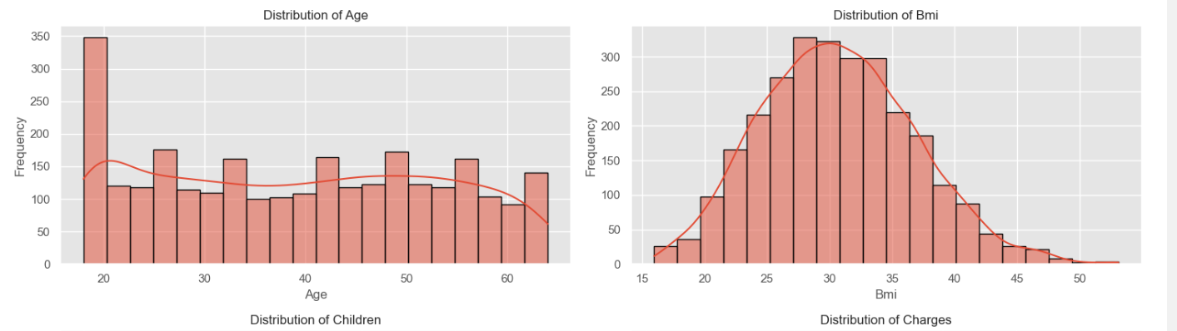
Histogram of the 5 variables
Age and bmi

Slide 7
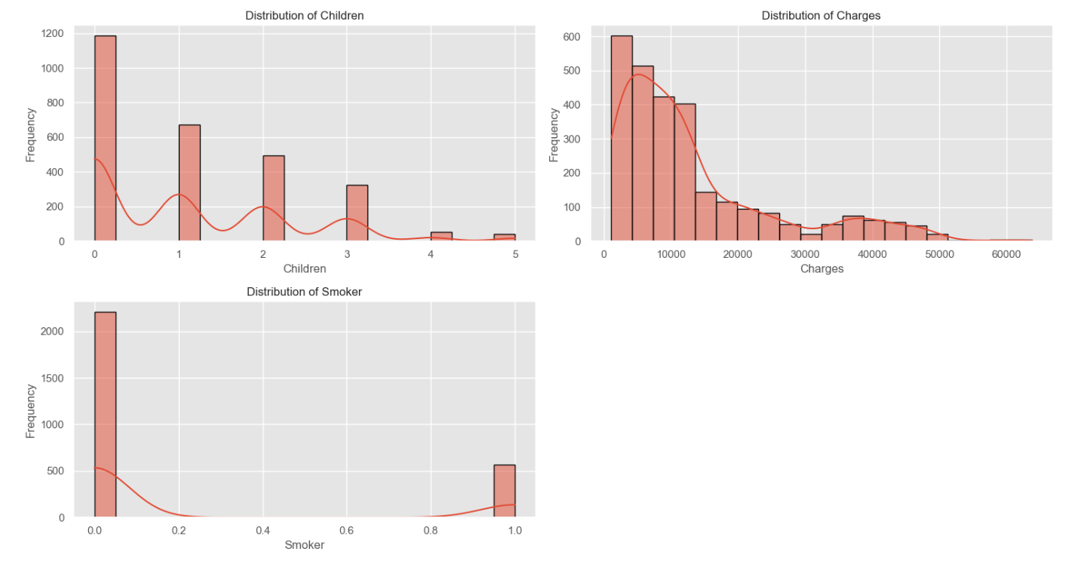
Histogram of the 5 variables
Number of children, charges and smoker status

Slide 8
Summary and Analysis of Histograms for Key Variables
The histograms below illustrate the distribution of five key variables in the dataset: age, BMI, children, charges, and smoker status. Each histogram provides insight into the frequency distribution, skewness, and potential outliers for these variables.
1. Age
Distribution: The age variable shows a fairly uniform distribution across a range of ages, indicating that the dataset includes a broad spectrum of age groups.
Outliers: There are no significant outliers, as extreme age values (such as very young or elderly individuals) appear plausible.
Conclusion: All age values seem realistic, so no adjustments are necessary.
2. BMI (Body Mass Index)
Distribution: The BMI variable is approximately normally distributed, though it shows a slight positive skew with more values concentrated in the higher range.
Outliers: Higher BMI values suggest a few individuals with obesity, and lower values indicate some underweight individuals.
Conclusion: BMI outliers should be retained as they represent meaningful health conditions relevant to medical cost analysis.
3. Children
Distribution: The number of children is right-skewed, with the majority of values clustered around zero to two children. Only a few individuals have more than three children.
Outliers: Families with more than four children are rare, but these cases are plausible and do not require removal.
Conclusion: No action is needed for outliers in the children variable, as these values reflect diverse family structures.

Slide 9
Summary and Analysis of Histograms for Key Variables
4. Charges
Distribution: The charges variable shows a significant positive skew, with a few individuals incurring extremely high medical expenses.
Outliers: High charges likely correspond to individuals with serious health issues or high healthcare utilization, making them essential for understanding cost drivers.
Conclusion: Retaining high charge values is crucial for accurate medical cost analysis, though transformations (e.g., log transformation) could be applied to reduce skewness and improve model performance.
5. Smoker Status
Distribution: Smoker status is a binary variable (1 for smokers, 0 for non-smokers) and does not have a typical continuous distribution.
Outliers: Since this variable is binary, it lacks traditional outliers.
Conclusion: Smoker status is a critical variable for modeling, as smoking behavior is known to significantly impact medical expenses. No adjustments are needed for this variable.
Overall Analysis
The distributions of age, BMI, children, and smoker status generally appear reasonable with realistic ranges, while charges exhibit notable skewness due to high-cost cases. Retaining all values, particularly outliers in charges, will help capture the range of healthcare costs. For predictive modeling, transformations may be applied to normalize charges, improving model accuracy.

Slide 10
descriptive characteristics about the variables
Age
Mean: 39.11
Mode: 18
Spread (Std Dev): 14.08
Min (Left Tail): 18, Max (Right Tail): 64
Interpretation: Age distribution is diverse, with a balanced mean and spread, reflecting a wide range of policyholder ages.
BMI (Body Mass Index)
Mean: 30.70
Mode: 32.3
Spread (Std Dev): 6.13
Min (Left Tail): 15.96, Max (Right Tail): 53.13
Interpretation: BMI values are centered around the overweight category, providing insight into health risks related to body weight ratios.
Children
Mean: 1.10
Mode: 0
Spread (Std Dev): 1.21
Min (Left Tail): 0, Max (Right Tail): 5
Interpretation: Most policyholders have few dependents, with a right-skewed distribution indicating that large families are less common.

Slide 11
descriptive characteristics about the variables
Charges (Medical Expenses)
Mean: $13,261.37
Mode: $1,121.87
Spread (Std Dev): $12,151.77
Min (Left Tail): $1,121.87, Max (Right Tail): $63,770.43
Interpretation: Charges show a high variability, with significant outliers on the high end, suggesting diverse healthcare utilization.
Smoker Status
Mean: 0.20
Mode: 0 (Non-smoker)
Spread (Std Dev): 0.40
Min (Left Tail): 0, Max (Right Tail): 1
Interpretation: 20% of the policyholders are smokers, making this a critical variable in evaluating health-related expenses.
Summary
These descriptive statistics reveal a diverse profile among policyholders, with significant variations in age, BMI, and medical expenses. The high variability in charges and the presence of smokers provide critical context for understanding healthcare costs.

Slide 12
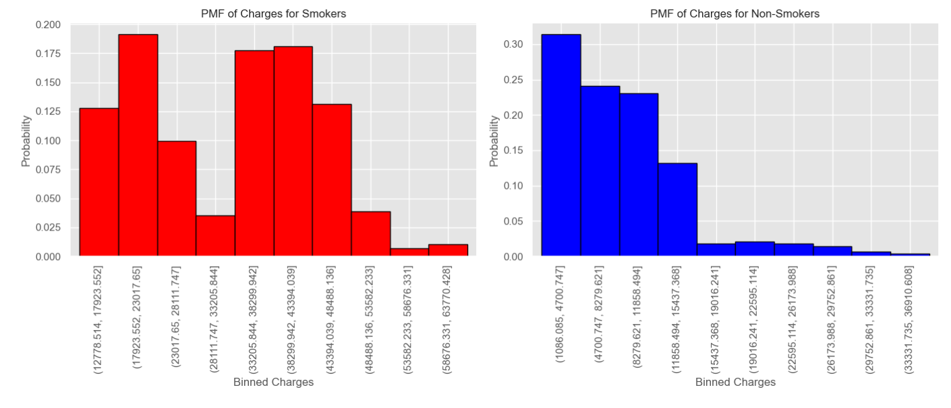
Probability Mass Function (PMF) for the charges variable under two different scenarios—smokers and non-smokers

Slide 13
Probability Mass Function (PMF) - Interpretation
PMF Overview:
The PMF for charges provides insight into the distribution of medical expenses across different groups, specifically contrasting smokers and non-smokers.
Smokers:
Skewed Distribution: The PMF for smokers is skewed toward higher medical expenses, indicating that smokers tend to incur significantly higher healthcare costs.
Higher Charges: There is a higher probability of elevated charges among smokers, emphasizing their greater healthcare utilization and associated expenses.
Non-Smokers:
Balanced Distribution: The PMF for non-smokers is more balanced, with a higher probability density around lower medical expenses.
Lower Costs: Non-smokers generally incur fewer medical expenses, reflecting lower healthcare demands.
Key Insight:
This analysis underscores the higher costs associated with smokers, which is a critical factor in health insurance cost modeling and risk assessment.

Slide 14
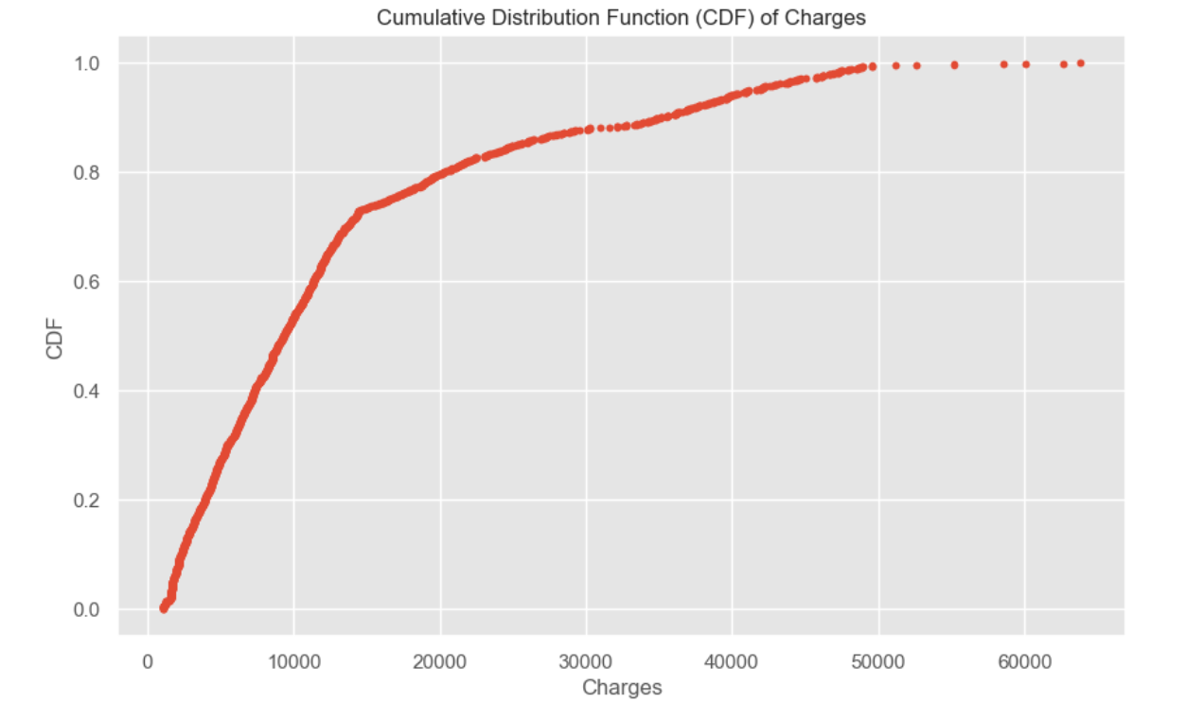
Cumulative Distribution Function (CDF) for a "Charges" variable in the dataset.

Slide 15
Cumulative Distribution Function (CDF) for a "Charges" variable - Interpretation
CDF Overview:
The CDF for charges illustrates the cumulative proportion of policyholders with medical expenses up to various thresholds.
Key Observations:
Expense Distribution: The CDF reveals what percentage of policyholders have medical expenses below specific cost levels.
Common vs. Rare Charges: Steeper sections of the CDF curve indicate charge values that are more common, while flatter sections represent higher, less frequent medical expenses.
Interpretation of Cost Patterns:
Lower Costs Dominance: A large portion of policyholders have lower medical expenses, as seen in the steep rise in the initial part of the CDF.
Threshold of High Expenses: The flatter sections toward higher costs show where expenses start to increase significantly for a smaller subset of policyholders.
Conclusion:
This cumulative analysis clarifies how medical costs are distributed, indicating that while many policyholders incur lower expenses, a smaller portion experience much higher charges. This insight is crucial for understanding medical expense variability and identifying cost thresholds that affect fewer individuals.

Slide 16
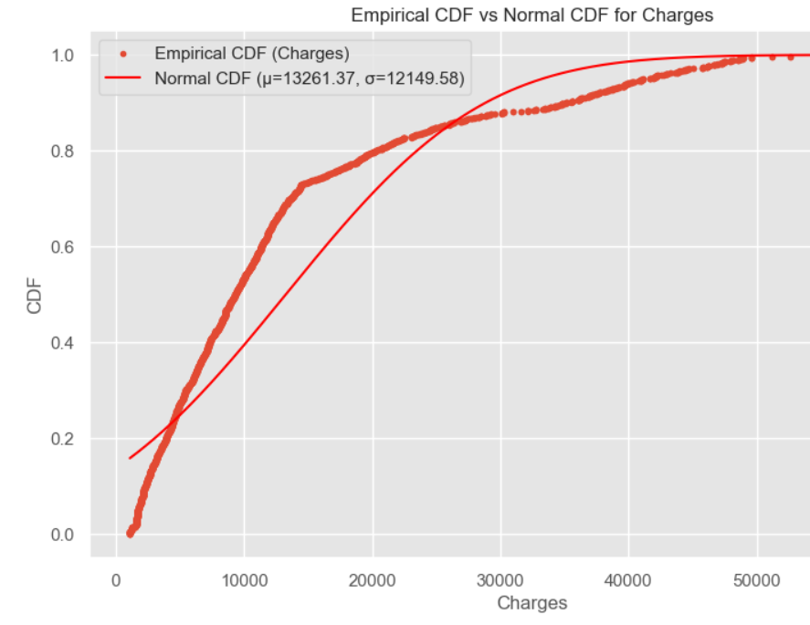
Analytical distributions - Graph
To model the distribution of a variable from the dataset analytically, lets use the Normal (Gaussian) distribution to approximate the distribution of the charges variable. Given that charges can reflect a wide range of healthcare expenses, modeling it with a normal distribution helps smooth the data and simplifies further analysis.

Slide 17
Analytical distribution : Key observations
The Empirical CDF represents the actual distribution of charges in the dataset.
The Fitted Normal CDF provides a smoothed, analytical approximation of the charges distribution.
Deviations in Tails: The normal model struggles to represent the extremes, reflecting real-world high medical expense outliers and the skew in the dataset.
The Normal distribution captures the general trend of charges, making it easier to analyze and model further. However, real-world complexities, such as high-cost outliers, require additional considerations to address deviations from the idealized normal model.
Relevance to the Dataset: While useful for analysis, this model highlights the need for advanced methods to account for skewed and complex data patterns in medical expenses.

Slide 18
Scatter plots
To explore the relationship between smoker status and charges, creating scatter plots for:
Smoker Status vs Charges: This plot will compare charges for smokers and non-smokers.
Age vs Charges for Smokers and Non-Smokers: This plot will help examine how age impacts charges separately for smokers and non-smokers.

Slide 19
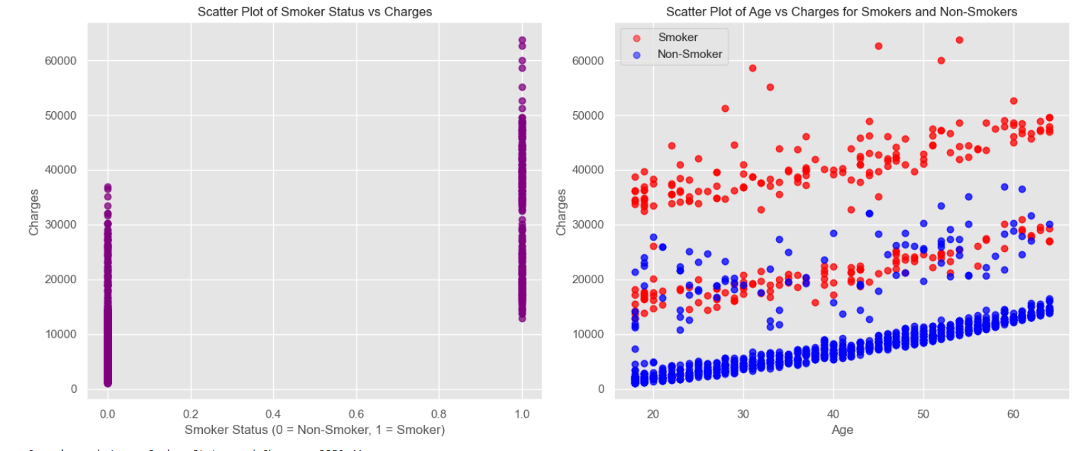
Scatter plot - graph

Slide 20
Scatter plot - analysis
Smoker Status vs. Charges:
Covariance: 3859.41
Insight: Indicates a positive relationship, where charges tend to increase for smokers compared to non-smokers.
Age vs. Charges for Smokers:
Covariance: 60,307.36
Insight: Stronger covariance suggests that age significantly impacts medical charges for smokers. Older smokers incur higher costs.
Age vs. Charges for Non-Smokers:
Covariance: 52,719.16
Insight: While still substantial, covariance is slightly lower for non-smokers, suggesting a moderated effect of age on
medical expenses compared to smokers.
Key Observations:
Covariance values highlight the impact of smoking status and age on medical charges.
Smoking Amplifies Age Impact: Charges rise more steeply with age for smokers than for non-smokers.
Implication for Analysis: These insights are crucial for understanding cost drivers and tailoring health insurance policies.

Slide 21
Hypothesis testing
To test the hypothesis, "BMI is a significant predictor of medical expenses, regardless of smoking status", correlation test between BMI and medical charges separately for smokers and non-smokers is performed. This will help determine if BMI has a significant impact on medical expenses and whether this relationship holds consistently across smoking status.
The correlation test quantifies the strength of association between BMI and charges, and by computing a p-value, the likelihood of observing this relationship by chance can be evaluated.

Slide 22
Hypothesis testing - results
Results for Non-Smokers
BMI vs. Charges: Non-Smokers
Correlation: 0.08
P-value: 0.0003 (statistically significant)
Interpretation:
A weak positive correlation suggests a minimal relationship between BMI and charges among non-smokers.
Despite the weak correlation, the p-value indicates the relationship is statistically significant.
Results for Smokers
BMI vs. Charges: Smokers
Correlation: 0.81
P-value: 0.0000 (statistically significant)
Interpretation:
A strong, positive correlation indicates that higher BMI values are associated with increased medical expenses among smokers.
The p-value confirms the relationship is not due to random chance.
Correlation Comparison: Smokers vs. Non-Smokers
Key Observations:
Strong correlation for smokers (0.81) vs. weak correlation for non-smokers (0.08).
Smoking status amplifies the effect of BMI on medical charges.
Implications:
Health insurance policies might need to consider the amplified impact of BMI for smokers in cost evaluations.

Slide 23
Regression analysis
Linear regression analysis using BMI as an explanatory variable and medical charges as the dependent variable will be conducted. This will help analyze the relationship between BMI and medical expenses, based on the hypothesis:
"BMI is a significant predictor of medical expenses, regardless of smoking status."
In this analysis, StatsModels will be used to perform the linear regression.

Slide 24
Regression analysis
Coefficient Interpretation
Intercept: The intercept value of 1097.5183 represents the estimated baseline of medical expenses when BMI is zero. However, since a BMI of zero is not practically meaningful, the intercept mainly serves as a mathematical baseline for the model.
Slope for BMI: The coefficient for BMI is 396.1993, indicating that for each unit increase in BMI, medical expenses are expected to increase by approximately $396.20. This positive slope suggests a direct relationship, where higher BMI values are associated with increased medical expenses.
Statistical Significance (p-value)
The p-value for the BMI coefficient is 0.000, which is well below the 0.05 threshold. This result indicates that BMI is a statistically significant predictor of medical expenses, meaning the observed effect is unlikely due to chance.
Model Fit (R-squared)
R-squared: The R-squared value of 0.040 suggests that the model explains approximately 4% of the variance in medical expenses based on BMI alone. Although BMI is a significant predictor, this low R-squared value indicates that there are likely other factors not included in this model that explain a substantial portion of the variability in medical expenses.

Slide 25

conclusion
In conclusion, the regression analysis reveals that BMI is a statistically significant predictor of medical expenses, with higher BMI associated with increased costs.
However, the model’s low R-squared value suggests that BMI alone is not a strong predictor of medical expenses, indicating that other factors also play a significant role.
Smoker status has a notable impact on medical charges, with smokers generally incurring higher expenses than non-smokers, as shown in the previous analyses.
These insights highlight the importance of considering multiple factors, such as smoking habits and BMI, when analyzing and predicting healthcare costs.

