Slide 1
Developing on AWS

Slide 2
Developing on AWS
Module 1: Course Overview

Slide 3
Developing on AWS

Slide 4
Course objectives
By the end of this course, you will be able to:
Configure IAM permissions to support your development environment.
Design, diagram, build, and deploy a cloud-native application using AWS SDKs.
Monitor and maintain an application by using AWS resources.

Slide 5

Prerequisites
AWS Cloud Practitioner Essentials
AWS Technical Essentials
Basic knowledge of a top-level programming language
Python
.NET
Java

Slide 6












Course overview
AWS Cloud
Application API calls
List
AWS Identity and Access Management (IAM)
AWS Serverless Application Model (AWS SAM)
Website hosting
Create/Update
End user
Amazon API Gateway
Search
DynamoDB
MP3 hosting
Delete
Amazon Cognito
Dictate
Amazon Polly
Amazon CloudWatch
AWS X-Ray
Notes:
You, as a developer, will use integrated development environments (IDEs) with AWS software development kits (SDKs) to develop the application.
You will learn how to host a static website, implement business logic, manage APIs, control access to the application, store and process user data and more.

Slide 7










Day 1: Agenda, morning
Module 1
Module 2
Module 3
Module 4
Course Overview
Building a Web Application on AWS
Getting Started with Development on AWS
Getting Started with Permissions
AWS Cloud
Connect by using Guacamole, SSH, or Remote Desktop.
EC2 instance contents
Amazon Simple Storage Service (Amazon S3)
Lab 1
IAM role
Visual Studio
IntelliJ IDEA
Configure the Development Environment
You
AWS Tools and SDKs
AWS Command Line Interface (AWS CLI)
AWS Security Token Service (AWS STS)
IAM
AWS Cloud9
AWS CloudFormation
Notes:
Module 1 – Introduction to the course.
Module 2 – Review the details the AWS architecture used to create a complete cloud-native application. Module 3 – Explore the benefits of AWS software development kits (AWS SDKs) when building an application.
Module 4 – Configure a development environment that supports AWS Identity and Access Management (IAM) permissions.
Lab 1 – Use AWS Cloud9 to configure and test IAM permissions in a development environment.
Labs will be performed from your computers. You will connect to the lab environment using Guacamole, SSH, or Remote Desktop. In lab 1, you set up your lab environment.

Slide 8




Day 1: Agenda, afternoon
Module 5
Module 6
Lab 2
Getting Started with Storage
Processing Your Storage Operations
Develop Solutions Using Amazon S3
AWS Cloud
Amazon S3
You
AWS Software Development Kits (AWS SDKs)
Notes
Amazon S3
Notes:
Module 5 – Compare feature sets and use cases for available AWS storage solutions.
Module 6 – Deploy a static website to Amazon Simple Storage Service (Amazon S3).
Lab 2 – Identify the appropriate AWS solutions for application workloads for big data.

Slide 9


Day 2: Agenda, morning
Module 7
Module 8
Lab 3
Module 9
Getting Started with Databases
Processing Your Database Operations
Develop Solutions Using Amazon DynamoDB
Processing Your Application Logic
AWS Cloud
Query and access data
Notes table with global secondary index
DynamoDB
Notes:
Module 7 – Compare feature sets and use cases for available AWS database options. Configure an Amazon DynamoDB database to store data from a web application.
Module 8 – Use the DynamoDB SDK to perform the create, read, update, delete (CRUD) operations, and explore database caching options.
Lab 3 – Configure a DynamoDB database to store data from a web application.
Module 9 – Compare the feature sets and use cases for available AWS compute solutions. Build an AWS Lambda function to store data from a web application in DynamoDB.

Slide 10


Day 2: Agenda, afternoon
Lab 4
Module 10
Lab 5
Developing Solutions Using AWS Lambda
Managing the APIs
Develop Solutions Using Amazon API Gateway
AWS Cloud
AWS Cloud
Amazon S3
AWS Lambda
You
Amazon Polly
API Gateway
You
Amazon S3
Notes:
Lab 4 – Build an AWS Lambda function to store data from a web application in DynamoDB.
Module 10 – Explore the methods available for Amazon API Gateway to connect AWS resources.
Lab 5 – Use Amazon API Gateway to connect Lambda and DynamoDB.

Slide 11


Day 3: Agenda, morning
Module 11
Module 12
Lab 6
Module 13
Building a Modern Application
Granting Access to Your Application Users
Capstone: Complete the Application Build
Deploying Your Application
You
AWS Cloud
Users
Amazon Cognito
API Gateway
DynamoDB
Lambda function
S3 bucket
Notes:
Module 11 – Evaluate the benefits of building a web application using a serverless approach.
Module 12 – Review how Amazon Cognito controls user access to AWS resources.
Lab 6 – Create an Amazon Cognito solution that provides users access to a web application.
Module 13 – Deploy your application.

Slide 12


Day 3: Agenda, afternoon
Module 14
Lab 7
Module 15
Observing Your Application
Observe the Application Using AWS X-Ray
Course Wrap-Up
AWS Cloud
Application API calls
List
AWS SAM
IAM
Website hosting
Create/Update
End user
Search
Amazon API Gateway
DynamoDB
MP3 hosting
Delete
Amazon Cognito
Dictate
Amazon Polly
Amazon CloudWatch
AWS X-Ray
Notes:
Module 14 – Identify the AWS services that support the monitoring of a web application.
Lab 7 – Deploy, monitor, and maintain a web application using AWS resources.
Module 15 – Course summary

Slide 13



Logistics
Facilities
Emergency exits
Fire alarm protocol
Security
Breaks and lunch
Food
Cell phones

Slide 14
Virtual logistics
Breaks and lunch
Chat
Mute/Unmute
Cameras

Slide 15

Registration
Qwiklabs: Class lab environment
Register for an account.
Verify that you have access to the classroom.
Go to http://aws.qwiklabs.com.
Gilmore: Student guide
Register for an account.
View the material online, or download all course materials through the Bookshelf application.
See the instructor for guidance.
Go to http://evantage.gilmoreglobal.com.

Slide 16

Gilmore VitalSource: Sign in
Course slide deck and hands-on lab guides are provided through the Gilmore VitalSource bookshelf.
Do one of the following:
Sign in to your previously created VitalSource account.
Select Create a VitalSource account.
Get the code from your trainer.

Slide 17
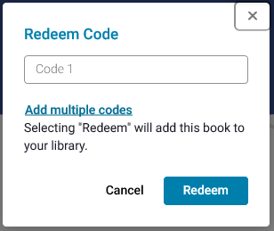
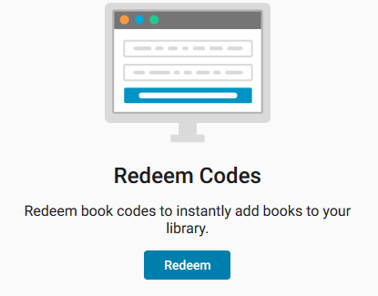
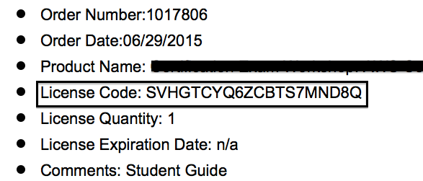
Redeem the license code
1
Sign in at: http://online.vitalsource.com
3
Enter the License Code provided in the email or handout.
2
.…
Notes:
|

Slide 18

Introduce yourself
Name
What do you do day-to-day?
What do you want to get out of this class?
What is your experience level with AWS?
Choose a language: Java, Python, or C#
Last Amazon.com purchase?
Notes:
Your introduction helps us to understand the experience level of the class and what each of you want to get out of the class.

Slide 19
Thank you

