Slide 1
Developing on AWS
Module 10: Managing the APIs
Lab

Slide 2







Agenda
Lab 4
Module 10
Lab 5
Develop Solutions Using AWS Lambda
Managing the APIs
Develop Solutions Using Amazon API Gateway
AWS Cloud
AWS Cloud
You
Amazon Polly
You
Amazon API Gateway

Slide 3








Your Application
AWS Cloud
Application API calls
List
AWS SAM
AWS Identity and Access Management (IAM)
Website hosting
Create/Update
End user
Amazon API Gateway
Search
DynamoDB
MP3 hosting
Delete
Amazon Cognito
Dictate
Amazon Polly
Amazon CloudWatch
AWS X-Ray
Notes:
You have built the backend database storage system and configured compute processing. Now you must configure a way for users to access those services over the internet. Amazon API Gateway connects all the application’s services together.

Slide 4
Module objectives
By the end of this module, you will be able to:
Describe the key components of Amazon API Gateway
Develop API Gateway resources to integrate with AWS services
Configure API request and response calls for your application endpoints
Test API resources and deploy your application API endpoint
Demonstrate creating API Gateway resources to interact with your application APIs

Slide 5
What is Amazon API Gateway?
Module 10: Managing the APIs

Slide 6





Accessing backend services
Create, publish, maintain, monitor, and secure APIs that access AWS or other third-party services.
AWS Cloud
Lambda function
EC2 instances
Users
DynamoDB table
Other AWS services
Third-party
service
Amazon API Gateway
REST, HTTP, or WebSocket APIs
Notes:
Amazon API Gateway is an AWS service for creating, publishing, maintaining, monitoring, and securing REST, HTTP, and WebSocket APIs. Use API Gateway to access AWS services or third-party services.
This diagram illustrates how the APIs you build with API Gateway provide a consistent developer experience for building AWS serverless applications. API Gateway handles all the tasks involved in accepting and processing thousands of concurrent API calls. These tasks include traffic management, authorization and access control, monitoring, and API version management.
API Gateway acts as a "front door" for applications to access data, business logic, or functionality from your backend services. Examples of this capability are workloads running on Amazon Elastic Compute Cloud (Amazon EC2), code running on AWS Lambda, any web application, or real-time communication applications.

Slide 7
Working with HTTP and REST APIs
HTTP API
AWS Cloud
https://api.example.com/myservice
API Gateway
Lambda function
AWS Cloud
REST API
https://api.example.com/myservice/notes/ https://api.example.com/myservice/notes/search
Lambda function
API Gateway
Lambda function
Notes:
Use HTTP APIs to create RESTful APIs with lower latency and lower cost than REST APIs. For example, you can create an HTTP API that integrates with a Lambda function on the backend. When a client calls your API, API Gateway sends the request to the Lambda function and returns the function's response to the client.
REST APIs are a collection of resources and methods that are integrated with backend HTTP endpoints, Lambda functions, or other AWS services. You can use API Gateway features to help you with all aspects of the API lifecycle, from creation through monitoring your production APIs. Your application will use a REST API.

Slide 8
Working with WebSocket APIs
AWS Cloud
$connect
$disconnect
https://api.example.com/myservice
Lambda function
API Gateway
$connect
$disconnect
Lambda function
Notes:
With API Gateway, you can create a WebSocket API as a stateful frontend for an AWS service (such as Lambda or DynamoDB) or for an HTTP endpoint. The WebSocket API invokes your backend based on the content of the messages it receives from client applications. In your WebSocket API, incoming JSON messages are directed to backend integrations based on routes that you configure.
Bidirectional APIs API Gateway WebSocket APIs are bidirectional. A client can send messages to a service, and services can independently send messages to clients. This bidirectional behavior enables richer client/service interactions because services can push data to clients without requiring clients to make an explicit request. WebSocket APIs are often used in real-time applications such as chat applications, collaboration platforms, multiplayer games, and financial trading platforms.
Routes
You can use three predefined routes: $connect, $disconnect, and $default. In addition, you can create custom routes. A route includes a route key, which is the value that is expected once a route selection expression is evaluated. The routeSelectionExpression is an attribute defined at the API level. It specifies a JSON property that is expected to be present in the message payload. A route selection expression is evaluated when the service is selecting the route to follow for an incoming message. The service uses the route whose routeKey exactly matches the evaluated value.
The API Gateway calls a route under the following conditions:
$connect route – When a persistent connection between the client and a WebSocket API is being initiated.
$disconnect route – When the client or the server disconnects from the API.
Custom route – After the route selection expression is evaluated against the message if a matching route is found. The match determines which integration is invoked.
$default route – If the route selection expression cannot be evaluated against the message or if no matching route is found.

Slide 9
API Gateway and your application
AWS Cloud
/notes
/GET
Application API calls
List
/notes/(id)
/POST
AWS SAM
IAM
Website hosting
Create/Update
/notes/search
/GET
End user
Amazon API Gateway
Search
DynamoDB
/notes/(id)
/DELETE
MP3 hosting
Delete
/notes/
/GET
Amazon Cognito
Presigned URL
Amazon Polly
Dictate
Amazon CloudWatch
AWS X-Ray
Notes:
A REST API in API Gateway is a collection of HTTP resources and methods that are integrated with backend HTTP endpoints, Lambda functions, or other AWS services. You can deploy this collection in one or more stages.
Typically, API resources are organized into one or more API methods that have unique HTTP verbs that API Gateway supports. With these methods, GET, POST, and DELETE, you will validate the requests and transform the responses returned from the Lambda functions.

Slide 10


API Gateway developer features
Host multiple versions
Data transformations
Configure API keys
SDK generation
Throttle limits
Developers
Mock integrations
Control and manage access
Response caching
Notes:
As a developer, API Gateway provides many features to enhance your applications functionality.
Stages
After creating an API, developers can set up a stage. A stage is a named reference to a deployment, which is a snapshot of the API. By using stages, you can do the following:
Configure stage settings to enable caching
Customize request throttling
Configure logging
Define stage variables
Attach a canary release for testing
For more information, see “Setting up a stage for a REST API” in the Amazon API Gateway Developer Guide (https://docs.aws.amazon.com/apigateway/latest/developerguide/set-up-stages.html).
API keys
After you create, test, and deploy your APIs, you can use API Gateway usage plans to make them available as product offerings for your customers. You can configure usage plans and API keys to allow customers to access selected APIs. Customers can access these APIs at agreed-upon request rates and quotas that meet their business requirements and budget constraints.
For more information, see “Creating and using usage plans with API keys” in the Amazon API Gateway Developer Guide (https://docs.aws.amazon.com/apigateway/latest/developerguide/api-gateway-api-usage-plans.html).
Throttling– To prevent your API from being overwhelmed by too many requests, Amazon API Gateway provides tools to adjust throttle limits to your API. API Gateway provides two basic types of throttling-related settings:
Server-side throttling limits are applied across all clients. These limit settings exist to prevent your API—and your account—from being overwhelmed by too many requests.
Per-client throttling limits are applied to clients that use API keys associated with your usage policy as client identifier.
For more information, see “Throttle API requests for better throughput” in the Amazon API Gateway Developer Guide (https://docs.aws.amazon.com/apigateway/latest/developerguide/api-gateway-request-throttling.html).
Access control – API Gateway supports multiple mechanisms for controlling and managing access to your API. Solutions include standard IAM roles and policies, resource policies, cross-origin resource sharing (CORS), and Lambda authorizers. For more information, see “Controlling and managing access to a REST API in API Gateway” in the Amazon API Gateway Developer Guide (https://docs.aws.amazon.com/apigateway/latest/developerguide/apigateway-control-access-to-api.html).
Data transformations – In API Gateway, an API's method request can take a payload in a different format from the corresponding integration request payload, as required in the backend. Similarly, the backend may return an integration response payload different from the method response payload, as expected by the frontend.
For more information, see “Setting up data transformations for REST APIs” in the Amazon API Gateway Developer Guide (https://docs.aws.amazon.com/apigateway/latest/developerguide/rest-api-data-transformations.html).
SDK generation – API Gateway supports generating an SDK for your language-specific application. Supported languages are Java, JavaScript, Java for Android, Objective-C or Swift for iOS, and Ruby.
For more information, see “Generating an SDK for a REST API in API Gateway” in the Amazon API Gateway Developer Guide (https://docs.aws.amazon.com/apigateway/latest/developerguide/how-to-generate-sdk.html).
Mock integrations – API developers can generate API responses from API Gateway directly, without the need for an integration backend. You decide how API Gateway responds to a mock integration request.
For more information, see “Set up mock integrations in API Gateway” in the Amazon API Gateway Developer Guide (https://docs.aws.amazon.com/apigateway/latest/developerguide/how-to-mock-integration.html).
Response caching – Enabling API caching in API Gateway can reduce the number of calls made to your endpoint. Caching can also improve the latency of requests to your API.
For more information, see “Enabling API caching to enhance responsiveness” in the Amazon API Gateway Developer Guide (https://docs.aws.amazon.com/apigateway/latest/developerguide/api-gateway-caching.html).
Latency Each service integrated with an application introduces latency. Using API Gateway, developers with enhanced observability tools can reduce their application’s latency.
For more information, see “Troubleshooting Amazon API Gateway with enhanced observability variables” in the AWS Compute blog (https://aws.amazon.com/blogs/compute/troubleshooting-amazon-api-gateway-with-enhanced-observability-variables/).
Security
Security is a shared responsibility between AWS and you. AWS Identity and Access Management (IAM) includes features that are available to use with API Gateway. For example, with identity-based and resource-based policies, you can specify which API operations are allowed or denied on specified resources. You can also specify conditions under which the operations are allowed or denied.
Using Amazon API Gateway, you can create private REST APIs. These REST APIs can be accessed only from your virtual private cloud (VPC) in Amazon VPC by using an interface VPC endpoint. You can use VPC endpoint policies for private APIs in API Gateway. VPC endpoint policies are IAM resource policies that you can attach to an interface VPC endpoint to control access to the endpoint.
For more information, see “Security in Amazon API Gateway” in the Amazon API Gateway Developer Guide (https://docs.aws.amazon.com/apigateway/latest/developerguide/security.html).
Controls
Use API Gateway to control your application at the API level. Tools include throttling to help limit applications from being overwhelmed by too many requests. With AWS WAF integration as the web application firewall, you can protect the applications from attacks.
For more information, see “Throttle API requests for better throughput” in the Amazon API Gateway Developer Guide (https://docs.aws.amazon.com/apigateway/latest/developerguide/api-gateway-request-throttling.html).

Slide 11
Working with API Gateway
Module 10: Managing the APIs

Slide 12
How API Gateway works in your application
API Gateway
Request
Authorize
Configure
Meter
Transform
Map
Request
Request
Backend service
integrations
Response
Response
End users
Response
Map
Transform
Configure
Note: Configure is the developer’s responsibility.
Notes:
When creating an API method, you must integrate it with an endpoint in the backend. A backend endpoint is also referred to as an integration endpoint. An integration endpoint can be a Lambda function, an HTTP webpage, or an AWS service action.
Setting up integration requests
Setting up an integration request involves the following:
Checking the message for any authorizations
Configuring how to pass client-submitted method requests to the backend
Configuring how to transform the request data, if necessary, to the integration request data
Specifying which Lambda function to call
Specifying which HTTP server to forward the incoming request to or specifying the AWS service action to invoke
Setting up integration responses (applicable to nonproxy integrations only)
Setting up an integration response involves the following:
Configuring how to pass the backend-returned result to a method response of a given status code
Configuring how to transform specified integration response parameters to preconfigured method response parameters
Configuring how to map the integration response body to the method response body according to the specified body-mapping templates

Slide 13

Core components of a REST API
Control method access through authorizations. Default is set to none or AWS_IAM.
Resource 1
/notes
Methods
GET
POST
HEAD DELETE ANY
Resource configs
API endpoint
Request
Response
Integration
Resource 2
/notes/search/{ID}
GET https://{api-id}.execute-api.{region}.amazonaws.com/notes
Notes:
An API Gateway REST API is made up of resources and methods. A resource is a logical entity that an application can access through a resource path. A method corresponds to a REST API request that is submitted by the user of your API and the response returned to the user.
API endpoint – A hostname for an API in API Gateway that is deployed to a specific Region. The hostname is of the form {api-id}.execute-api.{region}.amazonaws.com.
The following types of API endpoints are supported:
Regional – Regional APIs are deployed in the current AWS Region. When API requests predominantly originate from an EC2 instance or services within the same Region where the API is deployed, a regional API endpoint typically lowers the latency of connections. Regional is recommended for such scenarios. This is the default selection for Endpoint Type.
Edge-optimized – Edge-optimized APIs are deployed to the Amazon CloudFront network. An edge-optimized API endpoint optimizes access to an API by being deployed to an Amazon CloudFront distribution that is geographically closer to the client.
Private – Private APIs are accessible only from Amazon virtual private clouds (VPCs) using an interface VPC endpoint.
Resources – A collection of HTTP resources and methods that are integrated with backend HTTP endpoints, Lambda functions, or other AWS services. You can deploy this collection in one or more stages. In this example, the API resources are listed as /notes, /notes/search, and /notes/list.
Methods – Represents a client-facing interface by which the client calls the API to access backend resources. Methods include GET, POST, HEAD, DELETE, or any other method of choice. A method resource is integrated with an integration resource and consists of a request and one or more responses. You can control method access through authorizations. Default is set to none or set to AWS_IAM. The following are valid values for Authorization:
NONE – No client authentication is performed, and the method is open for access to any user.
AWS_IAM – This selection causes API Gateway to use IAM permissions to control client access to the method. Only users in an IAM role with permission to access the method are allowed to call it. Specifically, the client must sign the request with an AccessKey and corresponding SecretKey as provisioned by IAM to invoke the method. To do this, the client must support the Signature Version 4 (SigV4) protocols.
To require an API key to invoke the method, set API Key Required to true. To use a usage plan to throttle client traffic, enable API keys.

Slide 14
Types of integrations
categories | Initial Setup | Request and Response Configurations | Passthrough | Services
Proxy | Flexible, versatile, and streamlined integration setup | You do not set the integration request or the integration response. | No options to modify passthrough behaviors | AWS_PROXY HTTP_PROXY
Non-proxy | You are responsible for data mappings | You must configure both the integration request and integration response | You can choose passthrough behaviors | AWS HTTP
Mock | Useful for API testing | Returns a response without sending request to the backend | MOCK | MOCK
Notes:
Integrations connect a route to backend resources. HTTP APIs support the following:
Lambda proxy
AWS service
Private resources in a VPC
Mock and HTTP proxy integrations
AWS – Integrate the API method request with an AWS service action, including the Lambda function-invoking action. With the Lambda function-invoking action, this is referred to as the Lambda custom integration. With any other AWS service action, this is known as AWS integration.
AWS_PROXY – Integrate the API method request with the Lambda function-invoking action with the client request passed through as-is. This integration is also referred to as the Lambda proxy integration.
HTTP – Integrate the API method request with an HTTP endpoint, including a private HTTP endpoint within a VPC. This integration is also referred to as the HTTP custom integration.
HTTP_PROXY – Integrate the API method request with an HTTP endpoint, including a private HTTP endpoint within a VPC, with the client request passed through as-is. This is also referred to as the HTTP proxy integration.
MOCK – Integrate the API method request with API Gateway as a "loop-back" endpoint without invoking any backend.
With nonproxy integrations, you can choose to pass the client-supplied request payload through the integration request to the backend, without transformation, under the following conditions:
When a method request carries a payload and the Content-Type header does not match any specified mapping template
When no mapping template is defined
The process is known as integration passthrough.
For proxy integrations, API Gateway passes the entire request through to your backend. You do not have the option to modify the passthrough behaviors. For more information, see “Integration passthrough behavior” in the Amazon API Gateway Developer Guide (https://docs.aws.amazon.com/apigateway/latest/developerguide/integration-passthrough-behaviors.html).

Slide 15
Request and response processing
Module 10: Managing the APIs

Slide 16

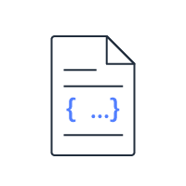




Request and response processing flow
API Gateway
Request processing
Request validation
Integration request
Request model
Request mapping
Method request payload
Response processing
Client
Backend services
Response mapping template
Integration response
Response model
Method response payload
Enforce your application's parameters
Notes:
Request and response mapping helps your application transform data to enforce your applications parameters. In API Gateway, an API method request can take a payload in a different format from the corresponding integration request payload, as required in the backend. Similarly, the backend may return an integration response payload different from the method response payload, as expected by the front end.
With API Gateway, you can use mapping templates to map the payload in the following ways:
From a method request to the corresponding integration request
From an integration response to the corresponding method response

Slide 17
Example: Request model
Request payload
Request model
{
"UserId": "StudentA",
"Notes": [
{
"Note": "Hello World!",
"NoteId": 11
}
]
}
{
"$schema": "http://json-schema.org/draft-04/schema#",
"title": "NotesInputModel",
"type": "object",
"required": [ "UserId" ],
"properties": {
"UserId": { "type": "string" },
"Notes": {
"type": "array",
"items": {
"type": "object",
"required": [ "NoteId", "Note" ],
"properties": {
"Note": { "type": "string" },
"NoteId": { "type": "integer" }
}}}}}
Notes:
Model defines the data structure of a payload.
A mapping template is a script expressed in Velocity Template Language (VTL) and applied to the payload using JSONPath expressions. A JSONPath expression is for a JSON field of the body of a request or a response. Use mapping templates to do the following:
Map parameters one-to-one
Map a family of integration response status codes (matched by a regular expression) to a single response status code

Slide 18
Request validation
{
"name": "params-only",
"validateRequestBody": "false",
"validateRequestParameters": "true"
}
Configure.
Required parameter of q1 is set and not blank.
GET /testStage/validation?q1=StudentA HTTP/1.1
Host: abcdef123.execute-api.us-east-1.amazonaws.com
Content-Type: application/json
Accept: application/json
Method request payload
{
"UserId": "StudentA",
"Notes": [
{
"Notes": "Hello World!",
"NoteId": 11 }
]
}
Request validation
Notes:
You can configure API Gateway to perform validation of an API request before proceeding.

Slide 19
Mapping templates, 1 of 2
Request mapping template
Production payload
#set($inputRoot = $input.path('$'))
{
"Environment": "$stageVariables.environment",
"Notes": [{
"NoteId": "$elem.NoteId",
"Note": "$elem.Note" }]
}
{
"Environment": "prod",
"Notes": [{
"NoteId": "11",
"Note": "Hello World!"
}]
}
Method request payload
Development payload
{
"Environment": "dev",
"Notes": [{
"NoteId": "11",
"Note": "Hello World!"
}]
}
Backend services
Notes:
Model defines the data structure of a payload.
The mapping template is a script expressed in Velocity Template Language (VTL) and applied to the payload using JSONPath expressions

Slide 20
Mapping templates, 2 of 2
Mapping template
Payload
#set($inputRoot = $input.path('$'))
<Notes>
<NoteId>$elem.NoteId</NoteId>
<Note>$elem.Note</Note>
</Notes>
{
"Environment": "prod",
"Notes": [{
"NoteId": "11",
"Note": "Hello World!"
}]}
Backend services
Method response payload
<Notes>
<NoteId>11</NoteId>
<Note>Hello World!</Note>
</Notes>
Client
Notes:
Model defines the data structure of a payload.
Mapping template is a script expressed in Velocity Template Language (VTL) and applied to the payload using JSONPath expressions. Remember that the payload includes information about the environment (prod). However, the mapping template strips that information out because it is not needed in the response payload. In this example the mapping template converts the JSON payload to an XML file.

Slide 21
API design as code
Module 10: Managing the APIs

Slide 22
Design APIs with Swagger
YAML file
Swagger
Import API designs
Export API designs
Faster development
Complex configurations
Store and reuse
swagger: "2.0"
info:
title: "PollyNotesAPI"
basePath: "/Prod"
schemes:
- "https"
paths:
...
security:
- PollyNotesPool: []
x-amazon-apigateway-integration:
httpMethod: "POST"
uri: "arn:aws:apigateway:[AWS_Region]:lambda:path/2015-03-31/functions/arn:aws:lambda:[AWS_Region]:[AWS_AccountId]:function:searchFunction/invocations"
responses:
default:
statusCode: "200"
...
Notes:
Swagger features
API definition as code
Portable API definition
JSON/YAML
Import/Export your API
API Gateway extensions
Can be used independently or part of the AWS CloudFormation template
Rich third-party resources, if tools are used

Slide 23
Testing APIs
Module 10: Managing the APIs

Slide 24



Invoke a REST API
REST APIs invoke URL
https://{restapi_id}.execute-api.{region}.amazonaws.com/{stage_name}/
API identifier
AWS Region
API deployment stage
AWS Management Console
AWS Command Line Interface (AWS CLI)
Note: Before you can invoke an API URL, you must deploy it in API Gateway.
Notes:
You can test a REST API in various ways. You can use the REST API’s invoke URL, the API Gateway console, or third-party tools such as Postman.
If an API permits anonymous access, you can use any web browser to invoke any GET method calls. You can do this by copying an appropriate invocation URL to the browser's address bar. To call a deployed API, clients submit requests to the URL for the API Gateway component service for API operation, known as execute-api. The URL for REST APIs follows this format:
https://{restapi_id}.execute-api.{region}.amazonaws.com/{stage_name}/
where:
{restapi_id} is the API identifier
{region} is the Region
{stage_name} is the stage name of the API deployment
You can find a REST API's root URL in the Stage Editor for the API in the API Gateway console.
You can use the API Gateway console to call an API by using the API Gateway TestInvoke feature. TestInvoke bypasses the invoke URL and allows API testing before the API is deployed.

Slide 25
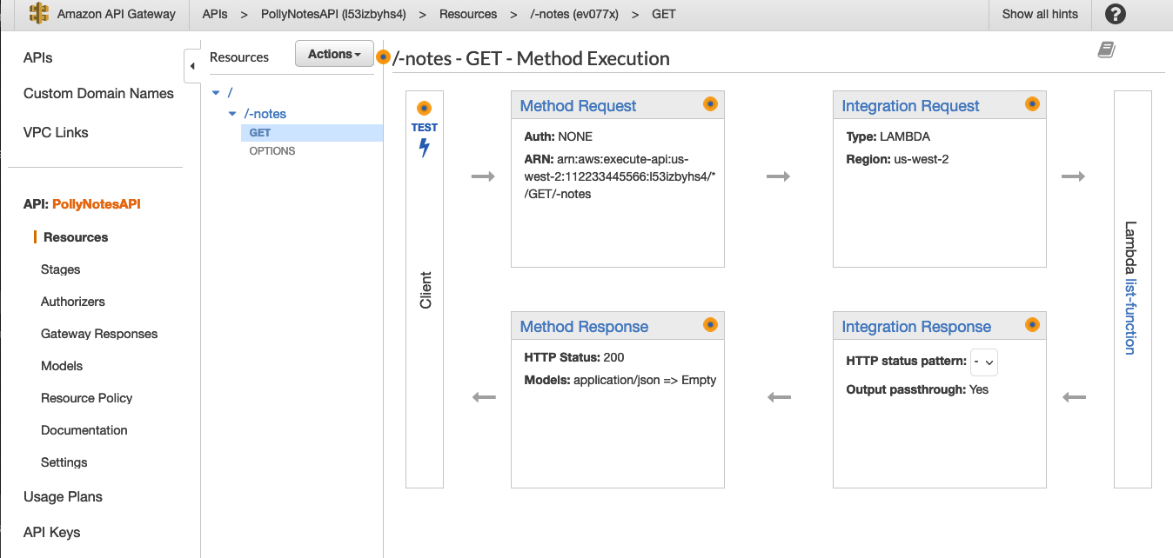

Test using the API Gateway console, 1 of 2
Notes:
To invoke a REST API from the API Gateway console, in the Method Execution pane, in the Client box, choose TEST.

Slide 26
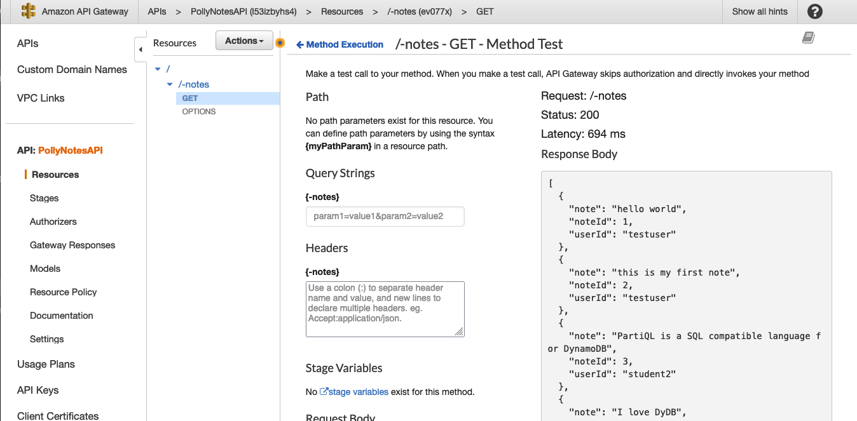
Test using the API Gateway console, 2 of 2
Note: Testing methods with the API Gateway console may result in changes to resources that cannot be undone.
Notes:
When the test is completed, the API Gateway console responds with a status of the request. Testing methods with the API Gateway console may result in changes to resources that cannot be undone. Testing a method with the API Gateway console is the same as calling the method outside of the API Gateway console. For example, if you use the API Gateway console to call a method that deletes an API's resources, if the method call is successful, the API's resources are deleted.

Slide 27
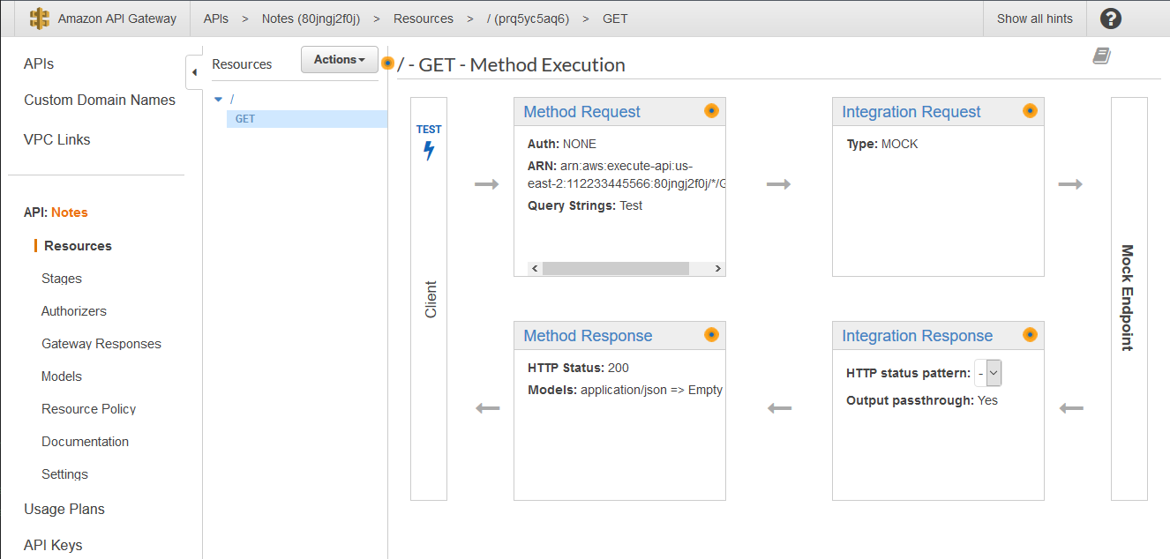
Mock integrations
Test without a completed backend
Test scenarios
Speed up API development
Notes:
API developers can generate API responses from API Gateway directly, without the need for an integration backend. As an API developer, you can use this feature to unblock dependent teams that need to work with an API before the project development is complete. You can also test multiple scenarios with the API before deploying it into production. With mock integrations, API developers are no longer held back by waiting for other teams to complete their integrations.
For more information, see “Set up mock integrations in API Gateway” in the Amazon API Gateway Developer Guide (https://docs.aws.amazon.com/apigateway/latest/developerguide/how-to-mock-integration.html).

Slide 28
Using the CLI to invoke a REST API
Terminal X
>> aws apigateway test-invoke-method --rest-api-id 81jpgj2f0j --resource-id Prq5yc5aq6 --http-method GET --path-with-query-string '/'
{
"status": 200,
"body": "",
"headers": {
"Content-Type": "application/json"
},
"multiValueHeaders": {
"Content-Type": [
"application/json"
]
},
"log": "Execution log for request c6b6f73a-1\nWed Aug 18 19:48:34 UTC 2021 : Starting execution for request: c6b6f73a-1\nWed Aug 18 19:48:34 UTC 2021 : HTTP Method: GET, Resource Path: /\nWed Aug 18 19:48:34 UTC 2021 : Method request path: {}\nWed Aug 18 19:48:34 UTC
2021 : Method request body before transformations: \nWed Aug 18 19:48:34 UTC 2021 : Method response body after transformations: \nWed Aug 18 19:48:34 UTC 2021 : Method response headers: {Content-Type=application/json}\nWed Aug 18 19:48:34 UTC 2021 : Successfully completed execution\nWed Aug 18 19:48:34 UTC 2021 : Method completed with status: 200\n",
"latency": 12
}

Slide 29
Deploying APIs
Module 10: Managing the APIs

Slide 30
API Gateway stages
Named reference to an API Gateway deployment
Staging offers solutions for:
Caching
Customized request throttling
Logging
Stage variables
Canary releases
Production stage
Stages
Development stage
Notes:
Now that you have configured and tested your API, it is time to deploy it into production and then iterate new versions. To deploy an API, create an API deployment and associate it with a stage. A stage is a logical reference to a lifecycle state of your API (for example, dev, prod, beta, v2).
When the deployment process is finished, the Stage Editor pane is displayed. The editor shows the URL to invoke the API's GET/ method request in the Invoke URL field.
Using the Stage Editor, you can also manage and optimize a particular deployment. For example, you can set up stage settings to enable caching, customize request throttling, configure logging, or define stage variables.

Slide 31
Using stage variables
AWS Cloud
Stage variables:
Name-value pairs
Act like environment variables
Use cases:
Have multiple data sources
Manage multiple release stages
Pass configurations to Lambda functions
/PROD/GET
list_function:PROD
Production
table
$stageVariables.environment
/notes
/DEV/GET
list_function:DEV
Development
table
Notes:
Stage variables, commonly called key-value pairs, are name-value pairs that you can define as configuration attributes. These attributes are associated with a deployment stage of a REST API. They act like environment variables and can be used in your API setup and mapping templates.
For example, you can define a stage variable in a stage configuration. You can then set its value as the URL string of an HTTP integration for a method in your REST API. Later, you can reference the URL string by using the associated stage variable name from the API setup. By doing this, you can use the same API setup with a different endpoint at each stage by resetting the stage variable value to the corresponding URLs. In the example diagram, staging variables can be used to direct traffic to a production and development environment, each with their own DynamoDB tables.
In the diagram, "/notes" invokes "list_function:{$stageVariables.environment}". Then API Gateway directs the request, depending on the given environment variable, toward unique data sources.
For more information, see “Setting up stage variables for a REST API deployment” in the Amazon API Gateway Developer Guide (https://docs.aws.amazon.com/apigateway/latest/developerguide/stage-variables.html).

Slide 32
Canary release
AWS Cloud
Reduce risk of deployments
Test performance
Develop in parallel
90% of users
CloudWatch
Stable version
/notes
10% of users
Production
table
Canary version
Notes:
A canary release is a software development strategy in which a new version of an API or other software is slowly rolled out as a new (or testing) version of an existing application. The base version remains deployed as a production release or a non-production release for normal operations on the same stage.
The purpose of a canary deployment is to reduce the risk of deploying a new version that affects the workload. The method will incrementally deploy the new version, making it visible to new users in a slow fashion. As you gain confidence in the deployment, you will deploy it to replace the current version in its entirety.
For more information, see “Performing canary deployments for service integrations with Amazon API Gateway” in the AWS Compute Blog (https://aws.amazon.com/blogs/compute/performing-canary-deployments-for-service-integrations-with-amazon-api-gateway/).

Slide 33
Steps for a canary release, 1 of 3
Make a feature change.
Deploy to the new stage.
If necessary:
Enable caching.
Set stage variables.
Enable logging with CloudWatch.
Enable canary on new stage.
AWS Cloud
CloudWatch
/notes
Stable stage
Production
table
New stage
Notes:
Code example
"methodSettings" : {
"String" : {
"metricsEnabled" : "true"
...
}
},
"variables" : {
"Var1" : "Val1"
},
"canarySettings" : {
"percentTraffic" : "10",
"deploymentId" : "A1b2C3",
"useStageCache" : "False“ },

Slide 34
Steps for a canary release, 2 of 3
Set the percentage of requests to canary.
Re-deploy APIs to the canary-enabled stage.
AWS Cloud
90% of users
CloudWatch
Stable stage
/notes
10% of users
Production
table
New canary stage
Notes:
Steps for a canary release continued:
Set the percentage of requests to canary.
Re-deploy APIs to the canary-enabled stage.

Slide 35
Steps for a canary release, 3 of 3
Promote canary.
AWS Cloud
CloudWatch
Earlier stable stage
/notes
100% of users
Production
table
New stable stage
Notes:
Steps for a canary release continued:
Promote canary.

Slide 36
Demo topics
Use your own demo or pull from Lab 5.
Cover console properties for API Gateway
Create resources
Integrations
Request validations
Mapping templates
Models
Testing
Deploying
Invoke
Bonus:
Stage Variables
Canary release

Slide 37
Demo
Module 10: Managing the APIs

Slide 38
Check your knowledge
Module 10: Managing the APIs

Slide 39
Knowledge check
1
☑
☒
☒
☑ True
☒ False
With Amazon API Gateway, developers can create, publish, maintain, monitor, and secure APIs.
2
In a canary release deployment, total API traffic is split between the current release and a canary release in a predictable pattern.
3
Mock integrations respond only to a 200 status code for API methods.
4
☑
☑
☑
A resource is a logical entity that an application can access through a resource path.
5
Stage variables are name-value pairs that you can define as configuration attributes associated with a deployment stage of a REST API.
6
To handle a diverse array of API calls intelligently, you can use an AWS Lambda function as a CRUD backend.
Notes:
(True)
(False) In a canary release deployment, total API traffic is separated at random into a production release and a canary release with a preconfigured ratio.
(False) API developers can configure any status code and decide how API Gateway responds to a mock integration request.
(True)
(True)
(True)

Slide 40
Lab 5: Develop Solutions Using Amazon API Gateway
Module 10: Managing the APIs

Slide 41
Lab 5 workflow: Develop Solutions Using Amazon API Gateway
AWS Cloud
You
Amazon API Gateway

Slide 42
Wrap-up
Module 10: Managing the APIs

Slide 43
Module summary
You are now able to:
Describe the key components of Amazon API Gateway
Develop API Gateway resources to integrate with AWS services
Configure API request and response calls for your application endpoints
Test API resources and deploy your application API endpoint
Demonstrate creating API Gateway resources to interact with your application APIs

Slide 44
Thank you

