Slide 1
Developing on AWS
Module 11: Building a Modern Application

Slide 2




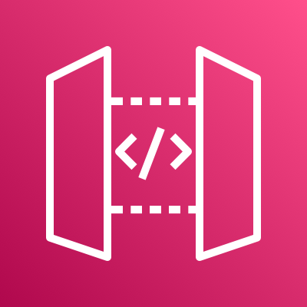



Agenda
Module 10
Module 11
Module 12
Lab 6
Managing the APIs
Building a Modern Application
Granting Access to Your Application Users
Authenticate Users with Amazon Cognito
AWS Cloud
Users
Amazon Cognito
Amazon API Gateway
Notes:
Module 10 – Configure Amazon API Gateway as a way to connect all of the application’s services together.
Module 11 – Evaluate the benefits of building a web application with a serverless approach.
Module 12 – Review how Amazon Cognito controls user access to AWS resources.
Lab 6 – Create an Amazon Cognito solution that provides users access to a web application.

Slide 3

Day 1 and 2 recap
Day 1
Your application
Developer tools (IDEs, SDKs, APIs)
Permissions
Storing and hosting your application
Day 2
Databases
Compute and storage
API management

Slide 4
Module objectives
By the end of this module, you will be able to:
Describe the challenges with traditional architectures
Describe the microservice architecture and benefits
Explain various approaches for designing microservice applications
Explain steps involved in decoupling monolithic applications
Explain how to orchestrate Lambda functions using AWS Step Functions
Notes:
You have been building a modern application. In this module, you learn what a modern application is and how it is developed. With a focus on microservices, you learn about the benefits of developing a modern application and additional considerations such as their orchestration.
Other modules will focus on the development agility and observability of a modern application.

Slide 5
Modern applications
Module 11: Building a Modern Application

Slide 6


Characteristics of modern applications
Architectural patterns
Microservices
Software delivery
DevOps
Operational model
Serverless
Completely independent
Code
Test
Deploy
Build
Plan
Release
Operate
Dev
Ops
Test
Monitor
Security
Notes:
AWS defines a modern application as a cloud-native application that is developed by a combination of modern technologies, architectures, software delivery practices, and operational processes. Modern applications are built with microservices architecture patterns, serverless operational models, and automated software delivery processes. By building modern applications, teams can deliver value more quickly, frequently, consistently, and safely.
A modern application is developed with a focus on the following characteristics:
Speed – Can be updated quickly based on customer and market needs.
Scale – Scales quickly to potentially millions of users, can handle petabytes of data, and is globally available.
Resilience – Resilient in the lifecycle and while deployed. Resiliency is built in the application to allow it to react quickly and recover from failure.
Security – Secure at the application and the lifecycle levels because security is set for each service.

Slide 7
Comparison of monolithic and microservice architectures
Monolith
Does everything
Microservice
Does one thing
Completely independent
APIs
APIs
Notes:
What is a monolithic application?
A monolith application has tightly coupled services in which the user interface and data are combined into a single program from a single platform. It is self-contained and independent from other computing applications.
What is a microservice application?
A microservice application service has the following characteristics:
Tightly scoped
Strongly encapsulated
Loosely coupled
Independently deployable
Scalable

Slide 8


Monolithic applications
Characteristics
Does everything
Tightly coupled functionality
State in each runtime instance
Single technology stack
Limited data options
Organized around technology layers
Deployment complexity
Rigid release schedules
Operational overhead
Traditional 3-tier architecture
Presentation
Process notes
Dictate notes
Search notes
Logic
Data
Notes:
A traditional 3-tier architecture is layered and logically modular, consisting of the following components:
Presentation – This layer manages HTTP requests and responds with HTML or JSON/XML (web services APIs).
Business logic – Application servers
Data layer – This layer includes the data access objects that access the database servers.
Drawbacks
Though this architecture is functional, if your business is fast-moving and fast-growing, you are not able to start or update an application as quickly as you want to. For example, the monolithic architecture presents the following challenges or drawbacks:
You can deploy only at the pace of the slowest component within the monolith.
If the coupling is high, so are the dependencies. As a result, your development and test complexity increases.

Slide 9


Modern applications: Microservice architecture
Characteristics
Minimal function services
Deployed separately, but interact together
Fit for purpose-based data options
Organized around business capabilities
State is externalized
Choice of technology for each microservice
Serverless and automated operational model
Microservice architecture
Completely independent
APIs
Process notes
APIs
Notes:
A modern application consists of many of the same components you have seen in the monolithic application, such as the data, logic, and presentation layers. But there are also a few key differences. Each microservice has a clean separation from the other microservices; each having its own persistence mechanisms.
Creating microservices or refactoring an existing monolith can be difficult.

Slide 10






Key benefits of a microservice architecture
Development agility
Fast and independent deployments
Increased security
Independent scaling
Increased availability and resilience
Organized based on business capabilities
Notes:
Because microservices are small and independent units, they provide the following benefits:
Development agility
Code is readable.
Technology stack is easier to change.
Collaboration increases in small teams.
Changes are made independently of other services.
Fast and independent deployments
Microservices are deployed independently.
Deployment times are shorter.
Deployment process is easier to automate.
Increased security
Each service is secure.
Independent scaling
A microservice can scale independently.
Increased availability and resilience
Fault isolation is improved.
Organized based on business capabilities
Reuse services in other applications.

Slide 11
Starting a new development effort
Enable experimentation by creating a culture of ownership
Componentize applications using microservices
Well-defined interfaces through APIs
Each microservice is optimized for a single function
Each service is independent of other services
Example: Domain-driven design
Functionality of microservice is within the context of the domain
Defines the integration points with other domains
Completely independent
APIs
APIs

Slide 12




Interaction patterns
API-Driven
Synchronous processing
Applications and services connect and communicate through APIs
AWS services expose their APIs
HTTP and HTTPS communication protocol
Event-Driven
Asynchronous processing
A message represents something has happened
AWS resources can generate events when their state changes
Consumer subscribes to an event
Provider generates an event
Listens for events from the bucket
Request
MP3
Response
API Gateway
Search
PUT event
Dictate
Notes:
Integration falls into two categories:
Synchronous or API-based
Asynchronous or event-based
Considerations
Modern applications use both types of integrations. When deciding on how to integrate, consider the following:
Are you communicating within a service or between services? In general, services are wrapped in an API but use messaging and events internally.
Event-driven communication is nearly infinitely scalable, and also scales to 0, which results in a cost benefit.
Event-driven applications enable the decoupling of services and of the teams that built them. This decoupling increases team agility.

Slide 13
Decoupling your monolithic application
Start small with simple services to decompose
Minimize dependency back to the monolith
Split complex dependencies early
Decouple frequently changing capabilities
Example: Strangler design pattern
Phased approach
Incrementally replace existing functionality with microservices
?
Notes:
Decoupling a monolithic application requires a well-thought-out process, which is implemented gradually.
To learn more, see “Advanced Developing on AWS” on the AWS Training website (https://aws.amazon.com/training/classroom/advanced-developing-on-aws/).

Slide 14
Software delivery: DevOps
Developers
Services
Delivery Pipelines
Monolithic
Build
Test
Release
Monitor
Microservices
Build
Test
Release
Monitor
Build
Test
Release
Monitor
Build
Test
Release
Monitor
Notes:
A traditional application has one release pipeline that is shared among many teams. This process often introduces bottlenecks. When teams have the authority to move fast, they can release new features continuously, often several times per day.
The way you operate an application that releases multiple times a day is different from one that releases once or twice a year. Under a DevOps model, development and operations teams take ownership of service with shared responsibility. Through a combination of cultural philosophies, practices, and tools, they find ways to deliver applications and services at high velocity.

Slide 15
Operation model – Serverless
Module 11: Building a Modern Application

Slide 16
What is serverless computing?
Traditional deployment
and operations
Serverless deployment
and operations
Provision an instance
Update the OS
Install the application platform
Build and deploy applications
Configure auto scaling and load balancing
Continuously patch, secure, and monitor servers
Monitor and maintain applications
Provision an instance
Update the OS
Install the application platform
Build and deploy applications
Configure auto scaling and load balancing
Continuously patch, secure, and monitor servers
Monitor and maintain applications
Notes:
With serverless computing, you can build and run applications and services without considering servers. Serverless applications don't require you to provision, scale, and manage any servers. You can build services for nearly any type of application or backend service. Everything required to run and scale your application with high availability is handled for you.
Building serverless applications means that you can focus on your core product. You don’t have to worry about managing and operating servers or runtimes in the cloud or on premises. By reducing this overhead, as a developer, you can reclaim time and effort that can be spent on developing scalable and reliable products.

Slide 17
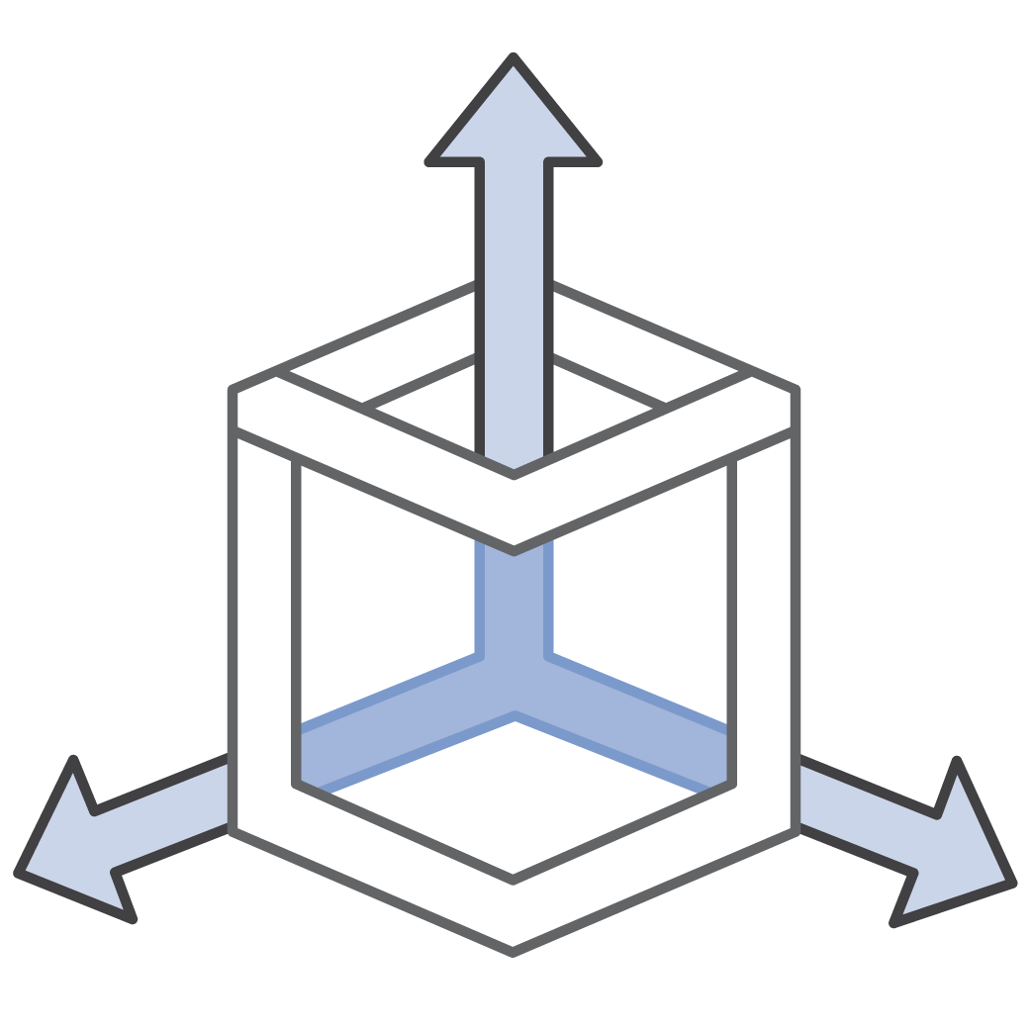


Benefits of serverless computing
No servers to provision or manage
Scales with usage
Seldom pay for idle servers
Availability and fault tolerance is built in
Notes:
Benefits include the following:
Don’t pay for idle, request-based pricing.
No infrastructure to provision, monitor, or manage
Scaling and fault-tolerance are built in
Easier to author, deploy, and secure
Enables best practices (events, stateless functions)
No need to provision or maintain any servers. No software or runtime is required to install, maintain, or administer.
You can automatically scale your application. Alternatively, you can scale the application by adjusting its capacity through toggling the units of consumption (throughput or memory) instead of units of individual servers.
Serverless applications have built-in availability and fault tolerance. You don't need to architect for these capabilities because the services running the application provide them by default.

Slide 18



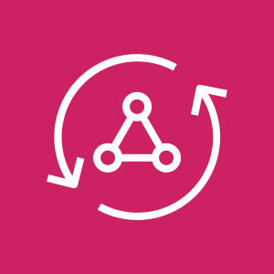













Serverless application stack
Compute
API Proxy
Analytics
AWS Lambda
AWS Fargate
Amazon API Gateway
AWS AppSync
Amazon Kinesis
Amazon Athena
Interposes Messaging
Developer Tools
Storage
Amazon SNS
Amazon SQS
Amazon EventBridge
AWS Tools and SDKs
Amazon S3
Amazon EFS
Database
Orchestration
Visibility
Amazon DynamoDB
Amazon Aurora
AWS Step Functions
Amazon CloudWatch
AWS X-Ray
Notes:
AWS provides a set of fully managed services that you can use to build and run modern applications.
AWS developed serverless services for all three layers of your stack, including:
Compute – AWS Lambda and AWS Fargate
Application integration – Amazon EventBridge, AWS Step Functions, Amazon Simple Queue Service (Amazon SQS), Amazon Simple Notification Service (Amazon SNS)
Data stores –Amazon Simple Storage Service (Amazon S3), Amazon DynamoDB, Amazon Elastic File System (Amazon EFS), or Amazon Aurora
However, other services are available to support your application lifecycle after production, such as Amazon CloudWatch or AWS X-Ray.
For more information, see “Serverless on AWS “ on the AWS Product website (https://aws.amazon.com/serverless/ ).

Slide 19
Your application
Module 11: Building a Modern Application

Slide 20









The application build
Which modern application features were applied in your application?
AWS Cloud
Application API calls
API driven
Independent functionality
Decoupled components
Technology agnostic
Independent deployment
Serverless
List
AWS SAM
IAM
Create/Update
Website hosting
End user
Amazon API Gateway
Search
DynamoDB
MP3 hosting
Delete
Amazon Cognito
Dictate
Amazon Polly
Amazon CloudWatch
AWS X-Ray
Notes:
Consider the application you have built in this course. This is a cloud-native, serverless, modern application.
What you have built so far by applying serverless concepts:
API driven
Independent functionality
Decoupled components
Technology agnostic
Independent deployment
Serverless
Missing components because it’s serverless:
Load balancers
Servers
What else can be done?

Slide 21
Orchestration through AWS Step Functions
Module 11: Building a Modern Application

Slide 22








Orchestration of complex distributed workflows
Manage state across distributed tasks while reducing application code and improving resiliency
AWS Cloud
AWS Step Functions
post-note workflow
Start
Custom logs
Detect sentiment
POST
Amazon Comprehend
{form data}
Record transaction
Client
API Gateway
Good or bad?
{Response}
Good
Bad
Notify admin
End
Amazon SES
Notes:
In general, modern cloud applications are composed of many services and components. As applications grow, an increasing amount of code is built to coordinate the interaction of all the components.
In this example, you see a workflow for a Step Function for Post note. Imagine a richer functionality to the one you have used in your application within the course.
What if before posting a note, you want to record the request in a custom log and detect its sentiment using Amazon Comprehend? Recording a log entry and detecting the sentiment can happen in parallel, and when complete, the transaction can be recorded. Good or bad can be a number of things as defined by the workflow. It can be an error, or even flagged inappropriate language.
AWS Step Functions provides serverless orchestration of such interactions.

Slide 23

Orchestration of business logic
Sequential tasks
Retry failed tasks
A
Select task based on data
A
B
A
B
?
C
Tasks in parallel
Wait duration/time/dynamic
Try/Catch/Finally
A
B
A
A
C
Notes:
Serverless applications can become complex. Your business logic has functions or operations for which you need to orchestrate your code. Instead of writing code through your Lambda functions, which handle business logic, retries, and time outs, you can use Step Functions.

Slide 24

AWS Step Functions
Coordinate the components of distributed applications using visual workflows.
Workflows manage:
Failures
Retries
Parallelization
Service integrations
Observability
AWS Step Functions
Multiple decision paths
Multiple step processes
Need to handle failures
Notes:
AWS Step Functions is a serverless orchestration service that lets you combine AWS Lambda functions and other AWS services to build business-critical applications.
A step function is based on state machines and tasks.
A state machine is a workflow with built-in controls.
A task is a state in a workflow that represents a single unit of work that another AWS service performs.
Each step in a workflow is a state. A state of each step is examined to make sure that the application runs in order and as expected.

Slide 25
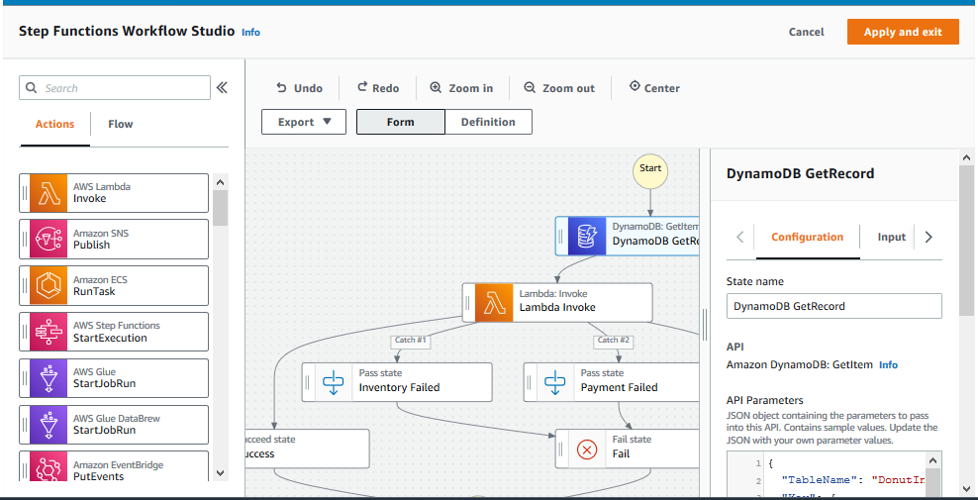
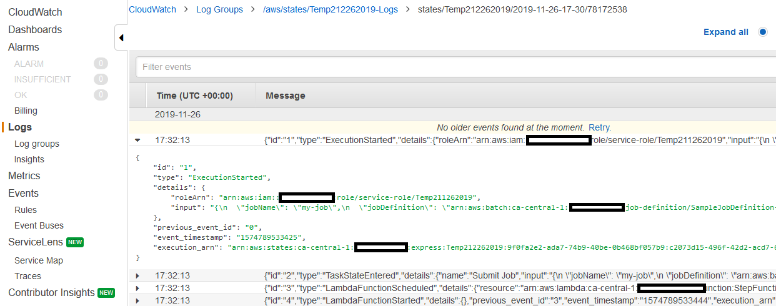
Getting started with Step Functions
Define
Visualize
Run and Monitor
JSON - Amazon States Language
https://states-language.net/
State Function Workflow Studio
Notes:
The workflows of the AWS Step Functions can be defined using a JSON-based language called the Amazon States Language, or using the Workflow Studio. The state machine defined in the workflow can be visualized during design time. From the AWS Management Console, you can visualize the workflow while it is running. You can also use Amazon CloudWatch metrics, CloudWatch Logs, AWS X-Ray, and other tools to log and monitor the workflows.

Slide 26
Anatomy of the Task state
How JSON information moves through a task state
State input
“InputPath”
Determine which parts of the JSON input to pass to the task.
“Parameters” Pass information to the API actions of connected resources.
State [X]
AWS service
Lambda function
Activity worker
“ResultPath”
Determines which information to pass to the output
“OutputPath” Filtering passed data
State Output
Notes:
AWS Step Functions use workflows defined as state machines. Workflows specify how states communicate and how data is passed between them.
States can perform a variety of functions in your state machine, including:
Task – Performs a single unit of work by doing the following:
Choice – Choose the appropriate branch of the flow.
Fail or Succeed – Stop the flow based on pass/fail.
Pass – Pass the input to the output as is, or combined with some fixed data.
Wait – Delay the flow for a specific amount of time.
Parallel – Begin parallel branching within the flow.
Map – Run the same steps for multiple entries of an array in the state input.
Individual states receive JSON as input and usually pass JSON as output to the next state. The InputPath, Parameters and ResultSelector fields provide a way to manipulate JSON as it moves through the workflow.
All work in a state machine is performed by tasks. The AWS Step Functions helps coordinate the actions between the various tasks. The input information goes into the InputPath. Its parameters are considered, and the state is set. The code is then invoked. The ResultPath is determined with the output data.

Slide 27
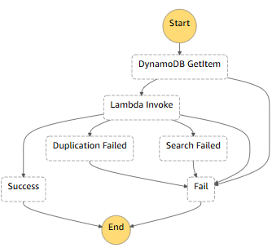
Example: Iterate a loop using Lambda
{ "Comment": "Example of the Amazon States Language using a Pass state",
"StartAt": "DynamoDB GetItem",
"States": {
"DynamoDB GetItem": {
"Type": "Task",
"Resource": "arn:aws:states:::dynamodb:getItem",
"Parameters": { "TableName": "NoteInventory", "Key": { "NoteName": {"S.$": "$.note" } } },
"ResultPath": "$.DynamoDB",
"Catch": [ { "ErrorEquals": [ "States.ALL" ], "Next": "Fail" } ],
"Next": "Lambda Invoke"
},
"Lambda Invoke": {
"Type": "Task",
"Resource": "arn:aws:states:::lambda:invoke",
"OutputPath": "$.Payload",
"Parameters": {
"Payload.$": "$",
"FunctionName": "arn:aws:lambda:us-east-2:069025409925:function:ProcessDynamoDBRecords2:$LATEST"
},
"Retry": [
{"ErrorEquals": [ "Lambda.ServiceException", "Lambda.AWSLambdaException", "Lambda.SdkClientException" ],
"IntervalSeconds": 2,
"MaxAttempts": 6, …
Notes:
Step Functions is a serverless orchestration service that lets you combine AWS Lambda functions and other AWS services to build business-critical applications.
This example is a JSON representation of a state machine with several task states.
The state machine starts at state DynamoDBGetItem.
State DynamoDBGetItem is of type Task. This task is performed by the resource whose Amazon Resource Name (ARN) is used. The tableName: NoteInventory parameter and the key parameters use the “$” notation to pull the value from the corresponding input. The ResultPath is updated with the retrieved value of the item. If an error occurs, the error is caught, and the flow is sent to the Fail state. If it is successful, the flow continues to the state Lambda Invoke.
In the Lambda Invoke state, notice the Retry statement.

Slide 28









Service integrations
AWS Lambda
Amazon SQS
Request
Amazon SageMaker
Amazon ECS
Step Functions invoke the task and pauses until the task is completed.
Amazon SNS
AWS Fargate
AWS Glue
Amazon DynamoDB
AWS Batch
And more.
Notes:
AWS Step Functions integrate with services using three service integration patterns:
Call a service and let Step Functions progress to the next state immediately after it gets an HTTP response.
Call a service and have Step Functions wait for a job to complete.
Call a service with a task token and have Step Functions wait until that token is returned with a payload.

Slide 29
Demo
Module 11: Building a Modern Application

Slide 30

Demo: Use AWS Step Functions to orchestrate Lambda functions
Visual development option
Task – parallel/sequence
Branching
Choice
Running
Integrations

Slide 31
Check your knowledge
Module 11: Building a Modern Application

Slide 32
Knowledge check
☑
☑
☑ True
☒ False
1
☒
With serverless architecture, teams focus on the application, while the cloud service provider manages the infrastructure.
2
Modern application development is an approach to designing, building, and managing applications in the cloud.
3
In Step Functions, all work in your state machine is done by AWS Lambda functions.
4
☑
☑
☒
The state machines of Step Functions support branching, parallel runs, retry/error handling, and initiating tasks.
5
Microservices are loosely coupled, have independent functionality, and are event-driven or API-driven.
6
Step Functions workflows manage parallelization and service integration, but you have to manage failures and retries.
Notes:
(True)
(True)
(False) All work in your state machine is done by tasks, which can invoke Lambda functions or other services.
(True)
(True)
(False) Workflows manage failures, retries, parallelization, service integrations, and observability.

Slide 33
Wrap-up
Module 11: Building a Modern Application

Slide 34
Module summary
You are now able to:
Describe the challenges with traditional architectures
Describe the microservice architecture and benefits
Explain various approaches for designing microservice applications
Explain steps involved in decoupling monolithic applications
Explain how to orchestrate Lambda functions by using AWS Step Functions

Slide 35
Thank you

