Slide 1
Developing on AWS
Module 12: Granting Access to Your Application Users
Lab

Slide 2








Agenda
Module 11
Module 12
Lab 6
Module 13
Building a Modern Application
Granting Access To Your Application Users
Capstone – Complete the Application Build
Deploying Your Application
AWS Cloud
Amazon Cognito
End user
Amazon API Gateway
Notes
Website hosting
MP3 hosting
Amazon Polly

Slide 3
Module objectives
By the end of this module, you will be able to:
Explore the authentication process using Amazon Cognito
Manage user access and authorize serverless APIs
Observe best practices for implementing Amazon Cognito
Demonstrate the integration of Amazon Cognito and review the JWT token

Slide 4
Complexities of authentication and authorization
Module 12: Granting Access to Your Application Users

Slide 5
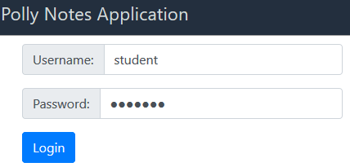



Authentication and authorization
Post notes
Edit notes
Delete notes
Authentication
Verifying that users are who they say they are
HTTP authentication
Login prompts
Custom methods
Authorization
Verifying whether users can perform the desired action
Access control
Authority tools
Protect data and operations
Users
Application
Notes:
|
Historically, application security from a user perspective required users to authenticate to the application to be granted authorizations. Users must verify to prove their identity before they are allowed to perform a desired action. User identity was woven into the application.

Slide 6
Authentication and authorization components for modern applications
User identity
Local to your application
Users
Guests
Authentication scheme
Single sign-on (SSO)
Multiple provider integrations
2FA/MFA
Federated users
Framework
Security Assertion Markup Language (SAML 2.0)
OAuth 2.0
OpenID Connect (OIDC)
Tokens (for example, JWT)
Security responsibilities and challenges
Users
Application
Notes:
Modern applications are similar but include a greater set of challenges for a developer to track. Developers must manage users, implement a robust authentication scheme, and build a framework to enable security.
User identification and authentication are important to your company. Developers often spend time choosing and configuring the right services to support their applications.
User identity – Are users created locally in the application, or are they federated from another source? How will the application handle guest access?
Authentication scheme – Choosing and configuring the right services to support the applications.
Framework – What protocols and methods will the services require to implement the user security solution?
These are security responsibilities and challenges a developer must face when implementing a solution. Ask yourself whether you want to assume these responsibilities and challenges as a developer.

Slide 7

A solution for authentication and authorization needs
Amazon Cognito
Authentication
Authorization
Users
Application
Notes:
Amazon Cognito is the solution for the authentication and authorization needs of applications.

Slide 8
Amazon Cognito
Module 12: Granting Access to Your Application Users

Slide 9



What is Amazon Cognito?
Provides authentication, authorization, and user management for your web and mobile apps.
Amazon Cognito
Identity
store
Access control for AWS resources
Compliance
Notes:
Using Amazon Cognito, your users can sign in directly to your applications with a user name and password. Alternatively, they can sign in through a third party such as Facebook, Login with Amazon, Google, or Sign in with Apple.
Amazon Cognito features include:
Identity store An identity store for all your apps and users. With Amazon Cognito, your users can sign in through the following:
Social identity providers such as Google, Facebook, and Login with Amazon
Enterprise identity providers, such as Microsoft Active Directory, using SAML 2.0
Access control With Amazon Cognito identity pools, you can create methods to grant user access to your AWS resources.
Support of multiple compliance programs Advanced security features to protect your users.
Additional features The following are additional features that you cam implement.
Integration
Integration with AWS services
Integration with external identify providers (IdPs) such as Google, Facebook, Sign in with Apple
Microsoft Active Directory integration
Security
Data encrypted at rest and in transit; compliant with standards such as the following:
Payment card industry (PCI) data security standards (DSS)
System and Organization Controls (SOC)
International Organization for Standardization (ISO) 9001
Standards-based authentication (OAuth 2.0, SAML 2.0, OpenID Connect)
Multi-factor authentication (MFA)

Slide 10


Amazon Cognito components, 1 of 3
User pool
Identity pool
Authentication: Sign-up/Sign-in
Amazon Cognito
Authorization: Grant users access to other AWS services
Do you need to verify that the user is who they say they are?
Do you need to grant that user AWS access keys?
Notes:
Amazon Cognito user pools
A user pool is a user directory in Amazon Cognito. With a user pool, your users can sign in to your web or mobile app through Amazon Cognito. Users can also sign in through social identity providers such as Google, Facebook, Login for Amazon, or Sign in with Apple, and through SAML 2.0 identity providers.
Amazon Cognito identity pools (federated identities)
Use Amazon Cognito identity pools (federated identities) to create unique identities for your users and federate them with identity providers. With an identity pool, you can obtain temporary, limited-privilege AWS credentials to access other AWS services.

Slide 11





Amazon Cognito components, 2 of 3
User pool
Manage user directory
Hosted UI
Standard tokens
Identity pool
AWS credentials
Federated identities
Unauthenticated guests
Amazon Cognito
Lambda authorizer
Your application
Amazon API Gateway
AWS Identity and Access Management (IAM)
AWS STS
Notes:
Your users can sign up (even through third-party federation), sign in, or gain access to services.

Slide 12
Amazon Cognito components, 3 of 3
Can be used together
User pool
Manage user directory
Hosted UI
Standard tokens
Identity pool
AWS credentials
Federated identities
Unauthenticated guests
Amazon Cognito
Lambda authorizer
Your application
Amazon API Gateway
AWS Identity and Access Management (IAM)
AWS STS
Notes:
Amazon Cognito user pools and Amazon Cognito identity pools (federated identities) can be used together.

Slide 13
Managing user access
Module 12: Granting Access to Your Application Users

Slide 14

Create user pools for sign-up and sign-in
Third-party federation
Third-party federation
OR
OR
Users
Amazon Cognito user pools
Define User Flows
Registration
Verify email/phone
Secure sign-in
Forgot password
Change password
Sign-out
Specify Security Requirements
Secure password handling
Multi-factor authentication
Enforce password policies
Encrypt all data server-side
Support authentication flows
Scalable to millions of users
Notes:
|
With Amazon Cognito User Pools, you can do the following:
Choose how the user will sign in, such as options for verifying email, phone number, or user name.
Require attributes for signing up and creating a user profile, such as email, birthdate, picture, custom attributes, and more.
Specify policies (for example, password strength, require administrator for signup, and set expiration of temp passwords).
Enable multi-factor authentication (MFA) and remembering user devices.
Set options for recovering user accounts.
Set options for sending short message service (SMS) and custom emails.
Add tags so that you can categorize and manage user pools.
Specify application clients with access to the user pool. App clients will receive a unique ID and an optional secret key to access the user pool.
Set up customized workflows with triggers. You can select AWS Lambda functions to run with certain events (for example, pre-sign-up, post authentication).

Slide 15



Attributes, scope, and groups
Attributes
Metadata that describes individual users
Standard attributes
Email
Name
Custom
Nickname
Picture
Groups
Groups represent different types of users
Your application
End users
Administrators
Users can belong to multiple groups.
Scope
Level of access to resource
Your application
Read attributes
Write attributes
OAuth scopes
Custom scopes
Notes:
Attributes
Attributes are pieces of information that help you identify individual users, such as name, email, and phone number. You get a set of default attributes, called standard attributes, with all user pools. You can also add custom attributes to your user pool definition in the AWS Management Console.
Groups
With the support for groups in Amazon Cognito user pools, you can create and manage groups, add users to groups, and remove users from groups. Use groups to create collections of users to manage their permissions or to represent different types of users. You can assign an AWS Identity and Access Management (IAM) role to a group to define the permissions for members of a group. Because a user can belong to more than one group, each group can be assigned a precedence. This is a non-negative number that specifies the precedence of this group relative to the other groups that a user can belong to in the user pool. Zero is the top precedence value. Groups with lower precedence values take precedence over groups with higher or null precedence values. If a user belongs to two or more groups, the group with the lowest precedence value has the IAM role applied to the cognito:preferred_role claim in the user's ID token.
Scope
A level of access that an application can request to a resource. Using Amazon Cognito, application developers can create their own OAuth 2.0 resource servers and define custom scopes in them. Custom scopes can then be associated with a client. The client can request them in OAuth2.0 authorization code grant flow, implicit flow, and client credentials flow. Custom scopes are added in the scope claim in the access token.

Slide 16
Granting access to your application with user pools
Module 12: Granting Access to Your Application Users

Slide 17



Flow for Amazon Cognito user pool
Attributes and Group
Users
1
Configuring level of access.
Amazon Cognito user pools
Scope
Tokens
3
Amazon Cognito issues tokens.
Application
App client
4
Use the application.
2
Assign attributes, group, and scope.
Notes:
The Amazon Cognito user pool flow for granting access to the application is as follows:
Configuring level of access. Configure attributes to identify your application users, for example - username, email, etc. You can define which attributes are mandatory and needed to verify.
Assign attributes, group, and scope. Define which app clients will access this user pool. Create user groups as needed to manage collectively users’ permissions or to represent different types of users. For each app client, you can define scope to control the level of access needed.
Amazon Cognito issues tokens. When a user signs into your app, Amazon Cognito verifies the login information. If the login is successful, Amazon Cognito creates a session and returns an ID, access, and refresh token for the authenticated user.
Use the application. You can use the tokens to grant your users access to your own server-side resources or to the Amazon API Gateway. Or you can exchange them for temporary AWS credentials to access other AWS services.

Slide 18
JSON Web Tokens: ID, access, and refresh
Header
{
"kid" : "1234example="
"alg" : "RS256",
}
Application
Payload
{
"sub": "aaaaaaaa-bbbb-cccc-dddd-eeeeeeeeeeee",
"aud": "xxxxxxxxxxxxexample",
"email_verified": true,
"token_use": "id",
"auth_time": 1500009400,
"iss": "https://cognito-idp.us-east-1.amazonaws.com/us-east-1_example",
"cognito:username": "StudentA",
"exp": 1500013000,
"given_name": "StudentA",
"iat": 1500009400,
"email": "StudentA@example.com",
"jti": "aaaaaaaa-bbbb-cccc-dddd-eeeeeeeeeeee",
"origin_jti": "aaaaaaaa-bbbb-cccc-dddd-eeeeeeeeeeee"
}
Example: ID token
ID
Access
Refresh
JSON Web Tokens
Amazon Cognito
Signature
HMACSHA256(base64UrlEncode(header) + "." + base64UrlEncode(payload), {secret})
Notes:
Amazon Cognito tokens
Amazon Cognito tokens are of JSON Web Token (JWT) format. JWT tokens have three sections:
Header – How to verify a token with encryption algorithm (alg) and the key ID (kid).
Payload – Encoded information about the claim of the key. The ID token contains encoded user information, such as cognito:username, email, or phone number. The access token contains information about the authenticated user, including cognito:groups, username, and scope.
Signature – Calculated based on the header and payload of the token.
ID token
Purpose: Contains details about your user, and confirms the identity.
Format: JWT, which defines the JSON object for sharing security information.
Header– How to verify the token with encryption algorithm and key id
{ "kid" : "1234example=“,
"alg" : "RS256" }
Claim– Payload with encoded user information, such as cognito:username, email, phone_number, and the following
Sub – Unique identifier for authenticated user
Aud – client_id that is used in the user authentication
token_use– Purpose of the token, such as ID
auth_time– When the authentication occurred
origin_jti– JWT identifier that indicates where the authentication happened.
Jti – Unique identifier of the JWT token
Signature– Verify the key source and that it has not been altered.
You can set the ID token expiration to any value between 5 minutes and 1 day. This value can be set per application client.
Access Token
Format: JWT
Purpose: Authorize API operations of the user in the user pool, but does not send details about the user.
Header – How to verify a token with encryption algorithm and key id).
Claim– Information about the authenticated user, including cognito:groups, username, scope, and the following:
sub– Unique identifier (UUID) for the authenticated user.
cognito:groups– List of groups the user belongs to.
token_use– The intended purpose of the token, such as access.
Scope – List of OAuth 2.0 scopes that define what access the token provides.
auth_time– When the authentication occurred.
iss– Which user pool issued the claim.
origin_jti– The originating JWT identifier, from when the authentication occurred.
jti– Unique identifier of the JWT.
Signature– Calculated based on the header and payload of the token.
Refresh Token
You can use the refresh token to retrieve new ID and access tokens. By default, the refresh token expires 30 days after your application user signs into your user pool. When you create an application for your user pool, you can set the application's refresh token expiration to any value between 60 minutes and 10 years.
You can set the access token expiration to any value between 5 minutes and 1 day. This value can be set per application client.

Slide 19
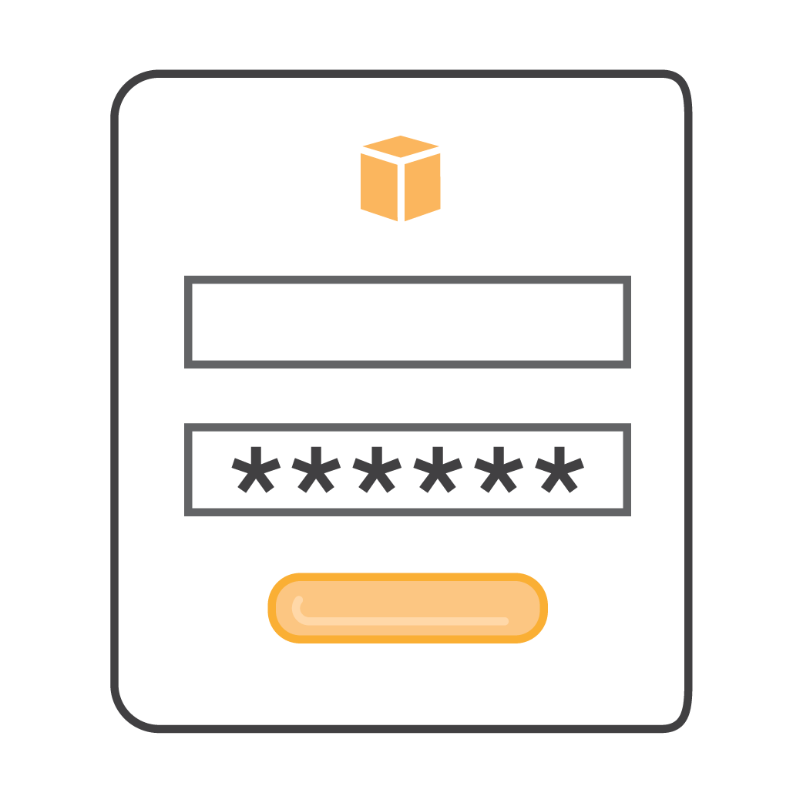




Authenticate users with a user pool
Amazon Cognito
1
User provides credentials and authenticates.
User pool
2
User pool returns refresh, access, and id tokens.
Apps
3
Use access token to access your own resources.
Server-side resources
ID token contains details about the user.
Access tokens contain details about what the user can access, but without sharing identity details.
Notes:
|
You can enable your users to authenticate with a user pool. Your app users can sign in directly through a user pool or federate through a third-party identity provider (IdP). The user pool manages the overhead of handling the tokens that are returned from social sign-in through Facebook, Google, Login with Amazon, and Sign in with Apple. The user pool also manages the handling of tokens from OpenID Connect (OIDC) and SAML IdPs.
After a successful authentication, your web or mobile app will receive user pool tokens from Amazon Cognito. You can use those tokens to retrieve AWS credentials that allow your application to access other AWS services. Alternatively, you might choose to use them to control access to your server-side resources or to the Amazon API Gateway.

Slide 20
Granting access to your application with identity pools
Module 12: Granting Access to Your Application Users

Slide 21


Identity pools for temporary access to AWS resources
1
App authenticates with valid IdP.
Identity provider
Amazon Cognito
2
JWT tokens
Identity pool
3
App sends authentication token.
Roles
4
Identity pool returns AWS credentials tied to IAM role.
AWS Services
5
Use AWS credential to access.
Apps
API Gateway
Amazon S3
Notes:
|
An identity pool is a store Amazon Cognito uses to keep your applications’ federated identities organized. Identity pool associates federated identities from social identity providers with a unique user-specific identifier. Identity pools do not store any user profiles. With identity pools, you can authenticate users through an external identity provider. Identity pools provide temporary security credentials to access your application’s backend resources in AWS or any service behind Amazon API Gateway.
An identity pool can be associated with one or many applications. If you use two different identity pools for two applications, the same end user will have a different unique identifier in each identity pool.

Slide 22
Securing API access
Module 12: Granting Access to Your Application Users

Slide 23

Amazon Cognito authorizer
1
Create a user pool.
End user
User Pool
End user authenticates with the application to the chosen user pool.
1
2
Create an API Gateway authorizer with the user pool.
3
Validate token.
JWT
2
Use a client-specific framework to call the deployed API Gateway API, and supply the appropriate token.
3
Integrate a REST API with an Amazon Cognito user pool.
Developer
Amazon API Gateway
Application
Perform tests with identity token.
4
4
Access
AWS services.
AWS services
Notes:
Integrate Amazon Cognito APIs directly into your application by using the AWS SDK for your chosen programming language. Amazon Cognito APIs provide complete control over user experience and flows.
Create and configure a user pool
To create and configure an Amazon Cognito user pool for your API, perform the following tasks:
Use the Amazon Cognito console, CLI/SDK, or API to create a user pool. You need user pool ID, client ID, and any client secret (if set any) for the rest of the configuration.
Use the API Gateway console, CLI/SDK, or API to create an API Gateway authorizer of COGNITO_USER_POOLS authorizer type with the chosen user pool.
Use the API Gateway console, CLI/SDK, or API to enable the authorizer on selected API methods. For Token source, use Authorization as the header name to pass the identity or access token that is returned by Amazon Cognito when a user signs in successfully.
Use the API Gateway Console or third-party tools to test the invocation by supplying an identity token that's provisioned from the user pool. For more information, see “Integrating Amazon Cognito With Web and Mobile Apps” in the Amazon Cognito Developer Guide (https://docs.aws.amazon.com/cognito/latest/developerguide/cognito-integrate-apps.html).
Calling API methods
To call any API methods with a user pool enabled, your API clients perform the following tasks:
Use the Amazon Cognito CLI/SDK or API to sign a user into the chosen user pool, and obtain an identity token or access token.
Use a client-specific framework to call the deployed API Gateway API and supply the appropriate token in the Authorization header.
API Gateway validates tokens with the Amazon Cognito user pool.
Invoke backend AWS services.

Slide 24




Your Application
AWS Cloud
Application API calls
/notes
/GET
List
/notes/(id)
/POST
AWS SAM
IAM
Website hosting
Create/Update
/notes/search
/GET
End user
Amazon API Gateway
Search
DynamoDB
/notes/(id)
/DELETE
MP3 hosting
Delete
/notes/
/GET
Amazon Cognito
Presigned URL
Amazon Polly
Dictate
Amazon CloudWatch
AWS X-Ray
Notes:
|
Amazon Cognito provides authentication, authorization, and user management for your web and mobile apps.
Users can sign in directly with a user name and password, or through a third party, such as Facebook, Login with Amazon, Google, or Sign in with Apple.

Slide 25



Alternative solution for granting access to your APIs
Lambda authorizer
Token-based
Request is parameter-based
Auth function
3
Lambda function authenticates the caller
Context +Token or Request parameters
If auth is successful, IAM policy and principal are returned.
2
4
Allowed
1
5
Apps
API Gateway
API Gateway evaluates the policy
Server-side resources
403 ACCESS_DENIED
Notes:
Lambda authorizers
A Lambda authorizer is an API Gateway feature that uses a Lambda function to control access to your API.
The following are two types of Lambda authorizers:
Token-based Lambda authorizer (also called a TOKEN authorizer) receives the caller's identity in a bearer token, such as a JWT or an OAuth token.
Request parameter-based Lambda authorizer (also called a REQUEST authorizer) receives the caller's identity in a combination of headers, query string parameters, stageVariables, and $context variables.
API Gateway Lambda authorization workflow
The client calls a method on an API Gateway API method, passing a bearer token or request parameters.
API Gateway checks whether a Lambda authorizer is configured for the method. If it is, API Gateway calls the Lambda function.
The Lambda function authenticates the caller by means such as the following:
Calling out to an OAuth provider to get an OAuth access token.
Calling out to a SAML provider to get a SAML assertion.
Generating an IAM policy based on the request parameter values.
Retrieving credentials from a database.
If the call succeeds, the Lambda function grants access by returning an output object containing at least an IAM policy and a principal identifier.
API Gateway evaluates the policy.
If access is denied, API Gateway returns a suitable HTTP status code, such as 403 ACCESS_DENIED.
If access is allowed, API Gateway runs the method. If caching is enabled in the authorizer settings, API Gateway also caches the policy so that the Lambda authorizer function doesn't need to be invoked again.
Authentication workflow for IAM identity-based policies
User federates into the application through a third-party party provider.
Amazon Cognito validates the user.
User issues a GetOpenIdToken and AssumeRoleWithWebIdentity requests.
User is validated with a token and issued AWS Security Token Service (AWS STS) access to server-side resources.
API Gateway evaluates the identity management policy against the API Gateway resource that the user requested and either allows or denies the request.
For more information, see “Understanding Amazon Cognito Authentication Part 4: Enhanced Flow” in the Front-End Web & Mobile AWS blog (https://aws.amazon.com/blogs/mobile/understanding-amazon-cognito-authentication-part-4-enhanced-flow/).

Slide 26
Demo
Module 12: Granting Access to Your Application Users

Slide 27
Demo notes
Cover Cognito UI – show user pools and identity pools
Create user pool and app client id
Add a user and verify access
Integrate API with Cognito pool and test
Resolve JWT token
REF: Sample apps: https://aws.amazon.com/cognito/dev-resources/

Slide 28
Check your knowledge
Module 12: Granting Access to Your Application Users

Slide 29
Knowledge check
1
☒
☑
☑
☑
True
False
Amazon Cognito user pools exchange authentication tokens for AWS credentials.
User and identity pools can be used together for authentication and authorization solutions.
2
3
To define the permissions for members of a group, you can assign an AWS Identity and Access Management (IAM) role to an Amazon Cognito group.
☒
4
☑
☒
☑
The JSON Web Token (JWT) payload section contains encoded information about the claim of the key.
5
When using third-party federation, developers must use identity pools.
Amazon Cognito identity pools can provide AWS credentials for unauthenticated users.
6
Notes:
|
(False) Amazon Cognito identity pools exchange authentication tokens for AWS credentials.
(True)
(True)
(True)
(False) Third-party federation is supported for both user pools and identity pools.
(True)

Slide 30
Lab 6: Capstone – Complete the Application Build
Module 12: Granting Access to Your Application Users

Slide 31
Lab 6 workflow: Authenticate users with Amazon Cognito
/notes
/GET
List
Amazon Cognito
/notes/(id)
/POST
Create/Update
/notes/search
/GET
End user
Amazon API Gateway
Search
Notes
/notes/(id)
/DELETE
Website hosting
Delete
/notes/
/GET
Dictate
Amazon Polly
MP3 hosting
Presigned URL

Slide 32

Lab 6 workflow: Complete the application build
Your Application
AWS Cloud
Application API calls
List
AWS SAM
IAM
Create/Update
Website hosting
End user
Amazon API Gateway
Search
DynamoDB
MP3 hosting
Delete
Amazon Polly
Amazon Cognito
Dictate
Notes:
IDE setup
Hosting your application
Database solutions
Compute with Lambda
Amazon API Gateway

Slide 33
Wrap-up
Module 12: Granting Access to Your Application Users

Slide 34
Module summary
You are now able to:
Explore the authentication process using Amazon Cognito
Manage user access and authorize serverless APIs
Observe best practices for implementing Amazon Cognito
Demonstrate the integration of Amazon Cognito and review the JWT token

Slide 35
Thank you

Slide 36
Terminology
OAuth2 Authorize website or application to access information through another without sharing passwords.
Decouples authentication from authorization
Provides secure delegate access
Uses tokens instead of credentials
OpenID Connect (OIDC) Confirms a user’s identity and allows them to access a protected HTTPS endpoint
Identity layer on top of OAuth2
Enables single sign-on scenarios
Uses tokens: ID, access, refresh
JSON Web Token (JWT) Defines JSON object for sharing security information. Consists of:
Header: How to verify a token with encryption algorithm and key ID
Claim: Payload with encoded user information
Signature: Verify the key source and that it has not been altered

