Slide 1
What’s Next? Course Wrap-Up

Slide 2
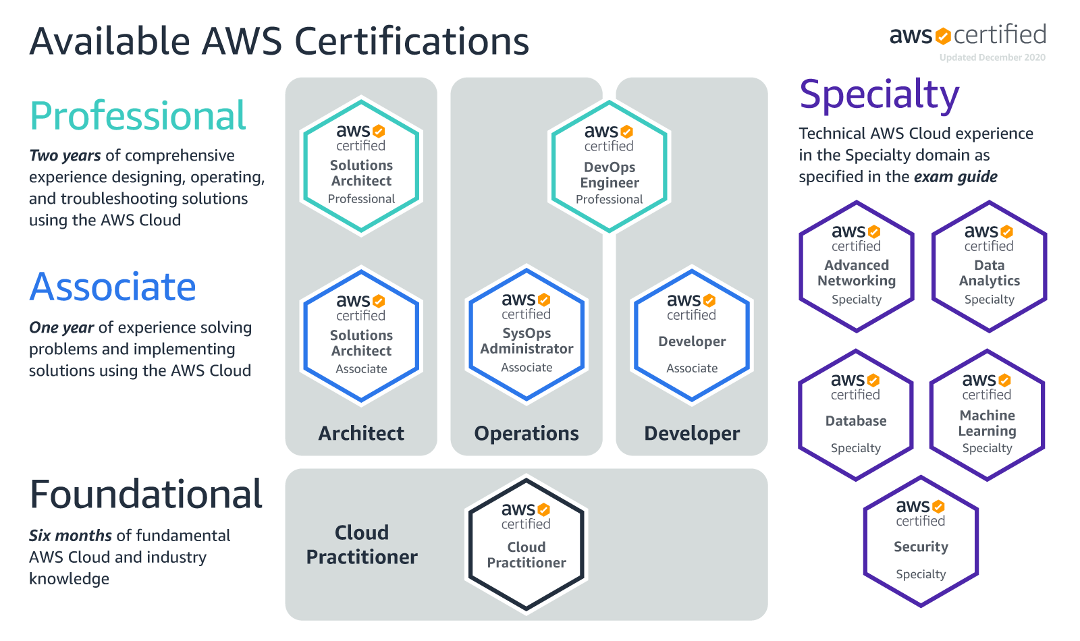
Validate Expertise with AWS Certification
Notes:
AWS Certifications recognize IT professionals who possess the skills and technical knowledge necessary for designing, deploying, and operating applications and infrastructure on AWS. Earning certification helps you gain visibility and credibility for your proven experience working with AWS and contributes to your organization’s proficiency with AWS-based applications.

Slide 3
Preparing for the Exam
Exam details: AWS Certified Solutions Architect – Associate Exam Detail Page
Training
Self-Paced Labs: http://amzn.to/1G6Nthc
Courses: http://amzn.to/2bobHzX
Resources
Whitepapers: http://amzn.to/2nBp2sp
Architecture Center: http://amzn.to/2fTOC5C
Documentation: http://amzn.to/1T9k1Og
Notes:
On the Exam Details page, you’ll find detailed information about the exam, as well as free sample questions and the exam blueprint to help you study.
Exam details: https://aws.amazon.com/certification/certified-solutions-architect-associate/
Training
Self-Paced Labs: https://aws.amazon.com/training/self-paced-labs/
Courses: https://aws.amazon.com/training/course-descriptions/
Resources
Whitepapers: https://aws.amazon.com/whitepapers/
Architecture Center: https://aws.amazon.com/architecture/ Documentation: https://docs.aws.amazon.com/index.html#lang/en_us

Slide 4
Recommended Prerequisites
Associate
One year of hands-on experience designing available, cost-efficient, fault-tolerant, and scalable distributed systems on AWS
AWS Training Class: Architecting on AWS
Both Associate and Professional
Review the AWS Cloud Computing whitepapers (listed earlier)
Experience architecting solutions with on-premises and AWS components

Slide 5
Thank You

