Slide 1
Exam Readiness: AWS Certified Solutions Architect - Associate

Slide 2
Agenda
The Exam: What to Expect
Domain 1: Design Resilient Architectures
Domain 2: Design High-Performing Architectures
Domain 3: Design Secure Applications and Architectures
Domain 4: Design Cost-Optimized Architectures

Slide 3

What is Covered in This Course?
Question Strategy
What to consider when choosing an answer
How to identify key aspects of the question
Content
What to study/key things to know for each domain
Practice questions in each domain
Note: This course is not a substitute for the Architecting on AWS training or hands-on experience with AWS services.
Notes:
The focus of this exam readiness course is to provide you with strategies for answering exam questions and describe the type of content that is included in the exam. The course does not review specific content. It identifies content that you will need to review on your own as part of the exam preparation. If you detect an unfamiliar term during the course, you may need to learn more about that concept.

Slide 4
Housekeeping
In case of emergency, please note the nearest exits.
Coffee break
Restrooms
Questions
We will regularly stop for questions.
We may need to limit or defer questions to ensure that we can cover all the content.

Slide 5
The Exam What to Expect

Slide 6
Why Certify?
Benefits for individuals
Demonstrate that you have the expertise
Earn recognition and visibility
Foster credibility with your employer and peers
Benefits for employers
Identify skilled IT professionals with an AWS background
Reduce risks and cost
Increase customer satisfaction
Notes:
You might be asking why you should become certified and where does the Solutions Architect - Associate Certification fit in the AWS levels of certifications.
AWS Certifications recognize IT professionals who possess the skills and technical knowledge necessary for designing, deploying, and operating applications and infrastructure on AWS. Earning certification helps you gain visibility and credibility for your proven experience working with AWS and also contributes to your organization’s proficiency with AWS-based applications.

Slide 7
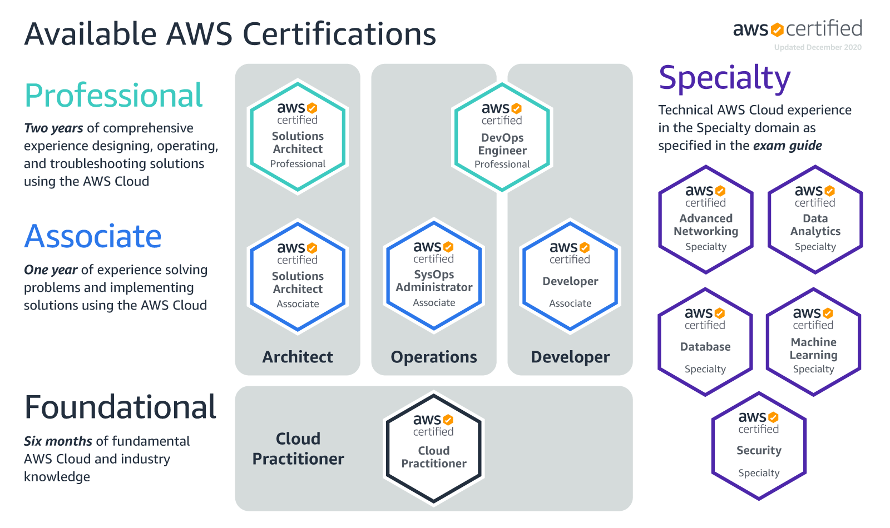
Validate Expertise with AWS Certification
See aws.amazon.com/certification for exam details.
Notes:
The AWS Certified Solutions Architect – Associate examination is intended for individuals who perform a Solutions Architect role. This exam validates an examinee’s ability to effectively demonstrate knowledge of how to architect and deploy secure and robust applications on AWS technologies.
The exam validates an examinee’s ability to:
Define a solution using architectural design principles based on customer requirements.
Provide implementation guidance based on best practices to the organization throughout the lifecycle of the project.
For more details, see https://aws.amazon.com/certification/certified-solutions-architect-associate/

Slide 8
Maintaining Your Edge
Re-certification
Every three years
Lower price
Increase certification level
AWS Certified Solutions Architect - Professional
Notes:
Maintain your certification by passing a shorter exam every two years. Alternatively, you can increase your level of certification by passing the SA professional certification.

Slide 9
Question Allocation
Domain* | % of Exam
1.0 Design Resilient Architectures | 30%
2.0 Design High Performing Architectures | 28%
3.0 Design Secure Applications and Architectures | 24%
4.0 Design Cost-Optimized Architectures | 18%
Total | 100%
*Guidelines that were used to design the exam
Notes:
Questions are grouped into the five domains.
The exam does not specify the domain related to the question; in fact, some questions could conceivably fall under multiple domains. But in terms of the test design, each question is associated with one domain, as shown in the table.
Use these benchmarks to help determine how to allocate your time studying.

Slide 10
The Exam: Logistics
Test center staff greets you in the lobby.
Two forms of ID required. One must be a government-issued ID with a photo.
You must empty your pockets and lock your personal contents up.
You are escorted to a test center PC to electronically take the test.
You must sign a non-disclosure agreement before taking the test.
Notes:
You must show two forms of personal identification (ID) to testing center staff. Your primary form of ID must be a valid, original, hard copy (not electronic), government-issued ID containing both a photo and signature. Your secondary form of ID needs to be valid and contain a signature such as a credit card. Both must be current. All personal belongings will be locked up. The test will be taken electronically after you sign a non-disclosure agreement.

Slide 11
The Exam: Mechanics
Questions are multiple choice, with both single selection and multiple selection.
There is no penalty for guessing.
You have 130 minutes to complete the exam.
You can mark a question for future consideration.
For Associate-level exams, no writing implements (pencil/paper, dry erase boards) are provided.
Before submitting the exam, you can review all your answers and which questions you marked so that you can go back to them easily.
Notes:
We recommend that you don’t spend too much time on questions that you don’t know. Instead, mark a question that you want to come back to and move on to the next one. At the end, you can return to all the marked questions for further review, if time permits. If you limit your time on questions you don’t know, you will have adequate time to answer the necessary percentage of questions that you know to pass the exam. At the end, and if you have time remaining, you can return to all the marked unanswered questions. There is no penalty for guessing. Be sure to answer every question! If you don’t know the answer, make the most intelligent guess, mark it for review, and return to it if you have extra time at the end.

Slide 12
The Exam: Sample Question
01
Which animal is a mammal?
Lobster
Cow
Butterfly
Alligator
Notes:
This is an example of a question with a single response.

Slide 13
The Exam: Sample Question
02
What colors are in the United States Flag?
Choose 3 answers
Red
Green
White
Yellow
Orange
Blue
Notes:
This is an example of a question that requires multiple answers. The test does not restrict or validate the number of answers selected, so ensure that you are selecting the specified number of answers.

Slide 14
The Exam: Sample Question
03
What is one set of correct steps to prepare breakfast of eggs, bacon, coffee and orange juice?
Squeeze the orange juice, toast the bacon, brew the coffee, boil the eggs
Boil the orange juice, fry the bacon, brew the coffee, boil the eggs
Squeeze the orange juice, fry the bacon, brew the coffee, boil the eggs
Squeeze the orange juice, fry the bacon, brew the coffee, bake the eggs
Squeeze the orange juice, fry the bacon, barbecue the coffee, boil the eggs
Notes:
This is an example of a question with a single answer, but the answer is a series of steps that must be performed either independently or in a specified order.

Slide 15
The Exam: Sample Question
Item Navigation
# | State | Flagged | Item text
NDA | Answered |  | By taking this exam, you agree to the AWS Certification Program Agreement governing our Certifica…
1 | Answered |  | You have a car that gets 25 miles to the gallon. The gas tank holds 12.5 gallons. You have already…
2 | Answered |  | The subscription to a magazine is $14 per year, which covers 12 issues. If you cancel your subscription…
3 | Answered |  | You are planning a drive of 300 km and want to arrive by 5:00 pm. If the speed limit is…
4 | Answered |  | A stone is dropped from a helicopter 5000 feet in the air. If gravity is 32.2. ft/s², when will the…
5 | Answered |  | How many 1 gallon buckets of paint will be needed to paint the walls of a room 10’ x 15’ if the…
6 | Unanswered |  | A jar of pickles is 16 cm tall and 12 cm in diameter. If the inside of a refrigerator is .5 m x .75m x …
7 | Answered |  | Johnny must be 4 feet tall to ride the roller coaster. Johnny is 6 years old and 3 feet 6 inches tall…
8 | Answered |  | A loop of string is wrapped tightly around the earth. If the string is lengthened by 6 cm, how…
9 | Answered |  | John has 3 more apples than Sue. Sue has twice as many apples as Danielle. How many…
Notes:
After your first pass through all exam questions, and if you have time remaining, you can review any question that you marked. During the exam, we recommend that you mark any question for which you are unsure of the answer.

Slide 16

General Strategies
01
Read both the question and the answer in full one time through.
02
Identify the features mentioned in the answers.
03
Identify text in the question that implies certain AWS features.
Examples: required IOPS, data retrieval times.
04
Pay attention to qualifying clauses (e.g., “in the most cost-effective way,” “will best fulfill”); these clauses may eliminate certain answers.
05
Eliminate obviously wrong answers to narrow the selection of possible right answers.
Notes:
These general strategies apply to all associate-level exams. By reading carefully and through the process of elimination, you can often answer questions or narrow the set of answers for those questions you’re unsure about.

Slide 17
Thank You

