Slide 1


17_84
Robotics and data driven technology
Brief introduction to industrial robtics
Notes:
Hier wird ein Bild eingefügt, das komplett formatfüllend die ganze Folie bedeckt (auch das Logo)

Slide 2
AMR Fleet Standard API
  REST and RESTful APIs
  Setting up the API
  Test the API
  Demo app
  Grpc

Slide 3
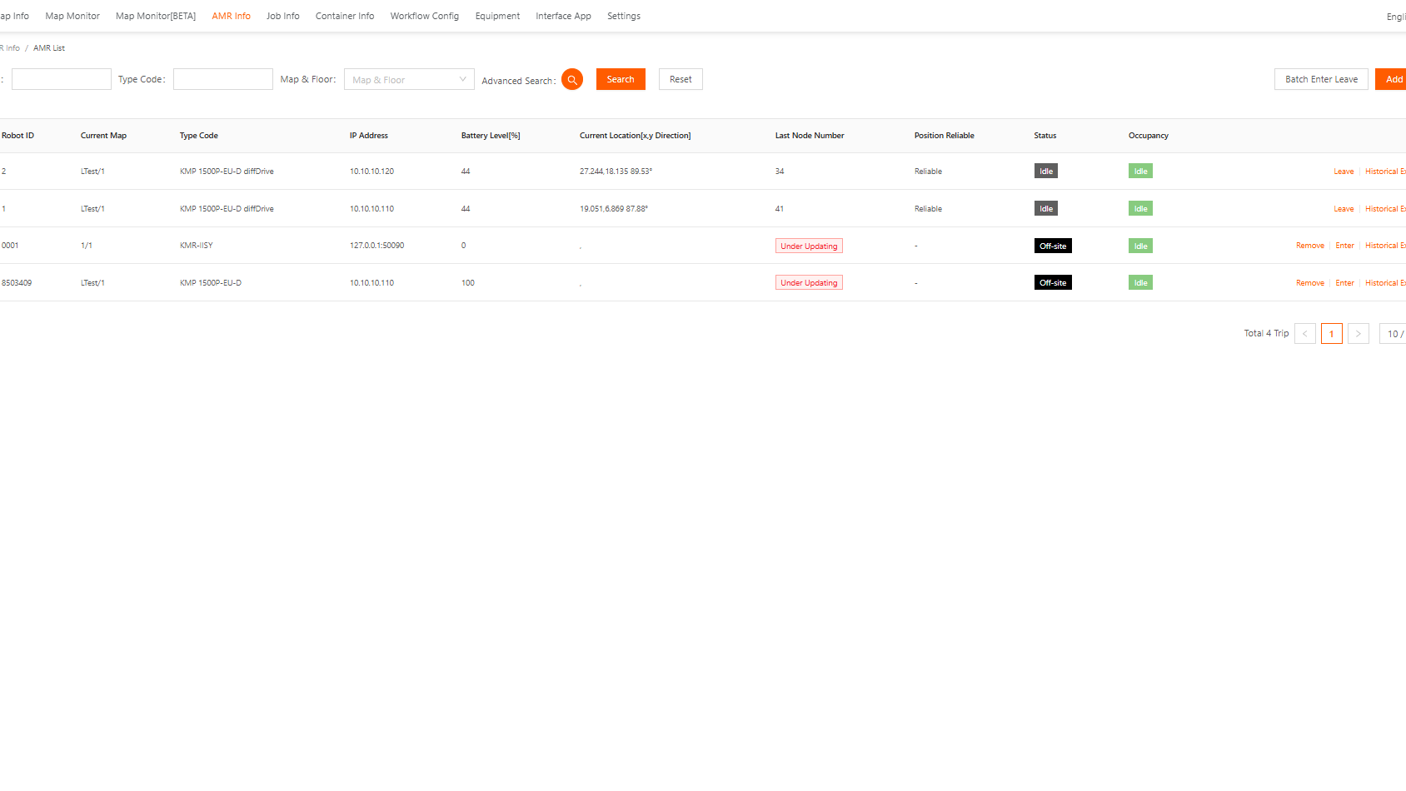

Slide 4
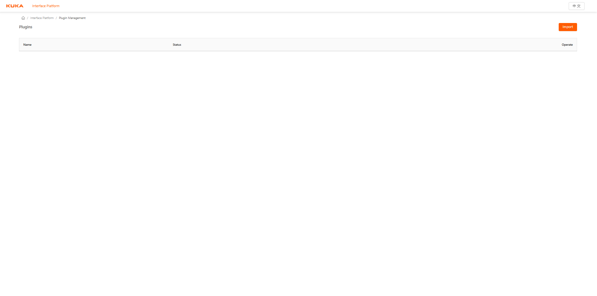

Slide 5
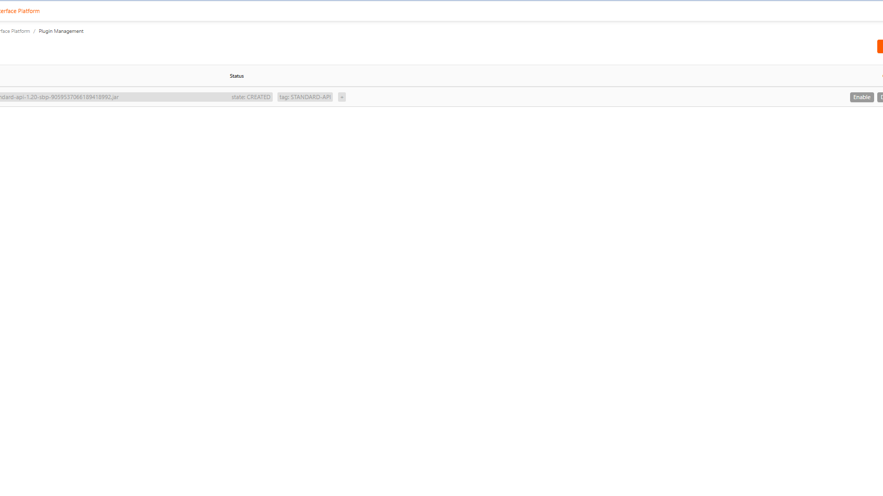

Slide 6
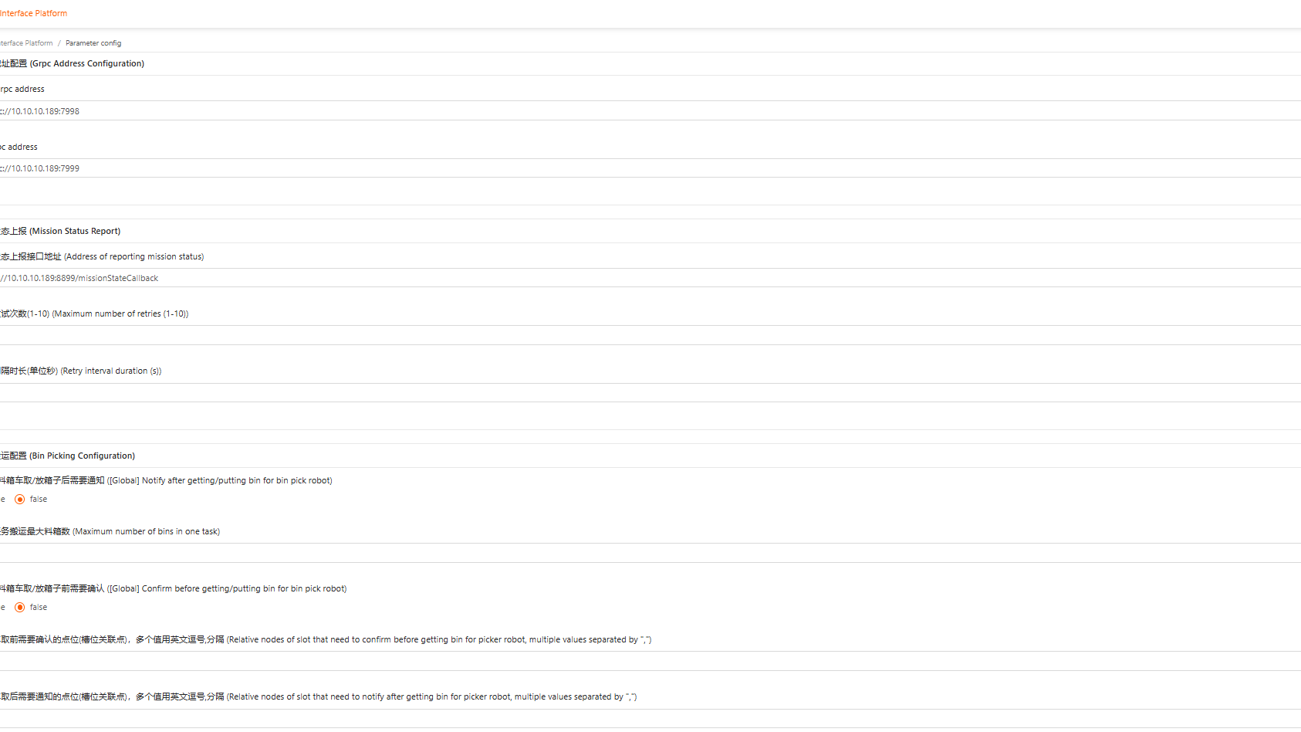

Slide 7



Client Side Server Side
REST API

Slide 9
Notes:
Diese Seite bleibt bis auf die Fußzeile unverändert

Slide 11
Headline page with Bullet points
  German Engineering since 1898
    Second Bullet depth
      Third Bullet depth
  Market for robotics
  Quality and sustainability
  Products and services

Slide 12
Headline Structure
German Engineering since 1898
Market for robotics
  This is a sub item
    This is another sub item
Quality and sustainability
Products and services
Future and innovation
Applications and industries
...
...
Summary
Conclusion

Slide 13
9_84
Add Core statement _Feature

Slide 24
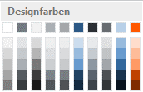
Colors
RGB 164, 167, 170
Standard color for diagrams (preset)
RGB 43, 88, 133
Standard color for diagrams (preset)
RGB 43, 48, 53
Standard color for diagrams (preset)
RGB 103, 108, 113
Standard color for diagrams (preset)
RGB 184, 208, 232
Standard color for diagrams (preset)
RGB 227, 229, 230
Standard color for diagrams
(additional color needs to be chosen manually)
RGB 255, 88, 0
Color for accentuation
RGB 180, 0, 0
Additional color for special mentions
RGB 0, 120, 10
Additional color for special mentions
RGB 255, 205, 0
Additional color for special mentions

Slide 25
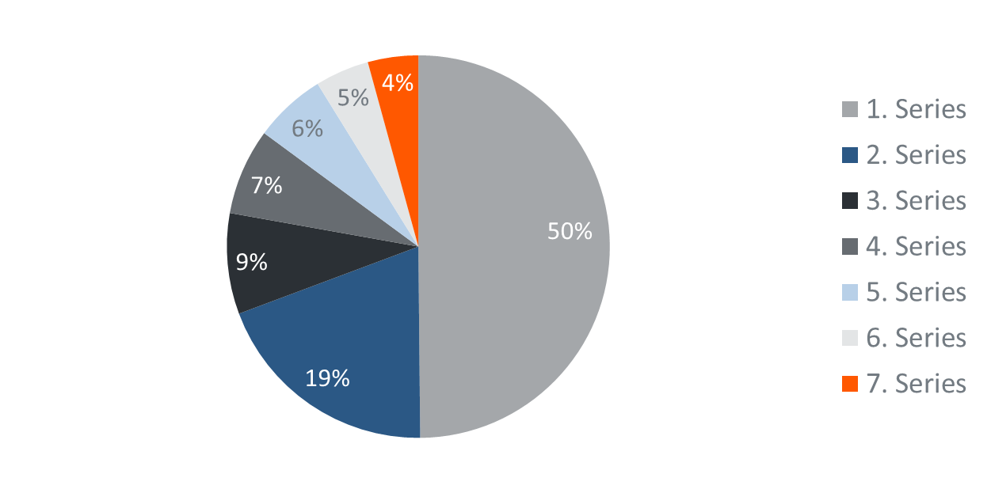
Headline Pie Chart

Slide 26
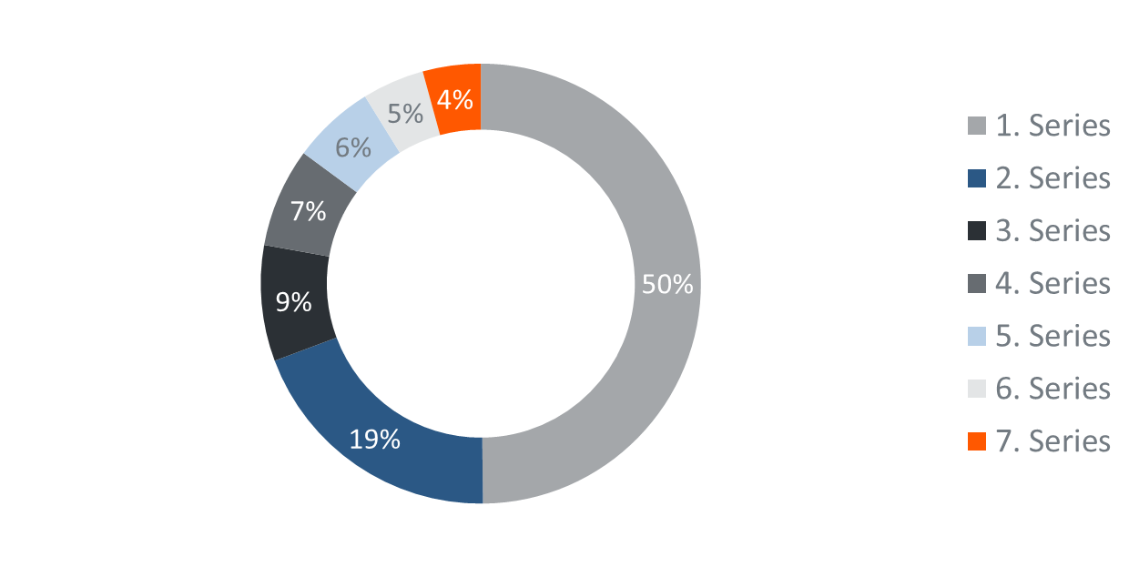
Headline Circle Chart

Slide 27
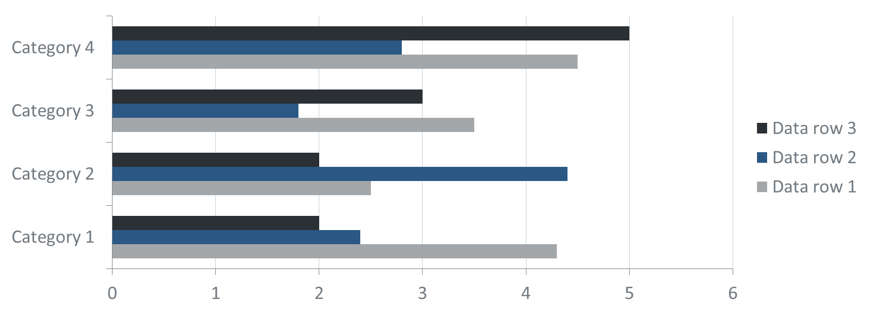
Headline Bar Chart

Slide 28
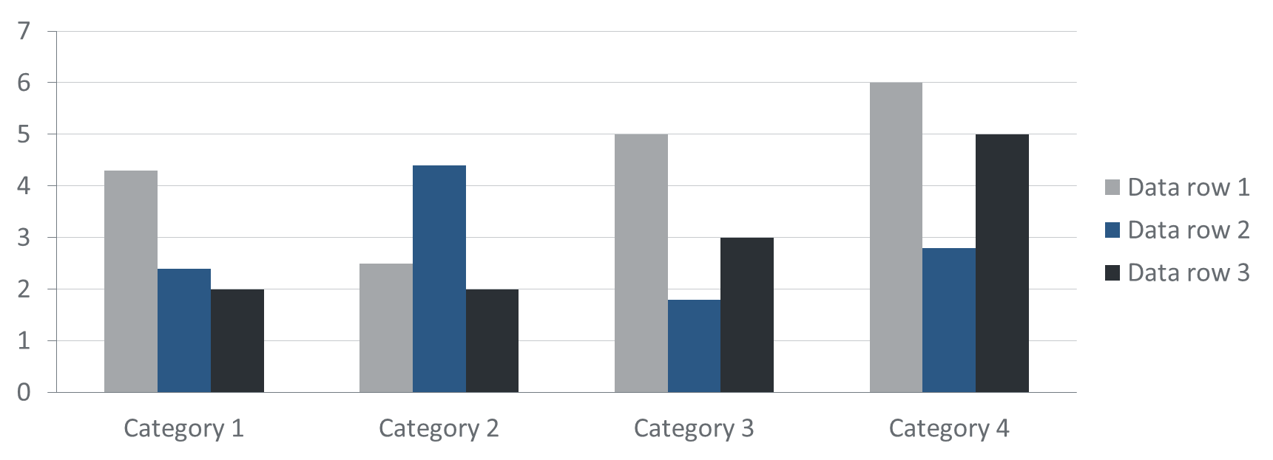
Headline Histogram

Slide 29
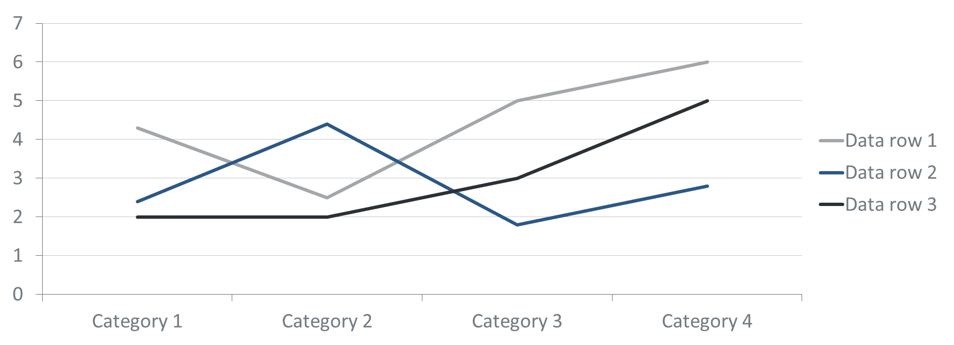
Headline Line Chart

Slide 30
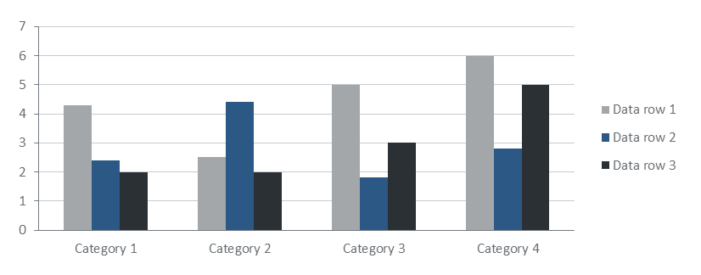

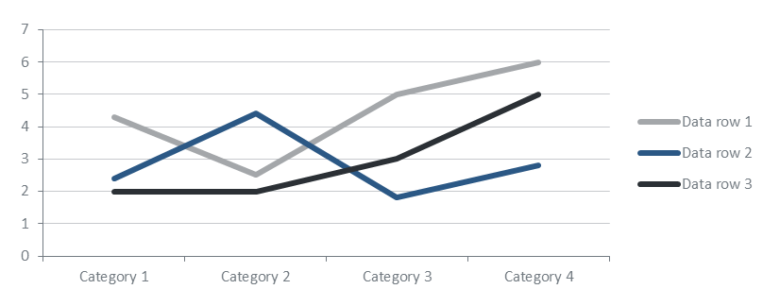
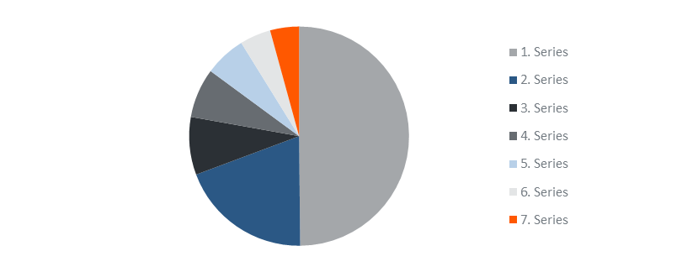
Headline Chart Overview

Slide 31
Headline Table
 | Column 1 | Column 2 | Column 3 | … | …
Row 1 | Content | Content | Content | … | …
Row 2 | … | … | … | … | …
Row 3
Row 4
Row 5
…
…

Slide 32
Headline Table
 | Column 1 | Column 2 | Column 3 | …
Row 1 | Content | … | … | …
Row 2 | … | …
Row 3
Row 4
Row 5
Row 6

Slide 35
CO-BRANDING SLIDES - ONLY FOR INTERNAL USE!
A set structure in regards to presentation and naming is available for logos of internal programs and projects.
This can be created or adapted in the slide master.
The usage for external business partnering is prohibited specifically.
In this particular case please contact the marketing department.
See Brand Portal for more information about Co-Branding.

Slide 36
CO-BRANDING SLIDES - ONLY FOR INTERNAL USE!
A set structure in regards to presentation and naming is available for logos of internal programs and projects.
This can be created or adapted in the slide master.
The usage for external business partnering is prohibited specifically.
In this particular case please contact the marketing department.
See Brand Portal for more information about Co-Branding.

Slide 37
CO-BRANDING SLIDES - ONLY FOR INTERNAL USE!
A set structure in regards to presentation and naming is available for logos of internal programs and projects.
This can be created or adapted in the slide master.
The usage for external business partnering is prohibited specifically.
In this particular case please contact the marketing department.
See Brand Portal for more information about Co-Branding.

Slide 38
CO-BRANDING SLIDES - ONLY FOR INTERNAL USE!
A set structure in regards to presentation and naming is available for logos of internal programs and projects.
This can be created or adapted in the slide master.
The usage for external business partnering is prohibited specifically.
In this particular case please contact the marketing department.
See Brand Portal for more information about Co-Branding.

Slide 39
CO-BRANDING SLIDES - ONLY FOR INTERNAL USE!
A set structure in regards to presentation and naming is available for logos of internal programs and projects.
This can be created or adapted in the slide master.
The usage for external business partnering is prohibited specifically.
In this particular case please contact the marketing department.
See Brand Portal for more information about Co-Branding.

Slide 40
CO-BRANDING SLIDES - ONLY FOR INTERNAL USE!
A set structure in regards to presentation and naming is available for logos of internal programs and projects.
This can be created or adapted in the slide master.
The usage for external business partnering is prohibited specifically.
In this particular case please contact the marketing department.
See Brand Portal for more information about Co-Branding.

