Slide 1

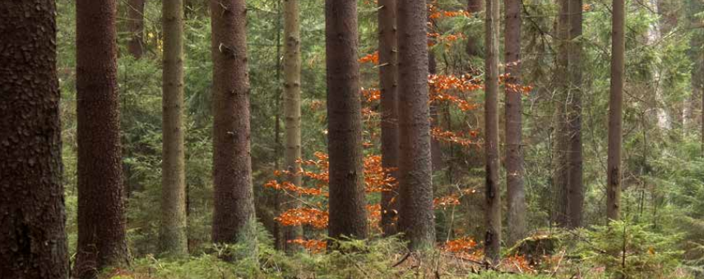
Final Project Presentation: Nkansah-Tieku Dennis
BOOTCAMP
Title: Tree Volume Prediction

Slide 2
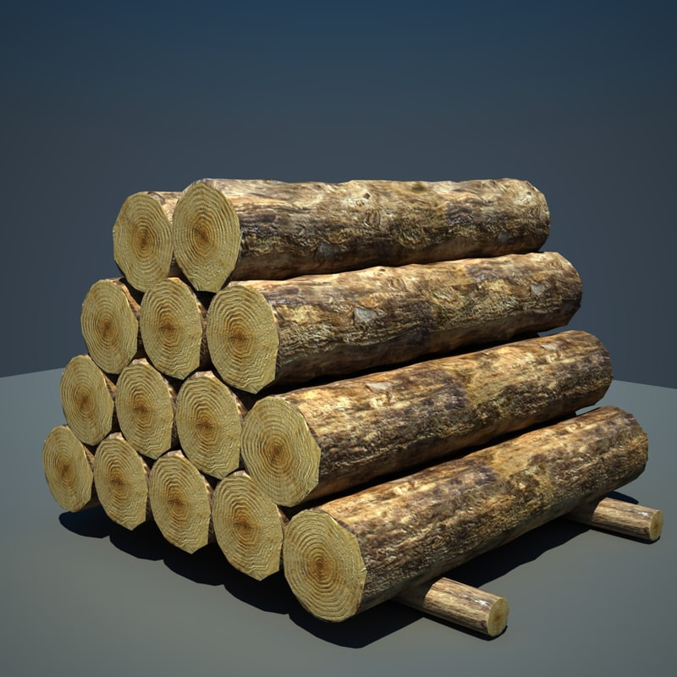
Background
The objective set out in this project is to be able to predict the volume of a given tree species based other features.
Holding other wood qualities constant, timber prices is determined based on its volume and therefore this feature is important for Forester and investors.

Slide 3
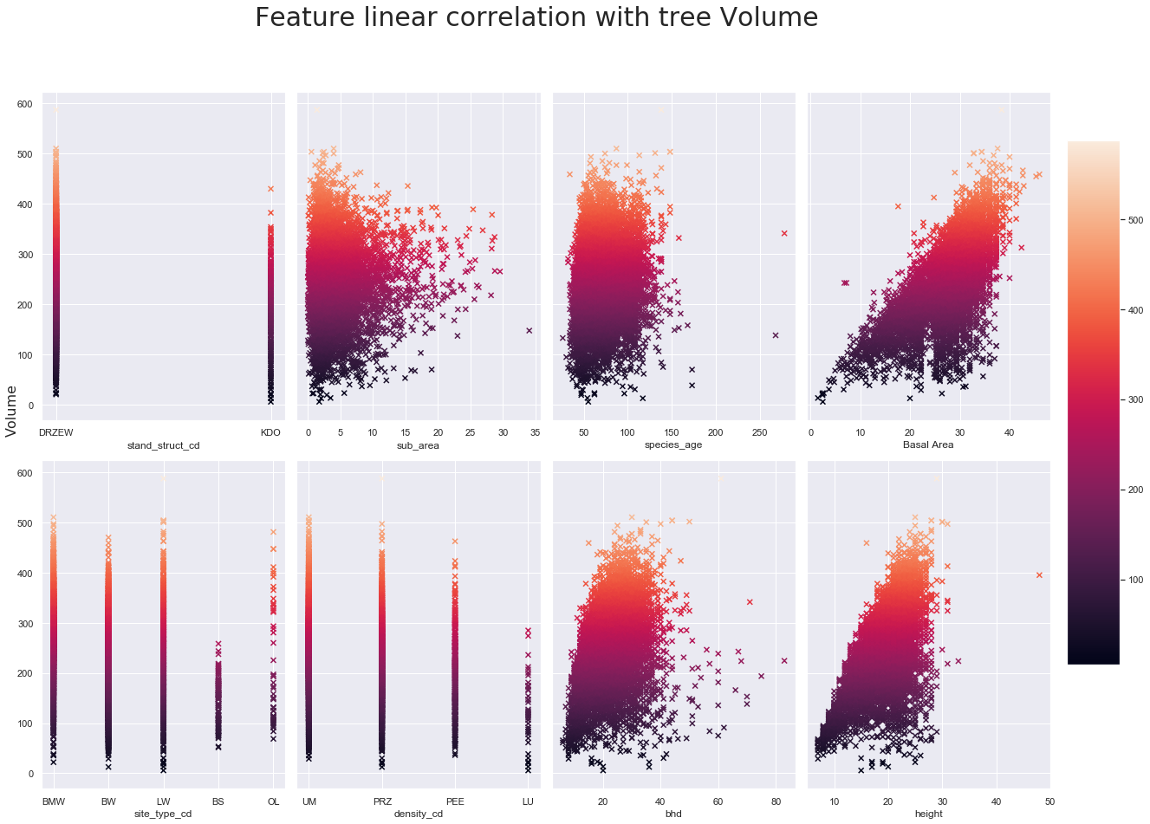
Data Exploration

Slide 4
Feature Selection
RFE
Selected all features ranked as 1
23 features obtained
RFR
Obtained mean best score of 0.935
Grid Search
Used for best parameters search
23 features obtained for the given mean score

Slide 5
Conclusion;
Height and basal area are the best predictors.
It was an interesting observation that species age did not have much influence on the volume of wood product of the tree species.

