Slide 1

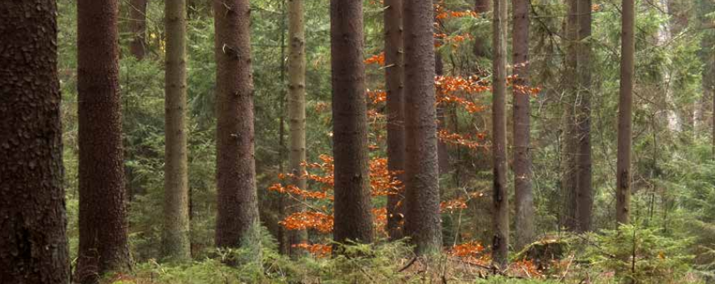
Final Project Presentation: Nkansah-Tieku Dennis
BOOTCAMP
Title: Tree Volume Prediction using Linear Regression

Slide 2
Background
The objective set out in this project is to be able to determine the volume of a given tree species based other features.
Holding other wood qualities constant, timber prices is determine based on its volume and therefore this feature is important for Forester and investors.
This information will provide guidance to investors in deciding the particular species type(s) and

Slide 3
Data Exploration
Features
Adress_forest
Stand_struc
Sub_area
Site_type
Storey
Density
Standdensity
Species
Species_rank
Part_cd
Species_age
Bhd
Height
Basal_area
Volume

Slide 4
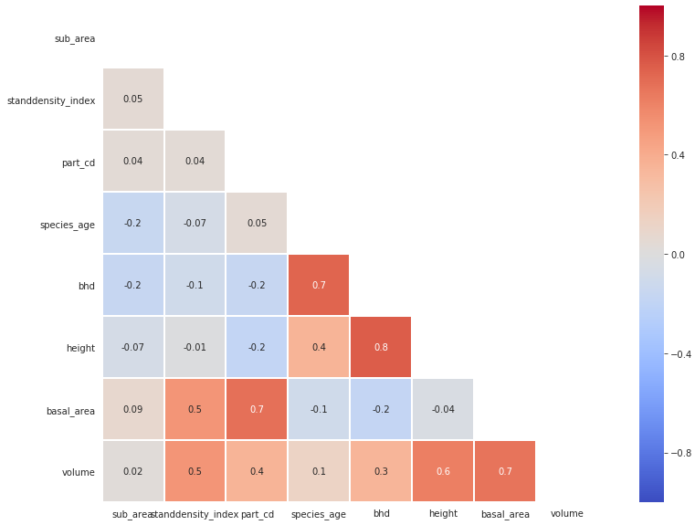
Data Exploration

Slide 5
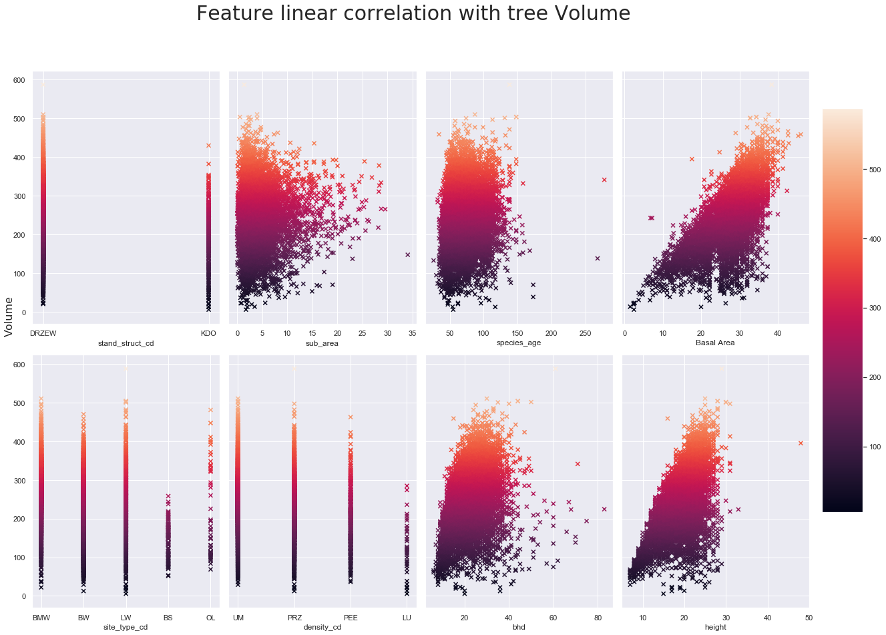
Data Exploration

Slide 6
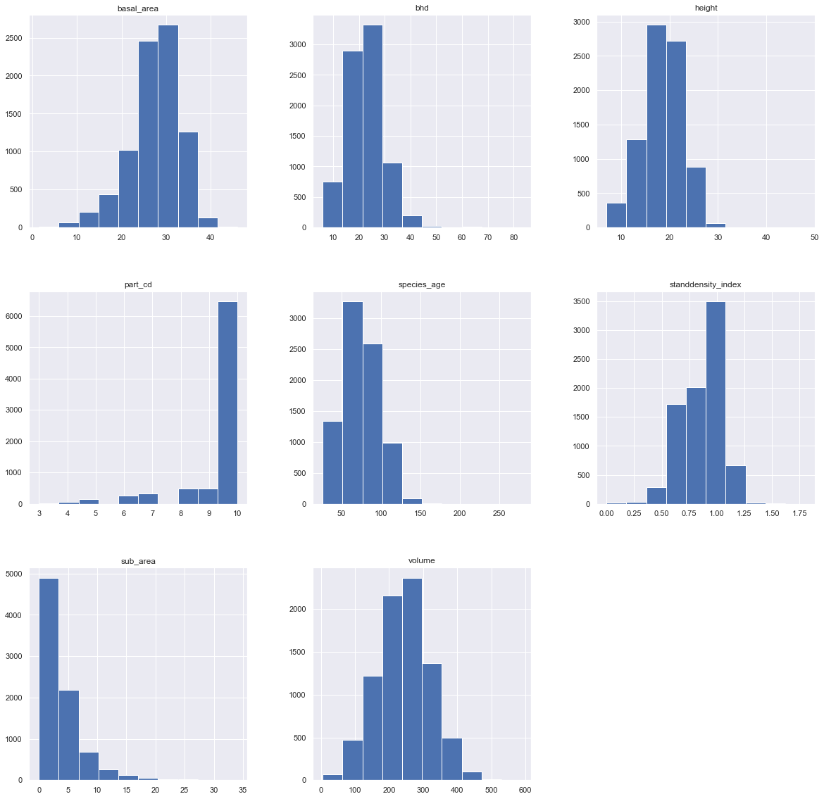
Data Exploration

Slide 7
Feature Selection
RFE
Selected all features ranked as 1
23 features obtained
RFR
Obtained mean best score of 0.935
Grid Search
Used for best parameters search
23 features obtained for the given mean score

Slide 8
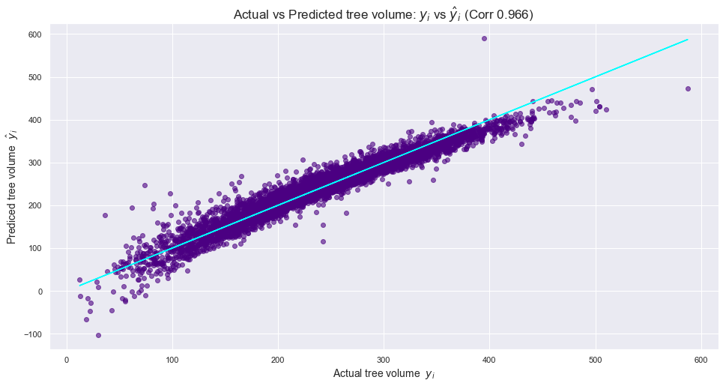
Model Validation
Linear Regression
R-squared: 0.928
MAE score: 14.571
MSE score: 411.319
Support Vector Regression (SVR)
Mean absolute error: 45.07
Mean squared error: 3842.55
Root mean squared error: 61.99
R2: 0.37

Slide 9
Conclusion;
Height and basal area are the best predictions.
It was an interesting observation that species age did not have much influence on the volume of wood product of the tree species.

