Slide 1
Group 003 Product Vision
Mathew Seng, Amar Vukovic, Daniel Kelly, Gabriel Douglass

Slide 2
Overview of Product
Communication management system between Graduate College and prospective graduate students

Slide 3
Why our product is needed
Currently, the graduate program coordinator for each department stores prospective graduate student information in an Excel sheet
No on-campus resource is currently available to manage this information more effectively
Simpler and more intuitive solutions are desired
Organization of existing solution can be improved upon
Faster communication with prospective graduate students can be achieved
A lot of potential for automating certain features

Slide 4
What our product will do
Provide a UI for faculty to upload, retrieve and contact prospective Graduate Students
Faculty Login and Logout
Upload existing Excel spreadsheets into a central database
Easily build custom queries
Mass emailing for queried students
Custom email templates
Logging of communication with prospective students

Slide 5
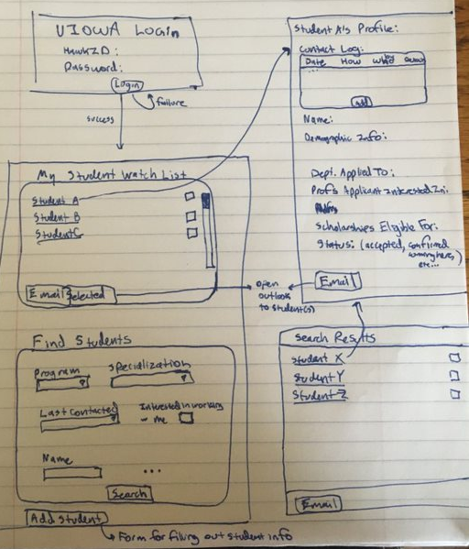
What our product will do

Slide 6
What are the alternatives?
Manually entering prospective graduate students and their information into Microsoft Excel and pulling contact information for specific needs
Manually searching through emails to find previous correspondences with students

