Slide 1
Group 3 Test Plan
Mathew Seng, Amar Vukovic, Daniel Kelly, Gabriel Douglass

Slide 2
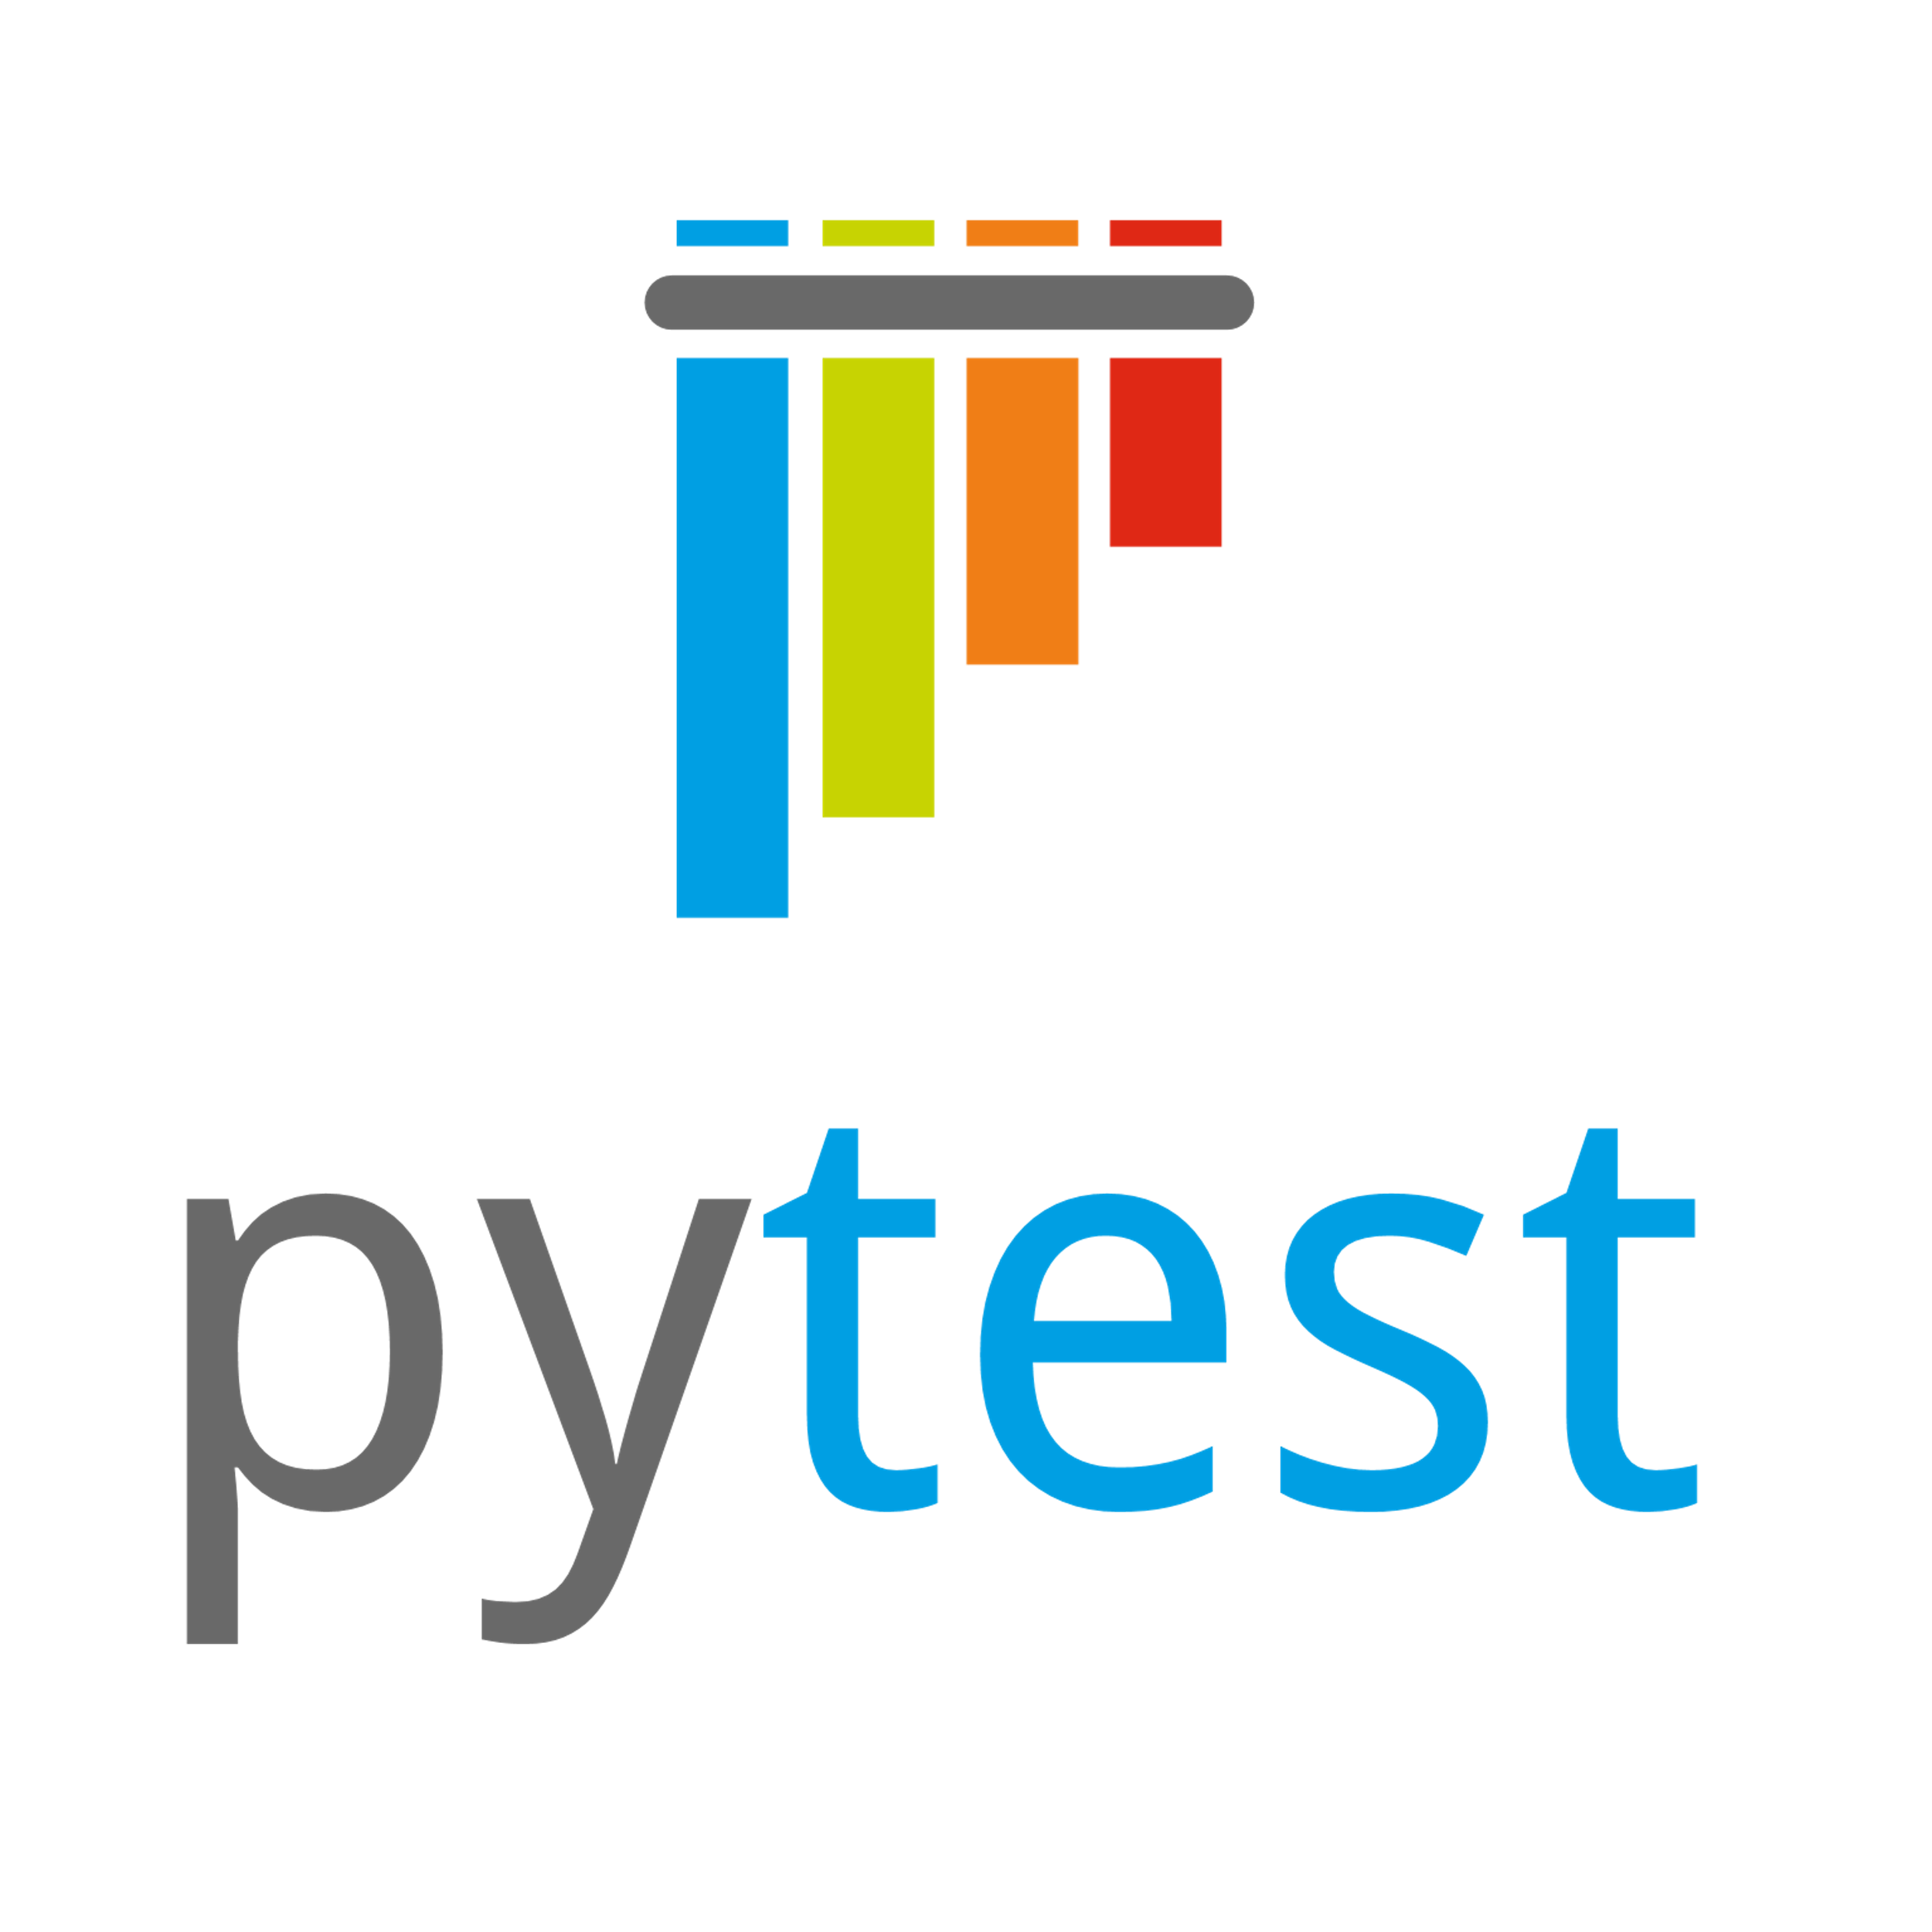


Testing Tools
TDD
pytest
pytest-django
BDD
pytest-bdd
Selenium
Coverage
pytest-cov
CI
GitHub Actions

Slide 3
Types of Testing
Unit Testing (pytest, pytest-django)
Integration Testing (pytest-bdd, Selenium)
Regression Testing (CI pipeline)
Acceptance Testing (pytest-bdd, Selenium)

Slide 4
Testing Responsibilities
Developers are expected follow red-green-refactor TDD procedure
For a feature to be merged into main branch it should have at least 90% code coverage as measured by pytest-cov
Each feature must have an associated pytest-bdd feature and comprehensive set of scenarios
Team members reviewing the PR for the feature will consider if the pytest-bdd feature and scenarios are thorough enough as part of each PR review
All team members must review and approve each pull request

Slide 5
Feature Acceptance Criteria & Process
1. Ensure each user story has well defined acceptance criteria (at beginning of sprint when stories are assigned)
2. When first iteration of story done being worked on, PR created and moved to Review/QA swim lane in ZenHub
3. Acceptance criteria verified by the Product Owner, story approved and issue closed or returned to assignee
4. Completed features will be shown to client when client is available, and requested changes will become new user stories

Slide 6
Questions?

