Slide 1
Unit Testing and U
TestingPresentation_RefreshesBestPractices_YieldsMoreTestCoverage
Notes:
Wasn’t really sure what unit testing was when I first started programming.
Figured if I wrote code carefully enough, I didn’t need it—or I could just find the bugs as they arose

Slide 2

Notes:
What’s the worst that could happen?

Slide 3
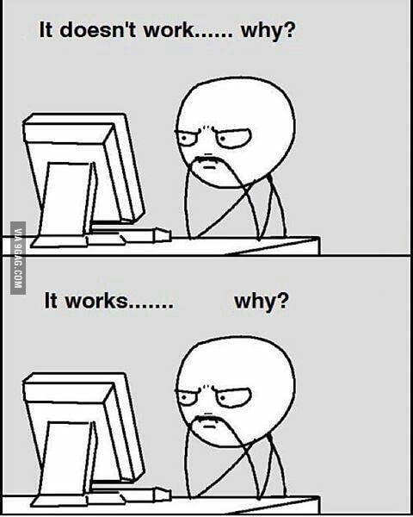
Debugging code…
…Doesn’t have to feel like this!
Notes:
But without unit tests—it can take a very long time to realize where your code is breaking and why.

Slide 4
What’s coming up…
Why we test
When to test
What to test
Dos and Don’ts
How to test
Best practices
Examples
Tools for testing
Notes:
So by now, all of us know what unit testing is.
This may only serve a as refresher, but maybe you’ll learn something new
And if you’re already doing everything—give yourself a pat on the back!

Slide 5
Why we Test

Slide 6
Why we test It makes your life easier
Confirms that your code actually works as you write it
Confirms that your code still works if (… when) you change it
Helps define the problem in sizeable chunks
Encourages better design and architecture
Documents code
More importantly… It makes MY life easier
Notes:
No assumptions and hopefully no sneaky bugs
Refactoring is good—unit tests encourage and empower us to do this
Helps contextualize the problem
Makes testing easier… if there are automated tests.

Slide 7
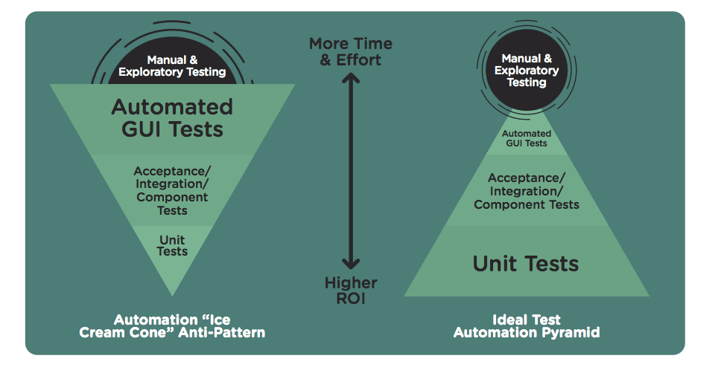
Easier life depicted on the right
Notes:
You want the most effort and coverage to go into unit tests up front
Even if it takes you weeks to write the perfect unit test… It’s taken care of for all future testing.
Unit test = individual code
Integration test = combined modules

Slide 8
When to Test
(ABT)

Slide 9


Slide 10
When to Test Always… Be… Testing
Ideally, write tests before writing code
Use the Red to Green rule
Use the tests to help you define the problem as manageable chunks
Found a bug? Write a test.
Notes:
Write a failing test first to limit false positives

Slide 11
What to Test

Slide 12
What to Test TEST ALL THE THINGS… not really, but sort of
Don’t…
Test multiple things at once (make separate tests)
Test private methods
Use other methods while testing a method (if you can help it)
Write tests that use external / uncontrollable resources (avoid if possible)
… And test everything else
Test a specific, desired output for a specific, intended input
Like the methods they test, tests should be single purpose
This is, after all, Unit Testing
Test every public method*
*But every public method should be performing one, specific task
Even if it seems unnecessary now, it might be a godsend later
If it seems complicated/difficult to test… consider refactoring the code
Notes:
Don’t use a system clock—use a mock for it
Don’t test against a real Db, mock out the data
Logging is a great example of a simple method that could fail for unexpected reasons

Slide 13
How to Test
Let’s make a calculator…

Slide 14
Testing Calculator (attempt 1)
What went wrong?
Testing multiple assertions
Not a unit test
Uses multiple methods in test
Test names aren’t clear
Variables for test cases could be better
Switches expected and actual results
No structure / not clear enough
We don't have a test case for every method (Reset)
Not serving as good documentation

Slide 15
Testing Calculator (attempt 2)
What’s still wrong?
Testing multiple assertions
Not a unit test
Uses multiple methods in test
Test results are dependent on other tests
Test names aren’t clear
Variables for test cases could be better
Switches expected and actual resultsjui
No structure / not clear enough
We don't have a test case for every method (Reset)
Not serving as good documentation
Notes:
-What if Reset() were broken?
-Using Assemble / Act / Assert will improve clarity, as will renaming test names
-All of which will serve as better documentation

Slide 16
Testing Calculator (attempt 3)
Pretty good, but what happens if we…
Use / mix negative numbers?
Divide by 0?
Use really, really, large numbers?
Use really, really small numbers or lots of decimals?
In other words, don’t just test what you know works. Find the edge cases

Slide 17
Tools for Testing

Slide 18
Tools for testing NUnit Attributes to Know
Attributes you should use
TestFixture
TestFixtureSetUp / OneTimeSetUp (newer versions of NUnit)
TestFixtureTearDown / OneTimeTearDown (new versions of NUnit)
SetUp
TearDown
TestCase
TestCaseSource
ExpectedException
MaxTime
Attributes you should try not to use
Order
Ignore
Random
Notes:
Attribute Test > TestCasesExample

Slide 19
Tools for testing
Moq
Make mocks of any class (that inherits from an interface) whose behavior you want to control
Refactor classes into interfaces when it makes sense
Can override properties and return values of methods
Factories
Create factories for any repetitive or cumbersome setups
Notes:
We talked earlier about not using external resources if possible – Mock it up!
AlarmTest
Factories = PushJobFetcherTests

Slide 20
Tools for testing (cont’d)
Visual Studio Test Explorer filter feature
Filter using drop-down or search-syntax
(class, project, error message, output, outcome, filepath)
FluentAssertions
Provide more semantic, chainable assertion statements
string actual = "ABCDEFGHI";
actual.Should()
.StartWith("AB")
.And.EndWith("HI")
.And.Contain("EF")
.And.HaveLength(9);
Notes:
Filter using drop-down or search-syntax (class, project, error message, output, outcome, filepath)

Slide 21
Testing Frameworks
NUnit, XUnit, and MSTest

Slide 22
Testing Frameworks C# Testing frameworks and libraries
NUnit (what we use for most of our code)
+ Most popular
+ Can include arguments with test cases
XUnit (what we use for LIB / Nuget)
Uses Facts/Theories approach
MSTest
+ Built into Visual Studio
+ Simple setup and integration
- Not as performant

Slide 23
Testing Frameworks Setting up NUnit
Visual Studio > Tools > Extensions and Updates
Online > Search “NUnit“
NUnit2 Test Adapter (version 2.6.4)

Slide 24
XUnit Syntax
Facts and Theories

Slide 25
XUnit Syntax (Facts)
Facts are tests that have no inputs
[Fact]
public void Add_TwoValuesGiven_ReturnsSumOfArguments()
{
var actual = Add(5, 10);
Assert.Equal(15, actual);
}

Slide 26
XUnit Syntax (Theories and Inline Data)
Theories are tests that have inputs (Inline Data)
[Theory]
[InlineData(5, 10)]
public void Add_TwoValuesGiven_ReturnsSumOfArguments(int num1, int num2)
{
var actual = Add(num1, num2);
Assert.Equal(15, actual);
}

Slide 27
Resources
https://github.com/nunit/docs/wiki/NUnit-Documentation
https://xunit.github.io/docs/getting-started-dotnet-core
http://fluentassertions.com/examples.html

