Slide 1

Vue.js
The progressive JavaScript framework
Notes:
1. Show App
2. Overview of framework
3. Design patterns
4 Criteria
-debugging experience
-reusability / modularity
-maintainability
-type safety
-performance

Slide 2
Why Vue?
Approachable
Easy to start if you already know HTML, CSS and JavaScript
Versatile
Can add view incrementally (just one div) and work your way up to using it within the entire web application
Performant
20KB min+gzip Runtime
Blazing Fast Virtual DOM
Minimal Optimization Efforts

Slide 3
Vue vs React
Both
utilize a virtual DOM
provide reactive and composable view components
maintain focus in the core library, with concerns such as routing and global state management handled by companion libraries
Vue
Automatically tracks which DOM elements need to re-render
No need for something like this.setState
No need for something like shouldComponentUpdate
HTML-based templates are easier to learn than JSX for the uninitiated

Slide 4
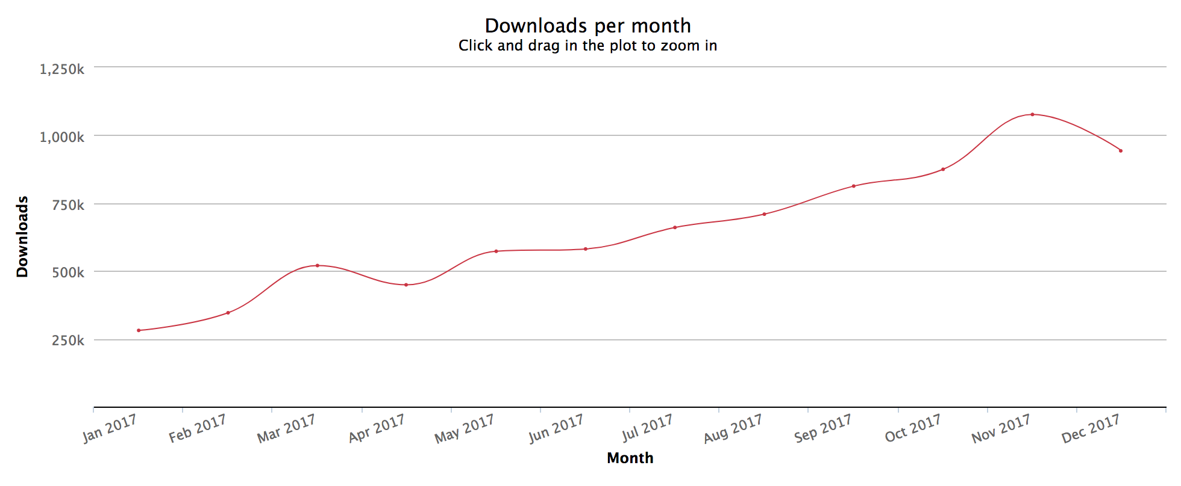
Framework popularity - Vue
Source: https://medium.com/javascript-scene/top-javascript-libraries-tech-to-learn-in-2018-c38028e028e6

Slide 5
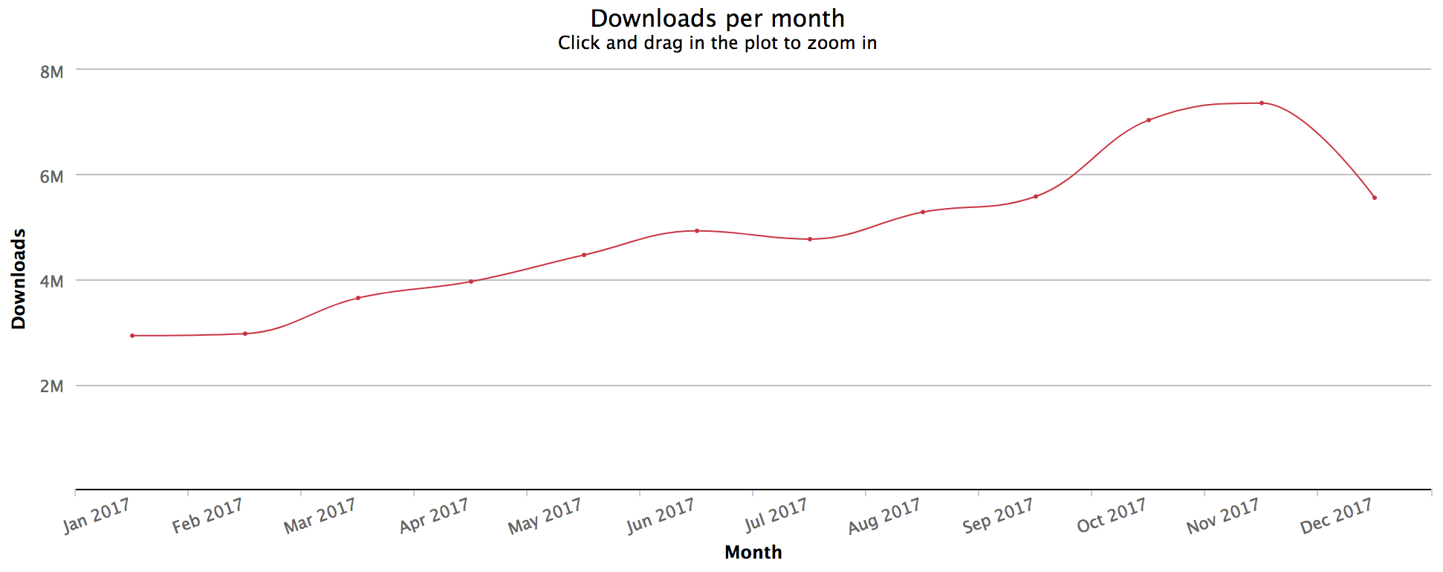
Framework popularity - React
Source: https://medium.com/javascript-scene/top-javascript-libraries-tech-to-learn-in-2018-c38028e028e6

Slide 6
Design Patterns
How to use Vue

Slide 7
Design Patterns – The Template
HTML-based template system
Use special tags to inject logic into the template:
v-bind
v-if / v-else if / v-else
v-show
v-on
@
Built-in transition-based tags

Slide 8
v-bind
Pass data to an element
If the data changes, the component or DOM element changes
v-if / v-else if / v-else: Provide expressions for rendering under certain conditions
v-show: Conditionally render something (like v-if, but more single-purpose)
v-on: Execute functions for specific events
@: Convenience shortcut for HTML event listeners:
@click, @input, @change, etc
v-enter, v-enter-active, v-enter-to, v-leave, v-leave-active, v-leave-to:
tags for css animations / transitions

Slide 9
Design Patterns – The Vue Instance
Defined in a script tag directly below the template
One Vue instance per file
Defined as a class which extends from the Vue class
Use decorators to describe various properties
Props, Event Emitters, Components, plus others
Lifecycle hooks to execute code at specific times
created, updated, beforeUpdate, mounted, etc
Single File Components using classes and property decorators are not the only way to Vue, but it’s the officially supported way to Vue with Typescript

Slide 10
Type safety
Intellisense, compile-time errors, and run-time errors

Slide 11
Type Safety in General
I rank what type safety provides in the following order:
Intellisense: catch bugs before they’re a problem
Compile-time errors: catch bugs before they affect users
Run-time errors (no type safety): catch bugs… eventually?

Slide 12
Type Safety in Vue
Class-level
You get complete type safety within each class (yay)
Intellisense while writing code
Compile-time errors if you break your type rules
Template-level
You get compiler errors for some things…
But you only get run-time errors for most things
Child-level
You only get run-time errors for mismatches between what the parent passes and what the child component expects
Prop-level
Type safety works for the most part, unless you have an Array of a specific type or a complex object that’s not a class

Slide 13
Debugging Vue

Slide 14
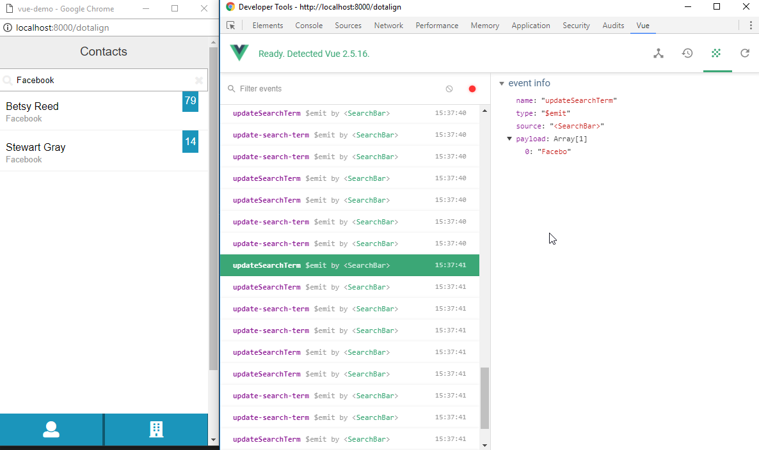
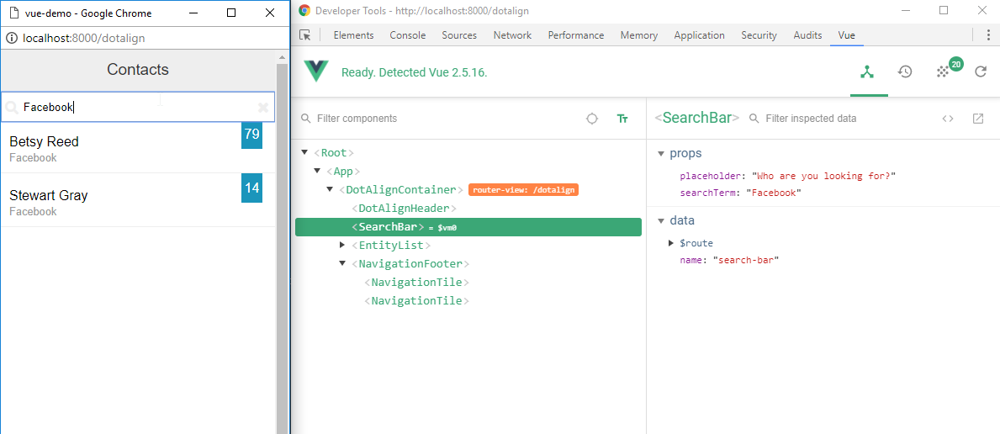
Debugging Vue
Typescript helps catch errors early
Chrome and Firefox plugins show Vue-specific elements, properties, events, and allow “time-travel” when using Vuex state management store

Slide 15
Debugging Vue – Unit Test
import Vue from 'vue' import MyComponent from 'path/to/MyComponent.vue' describe('MyComponent', () => { it('has a created hook', () => { expect(typeof MyComponent.created).toBe('function')
it('correctly sets the message when created', () => {
const vm = new Vue(MyComponent).$mount() expect(vm.message).toBe(‘Hello World') })

Slide 16
Reusability / Modularity
Components for the win

Slide 17
Reusability and Modularity
Vue allows for Single File Components
Can export, import, and use throughout the codebase
Typescript keeps portable components type safe and provides intellisense
Unfortunately, no awareness of property types and event emitters when creating templates

Slide 18
Maintainability

Slide 19
Maintainability
How easy is it to add functionality?
The patterns outlined by Vue make it easy to add functionality in a predictable way quickly
How difficult is it to add bad code?
Templates and convenience tags encourage writing sensible code
How difficult is it to break something on accident?
Without proper intellisense for props in the templates, and without parent/child awareness of props, there’s room for errors
Errors that only appear in the browser console can easily go unnoticed
How easy is it to read the code?
Templates are extremely human readable, free from clutter, and terse in their injected logic

Slide 20
Performance
Rendering contacts

Slide 21
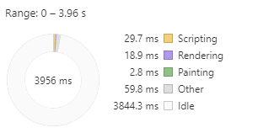
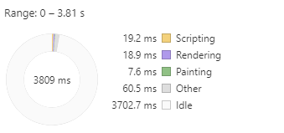
Performance
Rendering the contacts page: 18.9ms
Rendering updates to contacts page from search query: 18.9ms

Slide 22
Conclusion
It’s very quick and easy to get up and running with Vue
Convenience methods for common tasks keeps code minimal, organized, consistent, and quick to implement
Templates are usually clean, concise, and clear
Typescript functionality works great within the class-based, Single File Components, but…
Typescript intellisense is sorely missed within the actual template
Prop type safety is lacking (support isn’t great for Arrays or Objects)
Types and intellisense don’t track well between Parent and Child components

