Slide 1
UE20CS461A – Project Phase – 2
END SEMESTER ASSESSMENT
Project Title : Bimodal Detection Of Parkinson’s Disease
Project ID : 40
Project Guide : Prof. Vandana M L
Project Team : SHRUTESH REDDY L PES2UG20CS464
AKASH HARSHA HEGDE PES2UG20CS492
SUMANT KULKARNI PES2UG20CS469
MEGHANA N PES2UG20CS519

Slide 2
Outline
Abstract
Summary of Requirements and Design ( Phase - 1)
Summary of Methodology / Approach (Phase - 1)
Design Description
Modules and Implementation Details
Project Demonstration and Walkthrough
Test Plan and Strategy
Results and Discussion
Lessons Learnt
Conclusion and Future Work
References

Slide 3
Abstract
Parkinson’s disease have to be treated at an early stage to avoid severe conditions. So in our project we are trying to address this problem of detecting parkinson’s disease at an early stage to reduce severity of disease by using two machine learning models.
Timely diagnosis and adequate symptom management are imperative in dealing with Parkinson's disease.
The utilization of vocal and spiral drawing information has shown effectiveness in identifying Parkinson's disease.
The challenge at hand is to create a model based on machine learning that can identify Parkinson's disease with precise accuracy through vocal and spiral drawing datasets.

Slide 4
Summary of Requirements
Data: We have to ensure that the spiral dataset we collected will be correctly labelled as parkinson and non-parkinson and for the vocal dataset all the labels should be correct.
Models: We have to ensure that we are using the models efficiently with the dataset we chose for that with the inbuilts like tensorflow or PyTorch.
Data preprocessing and feature integration : We have to use correct preprocessing steps to ready the dataset for training and validation and we have to correctly integrate the features of both the models for final classifier.
Evaluation metrics : Choosing the correct evaluation metrics for the project is essential . Choose the correct metric that suits for your project like accuracy , F1 score, precision or recall.

Slide 5
Summary of Requirements
Testing and validation : Choosing correct and sufficient portion of the data for testing and validation is important. Choose portion of the data using splitting method.
Testing on new data : After training, test your models on new, unseen data to assess their real-world performance.

Slide 6
Background Review
Literature Review : Identifying and analyzing the successful models and studies that achieved accurate results is the strength and exploring the limitations and the challenges faced in the previous research is the weakness in this section.
Methodologies : Analyzing and highlighting the methodologies used in previous work like high-level neural networks, novel approaches for integrating the data and the major weakness would be the limitations in the methodologies like overfitting, sensitivity to noise or computational complexity.
Dataset : Identify high-quality datasets that have been used successfully in similar projects. Recognize the importance of well-labeled and diverse datasets for training and testing. For this the weakness would be Address any shortcomings in available datasets, such as limited size, lack of diversity, or potential biases.

Slide 7
Background Review
Integration of modalities : Looking for the successful integration techniques for the two datasets like fusion techniques, multi-modal architectures, or feature-level integration. Here the major issue would be aligning temporal aspects of different modalities or handling missing or noisy data.

Slide 8
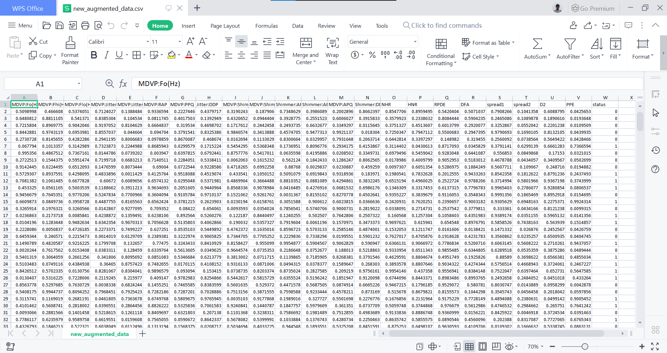
Dataset
Vocal Dataset :

Slide 9
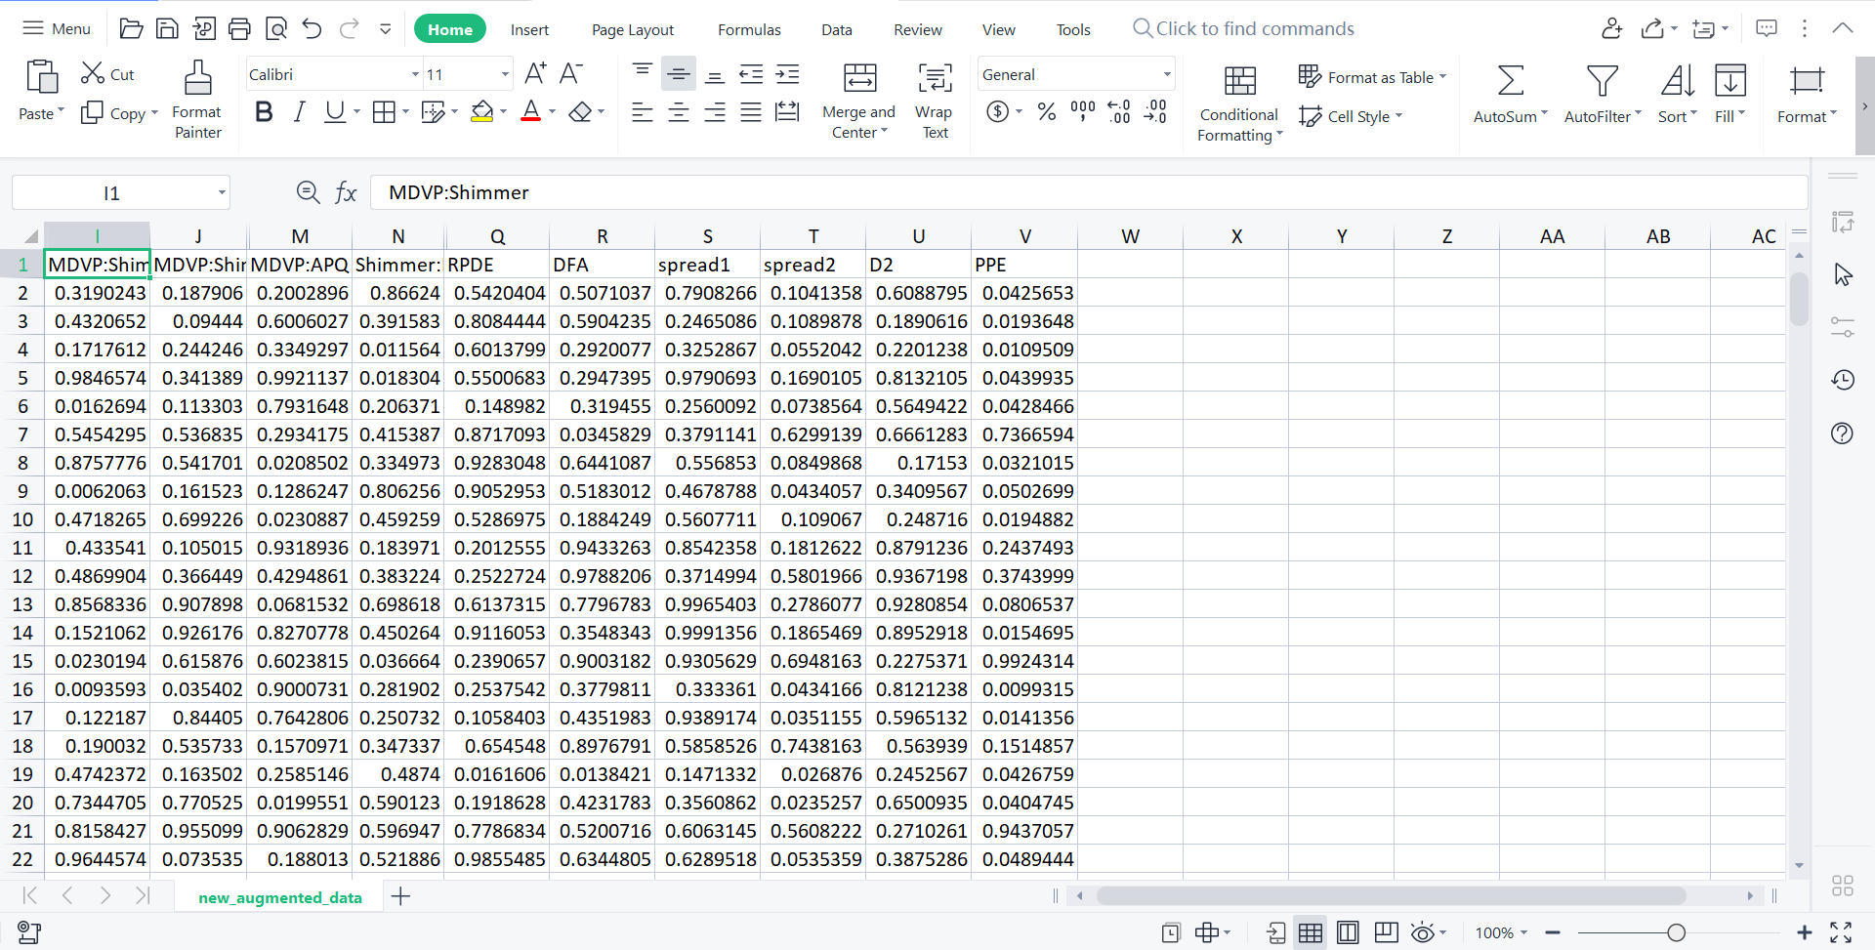
Dataset
Vocal Dataset after feature extraction :

Slide 10
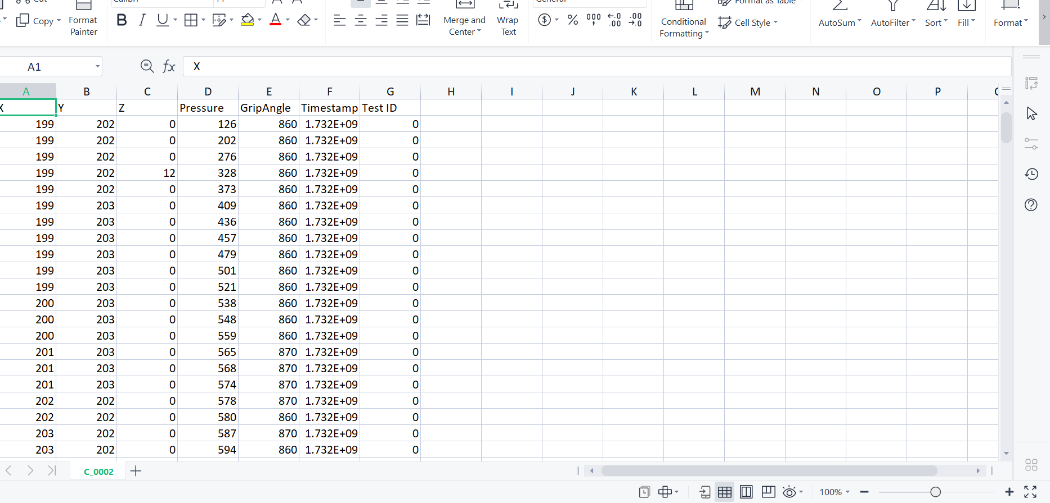
Dataset
Spiral Dataset

Slide 11
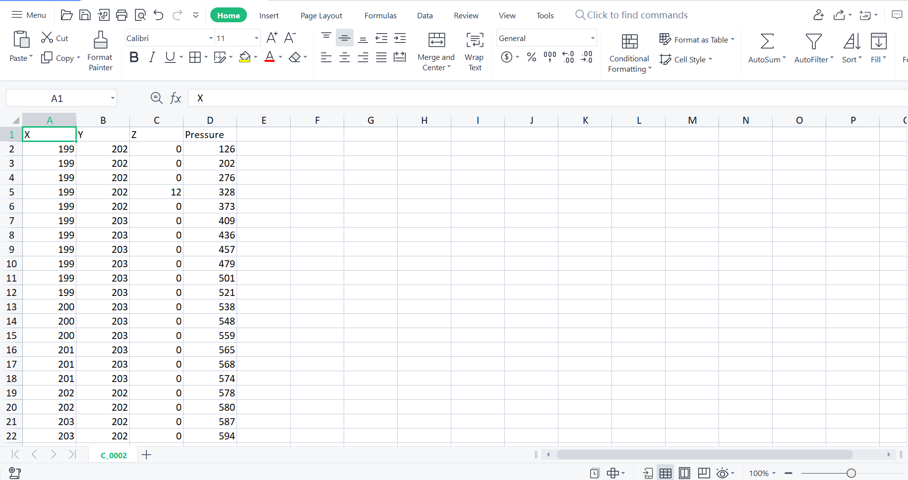
Dataset
Spiral Dataset after feature extraction :

Slide 12
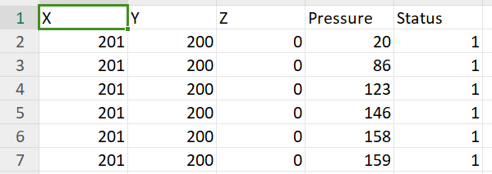
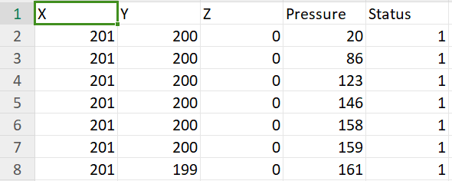
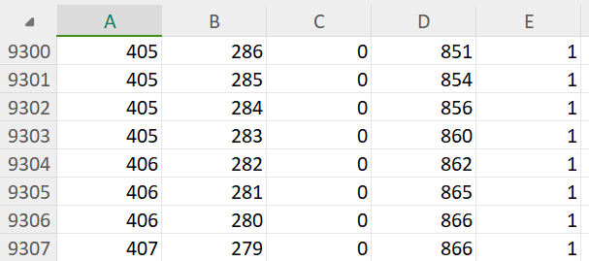
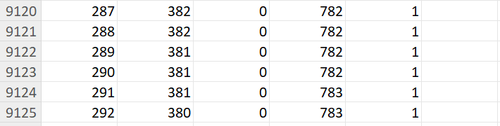
Dataset
Spiral Data before Time series normalization:
Person 1: Person 2:
.
.
.
.

Slide 13
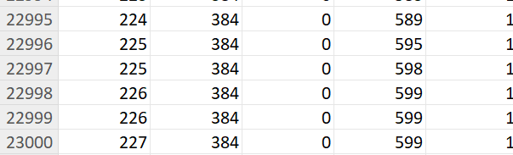
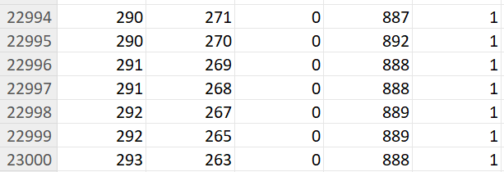
Dataset
Spiral Data after Time series normalization:
Person 1: Person 2:
.
.

Slide 14
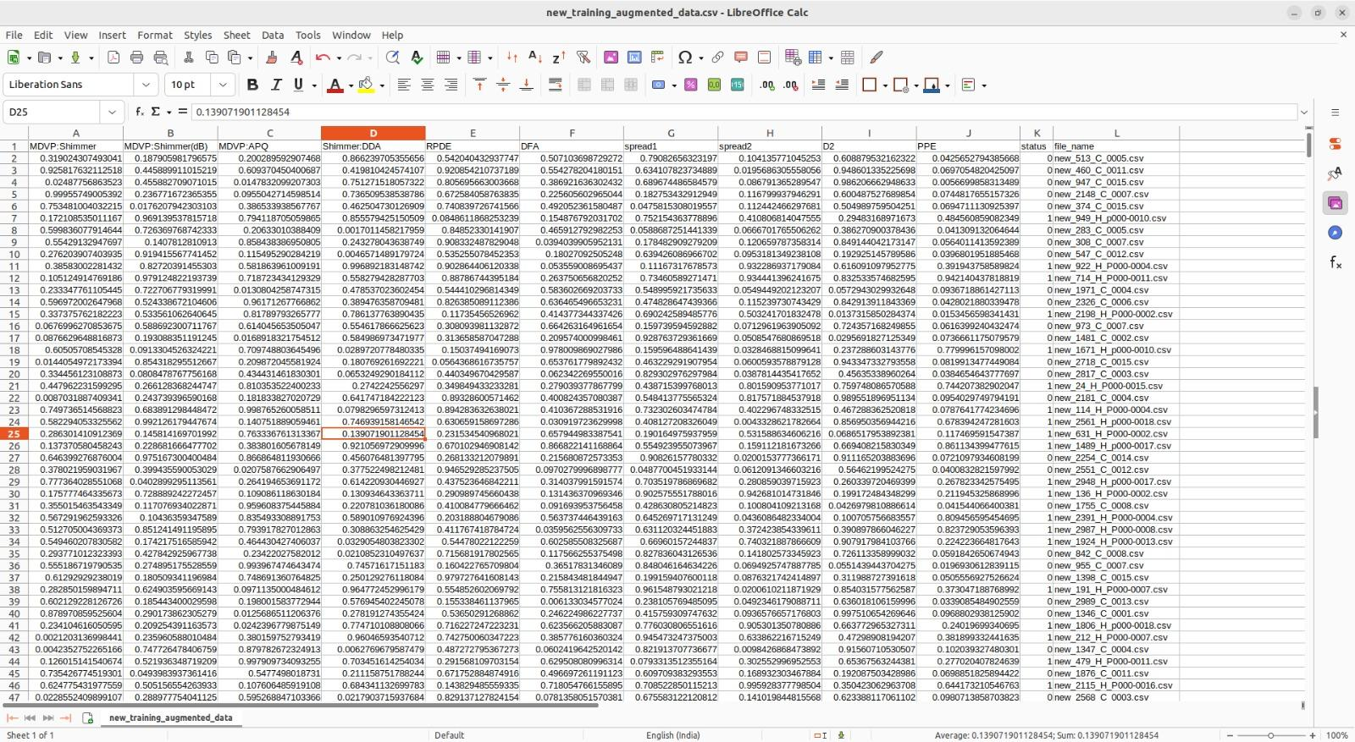
Dataset
Fused dataset :

Slide 15
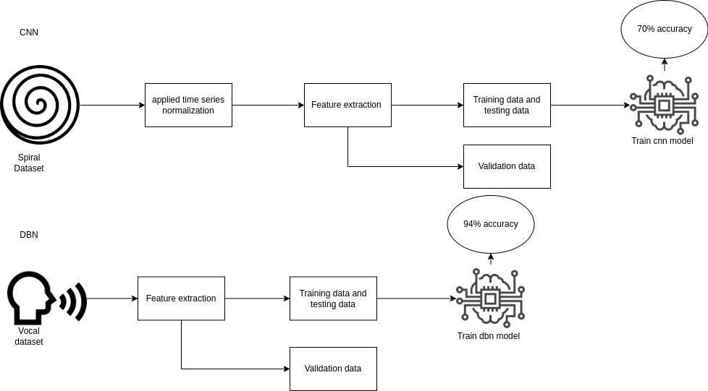
DBN & CNN

Slide 16
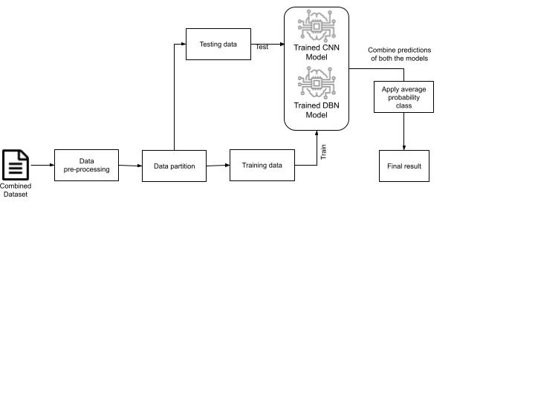
Ensemble

Slide 17
Explored Models
CNN is trained using only spiral dataset and got accuracy if 70%
DBN is trained using only Vocal dataset and got accuracy of 93%
Ensemble model
CNN is trained using fused dataset and got accuracy of 70%
DBN is trained using fused dataset and got accuracy of 97%
The ensemble model gave accuracy of 70%
So we concluded that DBN outperforms only CNN and ensemble model and gives higher accuracy

Slide 18
Design Details
Data Preprocessing : This stage includes cleaning of the dataset that means removing the outliers, removing the noise etc.Next is normalizing and scaling the input data for consistency.
Cnn for spiral data : This stage includes training the spiral dataset by using the method called capsule neural network and for testing and validation also cnn is used.
DBN for vocal data : Here we are using DBN model for training the vocal dataset with testing and validation.
Feature Integration : Here we are combining the features of both the datasets.

Slide 19
Design Details
Applying the ensemble model : In this stage we are applying the ensemble model for the integrated features and getting the result.
Testing and validation : Here we are Reserving a portion of our dataset for testing and validation to ensure the real-world performance of our designed system.

Slide 20
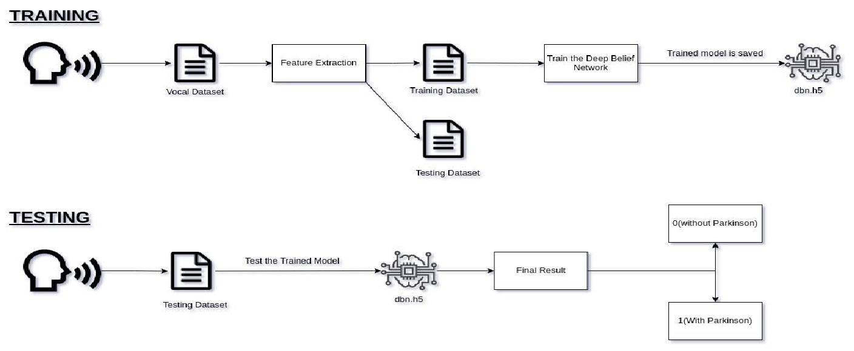
Design Description
DBN ARCHITECTURE:

Slide 21
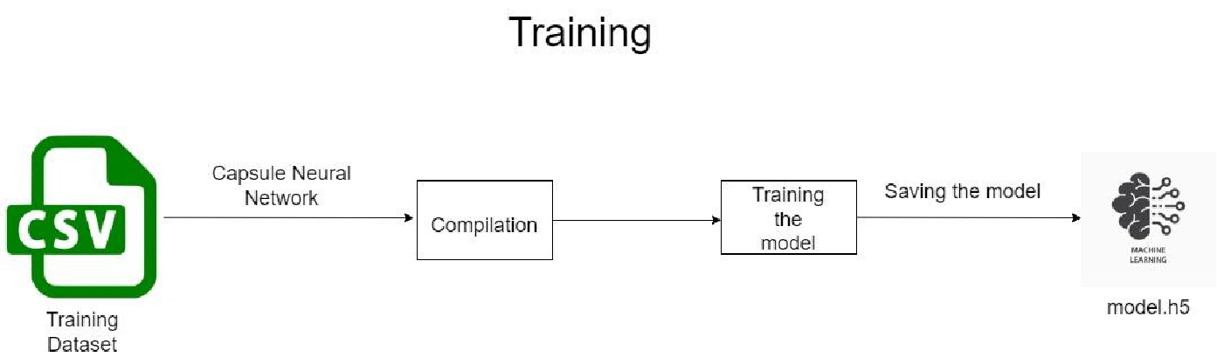
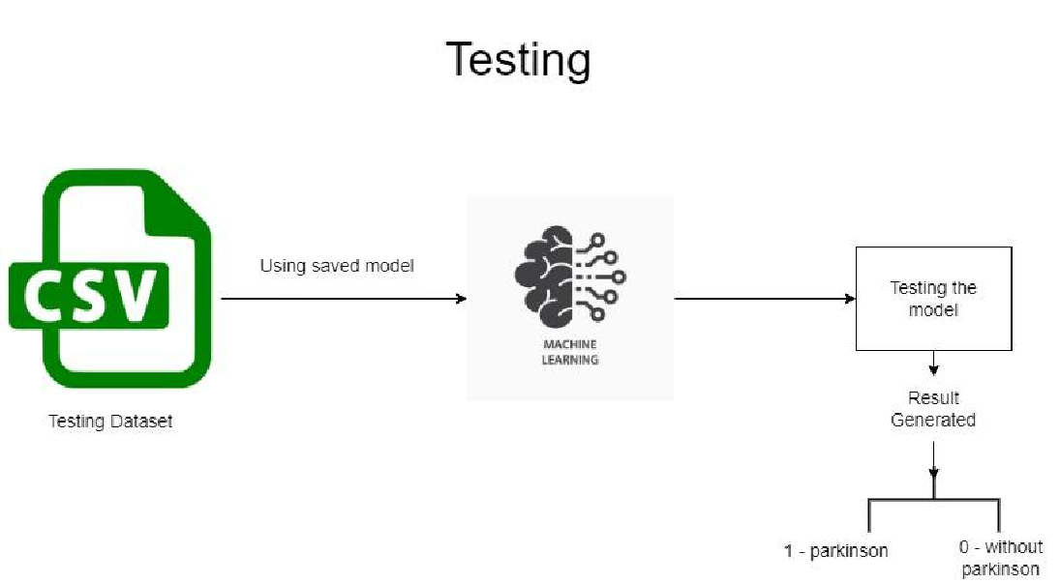
Design Description
CNN ARCHITECTURE:

Slide 22
Design Description
CNN ARCHITECTURE:
The network begins with an input layer that takes an image as input, similar to Convolutional Neural Networks (CNNs).
Instead of traditional max-pooling layers, CapsuleNets utilize Primary Capsules to represent low-level features and capture spatial relationships within local image regions.
The core of the architecture, this layer comprises capsules, each responsible for recognizing specific entities or features in the image.
Capsule layers employ a dynamic routing algorithm that facilitates communication between capsules. This mechanism enables capsules to reach consensus on predictions while accommodating pose variations.

Slide 23
Design Description
DBN ARCHITECTURE:
It is a type of artificial neural network architecture that is composed of multiple layers of Restricted Boltzmann Machines.
Each RBM layer comprises two types of nodes: visible units and hidden units.
The output of one trained RBM is then used as the input for the subsequent RBM.

Slide 24
Benefits of Proposed Methodology
Comprehensive Information Utilization: The use of both spiral and vocal data provides a holistic view of the patient's condition, potentially capturing diverse aspects of Parkinson's disease.
Potential for Improved Accuracy: Bimodal fusion has the potential to enhance the overall accuracy of the model by combining the strengths of each modality.
Interpretability Measures: Incorporating interpretability measures ensures transparency in the decision-making process, vital for gaining acceptance in medical settings.

Slide 25
Drawbacks of Proposed Methodology
Integration Challenges: Determining the optimal way to integrate features from different modalities is non-trivial and may require extensive experimentation.
Computational Intensity: Training capsule networks and deep belief networks can be computationally intensive, requiring access to powerful hardware resources.
Risk of Overfitting: Given the complexity of the models and the potential high dimensionality of the feature space, there's a risk of overfitting, especially if regularization techniques are not carefully applied.
Ethical and Privacy Concerns: Dealing with health-related data necessitates careful consideration of ethical and privacy concerns, requiring robust measures to protect patient information.

Slide 26
Algorithm of DBN
For the raw data , we have applied the wrapper method for extracting the the useful features that are required for our research.
From that we extracted 10 main features for the analysis.
Next we used DBN model for the training . There we used RBM layers for the deep analysis of the features.
From that we saved the model for next validation and testing.

Slide 27
Algorithm of DBN
We validated the data with the saved model and got pretty good accuracy.
Next process is the testing process, there we tested across the dataset with the saved model.

Slide 28
Pseudocode of DBN
Step 1 :
Initialize DBN
Initialize dbn layers()
Step 2:
Pre-training of RBM layers
for each rbm_layer in dbn_layers[:-1]:
Initialize rbm(rbm_layers)
train_rbm(rbm_layers,training_data)

Slide 29
Pseudocode of DBN
Step 3 : Fine tuning the entire DBN
Initialize fine_tuning_parameters()
for each epoch in fine_tuning_epochs:
for each training_example in training_data:
forward_pass(training_example)
backward_pass(training_example)
update(parameters)
Step 4 : Make predictions
for each test_example in test_data:
predict = predict(test_example)

Slide 30
Algorithm of CNN
Convolutional Neural Network (CNN) is used for binary classification.
Input data consists of time-series sequences (CSV files) from two classes: "Parkinson" and "Without Parkinson.
Data preprocessing includes data loading, normalization (MinMax scaling), and splitting into training and testing sets.
CNN architecture with Conv1D layers and Dropout layers is used for feature extraction and classification.
The model is trained using binary cross-entropy loss and the Adam optimizer.

Slide 31
Pseudocode of CNN
Step 1: Initialize capsule network
initialize capsule_network()
Step 2 : Primary capsule layer
for each primary_capsule in primary_capsule_layer:
compute_primary_capsule_activation(input_data)
Step 3: Capsule Layer(s)
for each routing_iteration in max_routing_iterations:
for each capsule_i in capsule_layer:
for each capsule_j in next_layer_capsules:
compute_routing_weight(capsule_i, capsule_j)
update_coupling_coefficients()

Slide 32
Pseudocode of CNN
Step 4: Pose Prediction
for each capsule in output_layer:
compute_final_pose(capsule)
Step 5: Loss Calculation
compute_loss()
Step 6: Backpropagation
backpropagate_gradients()
Step 7: Update Weights
update_weights()

Slide 33
Modules or Features of Application
Data Upload and Preprocessing
Data Visualization
Spiral data training using CNN
Vocal data Training using DBN
Feature Integration
Applying ensemble model
Evaluation and metrics module
Results and Reports
User Interface Design
Integrating UI and ML part

Slide 34

Walkthrough
CNN video demo:

Slide 35

Walkthrough
DBN video demo:

Slide 36
Walkthrough
Ensemble model video demo:

Slide 37
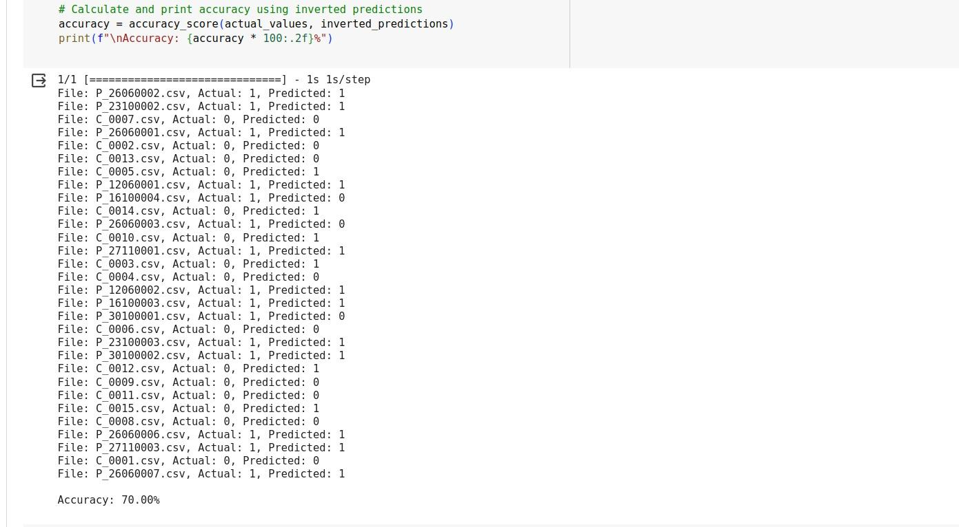
Walkthrough
CNN output screenshots:

Slide 38
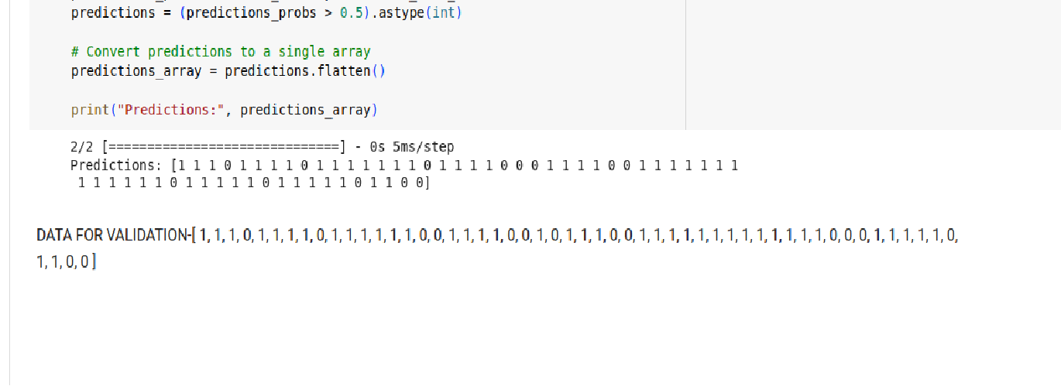
Walkthrough
DBN output screenshots:

Slide 39
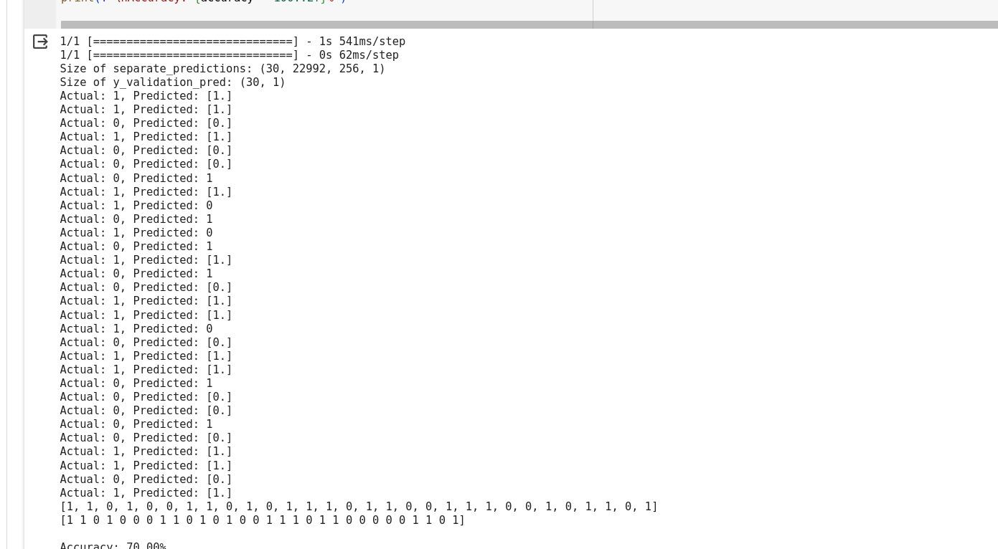
Walkthrough
Ensemble Model screenshots:

Slide 40
Results and Discussion
For DBN we got accuracy of 97%, as per the accuracy of the model, we got testing output.
For CNN we got accuracy of 70% in training, as per the accuracy of the model, we got testing output with accuracy of 70%.
For fused model we got 70% accuracy.

Slide 41
Results and Discussion
Yes, the results are same as expected. For unimodal of CNN we got accuracy of 70%.
For DBN we got 97% .
For Ensemble model we got accuracy of 70%.

Slide 42
Documentation
Project report submitted in department?
Yes
IEEE (similar) Format of Paper current status?
Yes, we completed

Slide 43
Documentation
Complete Project demonstration video :

Slide 44
Conclusion and Future work
Parkinson’s Disease is a neurological disorder that affects many people and it leads to death . So the main objective is to build a model so that it can detect the disease in the early stage and to help the patients to cure it.
For this we used two models and we got 97% accuracy in DBN model and 81.55% accuracy in CNN model.
The main challenge we faced here was to extract the features from the raw dataset. For that we used wrapper method as the solution.

Slide 45
Conclusion and Future work
From this, we learnt how the model works and how it trains and tests the data with the good result.
Patients can easily use this website for detection of the disease with ease.They just have to upload the voice recording and spiral drawing.
This project can be further improved by using the advanced AI tools for the prediction of the disease.

Slide 46
References
S. Aich, H. -C. Kim, K. younga, K. L. Hui, A. A. Al-Absi and M. Sain, "A Supervised Machine Learning Approach using Different Feature Selection Techniques on Voice Datasets for Prediction of Parkinson’s Disease," 2019 21st International Conference on Advanced Communication Technology (ICACT), PyeongChang, Korea (South), 2019, pp. 1116-1121, doi: 10.23919/ICACT.2019.8701961.
A. Ouhmida, O. Terrada, A. Raihani, B. Cherradi and S. Hamida, "Voice-Based Deep Learning Medical Diagnosis System for Parkinson's Disease Prediction," 2021 International Congress of Advanced Technology and Engineering (ICOTEN), Taiz, Yemen, 2021, pp. 1-5, doi: 10.1109/ICOTEN52080.2021.9493456.
K. M. M. Rao, M. S. N. Reddy, V. R. Teja, P. Krishnan, D. J. Aravindhar and M. Sambath, "Parkinson's Disease Detection Using Voice and Spiral Drawing Dataset," 2020 Third International Conference on Smart Systems and Inventive Technology (ICSSIT), Tirunelveli, India, 2020, pp. 787-791, doi: 10.1109/ICSSIT48917.2020.9214276.
H. N. Pham et al., "Multimodal Detection of Parkinson Disease based on Vocal and Improved Spiral Test," 2019 International Conference on System Science and Engineering (ICSSE), Dong Hoi, Vietnam, 2019, pp. 279-284, doi: 10.1109/ICSSE.2019.8823309.

Slide 47
References
J. Gandhi, A. Gadekar, T. Rajabally, P. Vinayakray-Jani and D. Ambawade, "Detection of Parkinsons Disease Via a Multi-Modal Approach," 2021 12th International Conference on Computing Communication and Networking Technologies (ICCCNT), Kharagpur, India, 2021, pp. 1-7, doi: 10.1109/ICCCNT51525.2021.9580135.

Slide 48
Thank You

