Slide 1
Reddit::Cache
October 2015

Slide 2


Slide 3

reddit

Slide 4
≠
reddit

Slide 5
“Haskell”

Slide 6
“Haskell”
“Pascal”

Slide 7
“Haskell”
“Pascal”
fib = 0 : 1 : zipWith (+) fib (tail fib)
program Fibonacci;
var
Fibonacci1, Fibonacci2 : integer;
temp : integer;
count : integer;
begin (* Main *)
writeln ('First ten Fibonacci numbers are:');
count := 0;
Fibonacci1 := 0;
Fibonacci2 := 1;
repeat
write (Fibonacci2:7);
temp := Fibonacci2;
Fibonacci2 := Fibonacci1 + Fibonacci2;
Fibonacci1 := Temp;
count := count + 1
until count = 10;
writeln;
end.

Slide 8
“Haskell”
“Pascal”
fib = 0 : 1 : zipWith (+) fib (tail fib)
program Fibonacci;
var
Fibonacci1, Fibonacci2 : integer;
temp : integer;
count : integer;
begin (* Main *)
writeln ('First ten Fibonacci numbers are:');
count := 0;
Fibonacci1 := 0;
Fibonacci2 := 1;
repeat
write (Fibonacci2:7);
temp := Fibonacci2;
Fibonacci2 := Fibonacci1 + Fibonacci2;
Fibonacci1 := Temp;
count := count + 1
until count = 10;
writeln;
end.

Slide 9

“Haskell”
“Pascal”
fib = 0 : 1 : zipWith (+) fib (tail fib)
program Fibonacci;
var
Fibonacci1, Fibonacci2 : integer;
temp : integer;
count : integer;
begin (* Main *)
writeln ('First ten Fibonacci numbers are:');
count := 0;
Fibonacci1 := 0;
Fibonacci2 := 1;
repeat
write (Fibonacci2:7);
temp := Fibonacci2;
Fibonacci2 := Fibonacci1 + Fibonacci2;
Fibonacci1 := Temp;
count := count + 1
until count = 10;
writeln;
end.

Slide 10
The Cache Namespace on CPAN

Slide 11
The Cache Namespace on CPAN
Cache::File

Slide 12
The Cache Namespace on CPAN
Cache::File
Cache::DBI

Slide 13
The Cache Namespace on CPAN
Cache::File
Cache::DBI
Cache::Redis

Slide 14
The Cache Namespace on CPAN
use Cache::File;

Slide 15
The Cache Namespace on CPAN
use Cache::File;
my $key = set($data);

Slide 16
The Cache Namespace on CPAN
use Cache::File;
my $key = set($data);
my $data = get($key);

Slide 17
The Cache Namespace on CPAN
use Cache::File;
my $key = set($data);
my $data = get($key);
my $bool = remove($key);

Slide 18
The Cache Namespace on CPAN
Cache::File
Cache::DBI
Cache::Redis

Slide 19
The Cache Namespace on CPAN
Cache::File
Cache::DBI
Cache::Redis
Cache::Reddit

Slide 20
Cache::Reddit

Slide 21
Cache::Reddit
use Cache::Reddit;

Slide 22
Cache::Reddit
use Cache::Reddit;
my $key = set($data); # new r/ post

Slide 23
Cache::Reddit
use Cache::Reddit;
my $key = set($data); # new r/ post
my $data = get($key);

Slide 24
Cache::Reddit
use Cache::Reddit;
my $key = set($data); # new r/ post
my $data = get($key);
my $bool = remove($key); # delete post

Slide 25
Cache::Reddit

Slide 26
Cache::Reddit
Unreliable

Slide 27
Cache::Reddit
Unreliable
Slow

Slide 28
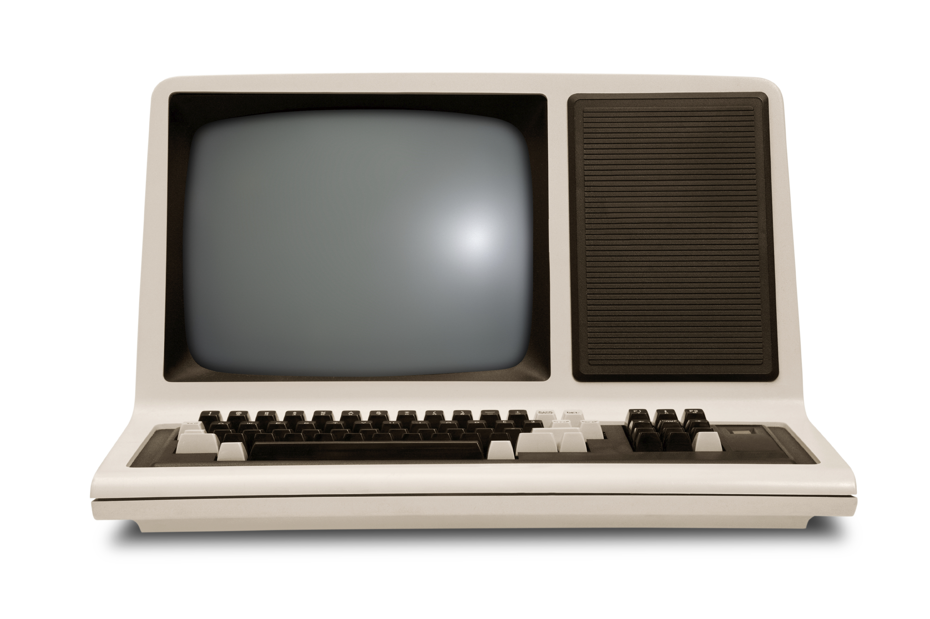

Slide 29
Cache::Reddit
Unreliable
Slow
Max Length

Slide 30
Cache::Reddit
Unreliable
Slow
Max Length
Algorithm

Slide 31
Cache::Reddit
Unreliable
Slow
Max Length
Algorithm
Data visible

Slide 32

Cache::Reddit
Unreliable
Slow
Max Length
Algorithm
Data visible

Slide 33
Cache::Reddit
Unreliable
Slow
Max Length
Algorithm
Data visible

Slide 34
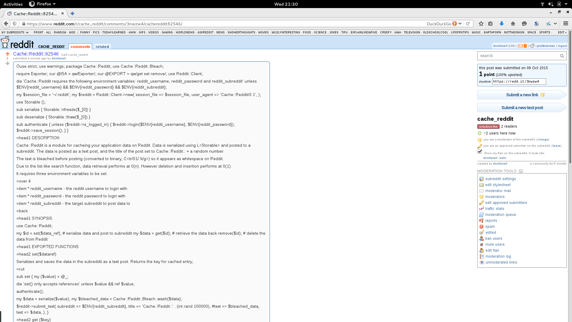

Slide 35
Bleaching Algorithm

Slide 36
Bleaching Algorithm
→ Data

Slide 37
Bleaching Algorithm
→ Data
→ “Data”

Slide 38
Bleaching Algorithm
→ Data
→ “Data”
→ 00100110100001100010111010000110

Slide 39
Bleaching Algorithm
→ Data
→ “Data”
→ 00100110100001100010111010000110
→ tr/01/ \t/

Slide 40
Bleaching Algorithm
→ Data
→ “Data”
→ 00100110100001100010111010000110
→ tr/01/ \t/
→ “ “

Slide 42
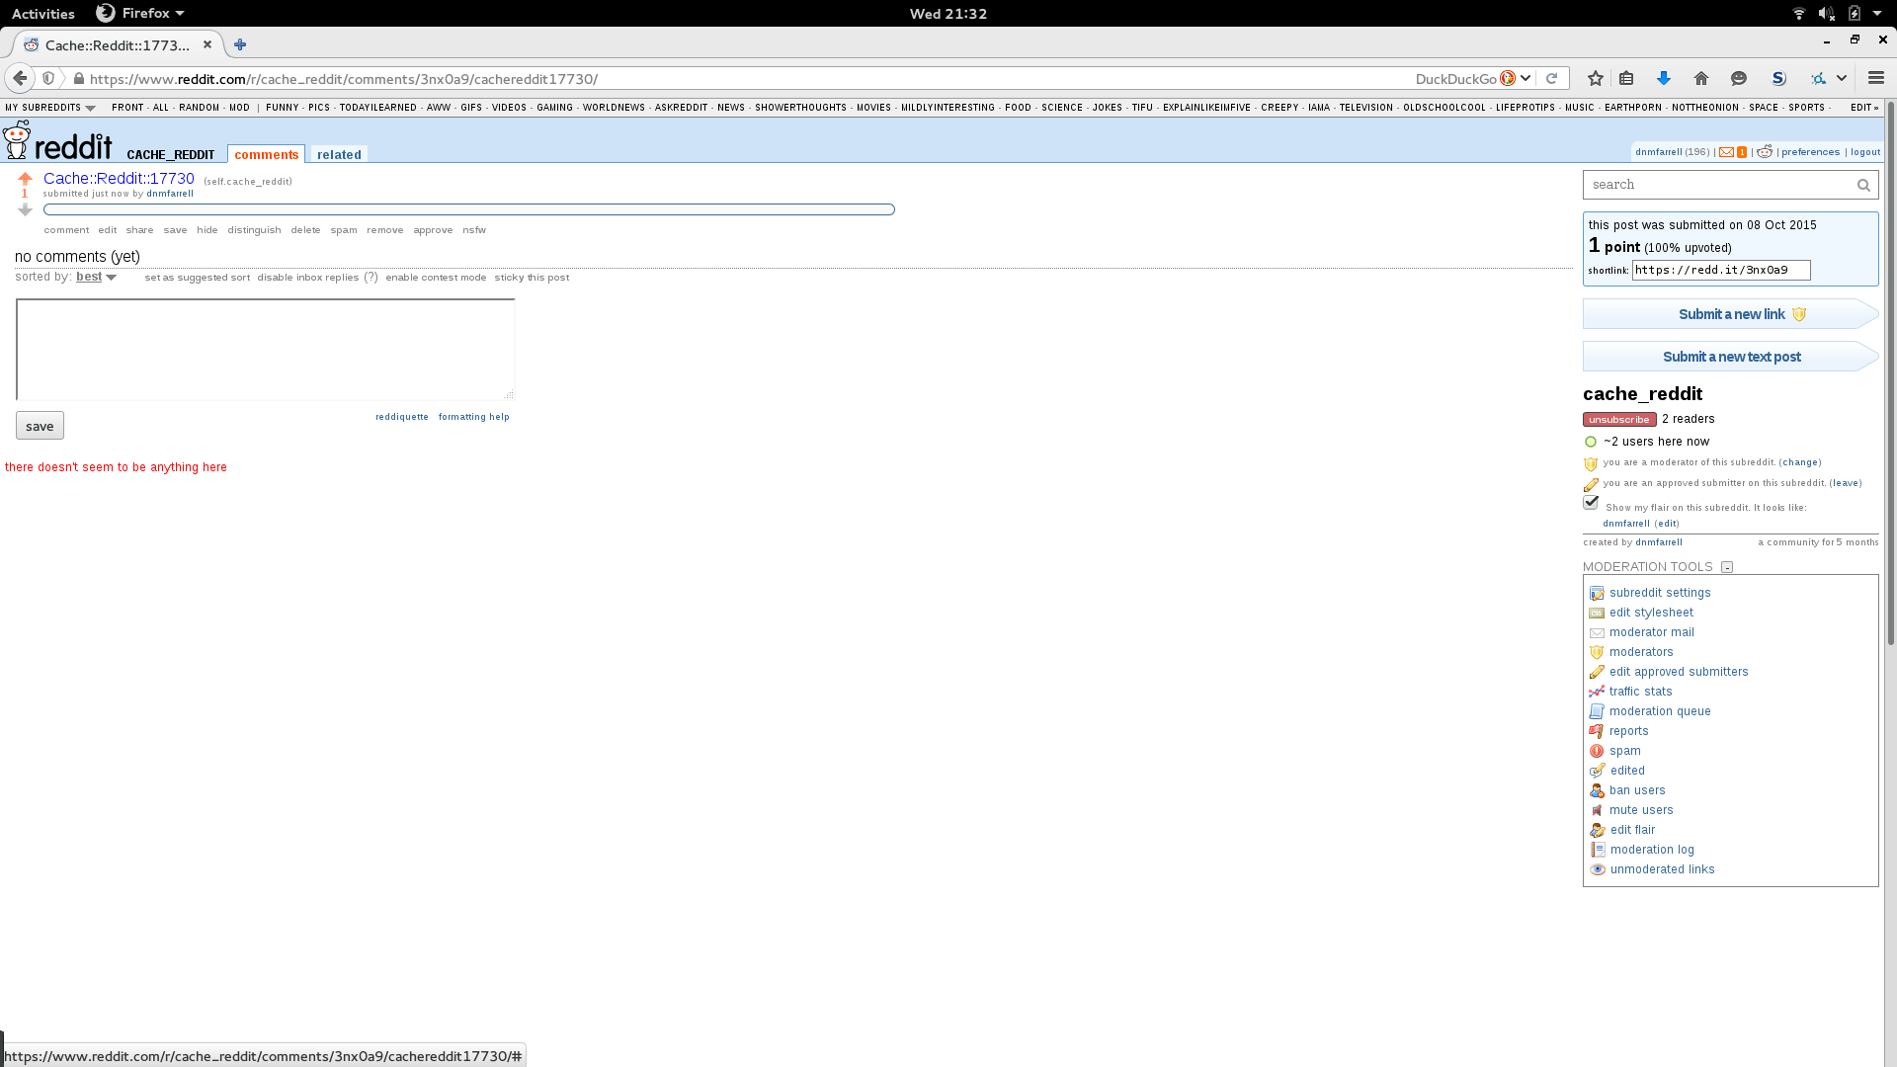

Slide 43
github.com/dnmfarrell/Cache-Reddit

