Slide 1
Timekeeping at the
US Naval Observatory
Demetrios Matsakis

Slide 2
USNO Clock Ensemble
Frequency Standards
  >70 High-Performance Cesiums
  24 Cavity-Tuned Masers
Distribution
  19 environmental chambers
  3 buildings
  Washington, DC and Colorado Springs, Co
Improved Standards
  Rubidium Fountain, one to be operational in 2007
  Cesium fountain, just for testing
  JPL Trapped-Ion Mercury Standard

Slide 3
Low-Precision Time Transfer
Number of Requests, last 365 days
Telephone Voice-Announcer
(202) 762-1401
850,000
Leitch Clock System
100,000
Telephone Modem
(202) 762-1594
200,000
Web Server
http://tycho.usno.navy.mil
850 million
Network Time Protocol (NTP)
200 billion
(4000-6000 requests/s in DC)

Slide 4
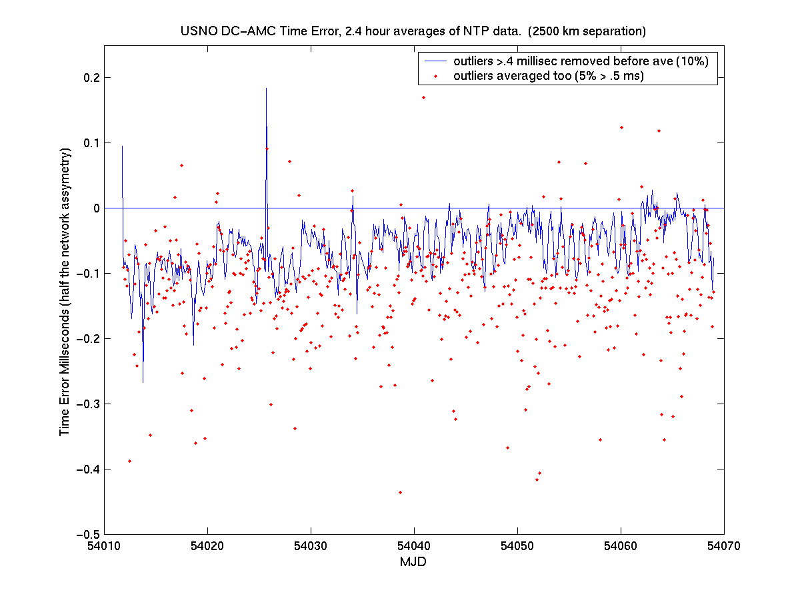
NTP Time Transfer USNO<->AMC

Slide 5
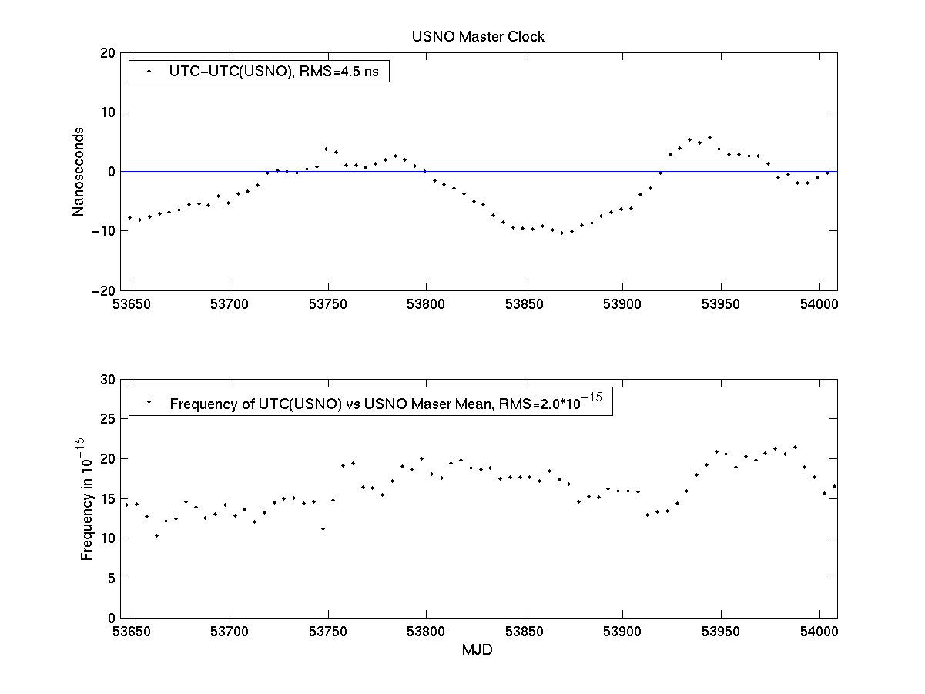
USNO Master Clock

Slide 6
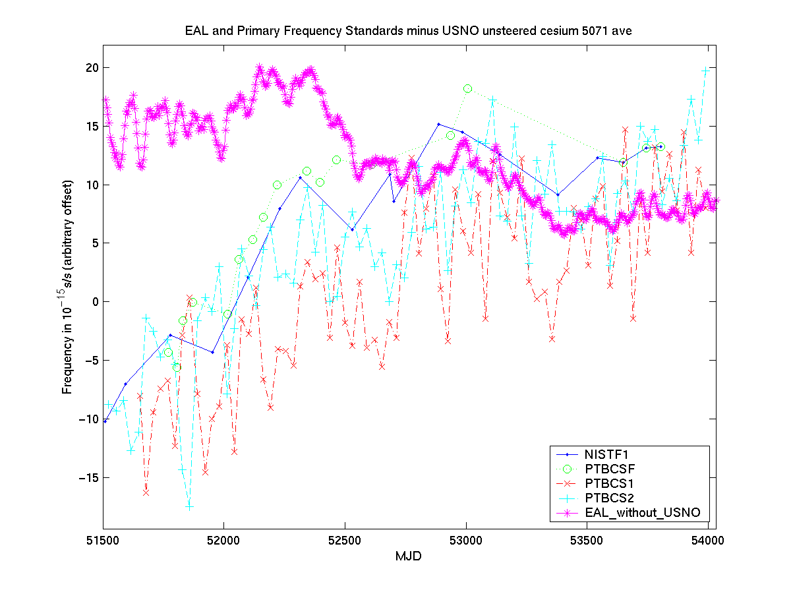
USNO Cesiums and SI second

Slide 7
Precise Time Transfer: TWSTT
Accuracy estimate: 1 ns RMS
  Based on repeatability of calibrations
  Breakiron et al., PTTI-04
USNO-PTB link
  calibrated once in 2006
  Hardware failure at X-band
  Satellite Change at Ku-Band
Some variations ~1-ns have occurred
  Trends
  Diurnal variations
  On several baselines
  Roughly consistent with 1 ns RMS

Slide 8
Precise Time Transfer: Carrier Phase GPS
USNO Carrier Phase GPS Receivers
  Their IGS designations are USNO, USN3, and AMC2
  20th century technology
  USNO and USN3 calibrations occasionally jump ~1 ns
  USNO/AIUB/BIPM paper at IFCS-06
Three newer receiver models just purchased
  To be tested, installed, and hopefully used.

Slide 9
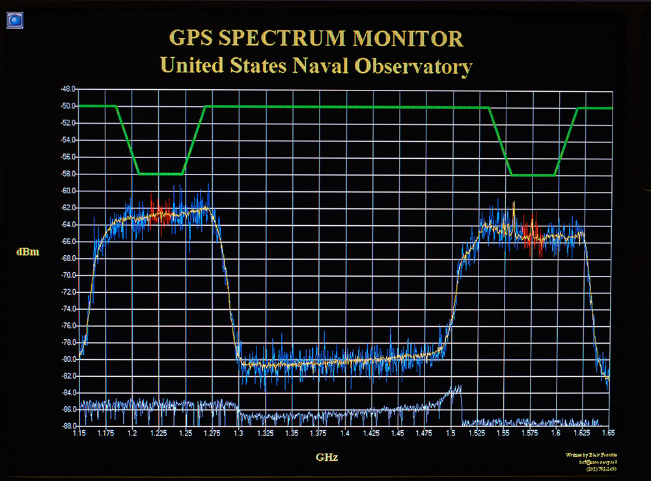
A display that is not just for tourists

Slide 10
USNO and GNSS Systems
Official GPS/GalileoTime Offset Monitoring
  For interoperability
  Galileo receiver installed (last week)
  USNO-PTF TWSTFT to begin in 2007
GPS/QZSS offset
  USNO and NICT to do TWSTFT via Hawaii
  Plan to install station in 2007

Slide 11
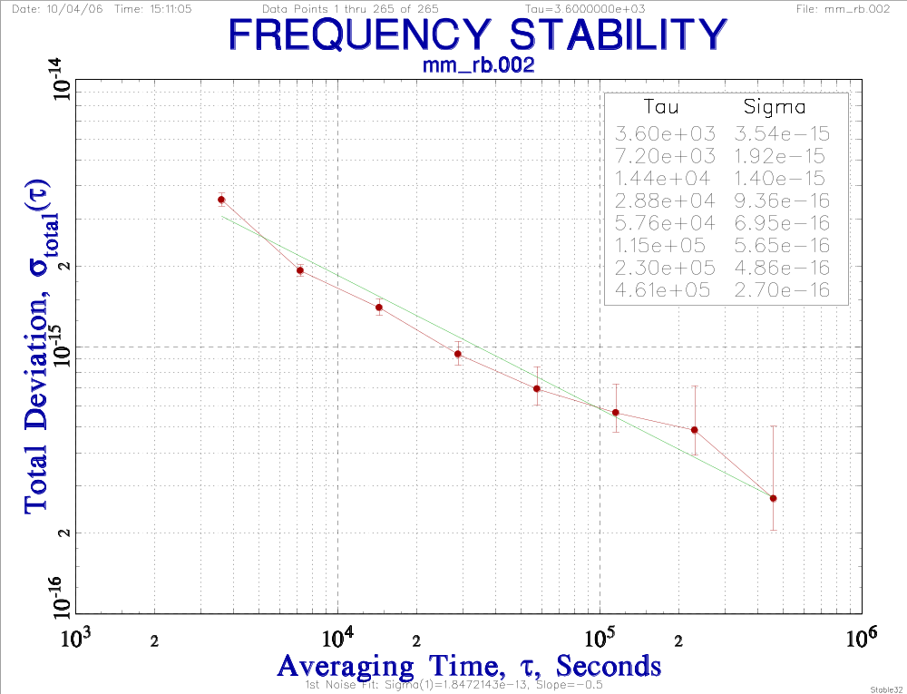
Rubidium Fountain

Slide 12
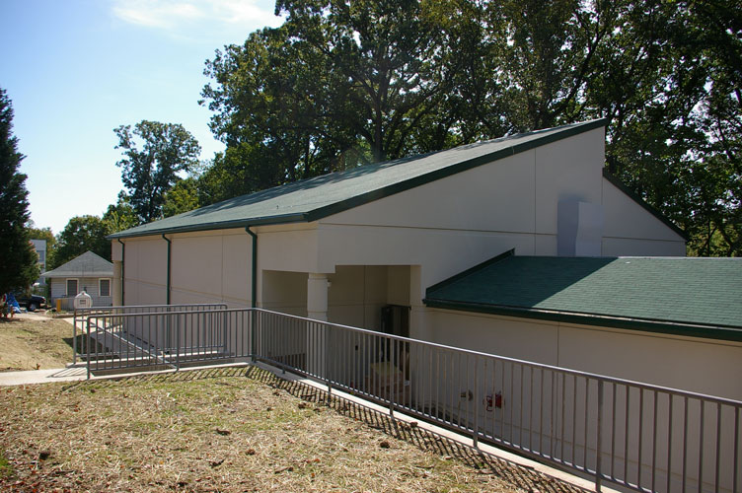
New Clock Building, P-050
Interior Construction Incomplete, Infrastructure Mostly Designed

Slide 13
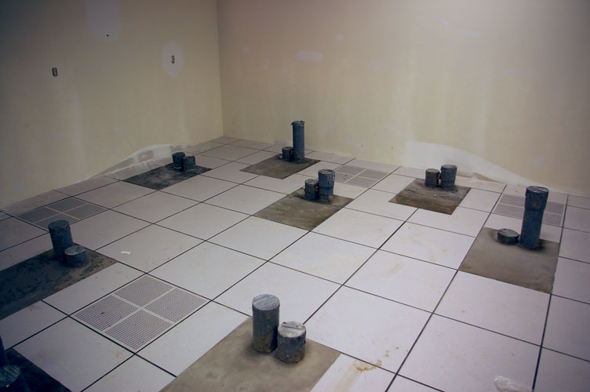
Clock Rooms in New Building
Clock Rooms 1-4: 9 piers for racks or masers

Slide 14
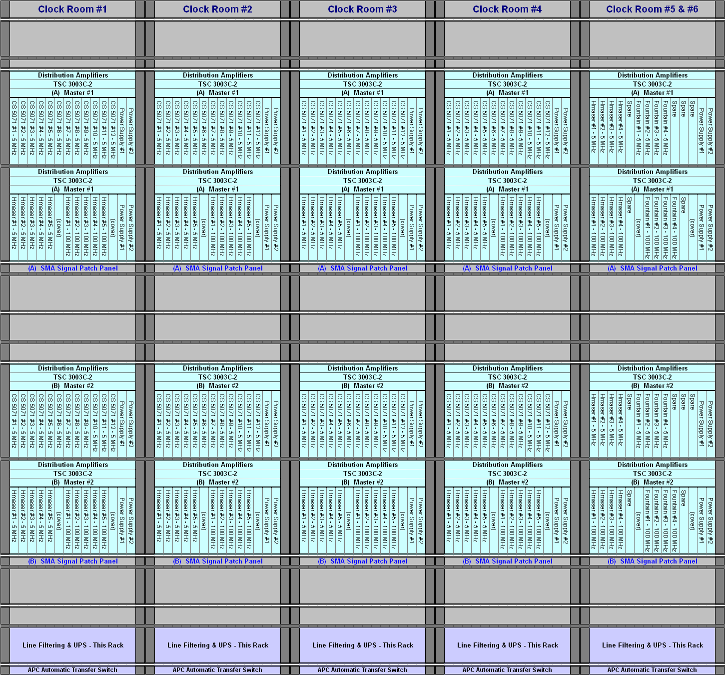
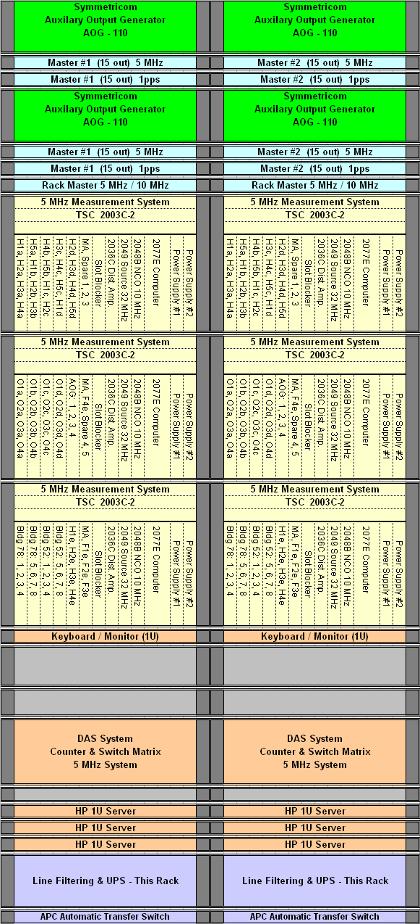
Standardized Racks

Slide 15
Summary
USNO specializes in real-time timekeeping
  UTC realization
  Dissemination
  Monitoring
  Device and analysis R&D
Upgrades are continuously happening
Robustness and performance are essential
Tour Friday morning 10 AM
  Not sure if we can help with transportation

