Slide 1
In the previous video…
Request Dispatcher
Dispatch the request object to another component
Created a JSP and Printed a message

Slide 2
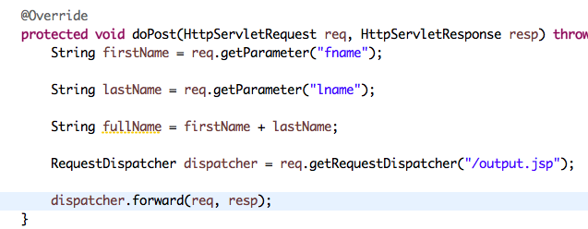
In this video…
Access the fullName inside the JSP
Print a message in the browser, Hello B2 Tech

Slide 4
setAttribute()

Slide 5
setAttribute(name, value)

Slide 6
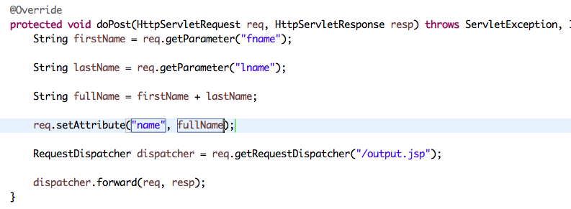

Slide 7


Slide 8
getAttribute()

Slide 9
getAttribute(name)

Slide 10


Slide 11


