Slide 1
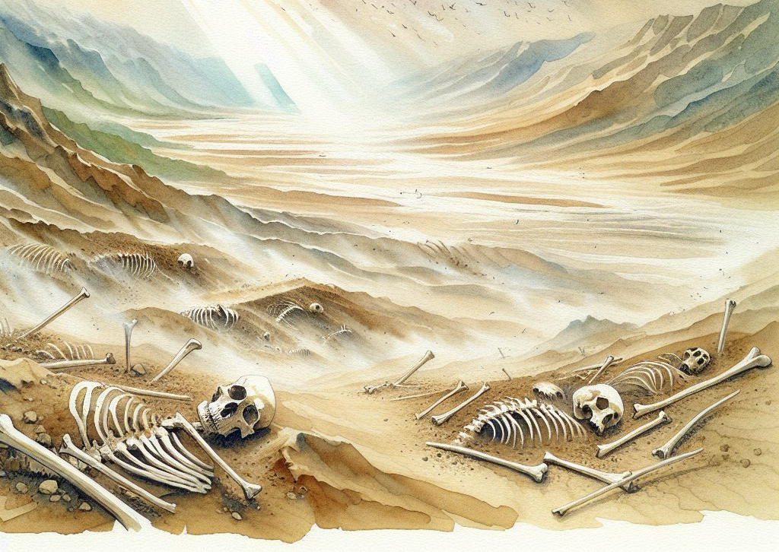
Ezekiel 37-
Vision of the Valley of Dry Bones
The Promise of the Lord for His Nation

Slide 2
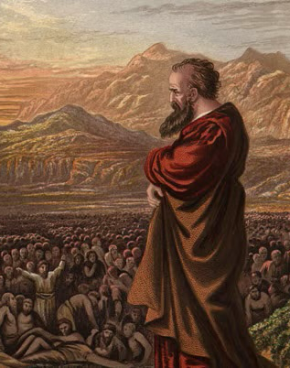
Sections
Vision of Dry Bones
Meaning of Vision
Accusations toward Israel
Response We Should Have

Slide 3
The Vision of Dry Bones
“The hand of ADONAI was upon me. The Ruach ADONAI carried me out and set me down in the middle of the valley. It was full of bones. He led me all around them. Behold, there were very many on the floor of the valley. Behold, they were very dry. Then He said to me, “Son of man, can these bones live?” I answered, “ADONAI Elohim, You know.”” Ezekiel 37:1-3
What can we understand from this?
First this is a vision, of things to come.
There are many bones, but not only that, they are very dry.
The bones are spread out, all in the valley.
To be very dry is to be long dead no flesh or tendons, only full death.

Slide 4
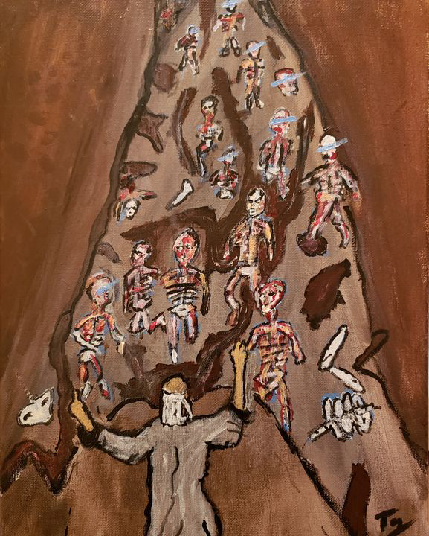
God Himself Poses the Question:
“Then He said to me, “Son of man, can these bones live?” I answered, “ADONAI Elohim, You know.” “Prophesy over these bones,” He said to me. “Say to them: ‘Dry bones, hear the word of ADONAI!’ Thus says ADONAI Elohim to these bones: “Behold, I will cause Ruach to enter you, so you will live. I will attach tendons to you, bring flesh on you and cover you with skin. Then I will put breath in you. You will live. You will know that I am ADONAI.” Ezekiel 37:3-6
The Lord directly asks:
Can these bones come to Life?
Seems impossible, “Lord you know” is a simple way for Ezekiel to leave it in His Hands.
A promise is made by the Lord God, to reform the bones, to make them new.

Slide 5
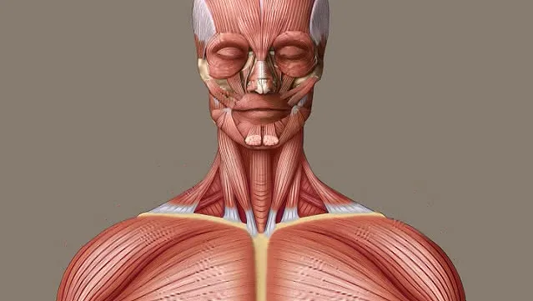
The Bones come together, flesh, yet no life…
“So I prophesied just as I was commanded. As I prophesied, there was a noise, and behold, an earthquake. Then the bones came together, bone to its bone. I saw, and behold, there were tendons on them, flesh came up and skin covered them above, but there was no breath in them.” Ezekiel 37:7-8

Slide 6
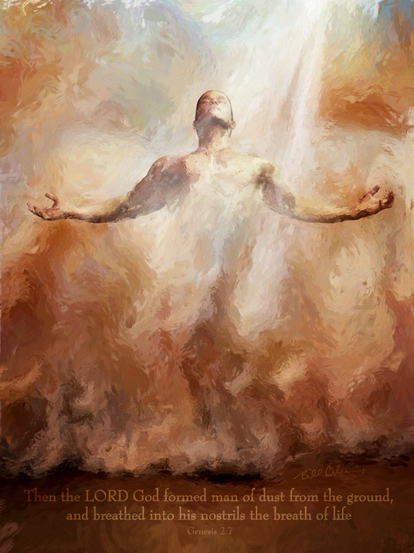
The Life is in the Breath
Life is not given to the bones until the Breath of God goes forth and life is restored to the body. Though with flesh and tendons after being apart, still no life until breath.
“Then He said to me, “Prophesy to the Ruach. Prophesy, son of man, and say to the Ruach, thus says ADONAI Elohim: ‘Come from the four winds, Ruach! Breathe upon these slain, that they may live.” So I prophesied just as He commanded me. The Ruach came into them and they lived. They stood up on their feet, a vast army.” Ezekiel 37:9-10

Slide 7
Meaning of the Vision
The Meaning of the Vision is given from Ezekiel 37:11-23
A Promise that the nation will return after exile
Which exile however? Some believe it’s the exile from Babylon.
It cannot be. Why? Because their sins are forgiven and one king rules over them!
This did not happen on their return, no King of David has been seen!
Except…

Slide 8
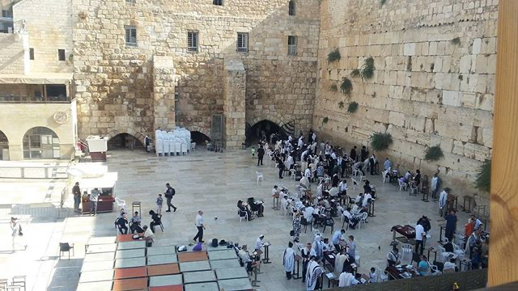
Yeshua Returns to save and reign
“My servant David will be king over them. They will all have One Shepherd. They will walk in My ordinances and observe My rulings and do them.” Ezekiel 37:24
Yeshua returns to reign, a king set over Israel FOREVER!
“ADONAI will then be King over all the earth. In that day ADONAI will be Echad and His Name Echad.” Zechariah 14:9
“No longer will there be any curse. The throne of God and of the Lamb shall be in the city, and His servants shall serve Him. They shall see His face, and His name shall be on their foreheads. Night shall be no more, and people will have no need for lamplight or sunlight—for ADONAI Elohim will shine on them. And they shall reign forever and ever!” The Revelation 22:3-5

Slide 9
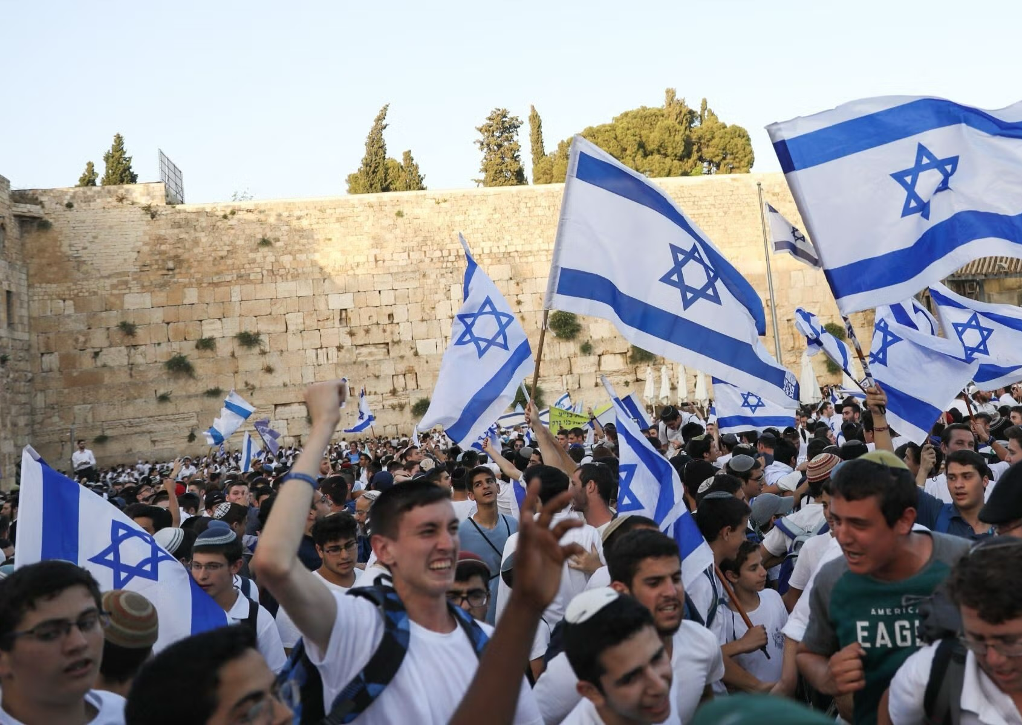
Accusations toward Israel
With all these verses many question: why is the nation of Israel in unbelief?
If they returned why stay this way?
Well because this is part of God’s plan for His people:
““Then I will pour out on the house of David and the inhabitants of Jerusalem a spirit of grace and supplication, when they will look toward Me whom they pierced. They will mourn for him as one mourns for an only son and grieve bitterly for him, as one grieves for a firstborn.” Zechariah 12:10
““and in this way all Israel will be saved, as it is written, “The Deliverer shall come out of Zion. He shall turn away ungodliness from Jacob. And this is My covenant with them, when I take away their sins.”” Romans 11:26-27 (Paul quotes Psalms 14:7 and Isaiah 27:9

Slide 10
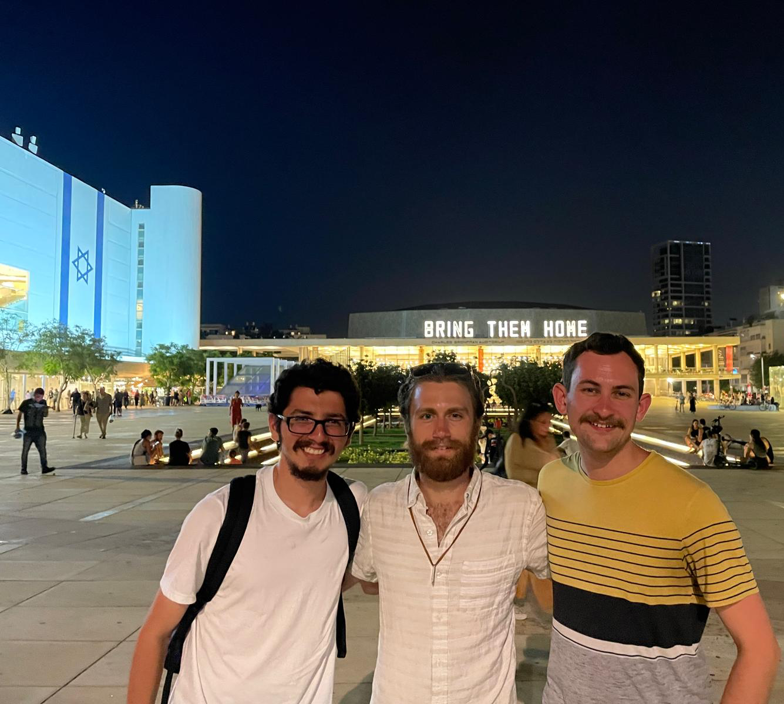
Response We Should Have
Trust in God’s Plan
“Why are the nations in an uproar, and the peoples mutter vanity? Kiss the Son, lest He become angry, and you perish along your way— since His wrath may flare up suddenly. Happy is everyone taking refuge in Him!” Psalm 2:1;12
Stand with Israel
“Pray for the peace of Jerusalem— “May those who love you be at peace! May there be shalom within your walls— quietness within your palaces.” For the sake of my brothers and friends, I now say: “Shalom be within you.” For the sake of the House of ADONAI our God, I will seek your good.” Psalms 122:6-9
Witness to the Jewish People
“I say then, they did not stumble so as to fall, did they? May it never be! But by their false step salvation has come to the Gentiles, to provoke Israel to jealousy. Now if their transgression leads to riches for the world, and their loss riches for the Gentiles, then how much more their fullness!” Romans 11:11-12

Slide 11
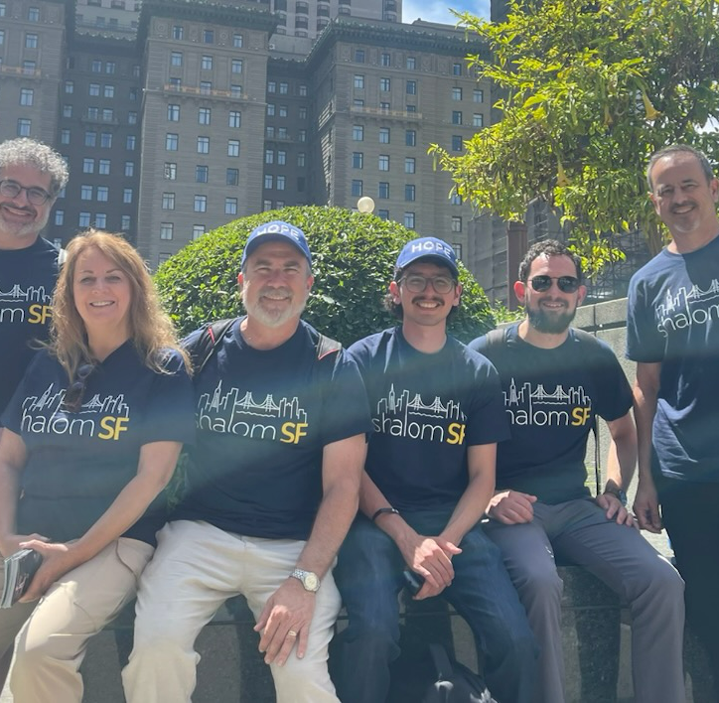
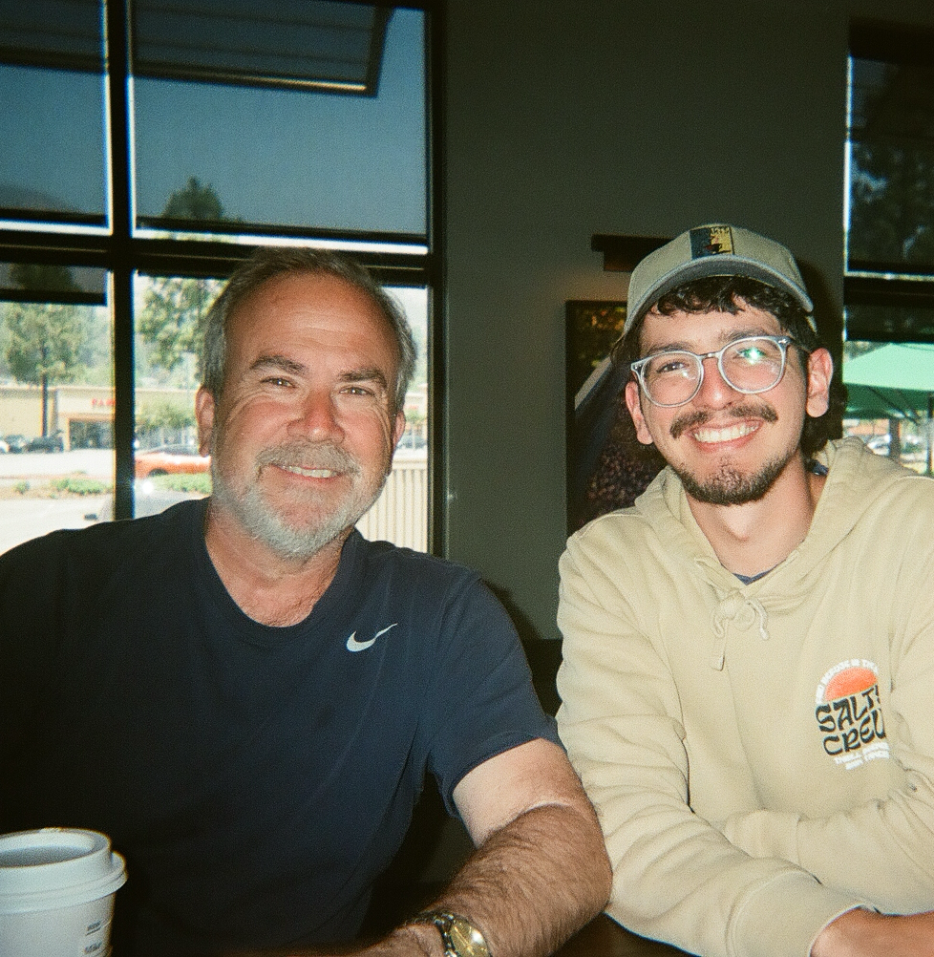
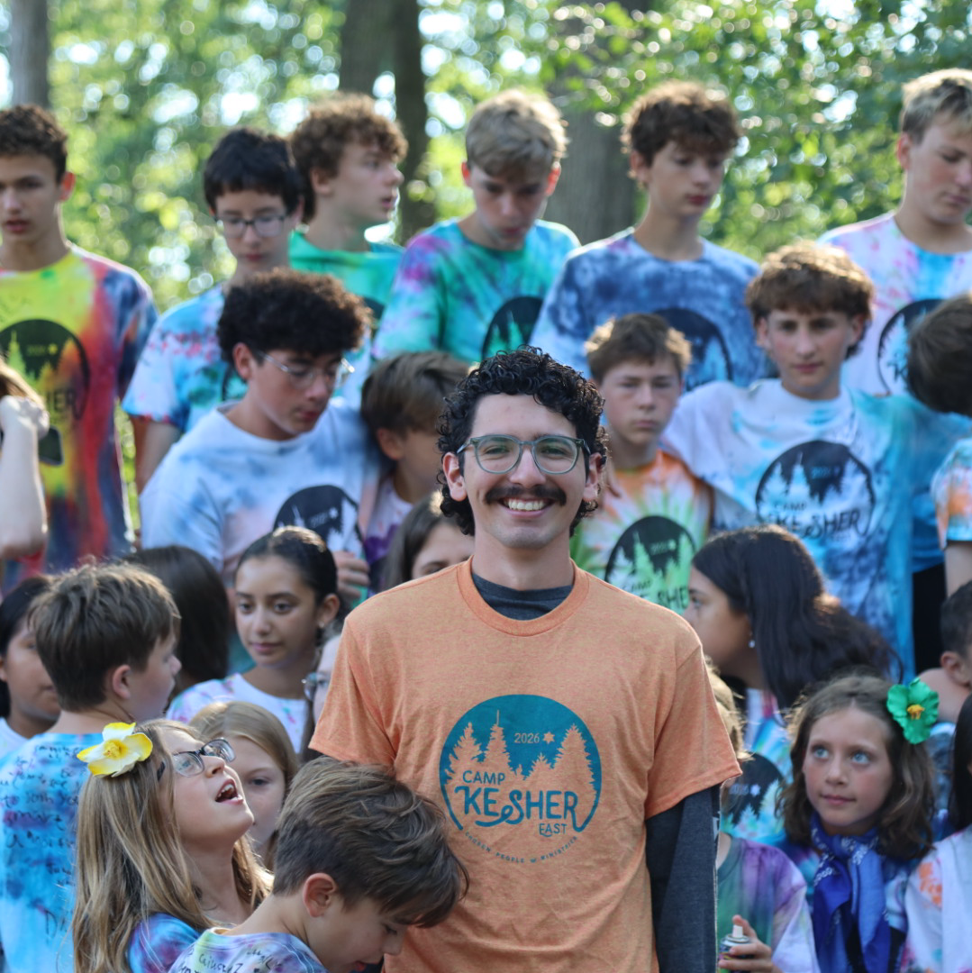

You can support that very ministry
By Praying, Giving and Getting Involved, we can reach many with the Gospel!

