Slide 2
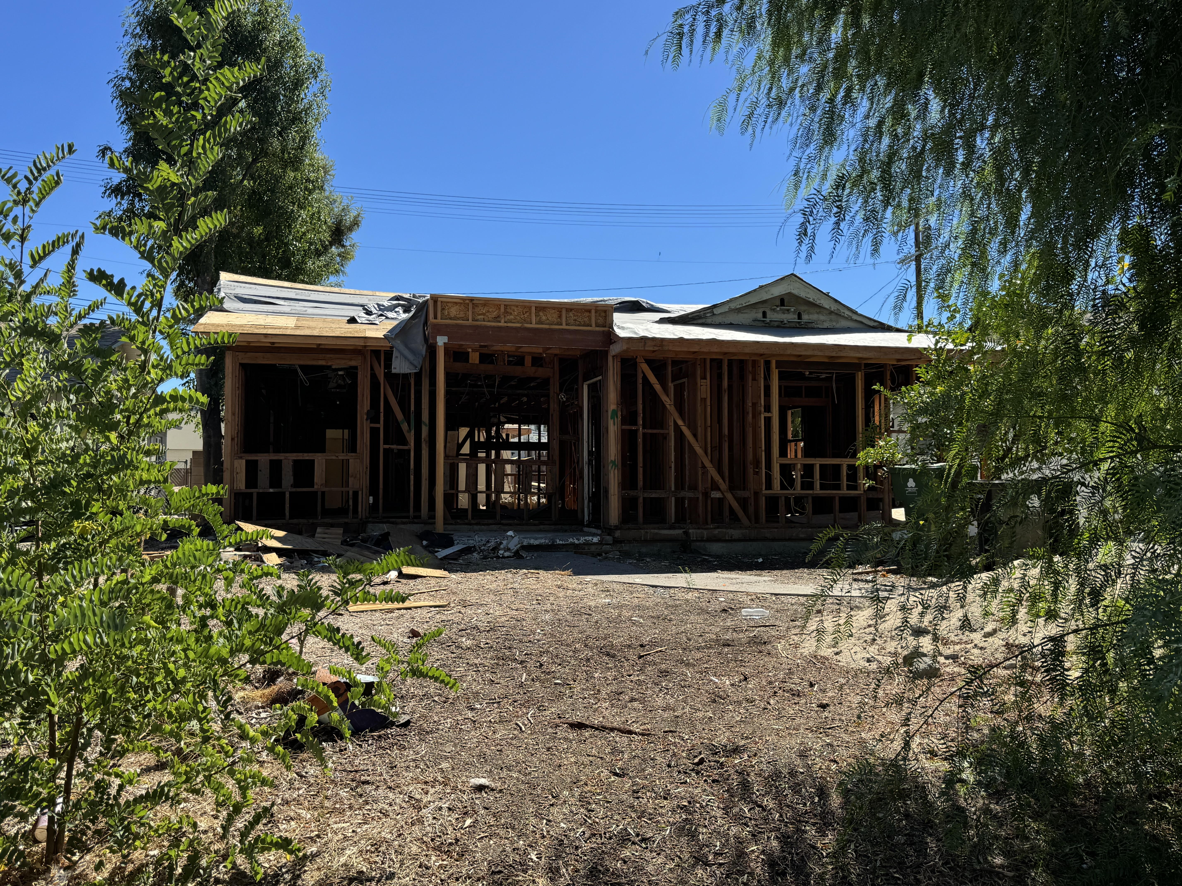
Neighborhood Rebuild

Slide 3
I. Introduction: Rebuilding the Second Temple.

Slide 5
II. Israel responded to G-d’s call to rebuild the Second Temple.

Slide 6
A. Israel received G-d’s decree.
2 Chronicles 36: (TLV) 22 Now in the first year of King Cyrus of Persia—fulfilling the word of ADONAI by the mouth of Jeremiah—ADONAI stirred up the spirit of King Cyrus of Persia so that he sent a proclamation throughout all his kingdom and also put it in writing, saying 23 “Thus says King Cyrus of Persia ‘ADONAI, the God of heaven, has given me all the kingdoms of the earth. He has appointed me to build Him a House in Jerusalem, which is in Judah…

Slide 7
B. Israel received G-d’s opportunity.
2 Chronicles 36:23 …Whoever among you of all His people may go up and may ADONAI his God be with him.’”

Slide 8
C. Israel received G-d’s leaders.
1 In the second year of King Darius, in the sixth month, on the first day of the month, the word of ADONAI came through Haggai the prophet to Zerubbabel son of Shealtiel, governor of Judah, and to Joshua son of Jehozadak, kohen gadol:
Prophet = Word
King = Conduct
Priests = Prayer - Relationship

Slide 9
App: Our life begins with the gospel.
John 2:19-22 (TLV) 19 “Destroy this Temple,” Yeshua answered them, “and in three days I will raise it up.”
20 The Judean leaders then said to Him, “Forty-six years this Temple was being built, and You will raise it up in three days?” 21 But He was talking about the temple of His body. 22 So after He was raised from the dead, His disciples remembered that He was talking about this. Then they believed the Scripture and the word that Yeshua had spoken.

Slide 10
III. Israel abandoned G-d’s call to rebuild the Second Temple.

Slide 11
A. Israel had the wrong priorities.
(TLV) 2 "Thus says ADONAI-Tzva'ot: ‘This people say the time has not come—the time for the House of ADONAI to be rebuilt. 3 Then the word of ADONAI came through Haggai the prophet: 4 "Is it a time for you yourselves to dwell in your paneled houses, while this House lies in ruins?

Slide 12
B. Israel had the wrong motives.
(TLV) 5 But now," thus says ADONAI-Tzva'ot:
“Consider your ways!
6 You sowed much but bring in little.
You eat but are never satisfied.
You drink but not enough to get filled.
You put on clothes but no one is warm.
And whoever earns wages works for a bag full of holes."

Slide 13
C. Israel had the wrong concerns.
7 Thus says ADONAI-Tzva'ot: "Consider your your ways! 8 Go up to the hills, bring wood and build the House. Then I will delight in it and I will be glorified," says ADONAI. 9 "You have looked for much, but indeed, there is little. What you have brought home, I have blown away. Why is this?"—it is a declaration of ADONAI-Tzva'ot—"because My House lies in ruins, while you are running, each to his own house (Ezr 4).

Slide 14
D. Israel had the wrong actions.
(TLV) 10 Therefore, because of you, the sky has withheld dew and the earth has withheld its yield. 11 For I have called for drought on the land, the hills and the grain, on the new wine, the oil, on what the ground brings forth, on mankind and beast, as well as all labor of hands."

Slide 15
App: Our life grows through surrender.
1 Cor. 6 (TLV) 19 Or don't you know that your body is a temple of the Ruach ha-Kodesh who is in you, whom you have from God, and that you are not your own? 20 For you were bought with a price. Therefore glorify God in your body.

Slide 16
IV. Israel resumed G-d’s call to rebuild the Second Temple.

Slide 17
A. Israel decided to submit to the Lord.
(TLV) 12 Then Zerubbabel son of Shealtiel and Joshua son of Jehozadak, kohen gadol, and all the remnant of the people, heeded the voice of ADONAI their God and the words of Haggai the prophet, since ADONAI their God had sent him. So the people revered ADONAI.

Slide 18
B. Israel decided to follow the Lord.
13 Then Haggai, the messenger of ADONAI, spoke to the people with the message of ADONAI, "I am with you!"—it is a declaration of ADONAI. 14 Then ADONAI stirred the spirit of Zerubbabel son of Shealtiel, governor of Judah, and the spirit of Joshua son of Jehozadak, kohen gadol, and the spirit of all the remnant of the people, and they came and did work on the House of ADONAI-Tzva'ot their God, 15 on the twenty-fourth day of the sixth month, in the second year of King Darius.

Slide 19
App. Our life flourishes through rest.
Eph 2 (TLV) 20 You have been built on the foundation made up of the apostles and prophets, with Messiah Yeshua Himself being the cornerstone. 21 In Him the whole building, being fitted together, is growing into a holy temple for the Lord. 22 In Him, you also are being built together into God's dwelling place in the Ruach.

Slide 20
Conclusion: For the glory of G-d.

