Slide 1
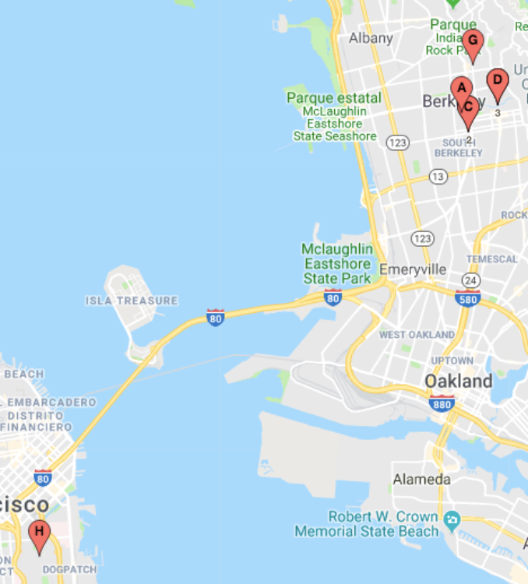
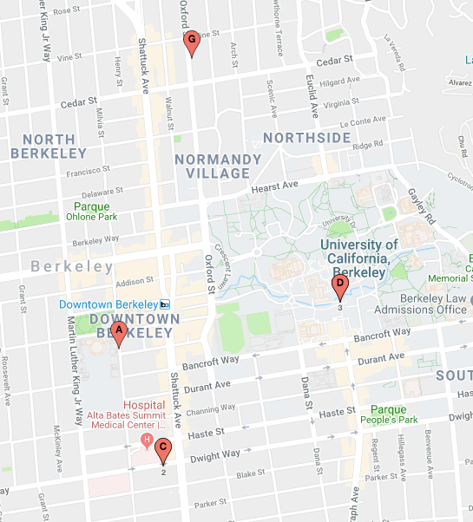

Slide 2
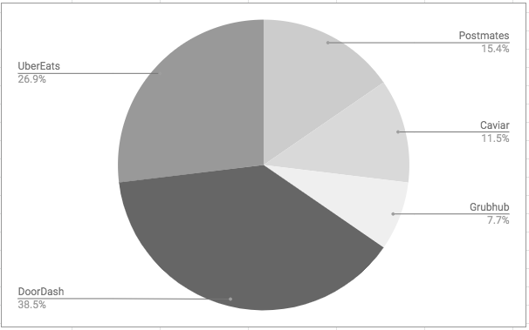

Slide 3
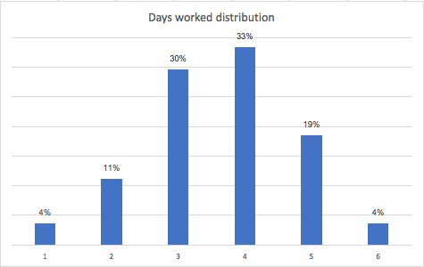
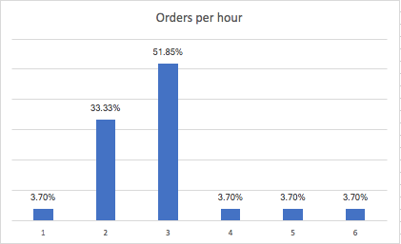

Slide 4
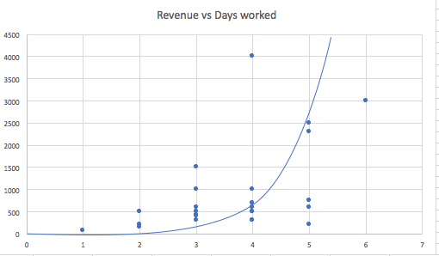
On average, a runner works 3.6 days a week, earning around $56.64 per day for a monthly total of $885.56. Every order produces an average income of $5.68 for the service, and $2.3 for the tip for a grand total of $7.88 per order. A person is expected to do 2.8 orders per hour.
$2.30
$5.68

Slide 5
