Slide 1
Accel-a-sketch
By: Dylan Noppers & Anthony Zotov

Slide 2

Purpose
Accelerometer controls/input
Simple design and functionality
Something simple for offline use

Slide 3
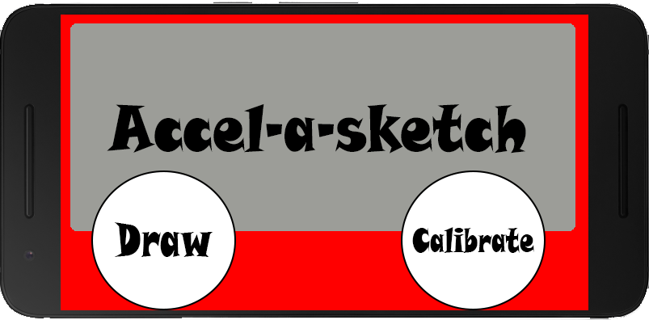
Main_Activity.java
Name of the application
No setting menu
Two simple buttons

Slide 4
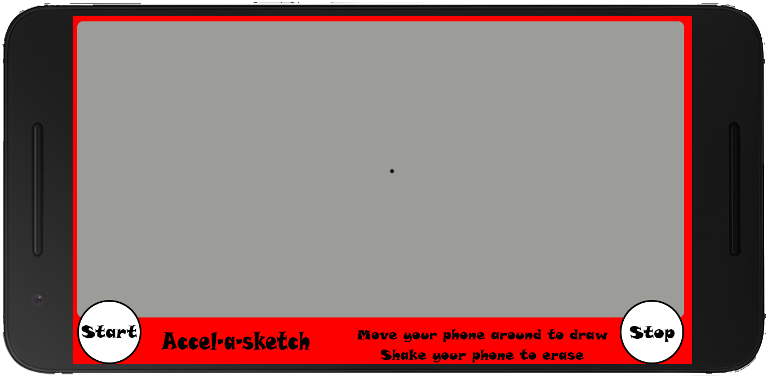
DRAW_Activity.Java
Large drawing area
Two simple buttons
Simple instructions

Slide 5
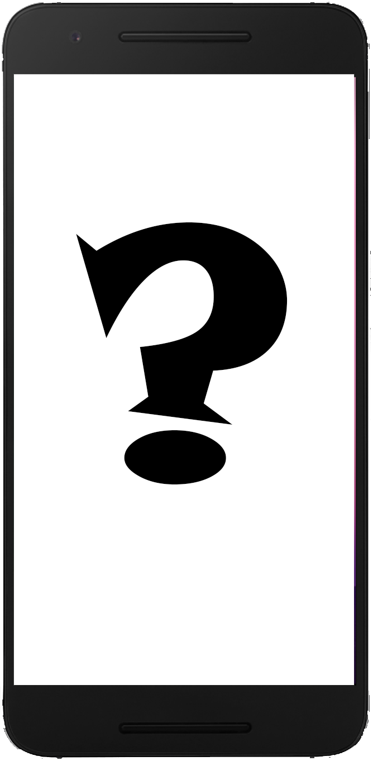
Calibration activity
Not sure about design
Not sure if even possible
Might not be in app at all

Slide 6
Demo

