Slide 1
Efecs Architecture
Requirements
Design Decisions
The Data Tier – Efecs-Data
Efecs-Data Clients
Common Shared Object Types – the DataContracts component
Interaction between a Client and Efecs-Data. The Efecs – Proxy
The World outside
Design Patterns Used
Design Principles

Slide 2
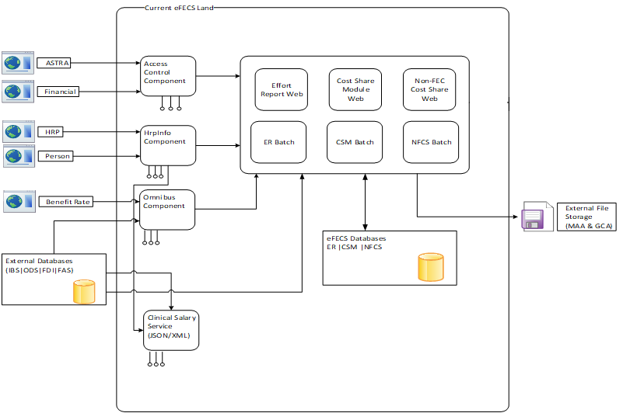
Efecs - What’s in Production?
Tech Stacks
ASP.NET Web Forms
ASP.NET MVC v2.0
ASP.NET View Engine
WCF Web Services
MS Enterprise Library

Slide 3
Requirements
Maintainability
Security
Performance
Reusability across different projects/systems
Abstraction
Robustness
Scalability

Slide 4
Design Decisions
Distributed
Service architecture
Layered
Separation of concerns
Loosely coupled
Simplicity + Structure
Employ proven design patterns and best practices

Slide 5
The Data Tier – Efecs-Data
Is a Web Service
Agnostic of its clients
Retrieves/updates data from variety of heterogeneous sources: DBs, Web Services, …
Abstracts data sources and operations via the Repository pattern
Only basic (fundamental) business logic
Serves to the rest of the world as a Façade over data operations
Implements the Bridge pattern so that with M types of clients and N types of data sources, there are only M + N types of data operations
Returns results in a standard/uniform ResponseModel

Slide 6
The Clients of Efecs-Data
Effort Report
Effort Report Background Process
Cost Share Module
Cost Share Background process
IDAA Background process
More to come…

Slide 7
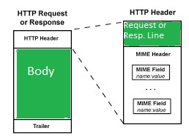
Passing Data between Efecs-Data and clients
Generic Response Model<T>
Status Code
Exception
T: Payload

Slide 8
Common Shared Object Types: the DataContracts component
Contains only interfaces
It is up to Efecs – Data and its numerous clients how to implement the interfaces
Each client only implements the interfaces it needs and can implement others as the need arises

Slide 9
Interaction between a Client and Efecs-Data. The Efecs-Proxy
Implements / provides a set of interfaces for the clients to use
Both synchronous and asynchronous methods are provided
Hides completely Efecs – Data from the clients
Hides completely the complexity of the HTTP communication
Interprets error-responses and translates them to throwing exceptions

Slide 10
The World outside
Asp.Net Core / .Net 6
Azure DevOps On-Prem:
CI/CD Pipelines
Source Control Repository (TFVC)
Artifact Server (NuGet Package)
Sprint Backlog Work Items
RDBMS
Other Web Services
JSON
XML
Types of client applications:
Browser-based
Console apps
Other …

Slide 11
The FcFramework Common Component
Out of the box API’s:
Logging
Notification
Common extensions
A pluggable .NET 6 Library
Used by all Efecs applications

Slide 12

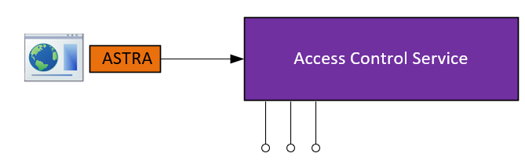
The new Efecs Architecture
Data Contracts
.NET 6
–
Apps
.NET 6
–
Components
Access Control Service
Access Control Client Proxy
Cost Share Batch & Web
Data Contracts
Efecs Data Service
Edws Client Proxy
Effort Report Batch & Web
Institutional Data Access Agreement Middleware
Health Checker
Institutional Data Access Agreement
Batch
.NET 6
–
Efecs Application Blocks
Access Control Service Proxy
Cost Share Web
(Acws.Proxy)
(One library to rule them all)
FcFramework
COMMON INFRASTRUCTURE
eFECS Data Service Proxy
Cost Share Batch
(Edws.Proxy)
Compilers
Languages
Runtime Components
Access Control Service Proxy
Effort Report Web
(Acws.Proxy)
eFECS Data Service Proxy
Effort Report Batch
(Edws.Proxy)

Slide 13
Design Patterns
Façade
Bridge
Adaptor
Proxy
Repository
Visitor
Strategy

Slide 14
Design Principles
Separation of responsibilities
Open-Closed principle
Interface segregation
Dependency injection
KISS
DRY

Slide 15


Slide 16
Reaction to Change
Change | Old Architecture | New Architecture
Configuration of a data source | Affects all M applications | Affects 0 (none) applications. Only done on the Data Service.
Add a new data source | Affects all M applications: Update config. Add (possibly redundant) new code to all applications Add (possibly redundant) error handling to all applications Add (possibly redundant) data validation to all applications | Affects 0 (none) applications. Only handled by the Data Service.
Replace a Stored Procedure by a new one | Affects all M applications | Affects 0 (none) applications. Only handled by the Data Service.
The endpoint of a WS is changed. | Affects all M applications | Affects 0 (none) applications. Only handled within the Data Service.
Any change (code or endpoint) within the Data Service | N/A | None or only handled within the Proxy.

Slide 17
Additional Benefits
Developers’ Confidence
The Software Development process is now:
More stable
Repeatable
Routine (industrial, not art)
Developer Productivity
Code Testability

Slide 18
Dev Team
Neil Oribe - Tech Lead
Kirk Udovich - Co-lead
Dimitre D. Novatchev (Joined in Summer 2020)
Jacob Lipman (newest member as of December 2020)

