Slide 1

The Coffee Value Chain
Commodity and FX Volatility in Emerging Markets
Daniel Singer
Benjamin Cifuentes
Gregory Terrinoni
Andrea Asbun

Slide 2

Motivation and Summary
How have FX and commodity price volatility affected coffee production, exports, and revenues, in the five largest Arabica-growing countries over time?
Prior to consulting available data, we hypothesized that higher FX and commodity price volatility were negatively correlated to production, exports, and revenues

Slide 3





Questions & Data
In order to answer our questions we consulted the following data sources:
ICO (International Coffee Organization)
Spot price indicator
Grower prices
UN ComTrade
Physical trade data
ICE Coffee Futures
International Monetary Fund
Foreign exchange rates
World Bank
Interest rates

Slide 4
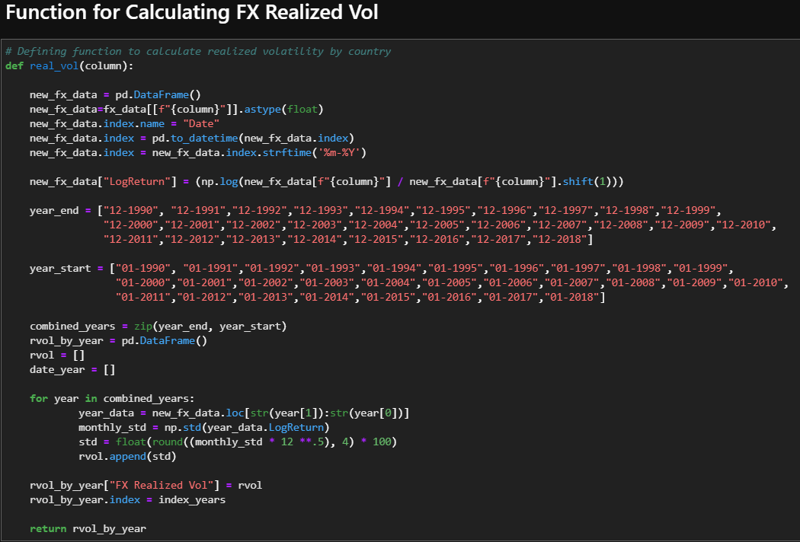
Data Clean Up and Exploration
Transposing columns and rows, locating columns
Specify dtype .astype(), Removing nulls
Date Formatting
split()
Looping through date index to fix format
Conditionally slicing data
Defined functions to calculate derived statistics
Concatenation of data
To visualize: Need for inclusion of location data with specific indicator information
Created master list(s) and wrote them to CSVs

Slide 5
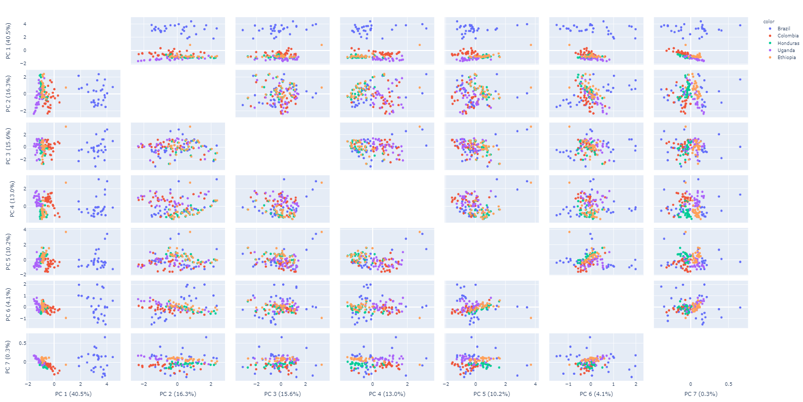
Data Analysis
Map
Production and exports over time
Currency vs. Exports
Currency depreciation positively correlated to increased exports
FX Volatility vs. Exports
Cannot infer much from this relationship
Coffee Futures Volatility and Production
Higher volatility leads to lower production levels
Colombia as an outlier
Correlation does not necessitate causation
Price elasticity of demand
Recession
Spot vs. Future
Diff between futures’ price and price paid to grower
High correlation between spot prices and future markets
Heat Map
PCA Analysis

Slide 6
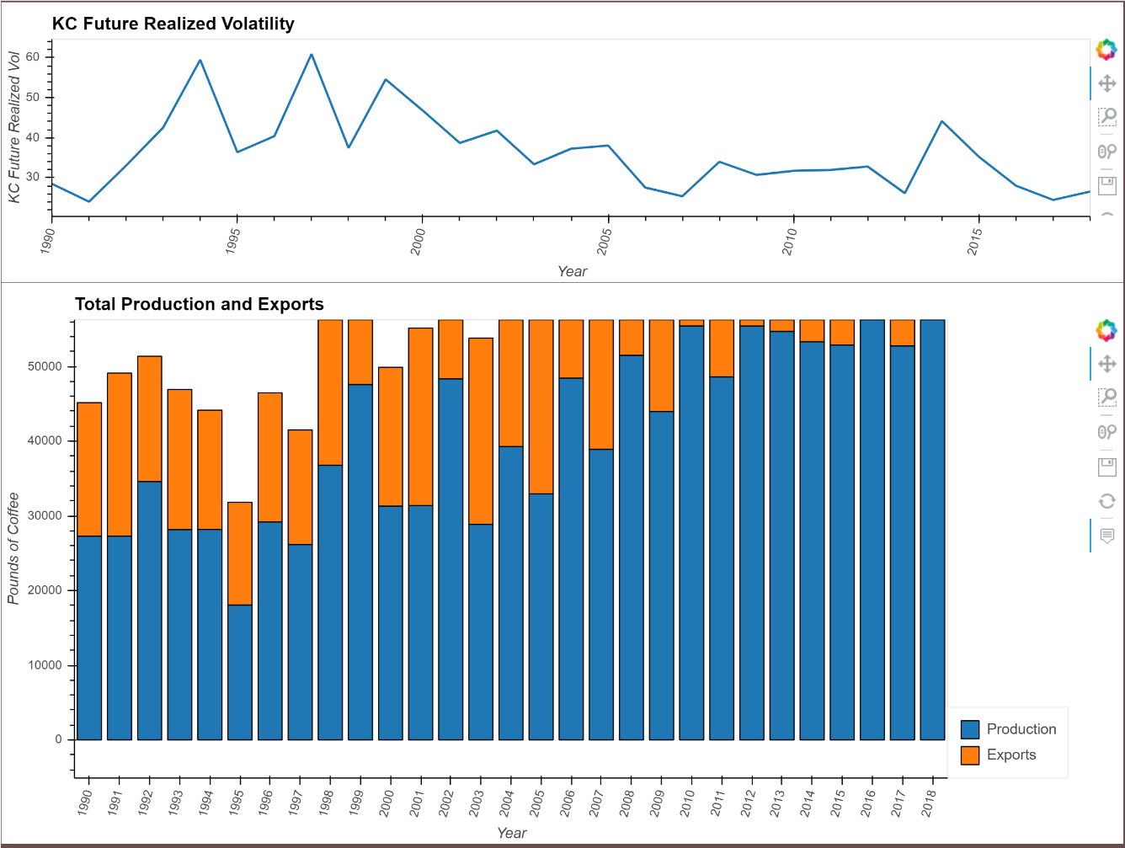
Discussion
Initial Hypothesis
FX rate weakness is positively correlated with exports
Where local currency is weaker against the dollar as a benchmark
KC (coffee futures) volatility is negatively correlated with production levels
What the data showed or did not show
Data validated our initial hypotheses, with some exceptions and caveats
Conclusions
Market price and FX volatility is generally intimately correlated to commodity production levels and exports
However, this relationship can be altered by consumer attitudes and choices
Different actors/markets/countries react and adapt differently to volatility

Slide 7

Postmortem
Coding Issues
Cleanup was our main issue
Problem: data sets from various sources, with varying layouts
Visualizations
Troubleshooting widgets
Multidimensional visuals
Difficulties seeing two panels at the same time
Additional Questions
How can fintech solutions help mitigate coffee volatility?
Applications for other commodities?
Blockchain

Slide 8

Questions?

