Slide 1
Customer / Employee Sentiment Analysis
AI-LAB Project
Dhruv Narayan Singh
219309066
CSE-5J
Musu Priyam
219301204
CSE-5J

Slide 2
What is sentiment analysis?
The process of analysing the words, the tone and even the pitch to find out the sentiment of a given text and derive conclusions from the same.
The sentiments can be categorised as Good, Neutral or Bad based on the sentiment score it has received after tokenization of the text.
How is the sentiment score calculated?
A sentiment analysis model, firstly separates each word and inserts it into an array. Now, using modules like StopWords, it removes often-used words like this/that/is/or etc.
Then, it assigns a token or a number to each word in the array, also known as tokenization. Once tokenized all the words, the sentiment score is calculated for each different word. Sentiment score for Good is always above 0, neutral is 0, and for Bad sentiments, the sentiment score is below 0.
Lastly, the sentiment scores of each word is added to calculate the complete sentiment score of the text or the paragraph. If the sentiment score is positive, the text is sentimentally good.

Slide 3
Project Explanation
Our project “Customer/Employee Sentiment Analysis” aims on providing public sentiments and reviews about a company or an organization an investor wants to invests in.
Upon using our software, the investor enters the name of the company he/she wants to know the public overview about. After entering companies’ name, the code extracts web-reviews from websites like LinkedIn, Glassdoor, Twitter, Facebook, Entrackr etc. about the company.
After web-scraping, these reviews are saved into a CSV file. Now, the first step is to remove all commonly used words from the reviews and then tokenize each word.
After tokenization, a self-made ML model based Naïve Bayes runs through the reviews. It finds out the sentiments of the each of the review with an accuracy of 92.714%.
Once, the sentiments are saved in the same CSV file, this data is imported to Power BI. In this visualisation tool, a dashboard is created, visually depicting the public sentiments and reviews about the company.
This dashboard gives a complete overview about the company from last many years. Investors can dynamically use this Power BI dashboard to analyse whether he/she should invest in the company or not.

Slide 4
Software Used
VS Code
Chrome Browser
Cloudflare DNS
LinkedIn Scraper
Chrome Developer Suite
Skillsets Acquired
Web-Scraping (BeautifulSoup, Selenium)
Data Visualization, Data Cleaning
ETL, Power BI (DAX)
NumPy, Pandas, Matplotlib, Seaborn
MS Excel
MySQL
Statistical Modelling

Slide 5
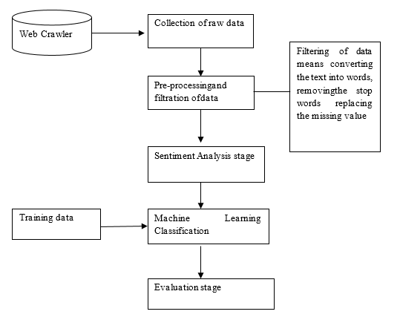
Sentiment Analysis Flowchart

Slide 6
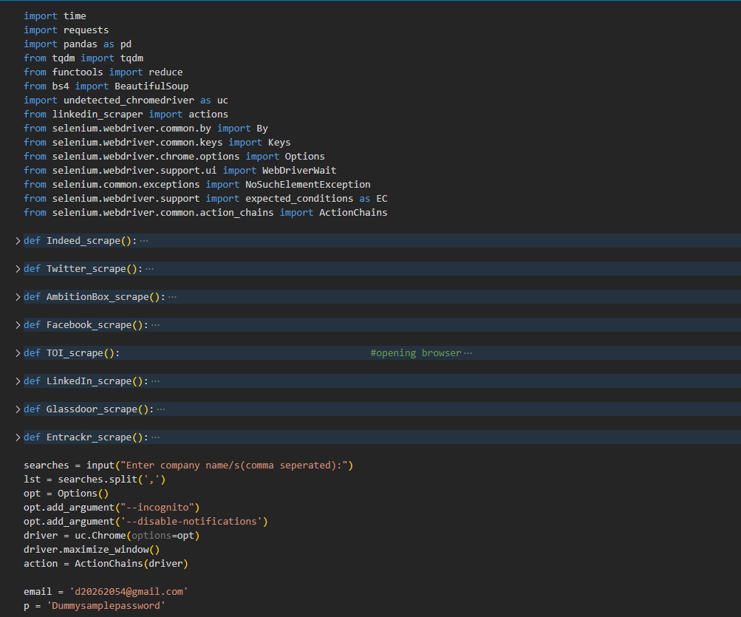
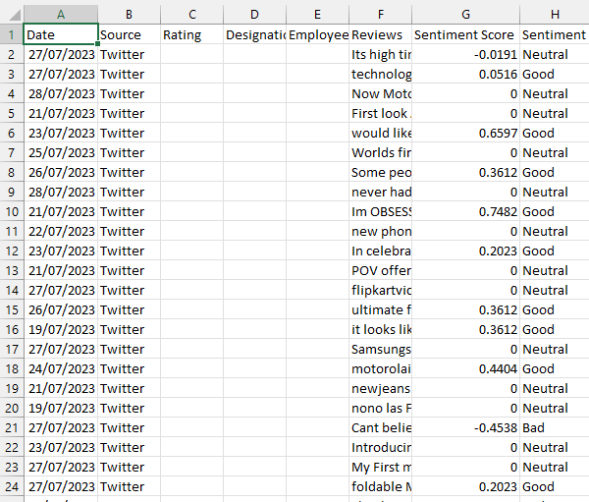
Code snapshot
O/P snapshot

Slide 7
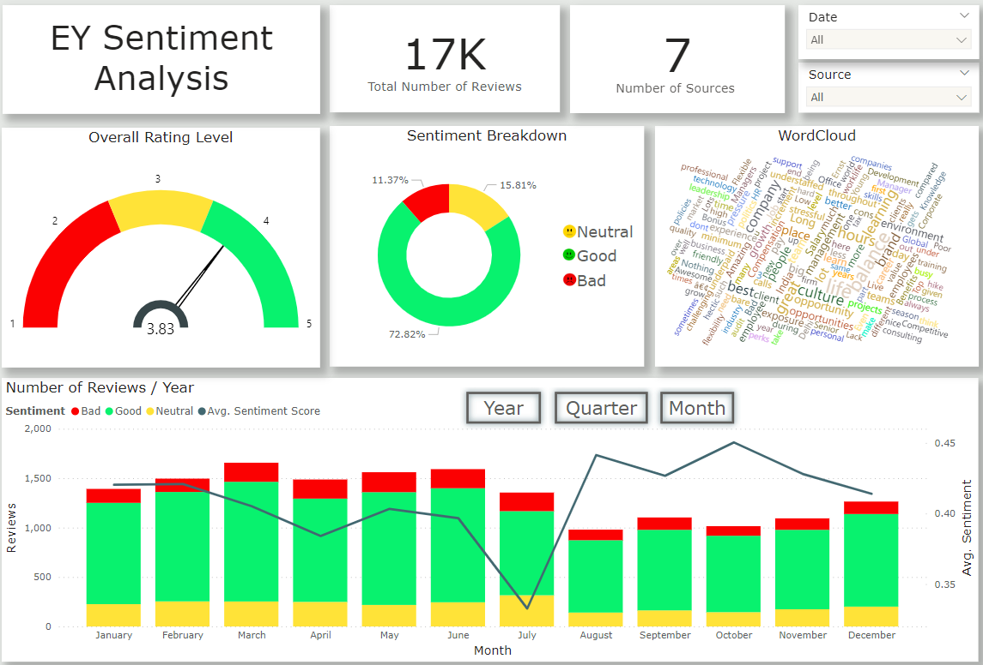
Power BI dashboard for Ernst & Young

Slide 8
Thank You

