Slide 1

Tracking the Planet’s Pulse: Analyzing CO₂, Global Temperature Anomalies, and Sea Level Rise

Slide 2

Tracking the Planet’s Pulse
Analyzing CO₂, Global Temperature Anomalies, and Sea Level Rise
Andres Melendez
Carlos Escamilla
Delilah Slabaugh
Tyler Heflin
Data Science
Bellevue University
June 29th, 2025

Slide 3

Introduction and Hypothesis
Context: Climate change urgency
Key Indicators: CO₂, global temperature anomalies, sea level rise
Hypothesis: As CO₂ increases, we expect to see a corresponding increase in temperature anomalies and sea level

Slide 4

Data Sources and Methods
NASA/NOAA datasets (CO₂, temperature anomalies, sea level)
Monthly time-series (1900 – 2025)
Methods: parsing, merging, rolling averages, regression, and visualization

Slide 5
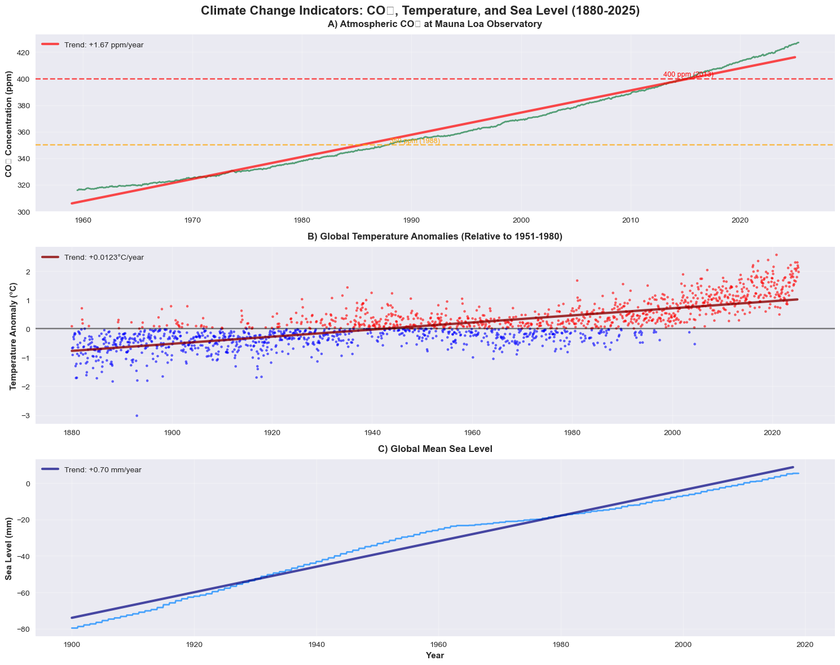
Long-Term Trends

Slide 6
Long-Term Trends (cont.)
CO₂: +1.67 ppm/year
Temperature: +0.0123°C/year
Sea level: +0.70mm/year

Slide 7

Correlation Analysis

Slide 8
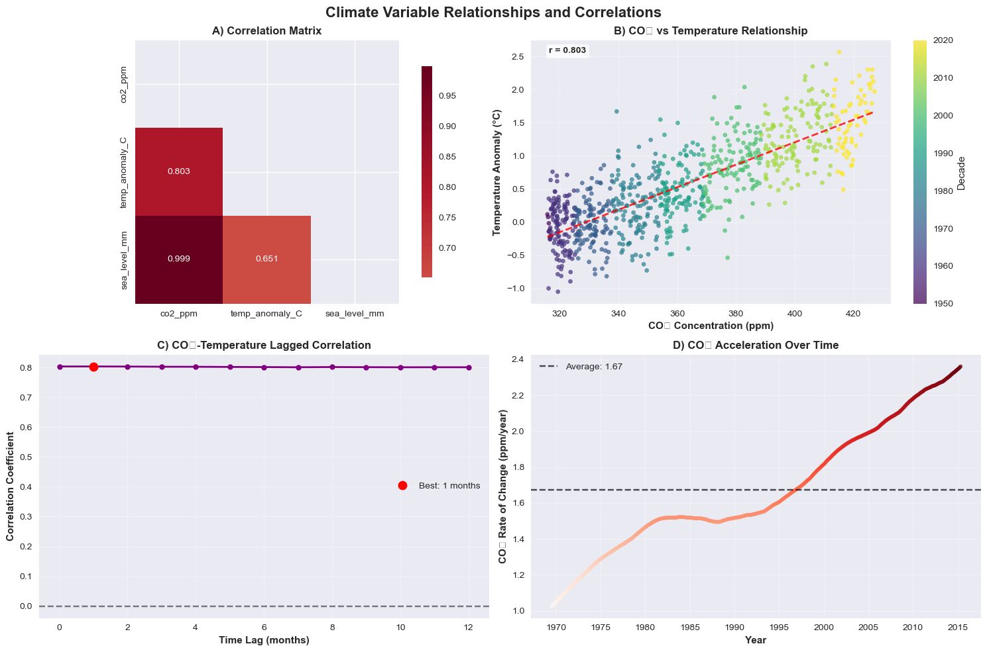
Correlation Analysis (cont.)
Pearson correlation matrix
Scatter plot (CO₂ vs. temperature, color-coded by decade)
Lag correlation (1-month lag, highest at r ≈ 0.803)

Slide 9
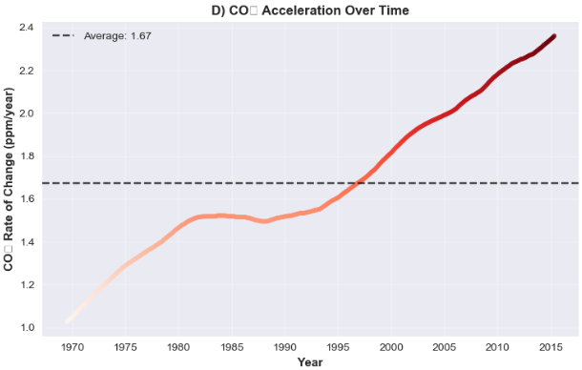
CO₂ Acceleration
Change point detection post-1970
Max acceleration, rate of increase as shown

Slide 10
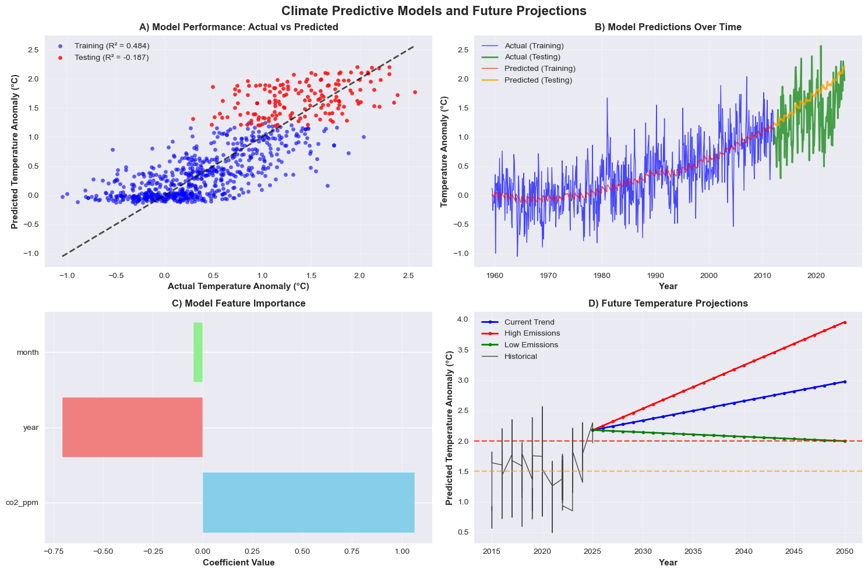
Predictive Modeling

Slide 11
Predictive Modeling (cont.)
Regression Results:
Train R² = 0.484
Test R² = -0.187 (possible overfitting)
Model feature importance (CO₂ as dominant)
Scatter plot for Actual vs. Predicted

Slide 12
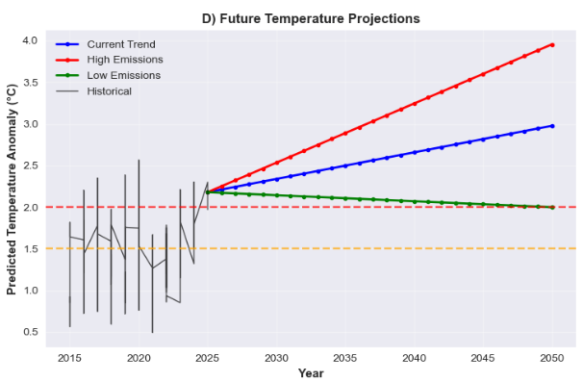
Future Projections
Emission Scenarios:
High: CO₂ > 480 ppm (RCP8.5-like)
Low: CO₂ ~ 400 ppm (RCP2.6-like)
Trajectories (Current vs. High vs. Low)

Slide 13
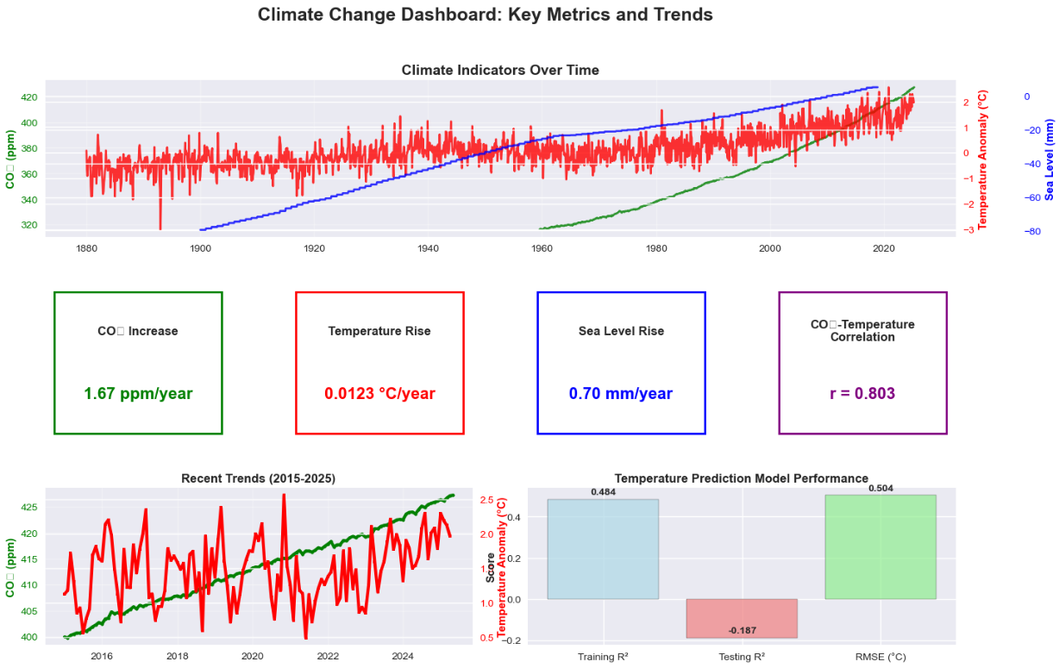
Comprehensive Dashboard Summary

Slide 14
Comprehensive Dashboard Summary (cont.)
Key visuals: trends, correlations, model performance, and projections
Enables exploration of CO₂, temperature, and sea levels over time
Includes feature impact breakdowns
Supports scientists, educators, and policy makers to explore various scenarios

Slide 15

Ethics and Limitations
Avoiding alarmism, see through the lens of responsibility
Potential for dataset uncertainty and model overfitting
Dataset transparency: GISTEMP, Mauna Loa, JPL RECON

Slide 16

Conclusions and Recommendations
CO₂ and temperature have strong, time-lagged correlation
Sea level closely follows both variables with observed acceleration
Predictive models offer useful signals, but further refinement will be needed
Useful for education, planning, and further scientific validation
Questions?

Slide 17

Thank You! Questions, thoughts, or follow-up? Let’s connect.
✉ Email: amelendez@my365.bellevue.edu; ceescamilla@my365.bellevue.edu; dslabaugh@my365.bellevue.edu; theflin@my365.bellevue.edu
☑ LinkedIn: Andres - https://www.linkedin.com/in/andres-melendez-8016461a2/; Carlos - https://www.linkedin.com/in/carlos-escamilla-21396a295/; Delilah – N/A; Tyler - https://www.linkedin.com/in/tyler-heflin-476817138/
ᯤ Portfolio: Andres – https://dre2322.github.io/portfolio/index.html; Carlos – https://carlose1977.github.io/portfolio; Delilah – https://dnsla.github.io/Portfolio/; Tyler – https://thfln.github.io/Portfolio
🖳 GitHub: Andres – https://github.com/Dre2322/; Carlos – https://github.com/carlose1977/; Delilah – https://github.com/dnsla/; Tyler – https://github.com/thfln/
🏦 Institution: Bellevue University – Department of Data Science – DSC450-T301 (Summer 2025)
This project was built using publicly available data from NASA GISTEMP, Mauna Loa CO₂ records, and NOAA JPL RECON.

