Slide 1
Three Dimension Vision Argument Reality Application
Prepared by:
DO Nhu Tai (176680)
Dec, 20th, 2017
Professor:
Lee, Chilwoo

Slide 2
Agenda
Introduction
Environment & Framework
Solved Problems
Results

Slide 3
1. Introduction
1. Introduction
Building a final project for argument reality and three dimension vision application
Environment
Framework: OpenCV with libraries such as calibrate, feature2d, and Aruco, MFC for visualization
Solved Problems
Detect markers and kind of Rigs
Calibrate camera and pose
Argument Reality in video

Slide 4
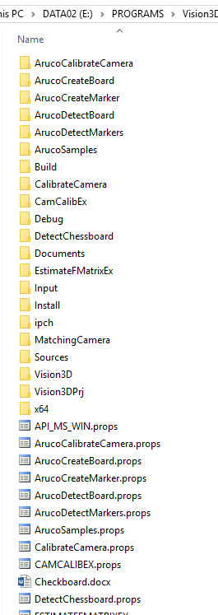
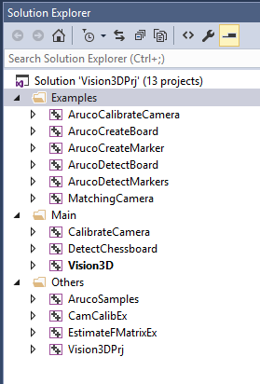
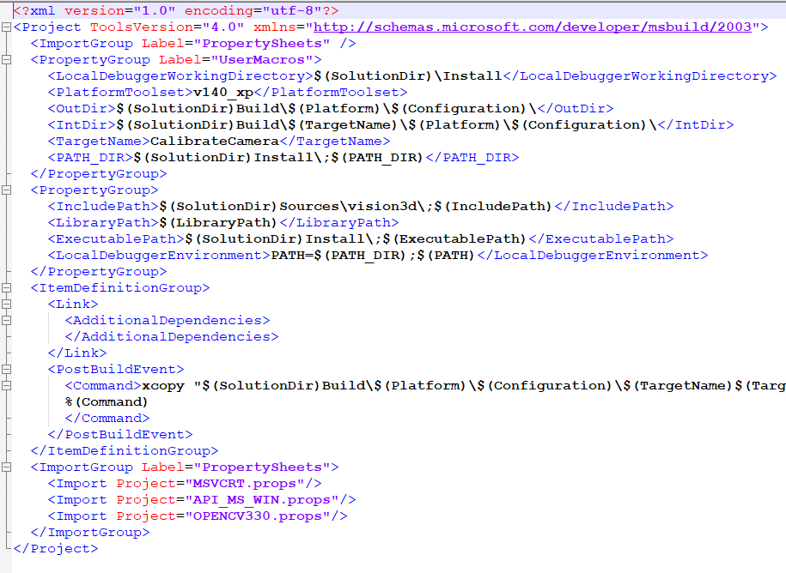
2. Environment & Framework
2. Environment & Framework
Develop on Visual Studio
Re-build OpenCV Library for supporting contribution module Aruco, xfeature2d, OpenGL, Viz
Property Manager Page for easy to manage project
Use MFC for GUI

Slide 5
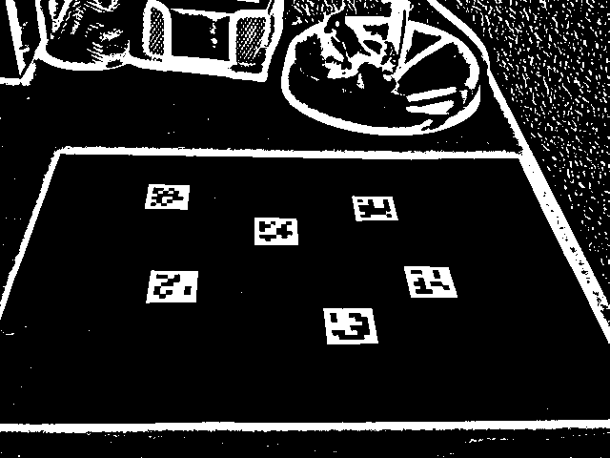
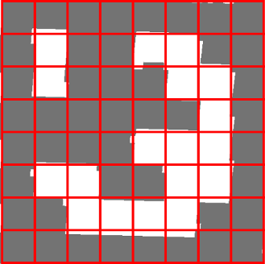

3. Solved Problems
3. Solved Problem
Find ChessBoard and Marker approach to two methods:
Using FindChessBoard in OpenCV
Optimize with Otsu Thresholding
Use Aruco Marker in OpenCV Contribute Module for createing and detecting chessboard and marker

Slide 6
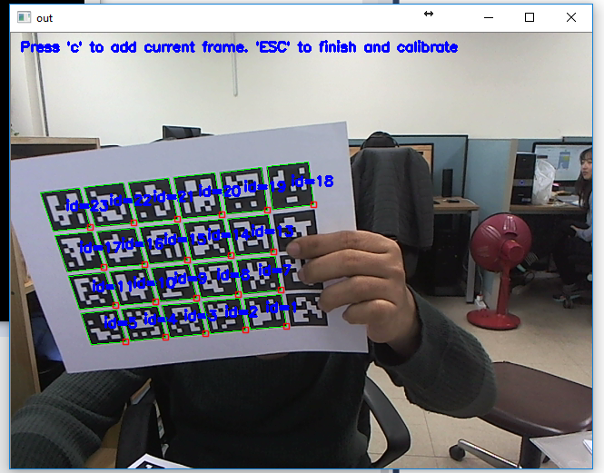
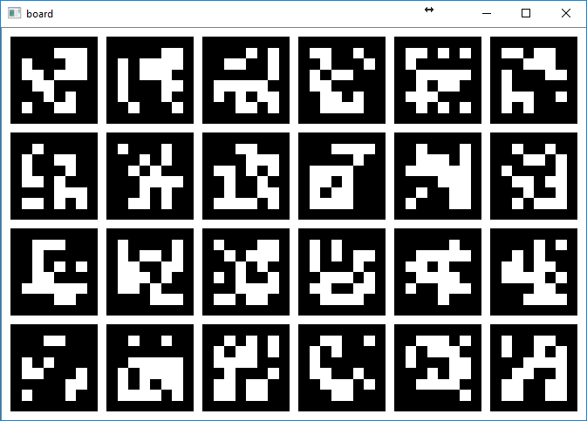
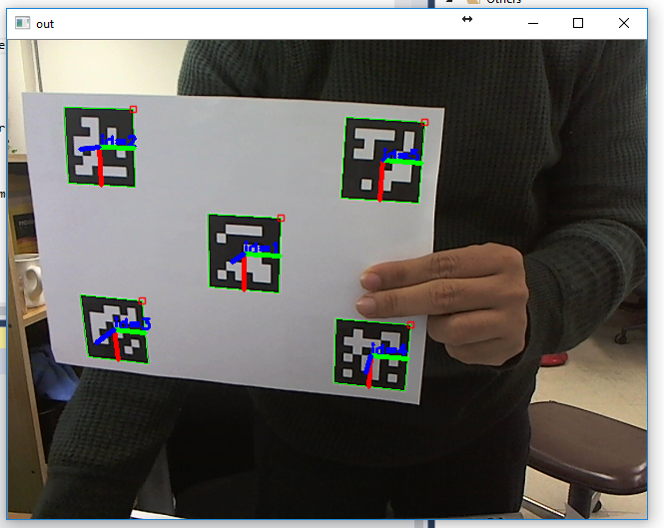
3. Solved Problems
3. Solved Problem
Calibration camera with OpenCV FindChessBoard and Aruco Chessboard
Detect Camera Pose with Arguco Checker

Slide 7
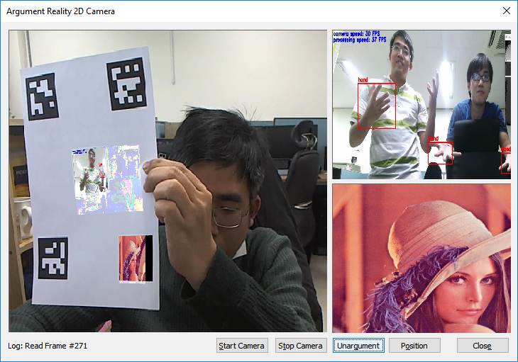
3. Solved Problems
3. Solved Problem
Argument Reality Camera From Video and Picture with Perspective Transform and Wrap Perspective

Slide 8
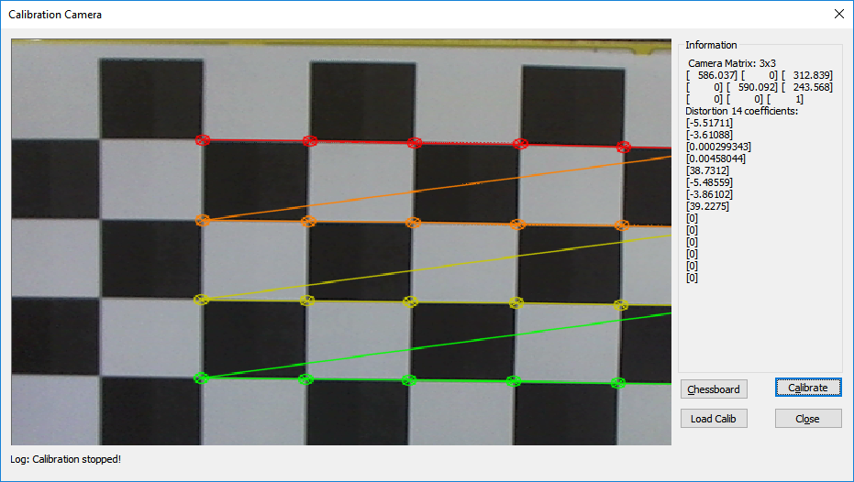
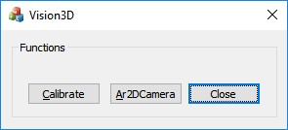
4. Results
4. Results: Calibration Camera

Slide 9
4. Results
4. Results: Argument Reality 2D Camera

Slide 10
THANKS FOR LISTENING!
Waiting for question!

