Slide 1
Artificial Intelligence Theory Term Project: Human Gender Prediction
2017.06.22
Nguyen Hai Duong
Source code: https://github.com/nhduong/human_gender_prediction

Slide 2
Contents
Problem Definition
Proposed Method
Experimental Results
Conclusion

Slide 3
Contents
Problem Definition
Proposed Method
Experimental Results
Conclusion

Slide 4


Problem Definition
Applications: Human-machine interaction, surveillance, etc.
?

Slide 5
Contents
Problem Definition
Proposed Method
Experimental Results
Conclusion

Slide 6
Proposed Method
Input image should be a face one
Simple CNN
Only one pooling layer after two convolutional layers

Slide 7
Contents
Problem Definition
Proposed Method
Experimental Results
Conclusion

Slide 8
Experimental Results (1/5)
Dataset: WIKI dataset [1]
70% 10% 20%
Randomly separating WIKI dataset
Unbalancing problem!
Horizontally flipping female training images
Total female training image after resampling is 17,670
[1] Rasmus Rothe, Radu Timofte, and Luc Van Gool, "Deep expectation of real and apparent age from a single image without facial landmarks," International Journal of Computer Vision (2016)

Slide 9
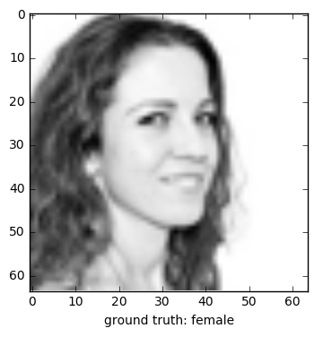
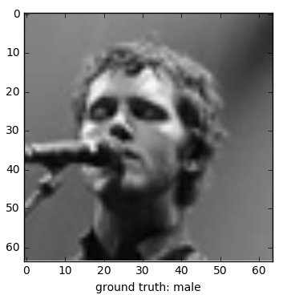
Experimental Results (2/5)
Dataset: WIKI dataset after resampling

Slide 10
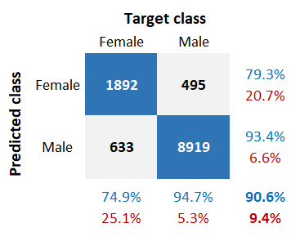
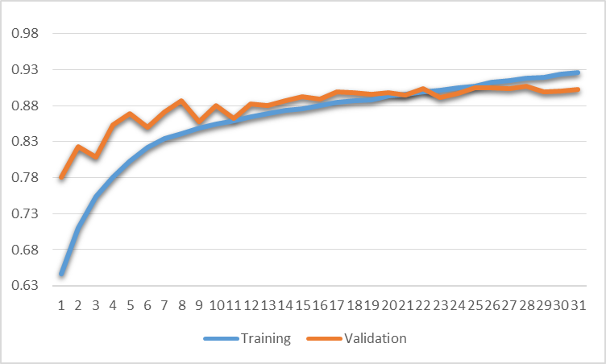
Experimental Results (3/5)
Average testing accuracy: 90.6%
accuracy
epoch
Figure 1. Training and validation accuracy.
Figure 2. Confusion matrix on testing set.

Slide 11
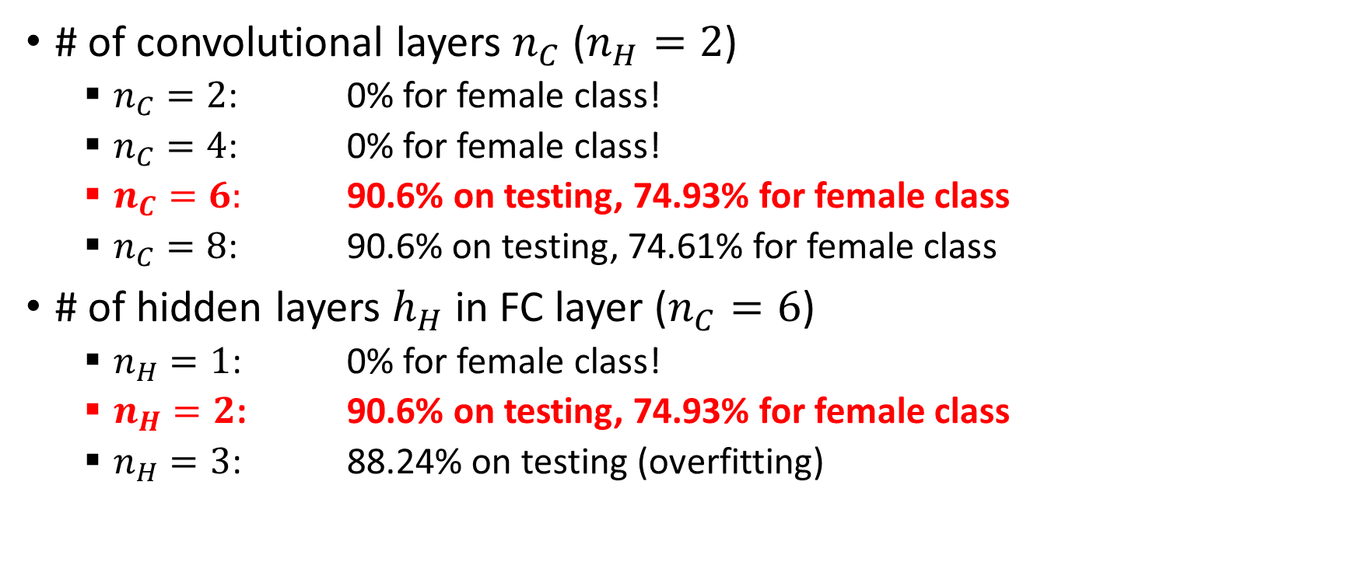
Experimental Results (4/5)
# of convolutional layers $n_{C}$ ($n_{H}=2$)
$n_{C}=2$: 0% for female class!
$n_{C}=4$: 0% for female class!
$n_{C}=6:$ 90.6% on testing, 74.93% for female class
$n_{C}=8$: 90.6% on testing, 74.61% for female class
# of hidden layers $h_{H}$ in FC layer ($n_{C}=6$)
$n_{H}=1$: 0% for female class!
$n_{H}=2$: 90.6% on testing, 74.93% for female class
$n_{H}=3$: 88.24% on testing (overfitting)

Slide 12
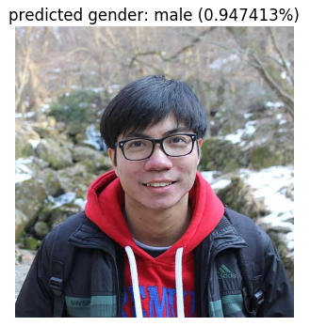
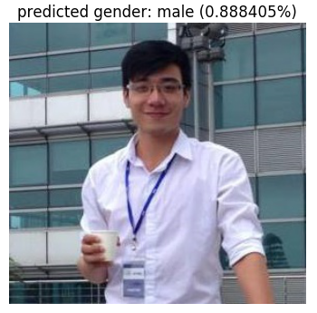
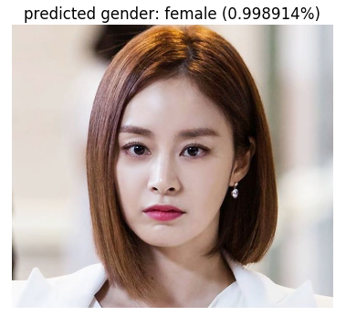
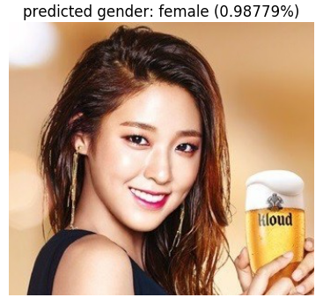
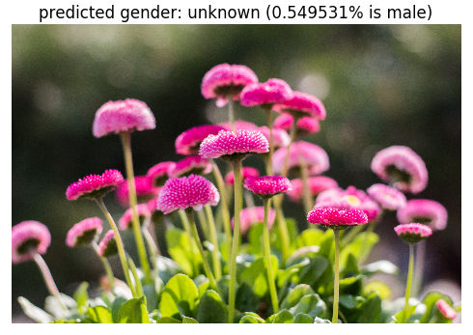
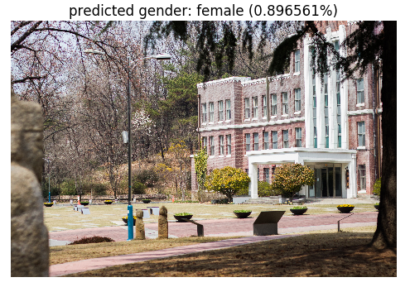
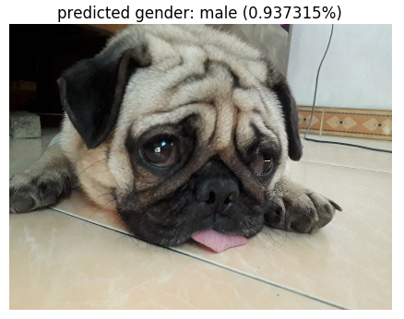
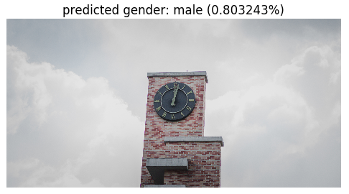
Experimental Results (5/5)
Successful cases
Failed cases
Face detection should be considered

Slide 13
Contents
Problem Definition
Proposed Method
Experimental Results
Conclusion

Slide 14
Experimental Results
The more the number of convolutional layers, the more the generated features
Pooling layers generate higher level features
Data unbalancing problem ← resampling, etc.
Human face detection should be taken into account

Slide 15
Thank you

