Slide 1
TensorFlow Installation on Windows with CPU/GPU Support
2017.03.16

Slide 2
Contents
Requirements
TensorFlow with CPU Support
TensorFlow with GPU Support

Slide 3
Requirements
CPU Version | GPU Version
Windows 7/8/8.1/10 64bit
Python 3.5.x
 | NVIDIA GPU card with CUDA Compute Capability 3.0 or higher
 | Visual Studio 2010/2012/2013/2015 (2015 is recommended)
 | The latest NVIDIA driver
 | CUDA® Toolkit 8.0
 | cuDNN v5.1

Slide 4
TensorFlow with CPU Support
Anaconda 4.2.0 with Python 3.5
TensorFlow 1.0.1

Slide 5
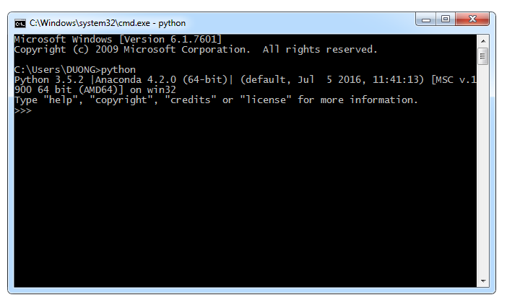
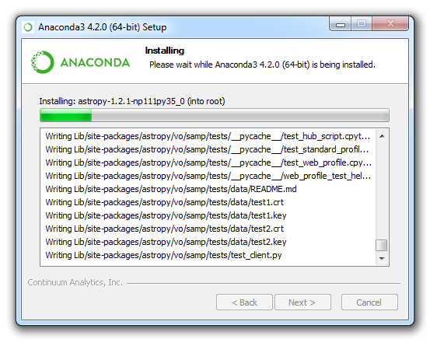
TensorFlow with CPU Support (1/3)
Python Installation
Install Anaconda 4.2.0 with Python 3.5
Download the installer:
https://repo.continuum.io/archive/Anaconda3-4.2.0-Windows-x86_64.exe
Validate the installation:
Open Command Prompt
Type python
Output:
Python 3.5.2 |Anaconda 4.2.0 (64-bit)…
…
>>>

Slide 6
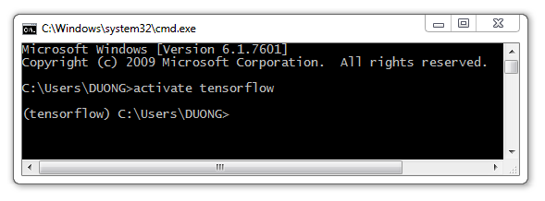
TensorFlow with CPU Support (2/3)
TensorFlow Installation
Create installation environment
Open Command Prompt as Administrator
Create a conda environment named tensorflow by the command:
C:\> conda create -n tensorflow
Output:
Fetching package metadata .........
…
Proceed ([y]/n)?
Press Enter
Activate the conda environment:
C:\> activate tensorflow
Your prompt should change to: (tensorflow) C:\> (instead of C:\>)

Slide 7
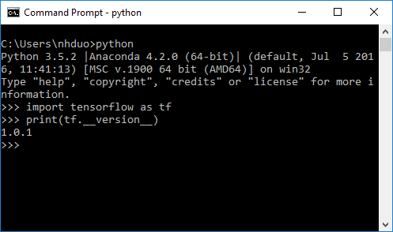
TensorFlow with CPU Support (3/3)
TensorFlow Installation
Install TensorFlow
Download and install TensorFlow by the following command:
(tensorflow)C:\> pip install --ignore-installed --upgrade https://storage.googleapis.com/tensorflow/windows/cpu/tensorflow-1.0.1-cp35-cp35m-win_amd64.whl
Validate your installation:
Open Command Prompt
Type python
Type import tensorflow as tf
Type print(tf.__version__)
Output:
1.0.1 (The version of the TensorFlow)

Slide 8
TensorFlow with GPU Support
Anaconda 4.2.0 with Python 3.5
Visual Studio 2010/2012/2013/2015
NVIDIA driver
CUDA® Toolkit 8.0
cuDNN v5.1
TensorFlow 1.0.1

Slide 9
TensorFlow with GPU Support (1/4)
Python Installation
Install Anaconda 4.2.0 with Python 3.5
Similar to the CPU version!

Slide 10
TensorFlow with GPU Support (2/4)
GPU Support Installation
GPU card with CUDA Compute Capability 3.0 or higher?
https://developer.nvidia.com/cuda-gpus
Download and install NVIDIA driver at:
http://www.nvidia.co.kr/Download/index.aspx
Download and install CUDA® Toolkit 8.0:
https://developer.nvidia.com/cuda-downloads
Download cuDNN v5.1: https://developer.nvidia.com/cudnn.
Extract downloaded file
Copy bin, include, and lib to
%ProgramFiles%\NVIDIA GPU Computing Toolkit\CUDA\v8.0
Restart your computer to apply system’s changes

Slide 11
TensorFlow with GPU Support (3/4)
TensorFlow Installation
Create installation environment (Similar to the CPU version!)
Open Command Prompt as Administrator
Create a conda environment named tensorflow by the following command:
C:\> conda create -n tensorflow
Output:
Fetching package metadata .........
…
Proceed ([y]/n)?
Press Enter
Activate the conda environment:
C:\> activate tensorflow
Your prompt should change to: (tensorflow) C:\> (instead of C:\>)

Slide 12
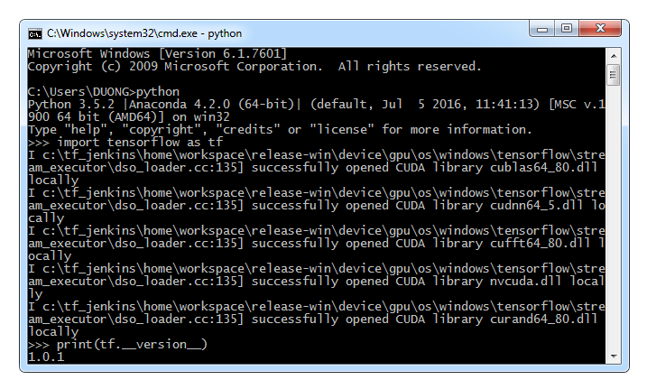
TensorFlow with GPU Support (4/4)
TensorFlow Installation
Install TensorFlow
Download and install TensorFlow by the following command:
(tensorflow)C:\> pip install --ignore-installed --upgrade https://storage.googleapis.com/tensorflow/windows/gpu/tensorflow_gpu-1.0.1-cp35-cp35m-win_amd64.whl
Validate your installation:
Open Command Prompt
Type python
Type import tensorflow as tf
Type print(tf.__version__)
Output:
…
Successfully opened CUDA library
…
1.0.1 (The version of the TensorFlow)

Slide 13
Integrated Development Environment (IDE)
Command Prompt
Notepad
Notepad++
PyCharm (heavy memory usage)
Spyder (lack of autocomplete for TensorFlow)
Eclipse + PyDev (lightweight, fast, and supports autocomplete)
…

Slide 14
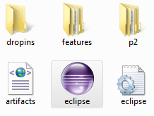

Eclipse IDE + PyDev + TensorFlow (1/5)
Eclipse
Install JRE 8
http://www.oracle.com/technetwork/java/javase/downloads/jre8-downloads-2133155.html
Download Eclipse 3.8
http://www.eclipse.org/downloads/download.php?file=/eclipse/downloads/drops/R-3.8.2-201301310800/eclipse-platform-3.8.2-win32-x86_64.zip
Extract downloaded file and execute eclipse.exe

Slide 15
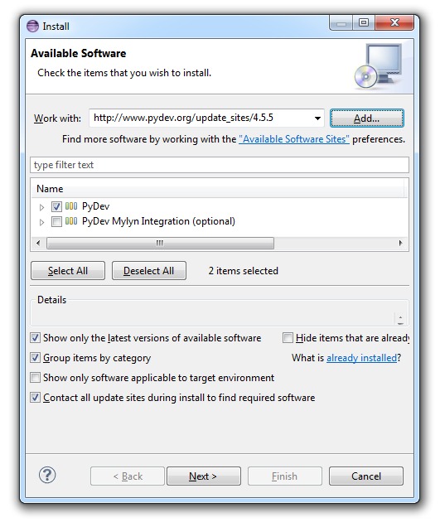
Eclipse IDE + PyDev + TensorFlow (2/5)
PyDev + TensorFlow
Install PyDev:
In Eclipse main window
Help > Install New Software…
Work with: http://www.pydev.org/update_sites/4.5.5
Add > Select PyDev > Next…
…
Restart Eclipse

Slide 16
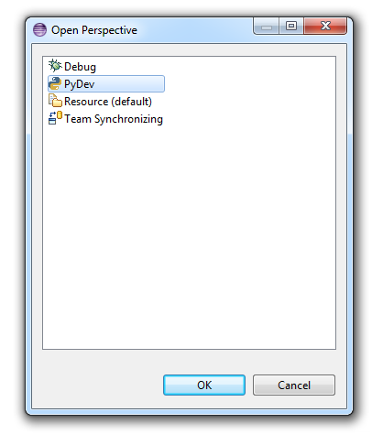
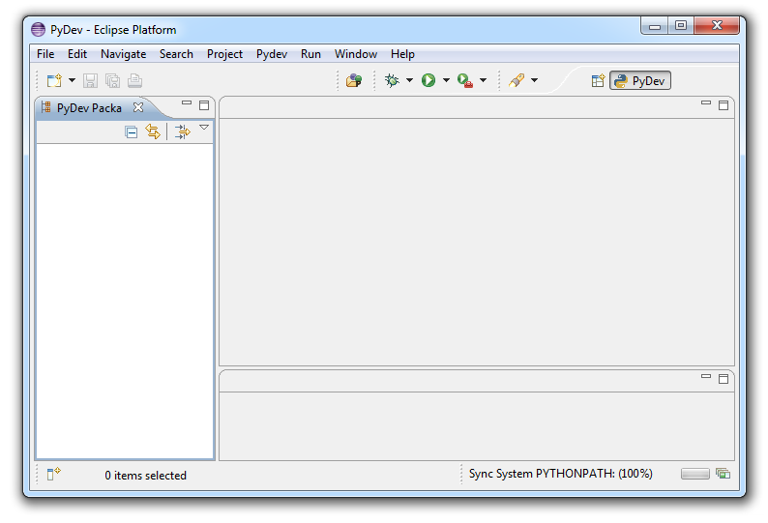
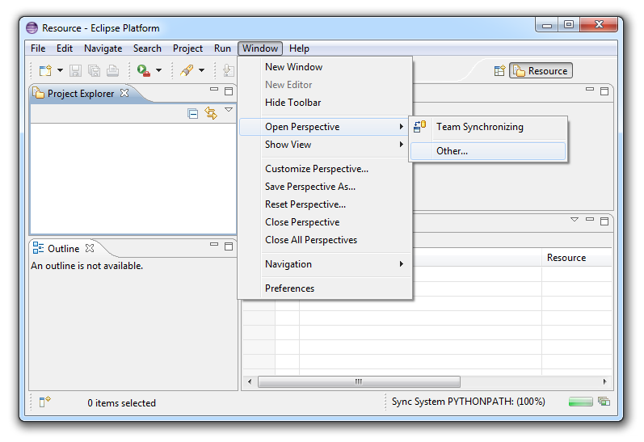
Eclipse IDE + PyDev + TensorFlow (3/5)
PyDev + TensorFlow
Start PyDev:
In Eclipse main window
Window > Open Perspective > Other…
Select PyDev > OK

Slide 17
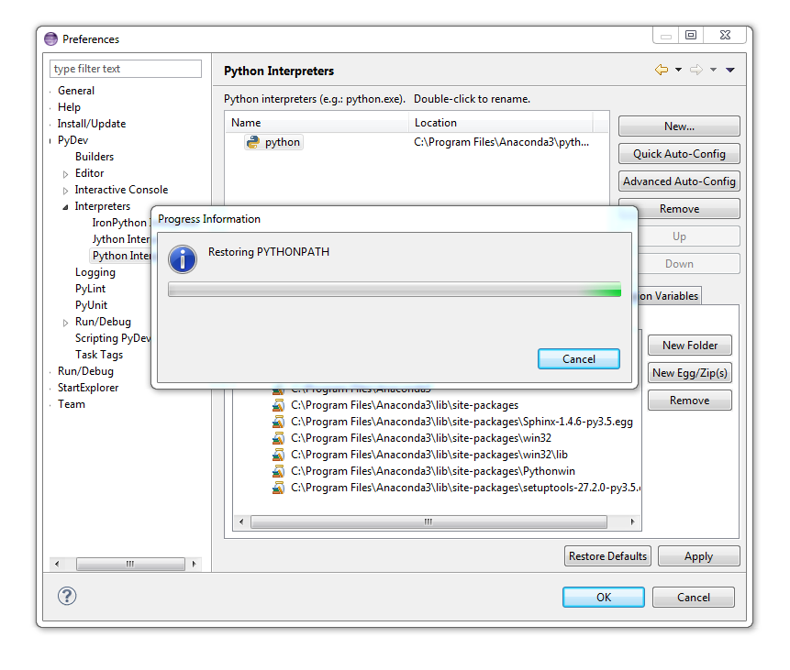
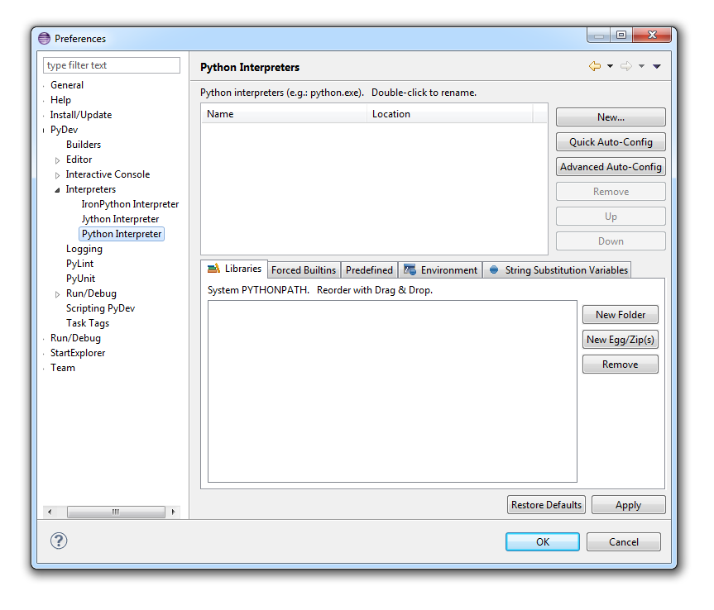
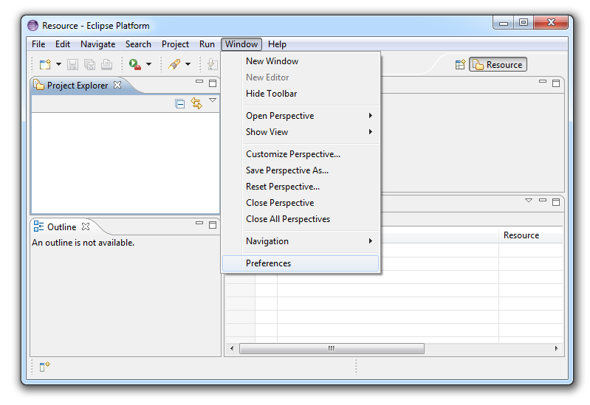
Eclipse IDE + PyDev + TensorFlow (4/5)
PyDev + TensorFlow
Setup PyDev interpreter:
In Eclipse main window
Window > Preferences
PyDev > Interpreters > Python Interpreter
Quick Auto-Config > Apply
OK

Slide 18
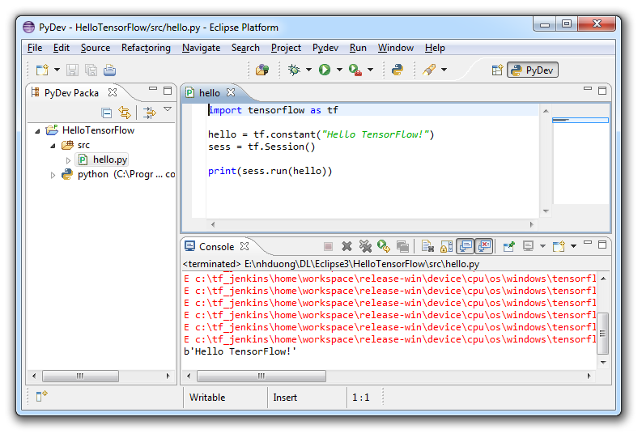
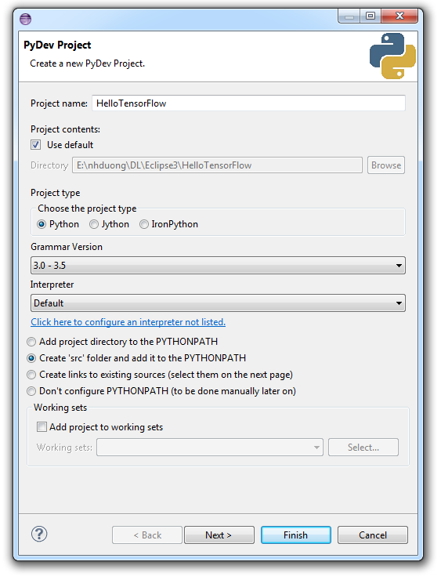
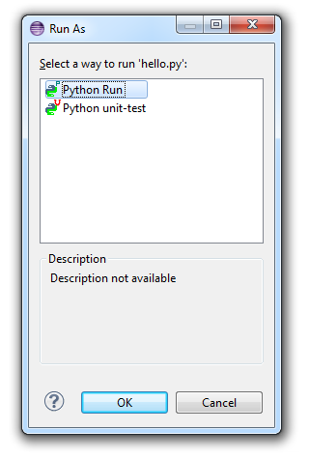
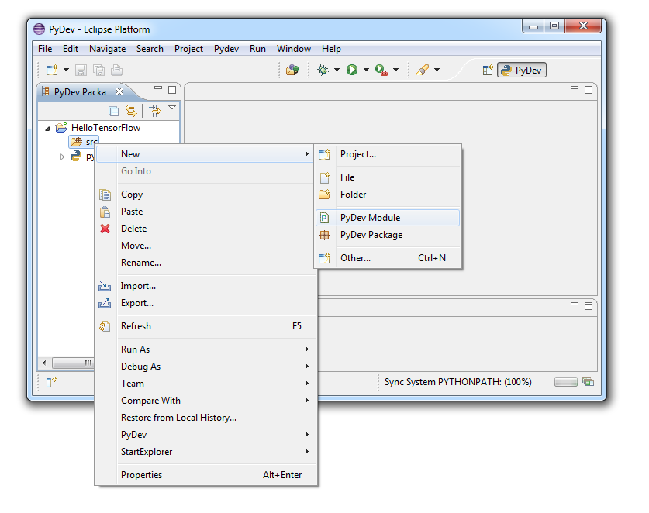
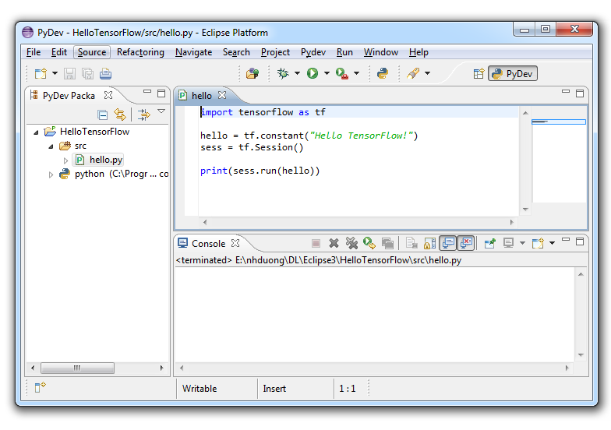
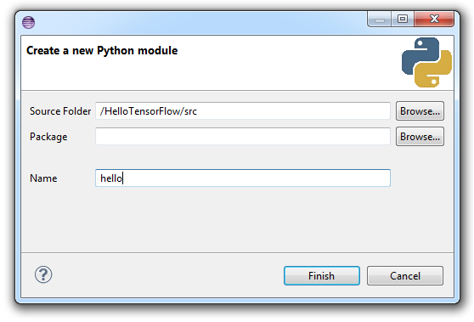
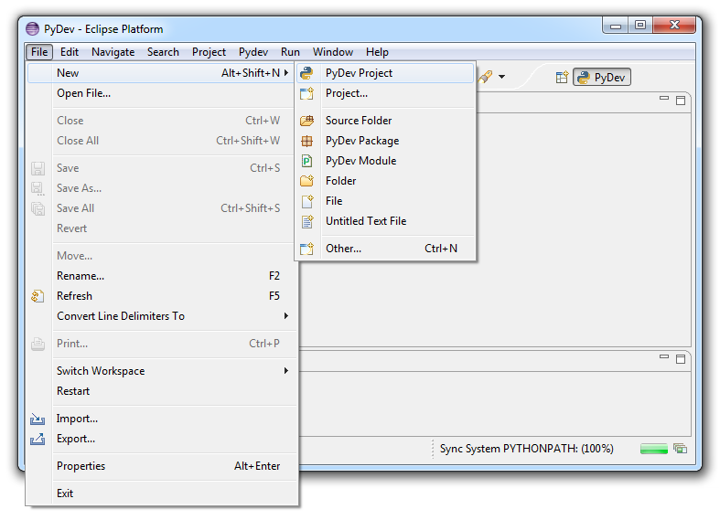
Eclipse IDE + PyDev + TensorFlow (5/5)
PyDev + TensorFlow
Hello TensorFlow program
In Eclipse main window
File > New > PyDev Project
Type Project name, select Create ‘src’…
Finish
Right-click src > New > PyDev Module
Type Name > Finish
…
Ctrl + F11 > select Python Run > OK

Slide 19
Thank you

