Slide 2

Introduction to Git and GitHub
Daniel-Iosif Trubacs
1 December 2023

Slide 3

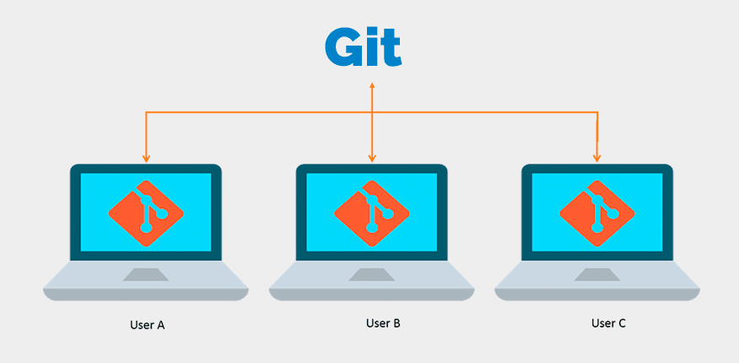
What is Git?
Git is the most popular version control system and most software hosting services (for example GitHub) are built around it.

Slide 4
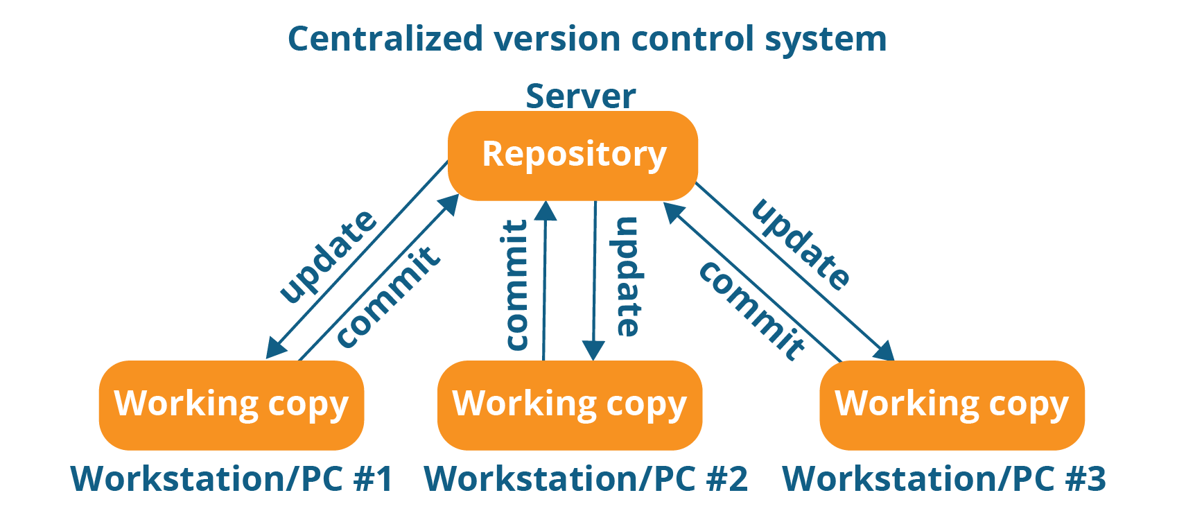
Version Control Systems
Version control is class systems responsible for managing changes in computer programs and applications.

Slide 5
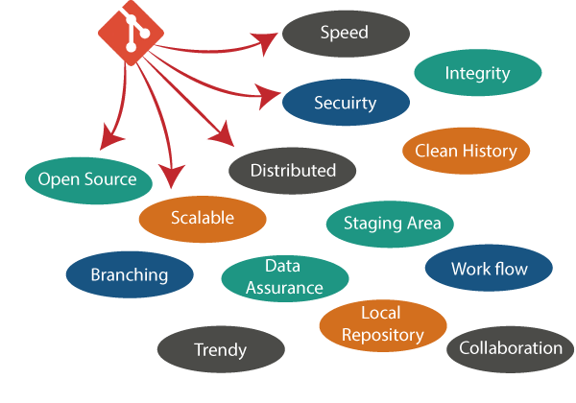
Why use Git?
Absolutely necessary when working in a team (from personal experience).
All companies use git to keep track of their software development.
Personal use such as keeping tracks of documents or reports.
Easiest way to maintain a good coding workflow.

Slide 6
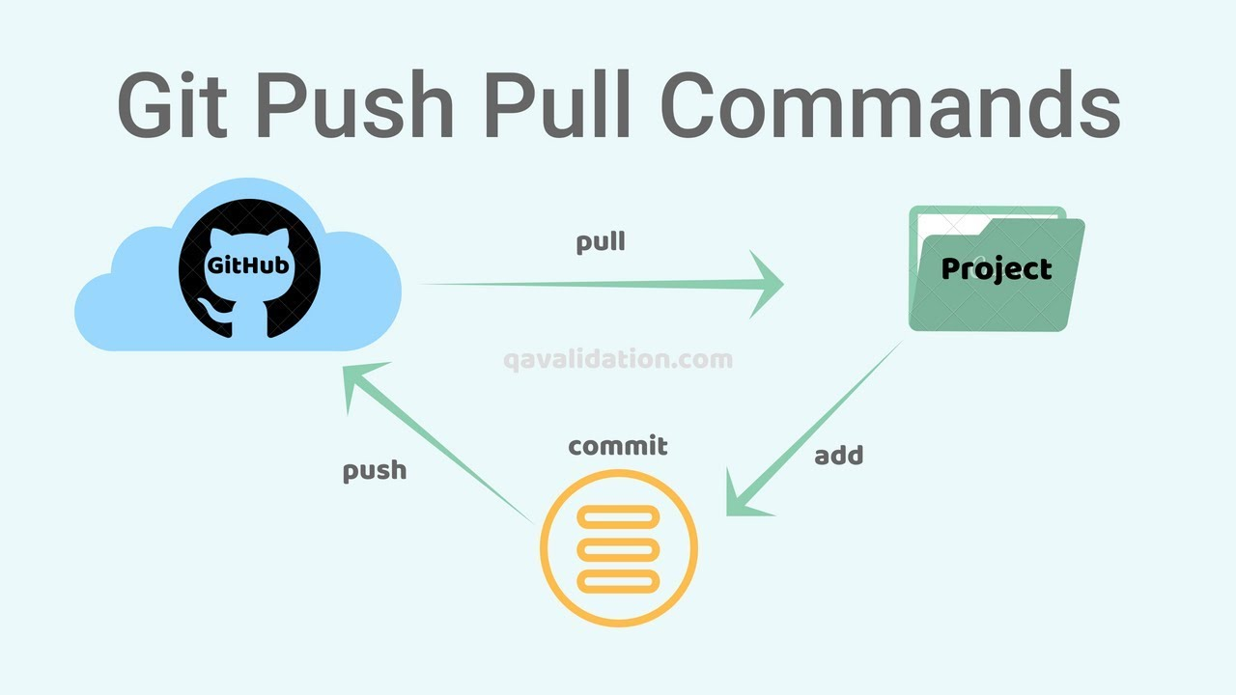
Basics of Git
Fetch (git fetch) – Checks the remote repository for changes.
Pull (git pull) – Retrieves changes from the remote repository.
Add (git add) – Adds files to the “Staging Area”, basically lets git know that these are files important.
Commit (git commit) – Saves current changes to your local repository (code stored on your local machine).
Push (git push) – Sends the local changes of the code to the remote repository.

Slide 7

Basics of Git
Git branches represent different version of the code. The most important branch is called main (formerly known as master).

Slide 8
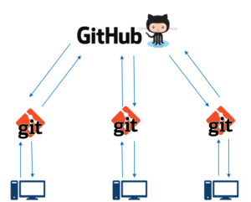
GitHub
Git is most efficient when used with a remote repository (remote server) to keep track of software development.
GitHub is the most popular cloud-based service used for version control.

Slide 9
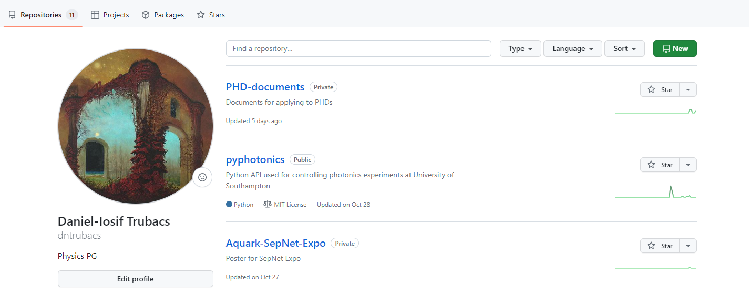
Installation
Download and install git from: https://git-scm.com/
Go to GitHub and create an account if you don’t have one.
Go to repositories and create a new one

Slide 10
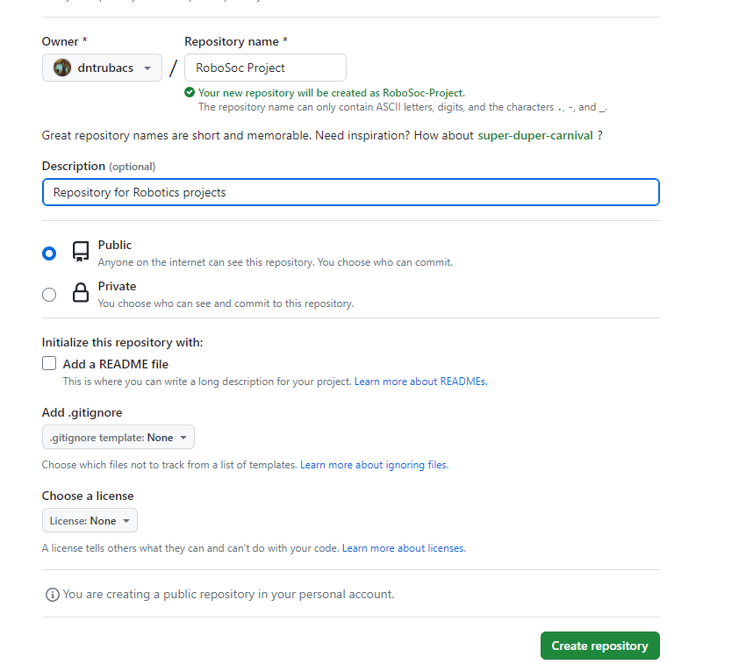
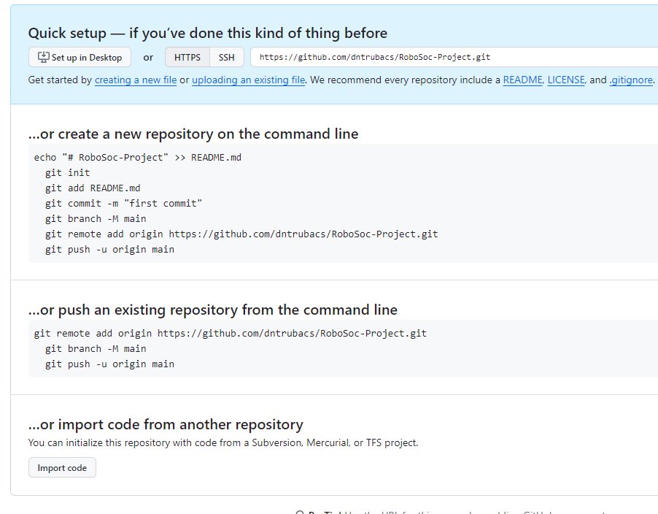
Installation
Complete the requirements and create the repository.

Slide 11
Installation
Create a Folder where you want to store your current project.
Open the Terminal (Command prompt) and navigate to the address of the folder:
Initialize a Git repository with the initial branch main:
Add the remote repository as origin:
cd C:\Users\Dani\robotics
git init --initial-branch=main
git remote add origin https://github.com/dntrubacs/RoboSoc-Project.git

Slide 12
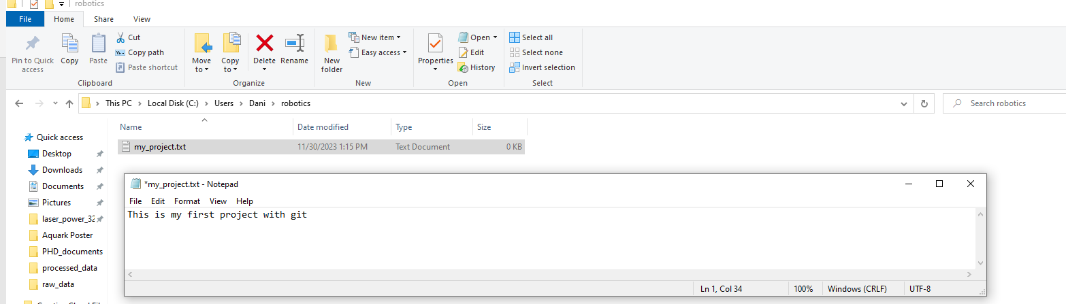
Installation
Fetch the latest version of the code (in this case the remote repository is empty)
In the case that the repository it’s not empty, pull the changes
Create a new text file and added to the folder:
git fetch
git init --initial-branch=main

Slide 13
Installation
Run git status to see what changes are currently:
Add the file to the local repository:
Commit the changes
git status
git add my_project.txt
git commit -m "My first commit"

Slide 14
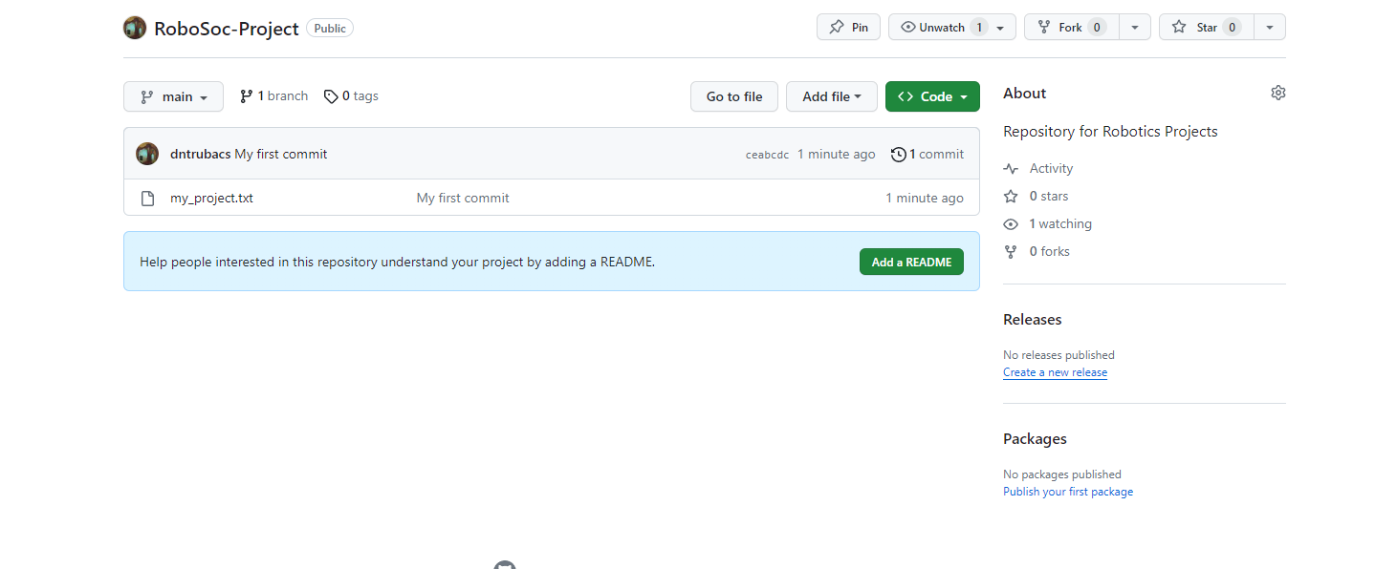
Installation
Push the changes to remote repository:
git push –u origin main

Slide 15
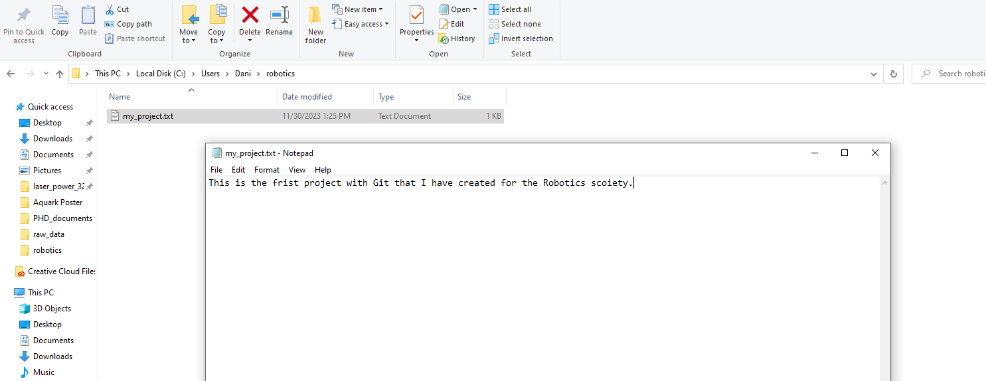
Further use
Now we want to make full use of git and make changes to our files. Create a new branch named development because we never want to push directly to main (main is usually protected).
Make some changes to file and then rut git status to see that recognizes the changes:
git checkout -b development main

Slide 16
Further use
Add the file to the Staging Area:
Commit and write a significant commit description:
Push the changes to the remote development branch:
git add my_project.txt
git commit -m "Changed project description"
git push -u origin development

Slide 17
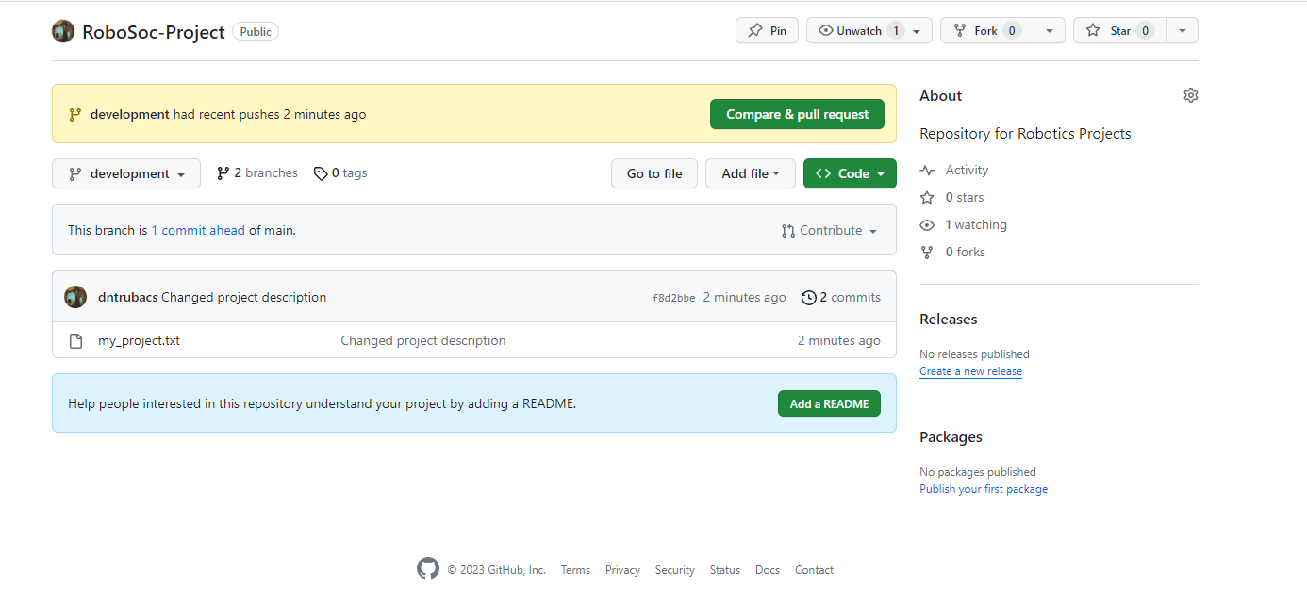
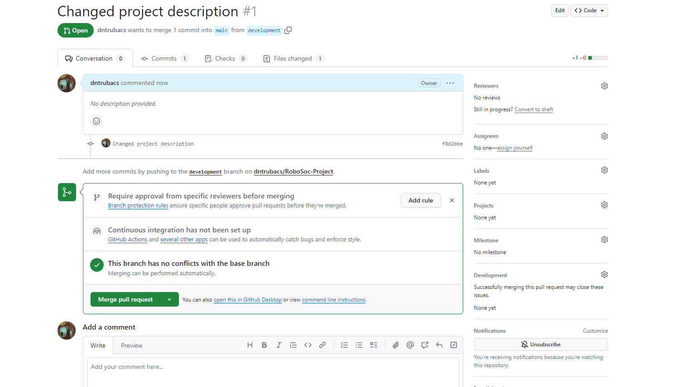
Further use
We can see now on the remote repository the changes, but we would like the changes to be to main (that’s where the main and most important of the code must be).
To do this, we will merge the branches.

Slide 18
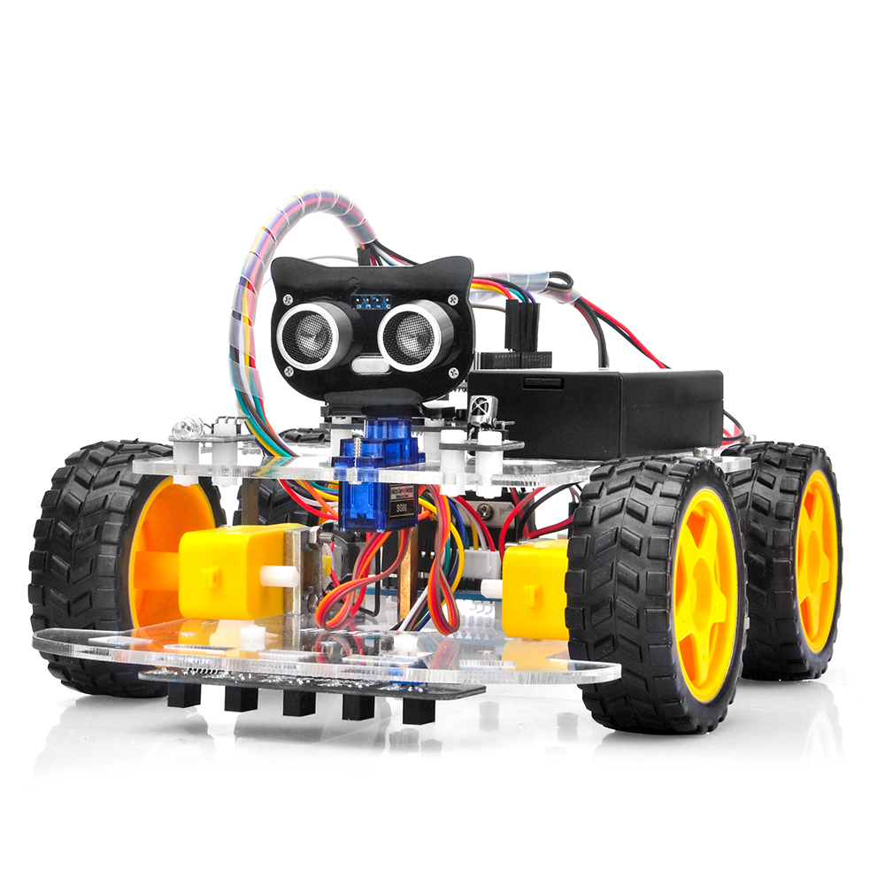
DIY
Now try to upload your current Arduino Robot Project to GitHub using Git!

Slide 19
Further Help
This has been just an introduction, but there are an infinity of possibilities you can use git. Some useful links:
Git tutorial: https://www.youtube.com/playlist?list=PL4cUxeGkcC9goXbgTDQ0n_4TBzOO0ocPR
Git basics from Atlassian: https://www.atlassian.com/git
More advanced Git uses from Atlassian : https://www.atlassian.com/git/tutorials/advanced-overview
How to create a workflow (CI/CD pipeline) in GitHub: /https://docs.github.com/en/actions/using-workflows/about-workflows

