Slide 1

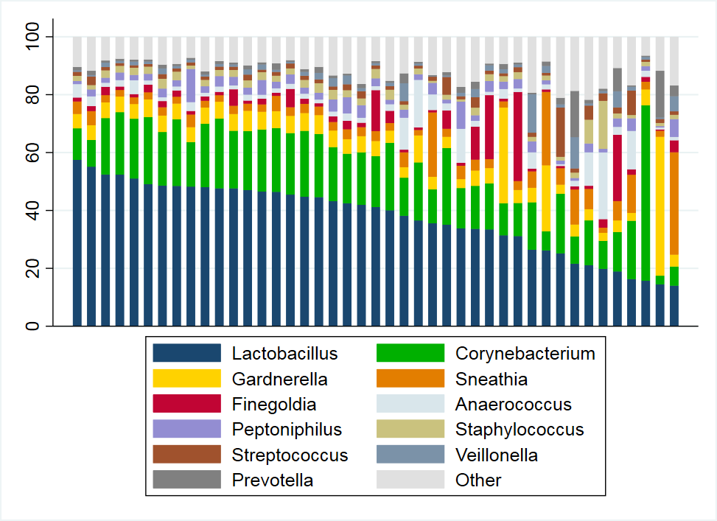
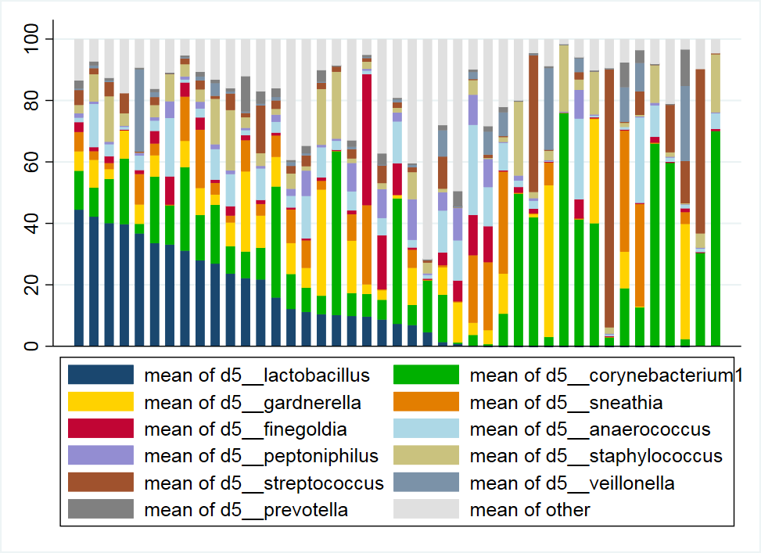
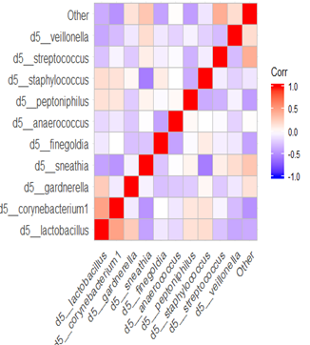
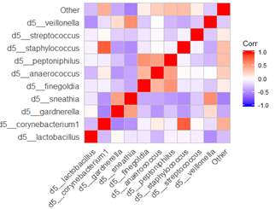
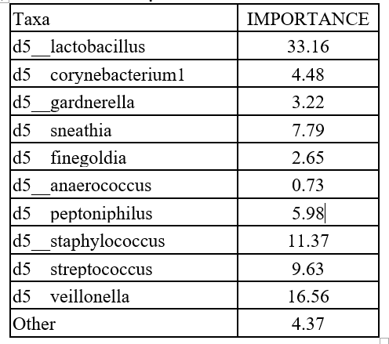
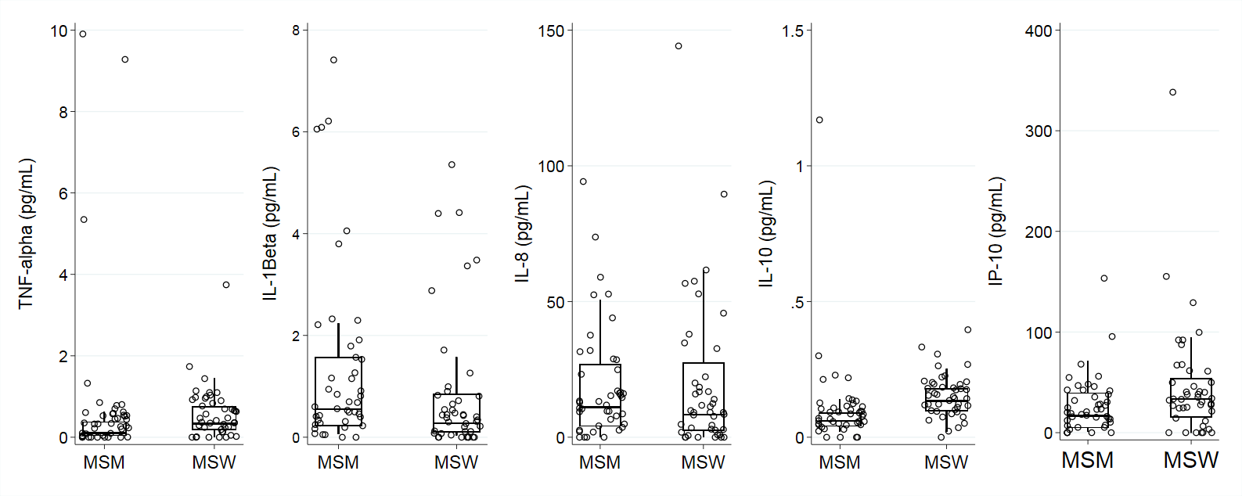
The role of penile microbiome in explaining differential mucosal inflammatory cytokines between men who have sex with men and men who have sex with women.
Debarghya Nandi¹, Dulal Bhaumik¹, Duncan Okal, Fredrick Otieno³, George N’gety, Eve Obondi, Robert C. Bailey¹, Supriya D. Mehta.¹
¹ Division of Epidemiology and Biostatistics, University of Illinois at Chicago School of Public Health, Chicago, IL, USA
. ² Department of DNA Services, University of Illinois at Chicago, Chicago, IL, USA ³ Nyanza Reproductive Health Society, Kisumu, Kenya.
Background
Results
Statistical Approach
Men who have sex with men (MSM) are disproportionately affected by HIV/STI as compared to men who have sex with women(MSW).
This is hypothesized to be due to different burdens of mucosal inflammation.
Correlation heatmap of top 10 penile microbiome taxa
Relative Abundance of top 10 penile microbial taxa
Filter MSM and MSW genus level taxa to remove taxa with < 1% of total sequence reads.
Normalize samples by dividing by total number of reads(RA) and use the Centered Log Ratio Transform(CLR).
Random Forest with 5 –fold CV to identify genus level taxa differing between MSM and MSW.
Linear regression to model cytokines as a function of the genus level taxa.
Brightness of colors (red for positive and blue for negative) depict strength of correlation.
MSM
MSW
MSM
MSW
Aim
We evaluate if there is any significant association of penile microbial composition with mucosal inflammation.
Lactobacillus, Corynebacterium1 and Gardnarella were observed to be most abundant for MSM and MSW.
Discussion
Taxa importance from Random Forest Classification of MSM vs MSW
Summary of urinary cytokine concentrations by MSM/ MSW status.
Prediction of status
Composition and influence of taxa has been observed to be significantly different for MSM and MSW.
Cytokine concentration
All cytokines except IL-8 were significantly elevated for MSW as compared to MSM.
Association of taxa with cytokines
Microbiome composition did not account for difference in TNF- α, IP – 10 or IL-10 between MSM and MSW.
Design and Methods
Samples were collected from 43 HIV (-) MSM and 43 HIV(-) MSW residing in Kisumu, Kenya.
Subjects were matched on age and circumcision status.
Penile microbiome was assessed via shallow meatal swab, with 16s rRNA amplicon sequencing of the V3-V4 regions.
Urinary cytokine concentrations were measured using Luminex.
Lactobacillus, Veilonella and Staphylococcus were selected by Random Forest as top features based on gini information.
A statistically significant difference in mean was observed for all cytokine groups except for IL-8. Wilcoxon Rank-Sum was used for this test at alpha = 0.05.
Acknowledgement
NIH, NIAID, DMID RO1 AI110369(PI- Mehta)
Staff and participants in Kisumu.

