Slide 1
component-model
A python package on top of PythonFMU for easy construction of FMUs based on python models
Siegfried.Eisinger@DNV.com, Jorge.Luis.Mendez@dnv.com and Claas.Rostock@DNV.com

Slide 2
PythonFMU++ a quick and nice way to construct FMUs
BouncingBall3D
InputTable
Crane
ForcedOscillator
Variable management
FMU build process
https://github.com/dnv-opensource/component-model
component-model
Units
Range
NP-arrays
Model
Variable
PythonFMU
Fmi2Slave
ScalarVariable
Updates

Slide 3
In addition to model class: interface
Define interface according to FMU rules
Parameters
Input connectors
Output connectors
for all these
units can be defined (provide start value as string with units)
range can be defined (lower and upper value)
variables can be numpy vectors

Slide 4
Variable definition example
Variable(
self,
name= "pos",
description= "The 3D position of the ball [m] …",
causality= "output",
variability= "continuous",
initial= "exact",
start= ("1 m", "1 m", "1 inch"),
rng= ((0, "100 m"), None, (0, "10 m"))
)
The model is owner of the variable
The value is accessible as ‘self.pos’ inside model
Position with units. z-axis in inch
Range of components.y-axis constant

Slide 5
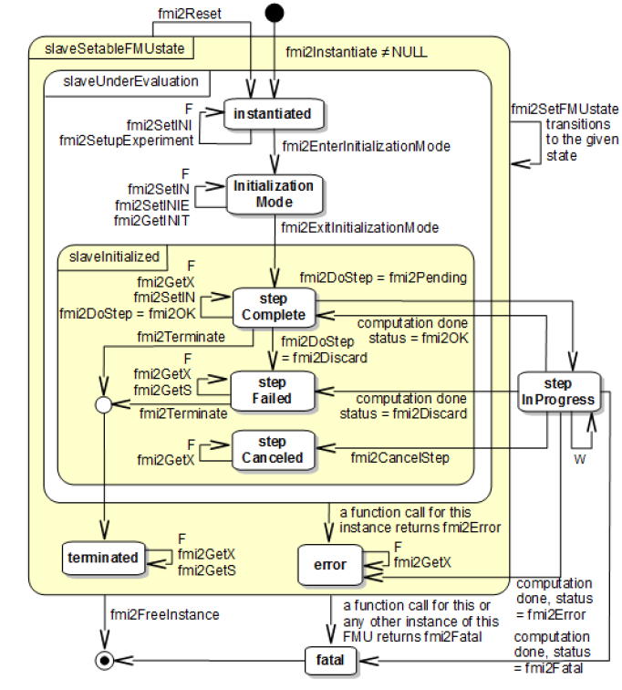
FMI flow within co-simulation
setup_experiment(start_time): model instantiated.
Internal states can be set
enter_initialization_mode(): Variables not yet initialized
exit_initialization_mode(): Variables initialized (initial=‘exact’ or ‘approx.’. Internal states dependent on these can be calculated
do_step(time,step_size): The inner loop of the model. !return True!
terminate(): Terminates the model. Normally left alone.

Slide 6
Full Variable instantiation options
Variable( model, # Variable owned by model
name: str, # Unique name within model
description: str = "", # Optional but highly recommended
causality: str | None = "parameter", # parameter, calculatedParameter, input, output, local
variability: str | None = "fixed", # constant, fixed, tunable, discrete, continuous
initial: str | None = None, # see fmi2, 2.2.7. -, exact, approx, calculated
typ: type | None = None, # explicit component type (necessary for int and str)
start = None, # initial value (with units, as str)
rng: tuple | None = tuple(), # optional range ((lower, upper), )
annotations: dict | None = None, # optional annotations as dict
value_check: Check = Check.all, # Check.r_none to deactivate range check
on_step: Callable | None = None, # optional function (time, step_size) called @do_step()
on_set: Callable | None = None, # optional function (val) called with changed value
owner: Any | None = None, # optional owner other than model, e.g. sub-model-unit
value_reference: int | None = None # optional manual setting. Unique! Careful!
)

Slide 7
component-model
A python package on top of PythonFMU for easy construction of FMUs based on python models
Siegfried.Eisinger@DNV.com, Jorge.Luis.Mendez@DNV.com and Claas.Rostock@DNV.com

