Slide 1
sim-explorer
Configuration-based experimentation package for OSP system models
Siegfried.Eisinger@DNV.com, Jorge.Luis.Mendez@DNV.com and Claas.Rostock@DNV.com

Slide 2
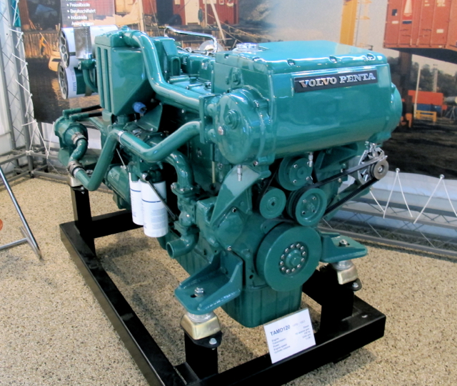
Modularization and collaboration crucial for simulation
System Models can/should be built from Component Models
Collaboration requires standardized interfaces
Protection of IPR requires precautions
Requires co-simulation technology
System Model
Component A
Component C1
Component B
Component D
Component C2
Diesel engine. Source: https://en.wikipedia.org/wiki/Volvo_Penta#/media/File:VolvoPentaTAMD120.jpg
Component Model (i.e. water pump)

Slide 3
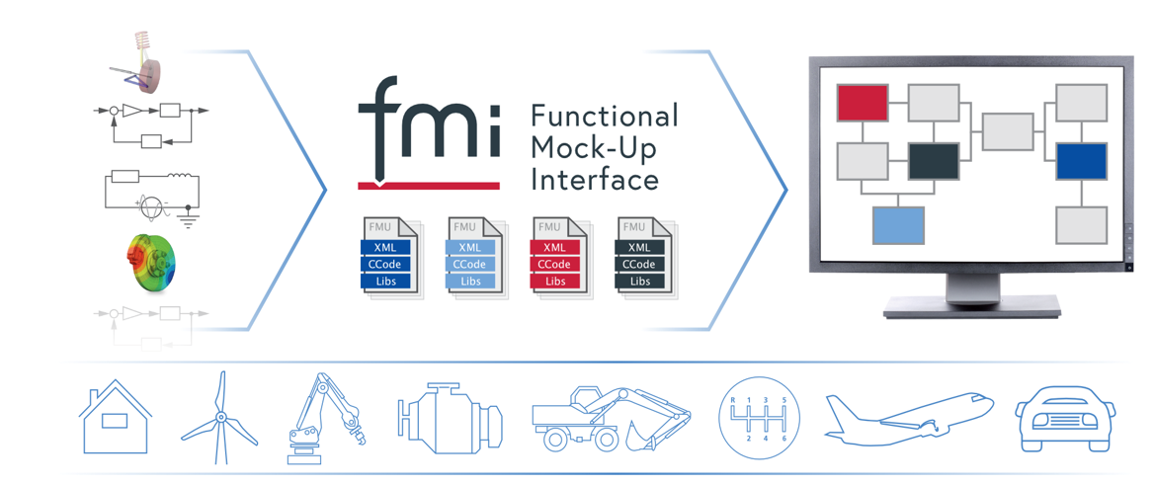
Functional Mock-up Interface (FMI):
Component interface and packaging standard developed by automotive industry.
Now version 3
www.fmi-standard.org

Slide 4
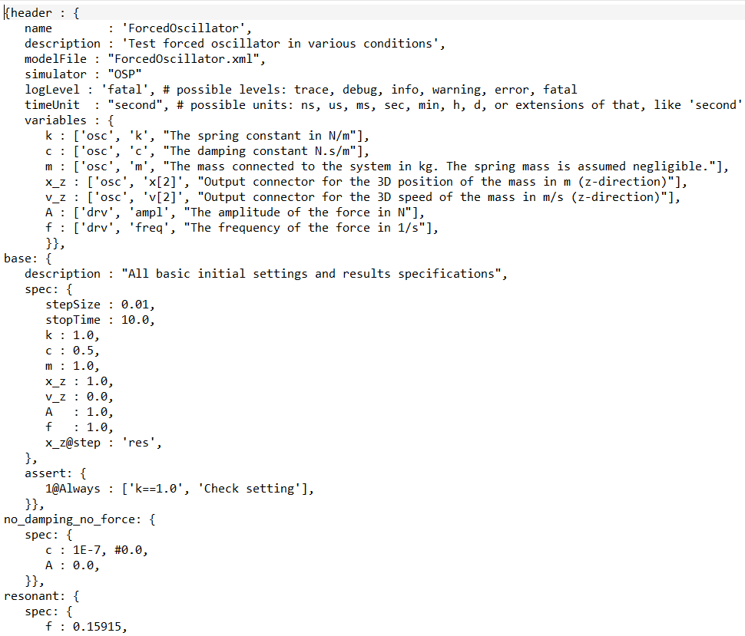
Sim-explorer an emerging OSP experimentation manager
How to efficiently
set up simulation experiments
capture results
re-run experiments
check results wrt. expectations
ensure readability by humans and machine
based on 25 years of experience with simulation studies for industry

Slide 5
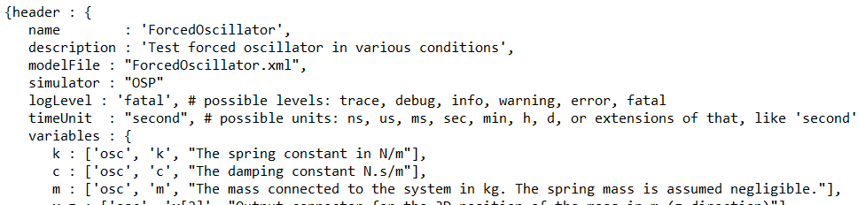
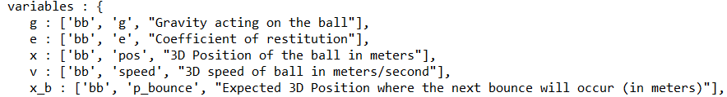


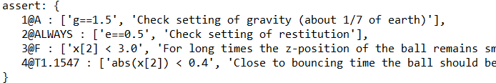
Sim-explorer properties
Uses json5 format
human and machine-readable
simplifies and extends json
Keys without quotation marks
Comments (#, //, /* ...*/, “””…”””)
Optional trailing comma
easily translatable to json
alias variable definitions
Instructions on which results to collect
Hierarchical case structure
Keep experiments as simple as possible
Include results expectations using expressions and (simplified) Temporal Logic

Slide 6
The ‘header’ element
name: Name of the experiment set
description: Optional (highly recommended) description of the experiments
modelFile: Optional explicit relative path to the OSP system structure.
default: “ospSystemStructure.xml” in same folder as .cases
simulator: Set the system simulator, e.g. ‘OSP’ or ‘STC’
logLevel: Optional setting of the OSP log level (default: “FATAL”) possible: TRACE, DEBUG, INFO, WARNING, ERROR, FATAL
timeUnit: Optional setting of basic time unit other than “second” possible: ns, us, ms, sec, min, h, d, or extensions of that, like 'second’
variables: alias variable definitions. Must be unique within the experiment set. See below.

Slide 7
(alias) variables
Variables are only uniquely defined together with their component (instance)
Component variable names may be clumsily long to work with
⇒ Alias variable definition: <alias-name> : [<model-name(s)>, <variab-name(s)>, <optional-description>]
Description of variable. Very useful. May in future be automatically provided from .fmu
Model variable name(s), e.g. vector. Same type enforces. Identification of variables: matching start of name and wildcards ‘*’
Model instance name(s). If several, they must relate to the same FMU. Identification of models: matching start of name and wildcards ‘*’
Variable name unique within experiment set. Programming naming rules recommended

Slide 8
Case definition
Case name unique within experiment set.
<case-name> : {
spec : { <settings>},
results : [ <settings],
assert : { <settings>}},
Settings using alias variables (see below)
Optional section. Can also be included within spec
Optional expected result (not yet implemented)

Slide 9
Set and get variables
<variable-name><slice><@time> : <value(s)>
Value of correct type or ‘res’, ‘result’ to mark get action
Optional time specification, e.g. @2.0, @step, @step 1.0
Optional slice of variable, e.g. [1], [1..2], [1,2,4]
Variable name as defined in alias variables
Examples:
g : 9.81, # set the gravitational acceleration
x[2]@step : ‘res’ # define the z-component of x as results variable, measured at every step
g@0.0 : ‘res’ # report initial setting of g. Note: not needed! Initial settings are always reported

Slide 10
Results
Results are reported as Json5 files with name (default) <case-name>.js5
There are functions to extract time series and plotting time series
Command Line Interface with results report.

Slide 11
Sim-explorer command line interface
usage: sim-explorer cases [options [args]]
sim-explorer cases --info
positional arguments:
cases The sim-explorer specification file.
options:
-h, --help show this help message and exit
--info Display the structure of the defined cases.
--run run Run a single case.
--Run Run Run a case and all its sub-cases.
-q, --quiet console output will be quiet.
-v, --verbose console output will be verbose.
--log LOG name of log file. If specified, this will activate logging to file.
--log-level { DEBUG,INFO,WARNING,ERROR,CRITICAL}
log level applied to logging to file.
-V, --version show program's version number and exit

Slide 12
Sim-explorer
Configuration-based experimentation package for OSP system models
Siegfried.Eisinger@DNV.com, Jorge.Luis.Mendez@DNV.com and Claas.Rostock@DNV.com

