Slide 1
Columbus Scala Enthusiasts
DSLs In Scala
Dan Wiebe
September 10, 2018

Slide 2
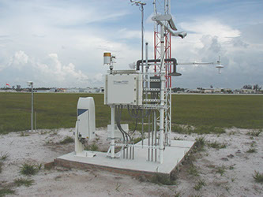
DSLs In Scala

Slide 3
DSLs In Scala
Automated
Weather
Observation
System

Slide 4
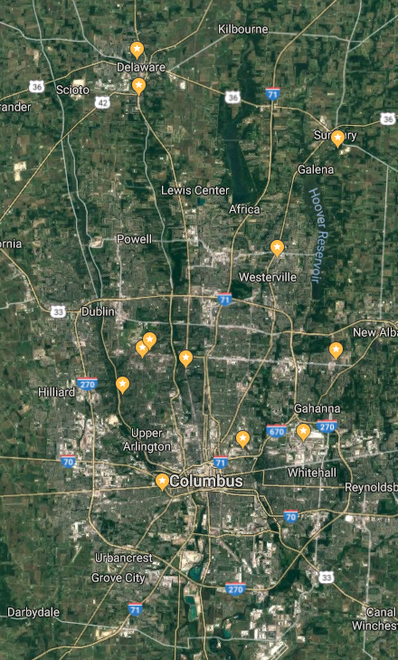
DSLs In Scala

Slide 5
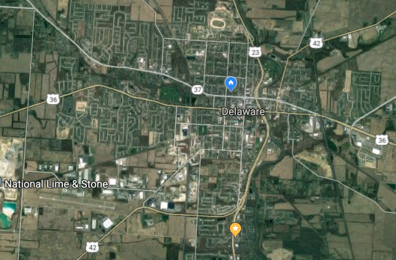
DSLs In Scala

Slide 6
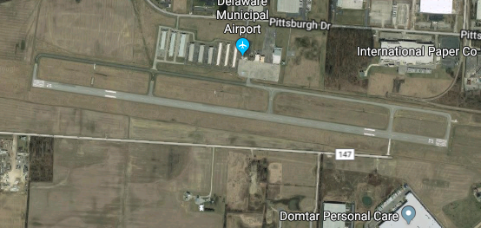
DSLs In Scala

Slide 7
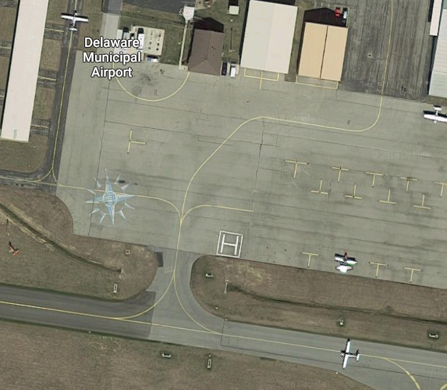
DSLs In Scala

Slide 8
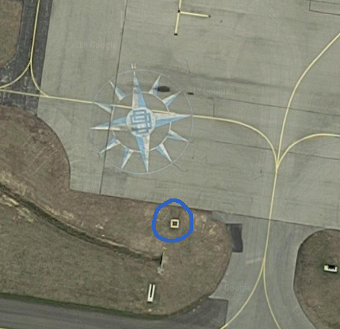
DSLs In Scala

Slide 9
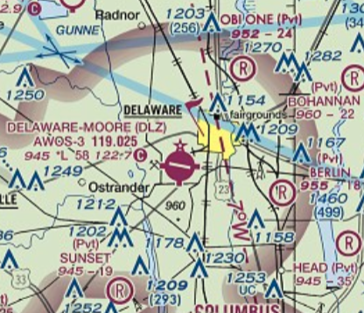
DSLs In Scala

Slide 10
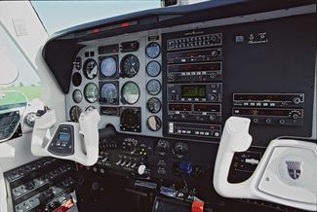
DSLs In Scala

Slide 11
DSLs In Scala
Delaware Municipal Airport automated weather observation, 02:44Z
Weather:
Wind 050॰ at 3kt
Visibility 5mi Drizzle
Ceiling 700ft Overcast
Temperature 15॰C
Dewpoint 15॰C
Altimeter 29.85inHg

Slide 12
DSLs In Scala
Delaware Municipal Airport automated weather observation, 02:44Z
Weather:
Wind 050॰ at 3kt
Visibility 5mi Drizzle
Ceiling 700ft Overcast
Temperature 15॰C
Dewpoint 15॰C
Altimeter 29.85inHg
METAR:
KDLZ 100244Z AUTO 05003KT 5SM DZ OVC007 15/15 A2985 RMK AO2

Slide 13
DSLs In Scala
val weatherService = new WeatherService ()
val driveTimeService = new DriveTimeService ()
val fromWeather = weatherService.source (fromLatitude,
fromLongitude)
val toWeather = weatherService.source (toLatitude,
toLongitude)
val driveTime = driveTimeService.source (fromLatitude,
fromLongitude, toLatitude, toLongitude)
val combiner = new Combiner ()
fromWeather ~> combiner
toWeather ~> combiner
driveTime ~> combiner ~> Sink.seq

