Slide 1

Future Tech Directions
SUBLOCC September 2018
Dan Wiebe

Slide 2
Agenda
Live Demo
Concrete Future Plans
Concepts
Q&A

Slide 3
Live Demo

Slide 4
Live Demo
Bootstrap Node
Server
Client
Origin Node
Relay Node
Exit
Node

Slide 5
Live Demo
Bootstrap Node
Server
Client
Origin Node
Relay Node
Exit
Node

Slide 6
Live Demo
Bootstrap Node
Server
Client
Origin Node
Relay Node
Exit
Node

Slide 7
Live Demo
Client
Origin Node
Relay Node
Exit Node
Server
AWS
Bootstrap Node
Router
Router
Router
ISP
ISP
Internet

Slide 8
Live Demo
Bootstrap Node
Server
Client
Origin Node
Relay Node
Exit
Node

Slide 10
Concrete Future Plans

Slide 11
Concrete Future Plans
Bidirectional GUI

Slide 12
Concrete Future Plans
GUI
(JavaScript)
sudo ./SubstratumNode --dns_servers 192.168.0.1
sudo ./dns_utility subvert
sudo ./dns_utility revert

Slide 13
Concrete Future Plans
GUI
(JavaScript)
Node
(Rust)

Slide 14
Concrete Future Plans
Partner With ISP
(Dan-style)

Slide 15
Concrete Future Plans
Hardware In the Loop

Slide 16
Concrete Future Plans
Linux
Windows
macOS
Netgear
D-Link
Ericsson
Router
Controller
Router
Cisco
Huawei
Linksys
macOS
Linux
Windows

Slide 17
Concrete Future Plans
Universal Plug ’n’ Play

Slide 18
Concrete Future Plans
Client
Origin Node
Relay Node
Exit Node
Server
AWS
Bootstrap Node
Router
Router
Router
ISP
ISP
Internet

Slide 19
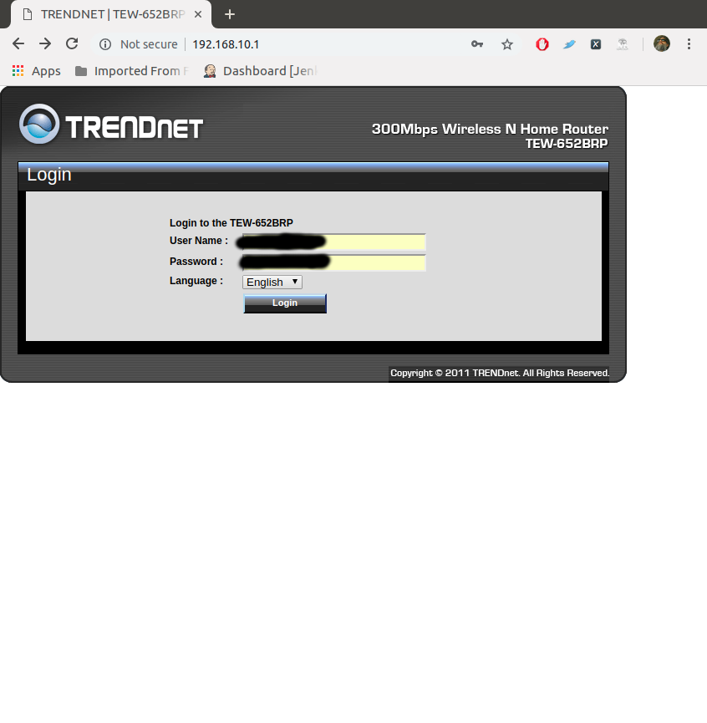
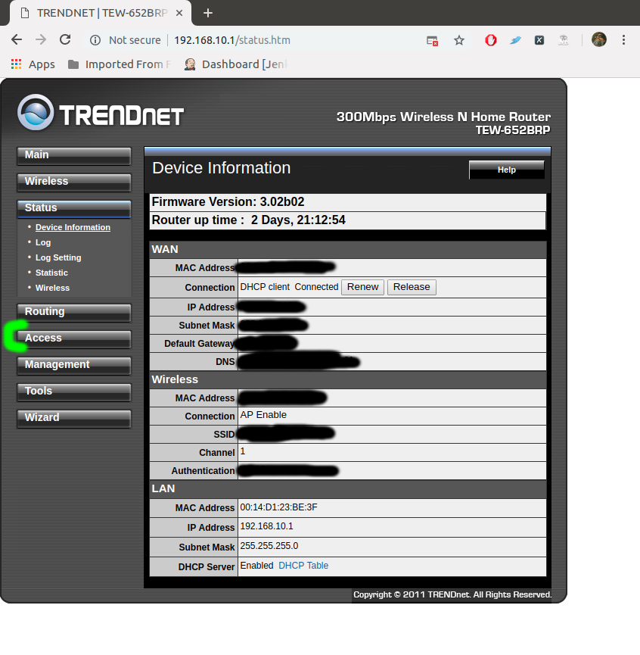
Concrete Future Plans

Slide 20
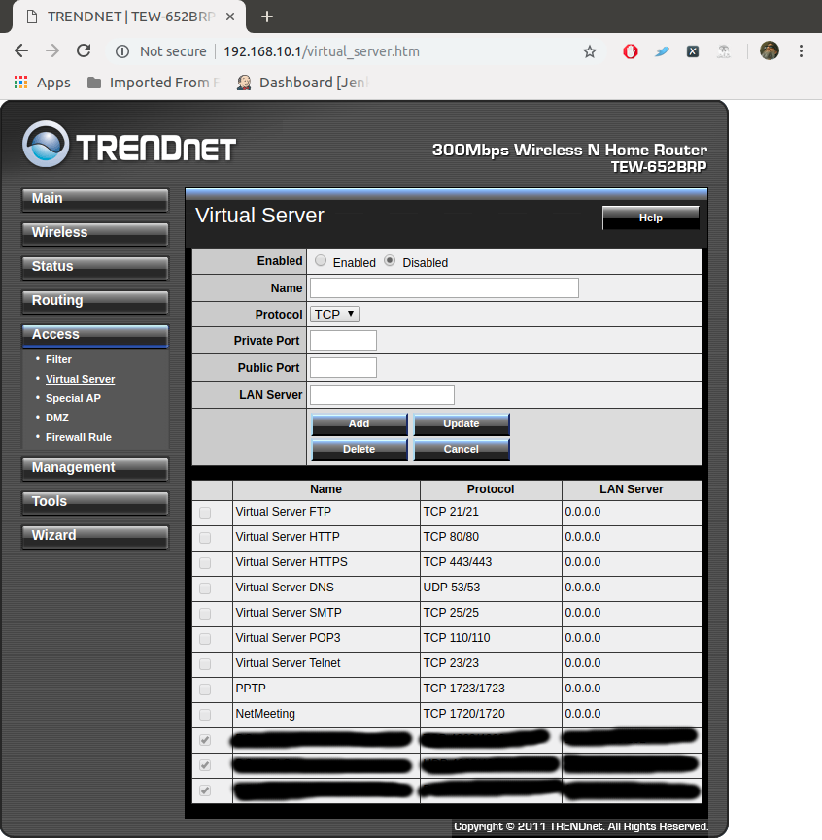
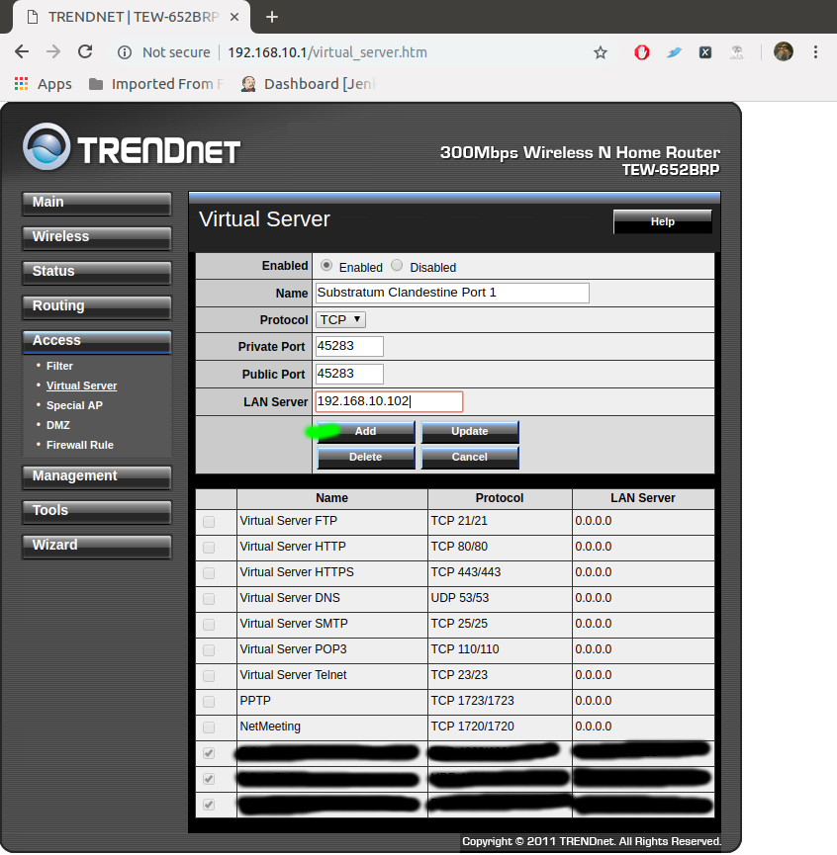
Concrete Future Plans

Slide 21
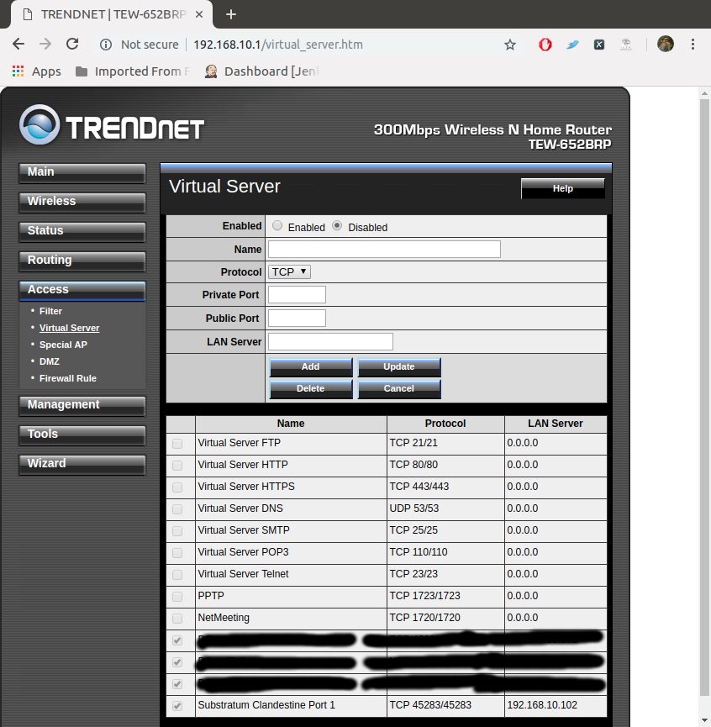
Concrete Future Plans

Slide 22
Concrete Future Plans
Dress Rehearsal
Private Beta

Slide 23
Concrete Future Plans
Terminal Intelligence

Slide 24
Concrete Future Plans
IP Geolocation / Top-Level Domain
Inaccessible List
Startup DNS Checking / “Free World Bit”

Slide 25
Concrete Future Plans
IP Geolocation
From To Country
1.0.1.0 1.0.1.255 Australia
1.0.3.0 1.0.3.255 Thailand
1.0.4.0 1.0.4.255 Canada
1.0.32.0 1.0.32.255 Japan
1.12.0.0 1.12.0.255 South Korea
1.37.0.0 1.27.0.255 Hong Kong
1.52.0.0 1.52.0.255 China
175.45.180.0 175.45.180.255 North Korea
192.119.196.0 192.119.196.255 Great Britain
193.109.83.0 193.109.83.255 Israel
193.120.12.0 193.120.12.255 Germany
193.124.40.0 193.124.40.255 Syria
193.124.61.0 192.124.61.255 Russian Federation
193.142.31.0 193.142.31.255 Iran
Top-Level Domains
Host Name Accessed From
*.com, *.org, *.net Everywhere but CN, KP, RU, IR
*.us United States
*.va Vatican City
*.kr South Korea
*.su Russian Federation
*.ru Russian Federation
*.sb Solomon Islands
*.kg Kyrgyzstan
*.cn China
*.il Israel
*.kp North Korea

Slide 26
Concrete Future Plans
IP Geolocation / Top-Level Domain
Inaccessible List
Startup DNS Checking / “Free World Bit”

Slide 27
Concrete Future Plans
IP Geolocation / Top-Level Domain
Inaccessible List
Startup DNS Checking / “Free World Bit”

Slide 28
Concrete Future Plans
Monetization

Slide 29
Concrete Future Plans
Transfer
Routing fee
from A to B
if perms A and Y
A Perm
Origin
Wallet A
Relay X
Wallet B
Relay Y

Slide 30
Concrete Future Plans
Transfer
Routing fee
from A to B
if perms A and Y
A Perm
Y Perm
Origin
Wallet A
Relay X
Wallet B
Relay Y

Slide 31
Concrete Future Plans
Fake Money
Real Money

Slide 32
Concrete Future Plans
Encryption

Slide 33
Concrete Future Plans
trait CryptDE {
fn encrypt (self, key: Vec<u8>, plainData: Vec<u8>) → Vec<u8>;
fn decrypt (self, key: Vec<u8>, cryptData: Vec<u8>) → Vec<u8>;
}

Slide 34
Concrete Future Plans
trait CryptDE {
fn encrypt (self, key: Vec<u8>, plainData: Vec<u8>) → Vec<u8>;
fn decrypt (self, key: Vec<u8>, cryptData: Vec<u8>) → Vec<u8>;
}
let cryptData = CryptDENull.encrypt ([0x12, 0x23, 0x34], b“Booga”)
0xED, 0xDC, 0xCB
‘B’, ‘o’, ‘o’, ‘g’, ‘a’
let plainData = CryptDENull.decrypt ([0xED, 0xDC, 0xCB], cryptData)

Slide 35
Concrete Future Plans
User Datagram Protocol

Slide 36
Concrete Future Plans
TCP
Server
Client
80

Slide 37
Concrete Future Plans
TCP
Server
Client
80
TCP
Server
Client
80
Origin
Exit
80
CORES

Slide 38
Concrete Future Plans
TCP
Server
Client
80
Origin
Exit
80
CORES
UDP
Server
Client
Origin
Exit
CORES

Slide 39
Concepts

Slide 40
Concepts
Masquerading
Traffic Analysis

Slide 41
Concepts
Infiltration

Slide 42
Concepts
Neighborhood Limitations

Slide 43
Questions and Answers

Slide 44
Thanks for Coming!

