Slide 1
#paper_reading_group
00
Acorn: Adaptive Coordinate Networks
for Neural Scene Representation
Made by 한우정

Slide 2
BackGround
#Acorn
01
New APPLICATION
End-to-end differentiable
Quickly Optimizer
Scalable in learning-based pipelines

Slide 3
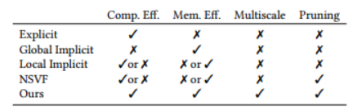
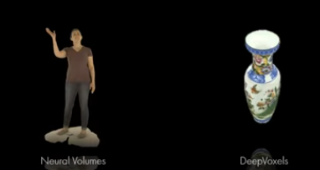

BackGround
#Acorn
02
Neural Scene Representation

Slide 4
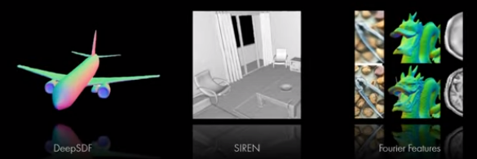

BackGround
#Acorn
02
Neural Scene Representation

Slide 5
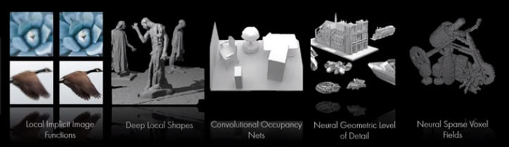
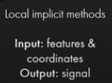
BackGround
#Acorn
02
Neural Scene Representation

Slide 6
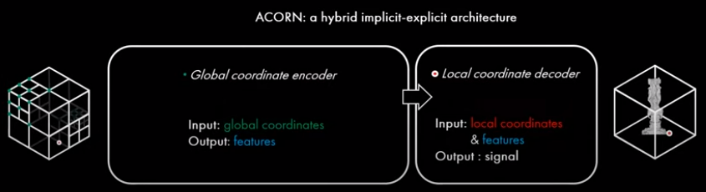
New Hybrid Implicit-Explixit Network Architecture
#Acorn
02
Neural Scene Representation

Slide 7
Introduction
#Acorn
01
CONTRIBUTES
A new multi-scale hybrid implicit-explicit signal representation network architecture
A training strategy that integrates an integer linear program for automatic multiscale resource allocation and pruning
State-of-the-art results for representing large-scale images and complex 3D scenes using neural representations.

Slide 8
Multiscale Coordinate Networks
#Acorn
03
Multiscale Coordinate Network: 2가지 main components
A multiscale block parameterization that partitions the input space according to the local signal complexity
A network architecture consisting of a coordinate encoder and a feature decoder that efficiently map input spatial and scale coordinates to an output value

Slide 9

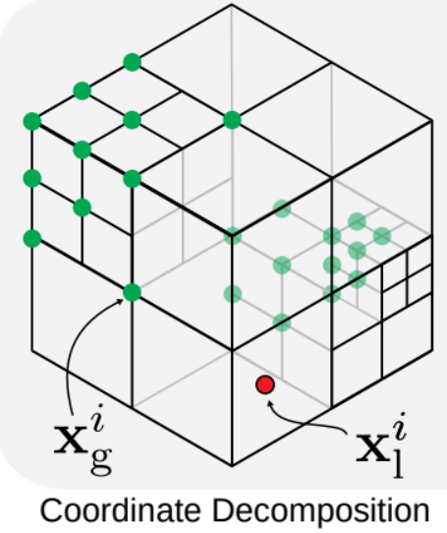
Multiscale Block Parameterization
#Acorn
03
Tree based partition of the input domain
2D: quad tree
3D: octree
입력도메인의 각 값을 multiscale로 표시하는 것이 아닌 single scale로 표현
각 값을 single scale에서 하나의 “active” block인 𝐵와 연관
Active Block은 입력공간의 영역을 고유하게 나타내는 octree/quadtree에서 현재 선택된 블록을 뜻한다. (active blocks의 selection은 optimization problem의 일부로 설명)

Slide 10

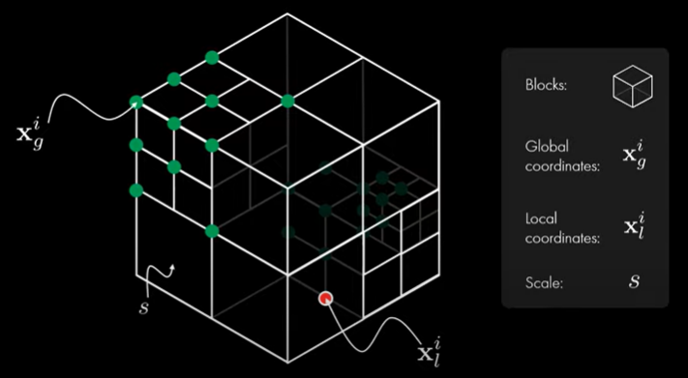
Multiscale Block Parameterization
#Acorn
03
Global box index
𝐵의 global coordinate를 줌
입력좌표영역의 dimension
마지막 요소는 Quadtree또는 Octree의 이산 레벨에 해당하는 블록의 정규화된 스케일을 encoding
Continuous local coordinate
𝐵i 내 입력 도메인을 매개변수화하기 위해 연속 local coordinate x

Slide 11
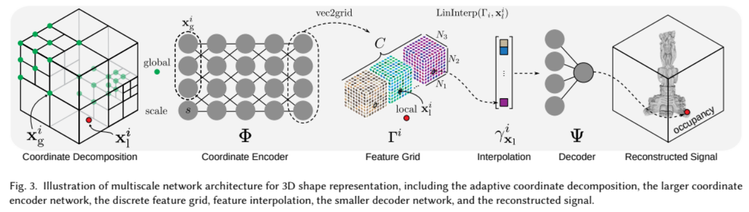
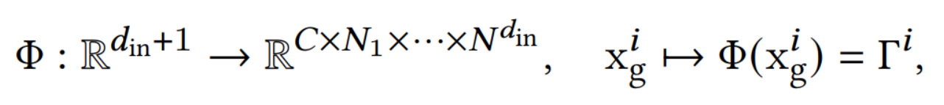


Neural Network Architecture
#Acorn
03
Coordinate Encoder
Feature Vector
Feature Decoder

Slide 12
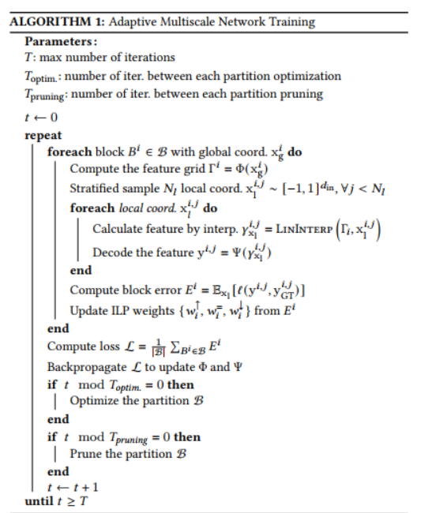
Online Multiscale Decomposition
#Acorn
03
A new automatic decomposition method that allocates network resources adaptively to fit a signal of interest
Online optimization: Interger Linear Problem(ILP)

Slide 13

Representing GIGAPIXEL images 대규모 2D Images
#Acorn
01
4.1 Image Fitting Task
네트워크의 출력과 각 block 에 대한 Target Image 사이는 MSE를 통하여 계산
Training 단계
500 iteration마다 block partition을 최적화
NB = 1024

Slide 14
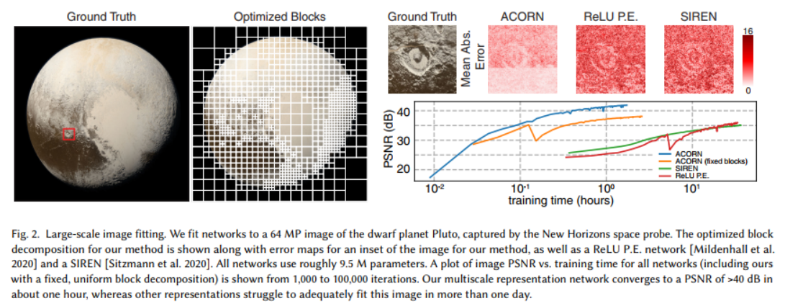
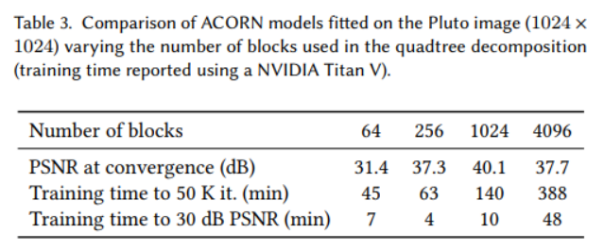
Representing GIGAPIXEL images 대규모 2D Images
#Acorn
04
4.2 Performance

Slide 15
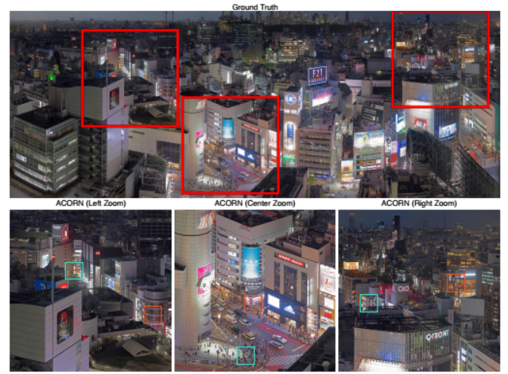
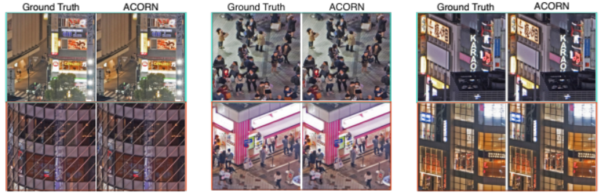
Representing GIGAPIXEL images 대규모 2D Images
#Acorn
04
4.2 Performance
GIGA Pixel Images: 19,456 x 51,200

Slide 16
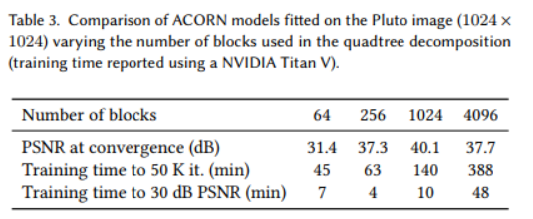
Representing GIGAPIXEL images 대규모 2D Images
#Acorn
01
4.3 Interplay between the quadtree decomposition, time and fitting accuracy

Slide 17
#Acorn
REPRESENTING COMPLEX 3D SCENES 복잡한 3D 장면
05
5.1 Occupancy Prediction Task
Network의 occupancy prediction y와 실제 occupancy yGT 사이에 이진 교차 엔트로피 손실을 적용

Slide 18
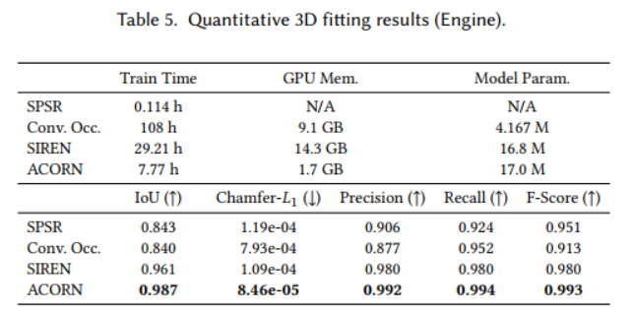
#Acorn
REPRESENTING COMPLEX 3D SCENES 복잡한 3D 장면
05
5.2 Applying Multiscale Model to Occupancy Prediction

Slide 19
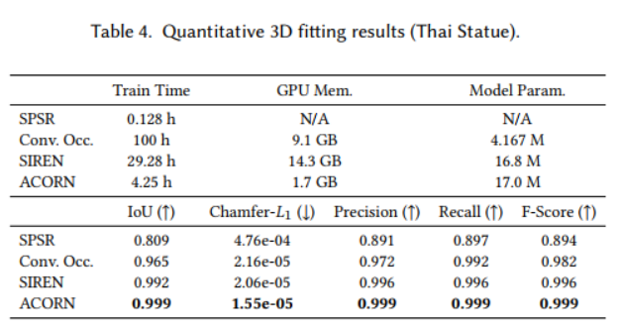
#Acorn
REPRESENTING COMPLEX 3D SCENES 복잡한 3D 장면
05
5.3 Metrics
10243 큐브의 occupancy를 예측하는 모든 모델의 성능을 평가
RTX 6000 GPU에서 실행

Slide 20
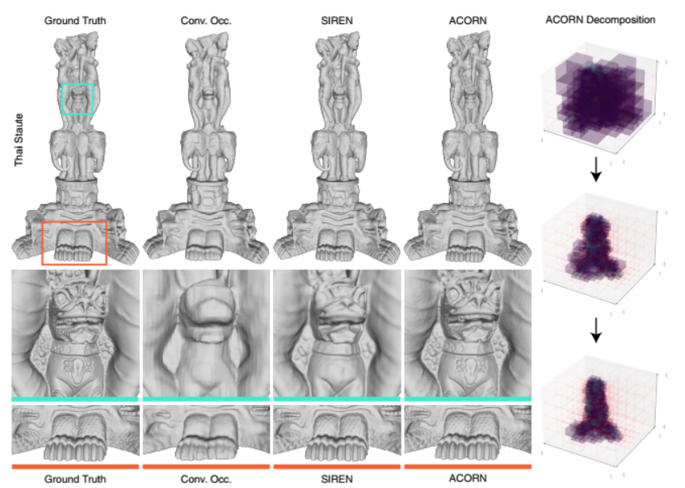
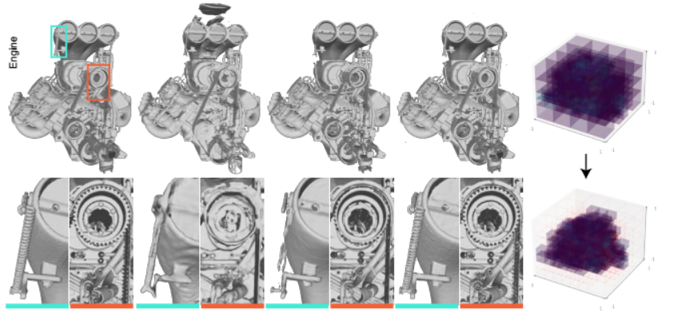
#Acorn
REPRESENTING COMPLEX 3D SCENES 복잡한 3D 장면
05
5.4 Evaluating Performance

Slide 21
Discussion Enjoy your stylish business and campus life with BIZCAM
#Acorn
01
우리는 large-scale 2D and complex 3D scenes 에 기존 신경 장면 표현보다 훨씬 빠르고 잘 맞는 an adaptive multiscale neural scene representation 제안
Limitations
1. Multiscale Decomposition
2. Integer linear program
3. While updating Partitioning, fitting loss temporary increase
4. maximum number of blocks is fixed a priori rather than globally optimized
5. Does not explixitly enforce continuity of the signal across blocks

Slide 22
Q&A
00
Thank you

