Slide 1

What are we going to see in this session?
Exploring Ansible Configuration file
Inventory Basics
Hosts and Groups [INI-Format]
Hosts and Groups [YAML-Format]
Hosts in Multiple groups
Host variables
Tips to manage inventory file efficiently
Modules
What is Modules?
Sample Modules
Where can you find all this modules for reference ?
Finding Module information’s from Command line
Run modules

Slide 2
Exploring Ansible Configuration file
Creating/Managing Ansible configuration file :
If installing ansible from a package manager, the latest “ansible.cfg” file should be present in “/etc/ansible”
If you installed ansible from pip or from source, you may want to create this file in order to override default settings in ansible an example file available in Github
You can get all this details by using command
ansible-config –version
Major things to notice in configuration file :
Your default hosts directory if you install it through YUM :
inventory = /etc/ansible/*
It can be modified based on your requirement.

Slide 3
Inventory Basics
Ansible works against multiple remote hosts in your infrastructure at the same time. How it does this?
It actually does this by selecting portions of systems listed in Ansible’s Inventory file.
Default location of Inventory file is [/etc/ansible/hosts]
You can also specify different inventory file using [–i <path>]
Generally, inventory files can be in different formats [YAML, ini, etc] but ansible uses [ini] as a default inventory file format.

Slide 4
Hosts and Groups [INI-Format]
Let's see some examples in INI format [This is the default format of Ansible]
The headings in [brackets] are group names, which are basically used to classify the hosts and deciding what systems you are controlling at what times and for what purpose.
# Single host without any group
mail.example.com
# Hosts listed under Group # Below we have classified all the web servers.
[WEB servers]
one.example.com
two.example.com
# Below we have classified all the DB servers.
[DB servers]
three.example.com
four.example.com
five.example.com

Slide 5
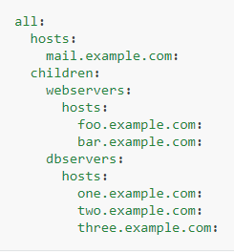
Hosts and Groups [YAML-Format]
Let's see some examples in YAML format.
[Note : This is not, and default format used by Ansible, Its just one of the options available for our comfort]
Here no [brackets] for group names and groups are classified under children's category

Slide 6
Hosts in Multiple groups
You can also put systems in more than one group, for instance a server could be part of both webserver and specific datacenter.
For Example, you can create groups that track.
What – Whether that host is Webserver, Database or Performance testing etc..
Where – You can specify the datacenter region.
When – You can specify whether it is PROD, TEST or STAAGING.

Slide 7
Host variables
This is called inventory variables (or) host variables.
Setting inventory variables in the inventory file is the easiest way.
For instance, suppose these hosts have different usernames and ports
[webservers]
server1.example.com ansible_port=5000 ansible_user=oracle
server2.example.com ansible_port=5001 ansible_user=mysql

Slide 8
Tips to manage inventory file efficiently
If you need to add lot of hosts with following similar patterns, you can do this rather than listing each hostname.
[webservers]
www[01:50].example.com

Slide 9
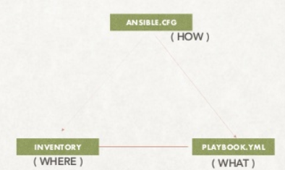
How, What & Where?
This image clearly shows how ansible works.
ANSIBLE.CFG file is going to instruct ansible how to work.
PLAYBOOK is to hold the instructions of what to do.
INVENTORY has the information of where to do.

Slide 10
What is Modules ?
Modules are programs that Ansible uses to perform operations on managed hosts.
They are ready-to-use tools designed to perform specific operations.
Modules can be executed from the Ansible command line or used in playbooks to execute the tasks.
Three Type of Modules :
Core Modules : These modules are written and maintained by Ansible development team. Core modules are most important modules and are used for common administrative tasks.
Extra Modules : These modules are developed by the community.
Custom Modules : These modules are mostly developed by end users itself.
If a module not already exist for a task, an admin can create by its own which is called custom ones. [Modules are written in Python]

Slide 11
Sample Modules
Ansible ships several hundreds of modules today, some samples are
apt/yum
copy
file
ping
service
git
get_url
shell

Slide 12
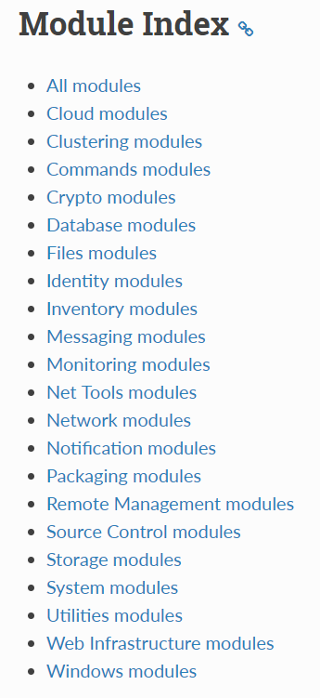
Where can you find all this modules for reference ?
Modules

Slide 13
Finding Module information’s from Command line
You can retrieve all the modules and use case of modules from machine where Ansible is installed.
ansible-doc –l
ansible-doc -l | grep copy
ansible-doc copy

Slide 14
RUN Modules
If Ansible doesn’t have a module that suits your needs, there are some “run command” modules.
command: Takes the command and executes it on the host. The most secure and predictable.
shell: Executes through a shell like /bin/sh so you can use pipes etc. Be careful.
script: Runs a local script on a remote node after transferring it.

Slide 15

End of this topic !
Any questions?

