Slide 1

What are we going to see in this session?
Getting started to setup machines
Preparing Inventory file
Enable SSH password less communication
Start communicating with your target machines
Host Key Checking
Interpreter
Adhoc commands & Exercise
Ansible Facts
Idempotence
YAML basics
Why YAML ?
YAML Basics
Dictionary Representation

Slide 2
Getting started to setup machines
So far, we have seen the basics of Ansible and how to install it, lets move further.
In this session let’s setup your inventory file with target server information and start communicating with those machines.

Slide 3
Preparing Inventory file
Edit [or create] your [hosts] file and update your remote systems details in it.
Your host files should look like this – either it can be IP or Hostname.
You can name your Group name as well.
[ping]
192.0.2.50
answeb01
ansdb01
Your inventory file is ready now.

Slide 4
Enable SSH password less communication
Before we get started, it’s important to understand how Ansible communicates with remote machines over the SSH protocol.
Ansible can communicate with machine in two ways.
Using SSH keys.
Using SSH user password.
If your communication is through SSH key then you need to generate the key from master server and publish it to your remote machines.
ssh-keygen
ssh-copy-id root@servername
Or you can manually copy the key and paste it into the authorized_keys of remote server.
If you wish the communication should be over password, it can be achieved by supplying the option [--ask-pass]

Slide 5
Start communicating with your target machines
Let's first do Ping Test :
Now try pinging all your nodes.
[Key based authentication]
ansible all -m ping
[Password based authentication]
ansible all -m ping --ask-pass (-k)
Let's run live commands on all of your nodes :
ansible all -a "/bin/echo hello"

Slide 6
Host Key checking
Ansible has host key checking enabled by default.
What is host key check ?
If the remote host is reinstalled and has a different key in [known_hosts], this will result in an error message until corrected.
Also, host key check will prompt for any new server which is deployed in Infrastructure.
If you wish to disable this behavior, you can do so by editing ansible.cfg
host_key_checking = False

Slide 7
Interpreter
What is interpreter?
In output you might have noticed a message from all remote machines about interpreter.
What exactly it is ?
Most Ansible modules are written in Python.
Hence python required an interpreter [Translator] available in each target machine when it executes the module.
Ansible will attempt to discover a suitable Python interpreter on each target host the first time when Python module is executed on target host.
How to ignore this message from output ?
You just need to declare the interpreter globally, by adding below line ansible.cfg under [defaults]
interpreter_python = /usr/bin/python3

Slide 8
Ansible Facts
Facts are basically used to get the complete information about your remote systems.
These can be used to implement conditional execution of tasks but also just to get ad-hoc information about your system. You can see all facts via below command.
ansible all -m setup
Using Grep :
ansible all -m setup | grep ansible_os_family
ansible all -m setup | grep ansible_architecture
ansible all -m setup | grep fstype
We shall discuss more about Facts in the playbooks section.

Slide 9
Idempotence
Before moving further you should know what is idempotence and how ansible use idempotence.
Idempotence is the concept which is borrowed from Mathematics.
Ansible uses this concept very much.
An idempotence refers one operation can be applied multiple times without changing the result beyond the initial apply.
Hence all modules of Ansible are idempotent.

Slide 10
Why YAML
YAML – Yet Another Markup Language
We use YAML because it is easier for humans to read and write than other common data formats like XML or JSON.
We use .yml as an extension for configuration file or scripts written in YAML language.

Slide 11
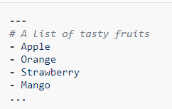
YAML Basics
All YAML files (regardless of their association with Ansible or not) can optionally begin with [---] and end with […]
This is part of the YAML format and indicates the start and end of a document.
Example :
Here you can see all the members of a list are eventually beginning with a dash and a space “-”

Slide 12
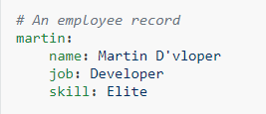
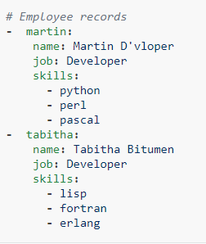
Dictionary Representation
Ansible allows you to represent dictionary format.
It can declare in very simple form key: value [The colon must be followed by a space]
In below example you can see how an employee record is represented in YAML.
Martine is an employee, and you can see how his details are registered dictionary format.
More complicated data structure are also possible.

Slide 13

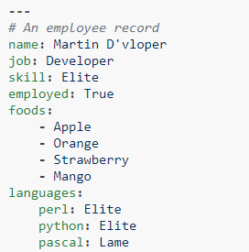
Cont.
Dictionaries and lists can also be represented in an abbreviated form if you really want it to be.
We can also use Boolean values(true/false) in several forms.
You can see the complete combinations below of what we have learned so far.

Slide 14

End of this topic !
Any questions?

