Slide 1
Textbook(s): 1) Mastering Cloud Computing, Rajkumar Buyya, Christian Vecchiola, S Thamarai Selvi, Tata McGraw Hill Education Private Limited, 2013 2) OpenStack in Action, V. K. CODY BUMGARDNER, Manning Publications Co, 2016
CLOUD COMPUTING

Slide 2
“Computer Utilities” Vision Implications of the Internet
1969 – Leonard Kleinrock, one of the chief scientists of the original Advanced Research Projects Agency Network (ARPANET) project
“As of now, computer networks are still in their infancy, but as they grow up and become sophisticated, we will probably see the spread of ‘computer utilities’, which, like present electric and telephone utilities, will service individual homes and offices across the country”
Computers Redefined
1984 – John Gage, Sun Microsystems
“The network is the computer”
2008 – David Patterson, U. C. Berkeley
“The data center is the computer. There are dramatic differences between of developing software for millions to use as a service versus distributing software for millions to run their PCs”
2008 – “The Cloud is the computer” – Buyya!

Slide 3
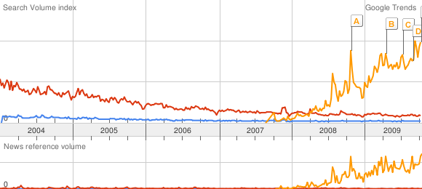
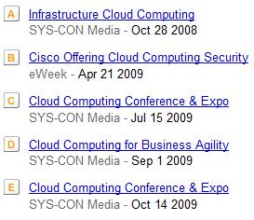
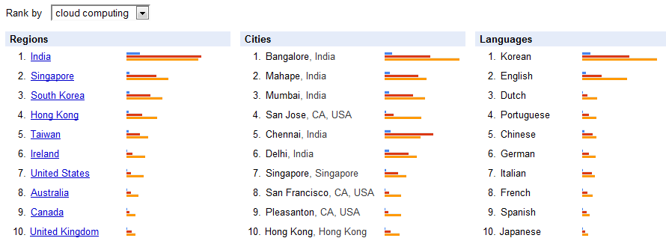
Gold rush: Too many people are “In Search” of Cloud Computing!

Slide 4
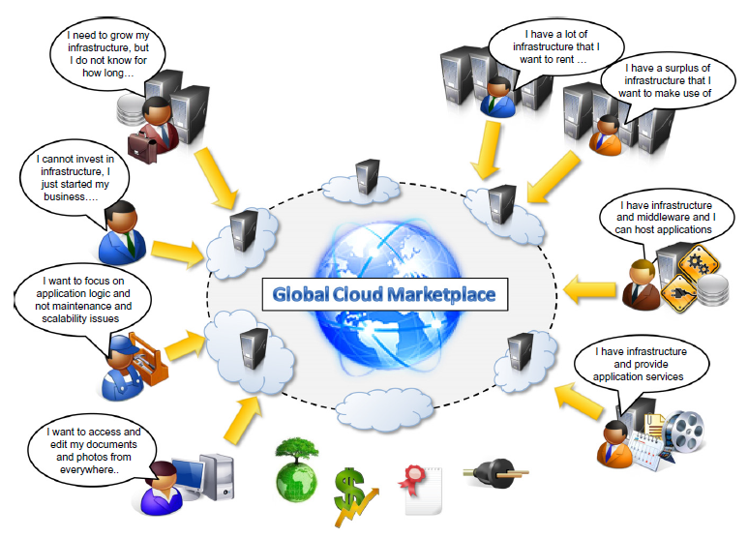

Slide 5
Defining Clouds: There are many views for what is cloud computing?
In such a model, users access services based on their requirements without regard to where the services are hosted. This model has be en referred to as utility computing or, recently (since2007), as cloud computing. The latter term often denotes the infrastructure as a “cloud” from which businesses and users can access applications as services from anywhere in the world and on demand.
Hence, cloud computing can be classified as a new paradigm for the dynamic provisioning of computing services supported by state-of-the-art data centers employing virtualization technologies for consolidation and effective utilization of resources.

Slide 6
Defining a Cloud Computing
Cloud computing refers to both the applications delivered as services over the Internet and the hardware and system software in the datacenters that provide those services.
Cloud computing is a model for enabling ubiquitous, convenient, on-demand network access to a shared pool of configurable computing resources (e.g., networks, servers, storage, applications, and services) that can be rapidly provisioned and released with minimal management effort or service provider interaction.
A cloud is a type of parallel and distributed system consisting of a collection of interconnected and virtualized computers that are dynamically provisioned and presented as one or more unified computing resources based on service-level agreements established through negotiation between the service provider and consumers.
Notes:
Ubiquitous-present, appearing, or found everywhere

Slide 7
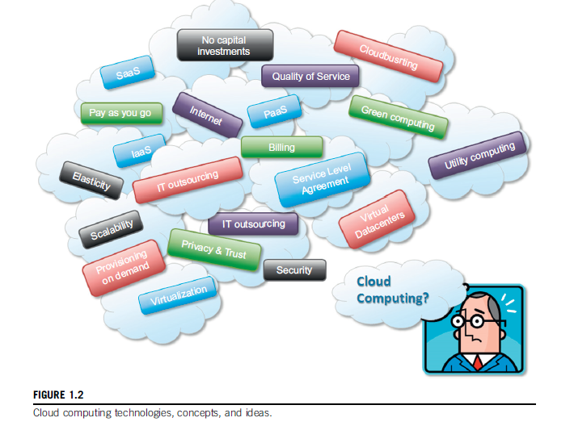

Slide 8
The Internet plays a fundamental role in cloud computing, since it represents either the medium or the platform through which many cloud computing services are delivered and made accessible. This aspect is also reflected in the definition given by Armbrustetal Cloud computing refers to both the applications delivered as services over the Internet and the hardware and system software in the datacenters that provide those services.
Buyya’s definition
Cloud computing is a model for enabling ubiquitous, convenient, on-demand network access to a shared pool of configurable computing resources (e.g., networks, servers, storage, applications, and services) that can be rapidly provisioned and released with minimal management effort or service provider interaction.

Slide 9
Characteristics and benefits Cloud
Computing has some interesting characteristics that bring benefits to both cloud service consumers (CSCs) and cloud service providers(CSPs). These characteristics are:
• No up-front commitments
• On-demand access
• Nice pricing
• Simplified application acceleration and scalability
• Efficient resource allocation
• Energy efficiency
• Seamless creation and use of third-party services

Slide 10
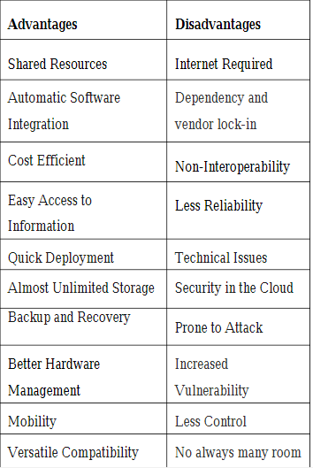
Cloud Computing

Slide 11
Historical Developments
The idea of renting computing services by leveraging large distributed computing facilities has been around for long time. It dates back to the days of the mainframes in the early 1950s.
From there on, technology has evolved and been refined. This process has created a series of favorable conditions for the realization of cloud computing.
Figure 1.6 provides an overview of the evolution of the distributed computing technologies that have influenced cloud computing.
In tracking the historical evolution, we briefly review five core technologies that played an important role in the realization of cloud computing.
These technologies are distributed systems, virtualization, Web 2.0, service orientation, and utility computing.

Slide 12
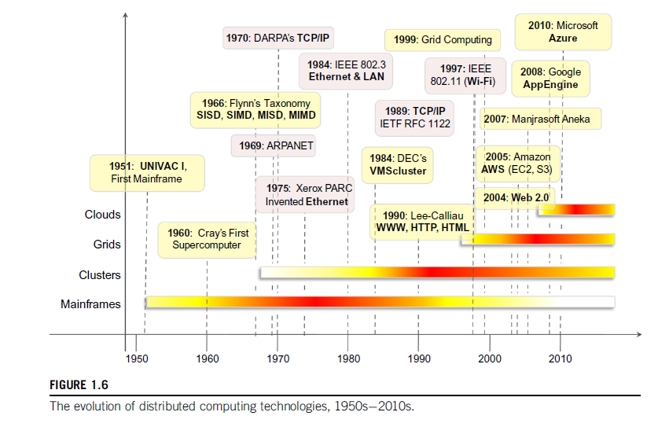

Slide 13
Basic concepts of Distributed Systems
Clouds are essentially large distributed computing facilities that make available their services to third parties on demand. As a reference, we consider the characterization of a distributed system proposed by Tanenbaumetal.[1]:
A distributed system is a collection of independent computers that appears to its users as a single coherent system.
A distributed system it is composed of multiple independent components and that these components are perceived as a single entity by users. This is particularly true in the case of
cloud computing, in which clouds hide the complex architecture they rely on and provide a single interface to users. The primary purpose of distributed systems is to share resources and utilize them better.
This is true in the case of cloud computing, where this concept is taken to the extreme and resources (infrastructure, runtime environments, and services) are rented to users.
Notes:
Coherent system-multistate component

Slide 14
In fact, one of the driving factors of cloud computing has been the availability of the large computing facilities of IT giants( Amazon, Google) that found that offering their computing capabilities as a service provided opportunities to better utilize their infrastructure.
Distributed systems often exhibit other properties such as heterogeneity, openness, scalability, transparency, concurrency, continuous availability, and independent failures.
To some extent these also characterize clouds, especially in the context of scalability, concurrency, and continuous availability. Three major milestones have led to cloud computing: mainframe computing, cluster computing, and grid computing.
Notes:
Heterogeneity-one or more processor, concurrency-at same time.

Slide 15
Mainframes These were the first examples of large computational facilities leveraging multiple processing units. Mainframes were powerful, highly reliable computers specialized for large data movement and massive input/output (I/O) operations.
One of the most attractive features of mainframes was the ability to be highly reliable computers that were “always on” and capable of tolerating failures transparently. No system shutdown was required to replace failed components, and the system could work without interruption.
Batch processing was the main application of mainframes. Now their popularity and deployments have reduced, but evolved versions of such systems are still in use for transaction processing (such as online banking, airline ticket booking, supermarket and telcos, and government services).

Slide 16
Clusters:-Cluster computing started as a low cost alternative to the use of mainframes and supercomputers. The technology advancement that created faster and more powerful mainframes and supercomputers eventually generated an increased availability of cheap commodity machines as a side effect.
These machines could then be connected by a high bandwidth network and controlled by specific software tools that manage them as a single system. Starting in the 1980s, clusters become the standard technology for parallel and high-performance computing.
Cluster technology contributed considerably to the evolution of tools and frameworks for distributed computing, including Condor[5], Parallel Virtual Machine (PVM)[6], and Message Passing Interface (MPI).
One of the attractive features of clusters was that the computational power of commodity machines could be leveraged to solve problems that were previously manage able only on expensive supercomputers. More over, clusters could be easily extended if more computational power was required.
Notes:
Commodity-material
Condor is probably the most widely used and long-lived middleware for managing clusters, idle workstations, and a collection of clusters.

Slide 17
Grid:-Grid computing appeared in the early 1990s as an evolution of cluster computing. In an analogy to the power grid, grid computing proposed a new approach to access large computational power, huge storage facilities, and a variety of services. User scan “consume” resources in the same way as they use other utilities such as power, gas, and water. Grids initially developed as aggregations of geographically dispersed clusters by means of Internet connections.
Several developments made possible the diffusion of computing grids:
(a) clusters became quite common resources;
(b) they were often underutilized;
(c) new problems were requiring computational power that went beyond the capability of single clusters; and (d) the improvements in networking and the diffusion of the Internet made possible long-distance, high-bandwidth connectivity. All these elements led to the development of grids, which now serve a multitude of users across the world.
Notes:
Dispersed-spread over a wide area
Diffusion-spread over a wide area or between large no of people

Slide 18
Virtualization
Virtualization is another core technology for cloud computing. It encompasses a collection of solutions allowing the abstraction of some of the fundamental elements for computing, such as hard- ware, runtime environments, storage, and networking.
Virtualization has been around for more than 40 years, but its application has always been limited by technologies that did not allow an efficient use of virtualization solutions.
Today these limitations have been substantially overcome, and virtualization has become a fundamental element of cloud computing.
This is particularly true for solutions that provide IT infrastructure on demand. Virtualization confers that degree of customization and control that makes cloud computing appealing for users and, at the same time, sustainable for cloud services providers.
Virtualization is essentially a technology that allows creation of different computing environments. These environments are called virtual because they simulate the interface that is expected by a guest. The most common example of virtualization is hardware virtualization.
Notes:
sustainable –able to be maintained at a certain rate or level

Slide 19
This is the base technology that enables cloud computing solutions to deliver virtual servers on demand, such as Amazon EC2, Right Scale, Vmware vCloud, and others.
Together with hardware virtualization, storage and network virtualization complete the range of technologies for the emulation of IT infrastructure. Virtualization technologies are also used to replicate runtime environments for programs.
Applications in the case of process virtual machines (which include the foundation of technologies such as Java or .NET), instead of being executed by the operating system, are run by a specific program called a virtual machine.
This approach is used in cloud computing to provide a platform for scaling applications on demand, such as Google AppEngine and Windows Azure.

Slide 20
Web 2.0
The Web is the primary interface through which cloud computing delivers its services. At present, the Web encompasses a set of technologies and services that facilitate interactive information sharing, collaboration, user centered design and application composition. This evolution has transformed the Web into a rich platform for application development and is known as Web 2.0.
This term captures any way in which developers architect applications and deliver services through the Internet and provides new experience for users of these applications and services.
Web 2.0 brings interactivity and flexibility into Web pages, providing enhanced user experience by gaining Web-based access to all the functions that are normally found in desktop applications. These capabilities are obtained by integrating a collection of standards and technologies such as XML, Asynchronous Java Script and XML (AJAX), Web Services, and others. These technologies allow us to build applications leveraging the contribution of users, who now become providers of content.

Slide 21
Web2.0 applications are extremely dynamic they improve continuously, and new updates and features are integrated at a constant rate by following the usage trend of the community.
There is no need to deploy new software releases on the installed base at the client side. Users can take advantage of the new software features simply by interacting with cloud applications. Light weight deployment and programming models are very important for effective support of such dynamism. Loose coupling is another fundamental property.
New applications can be “synthesized” simply by composing existing services and integrating them, thus providing added value. This way it becomes easier to follow the interests of users.
Finally, Web2.0 applications aim to leverage the “long tail” of Internet users by making themselves available to everyone in terms of either media accessibility or affordability.
Examples of Web2.0 applications are Google Documents, Google Maps, Flickr, Facebook, Twitter, YouTube, delicious, Blogger, and Wikipedia. In particular, social networking Websites take the biggest advantage of Web2.0.
The level of interaction in Websites such as Facebook or Flickr would not have been possible without the support of AJAX, Really Simple Syndication (RSS), and other tools that make the user experience incredibly interactive.

Slide 22
Service-oriented computing
Service orientation is the core reference model for cloud computing systems. This approach adopts the concept of services as the main building blocks of application and system development. Service-oriented computing (SOC) supports the development of rapid, low-cost, flexible, interoperable, and evolvable applications and systems.
A service can perform any function anything from a simple function to a complex business process. Virtually any piece of code that performs a task can be turned into a service and expose its functionalities through a network accessible protocol. A service is supposed to be loosely coupled, reusable, programming language in dependent, and location transparent. Loose coupling allows services to serve different scenarios more easily and makes them reusable.
Services are composed and aggregated into a service oriented architecture (SOA) ,which is a logical way of organizing software systems to provide end users or other entities distributed over the network with services through published and discoverable interfaces.

Slide 23
Service oriented computing introduces and diffuses two important concepts, which are also fundamental to cloud computing: quality of service (QoS) and Software-as-a-Service(SaaS).Quality of service (QoS) identifies a set of functional and non functional attributes that can be used to evaluate the behavior of a service from different perspectives. These could be performance metrics such as response time, or security attributes, transactional integrity, reliability, scalability, and availability. QoS requirements are established between the client and the provider via an SLA that identifies the minimum values (or an acceptable range) for the QoS attributes that need to be satisfied upon the service call.
The concept of Software-as-a-Service introduces a new delivery model for applications. The term has been inherited from the world of application service providers (ASPs), which deliver software services-based solutions across the wide area network from a central datacenter and make them available on a subscription or rental basis.
The SaaS approach reaches its full development with service-oriented computing (SOC), where loosely coupled software components can be exposed and priced singularly, rather than entire applications.

Slide 24
Utility-oriented computing
Utility computing is a vision of computing that defines a service provisioning model for compute services in which resources such as storage, compute power, applications, and infrastructure are packaged and offered on a pay-per-use basis. The idea of providing computing as a utility like natural gas, water, power, and telephone connection has along history but has become a reality today with the advent of cloud computing.
Among the earliest forerunners of this vision we can include the American scientist John McCarthy, who, in a speech for the Massachusetts Institute of Technology (MIT) centennial in 1961, observed:
“If computers of the kind I have advocated become the computers of the future, then computing may some day be organized as a public utility, just as the telephone system is a public utility. The computer utility could become the basis of a new and important industry.”

Slide 25
The cloud reference model
Cloud computing supports any IT service that can be consumed as a utility and delivered through a network, most likely the Internet. Such characterization includes quite different aspects: infrastructure, development platforms, application and services.

Slide 26
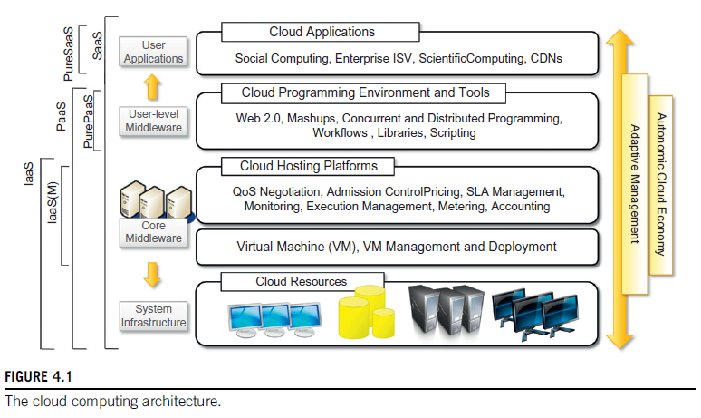

Slide 27
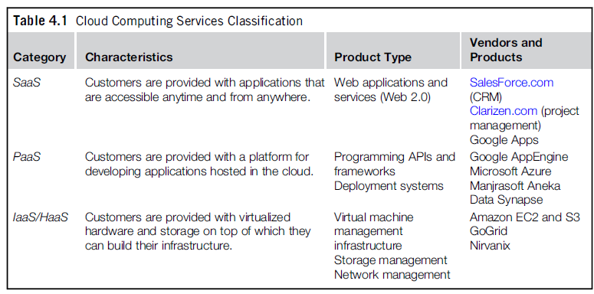
Cloud Service Models
Cloud Software as a Service (SaaS)
Cloud Platform as a Service (PaaS)
Cloud Infrastructure as a Service (IaaS)

Slide 28
Infrastructure as a Service (IaaS)
The capability provided to the consumer is to provision processing, storage, networks, and other fundamental computing resources.
Consumer is able to deploy and run arbitrary software, which can include operating systems and applications.
The consumer does not manage or control the underlying cloud infrastructure but has control over operating systems, storage, deployed applications, and possibly limited control of select networking components (e.g., host firewalls).

Slide 29
Platform as a Service (PaaS)
The capability provided to the consumer is to deploy onto the cloud infrastructure consumer created or acquired applications created using programming languages and tools supported by the provider.
The consumer does not manage or control the underlying cloud infrastructure including network, servers, operating systems, or storage, but has control over the deployed applications and possibly application hosting environment configurations.

Slide 30
Software as a Service (SaaS)
The capability provided to the consumer is to use the provider’s applications running on a cloud infrastructure.
The applications are accessible from various client devices through a thin client interface such as a web browser (e.g., web-based email).
The consumer does not manage or control the underlying cloud infrastructure including network, servers, operating systems, storage, or even individual application capabilities, with the possible exception of limited userspecific application configuration settings.

Slide 31
Cloud Deployment Models
Public Cloud.
Private Cloud.
Community Cloud.
Hybrid Cloud.

Slide 32
Public Cloud
The cloud infrastructure is made available to the general public or a large industry group and is owned by an organization selling cloud services.

Slide 33
Private Cloud
The cloud infrastructure is operated solely for a single organization. It may be managed by the organization or a third party, and may exist on-premises or off-premises.

Slide 34
Community Cloud
The cloud infrastructure is shared by several organizations and supports a specific community that has shared concerns (e.g., mission, security requirements, policy, or compliance considerations). It may be managed by the organizations or a third party and may exist on-premises or off-premises.

Slide 35
Hybrid Cloud
The cloud infrastructure is a composition of two or more clouds (private, community, or public) that remain unique entities but are bound together by standardized or proprietary technology that enables data and application portability (e.g., cloud bursting for load-balancing between clouds).

Slide 36
Open Challenges-Cloud Computings
Cloud definition
Cloud interoperability and standards
Scalability and fault tolerance
Security, trust, and privacy
Organizational aspects

